Slide 1
Risk-Ex Neha Gupta

Slide 2
Introduction
How risk can impact the returns on our investments.
Calculating risk of portfolio (Beta).
Correlation of individual stock returns and market returns.
Make better investment.

Slide 3
Methodology
Data Source: Historical stock price data from various sources
Preparing Data for analysis by transforming the data.
Applying
CAPM on
FAANG stocks + market returns
Feature Engineering: Percentage change in prices over two consecutive days
Applying
Fama-French
for expected return of
FAANG stocks vs market returns

Slide 4
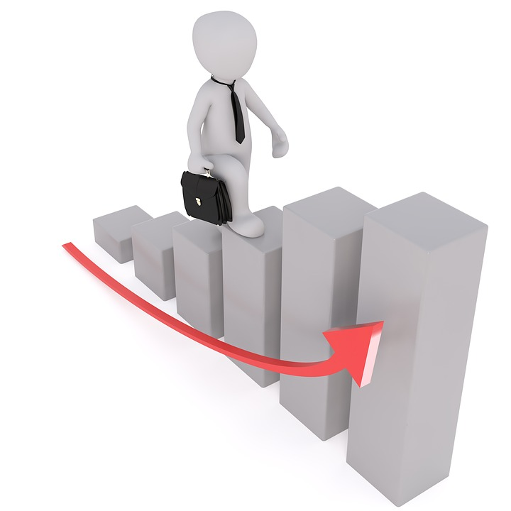
Beta Analysis
Stock Name | Beta For CAPM (vs S&P 500) | Beta for Fama-French 3 Factor
S&P 500 | N/A | 0.9851
Google | 1.1891 | 1.1460
Facebook | 1.2527 | 1.1947
Netflix | 1.5238 | 1.4343
Apple | 1.1500 | 1.0636
Amazon | 1.3470 | 1.2499

Slide 5
Adjusted R-Square Analysis
Stock Name | R-Squared For CAPM (vs S&P 500) | R-Squared for Fama-French 3 Factor
S&P 500 | N/A | 0.997
Google | 0.471 | 0.506
Facebook | 0.308 | 0.370
Netflix | 0.219 | 0.248
Apple | 0.393 | 0.397
Amazon | 0.340 | 0.383

Slide 6
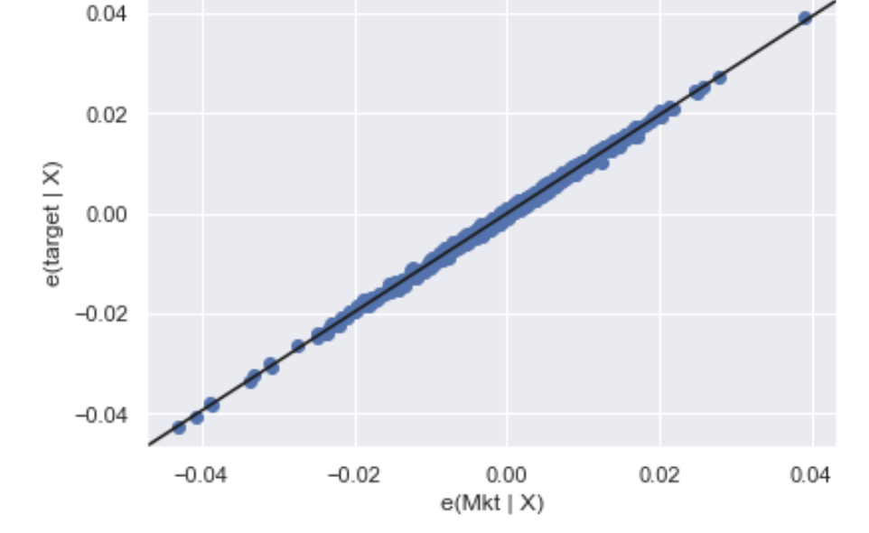
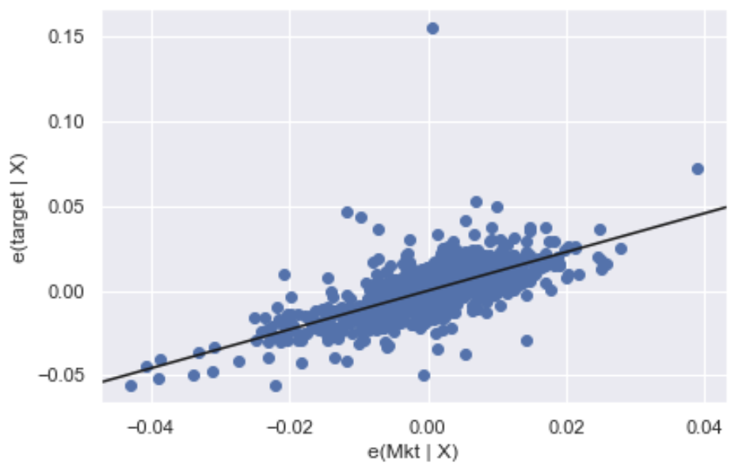
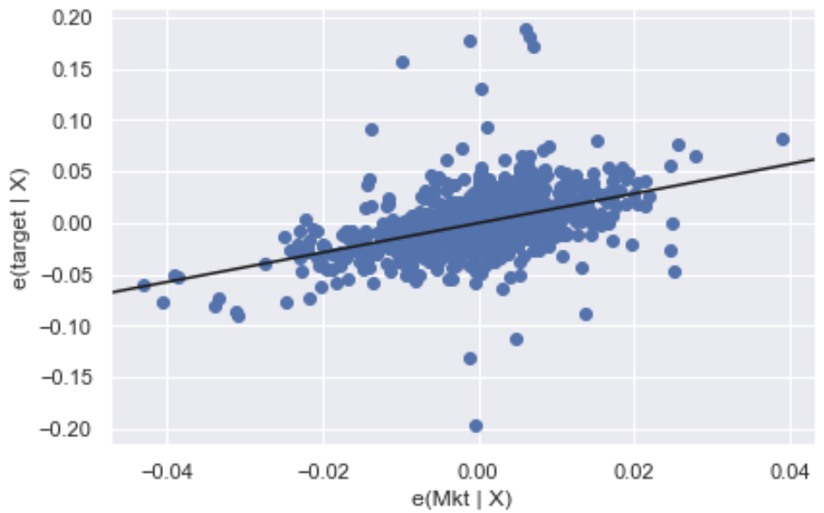
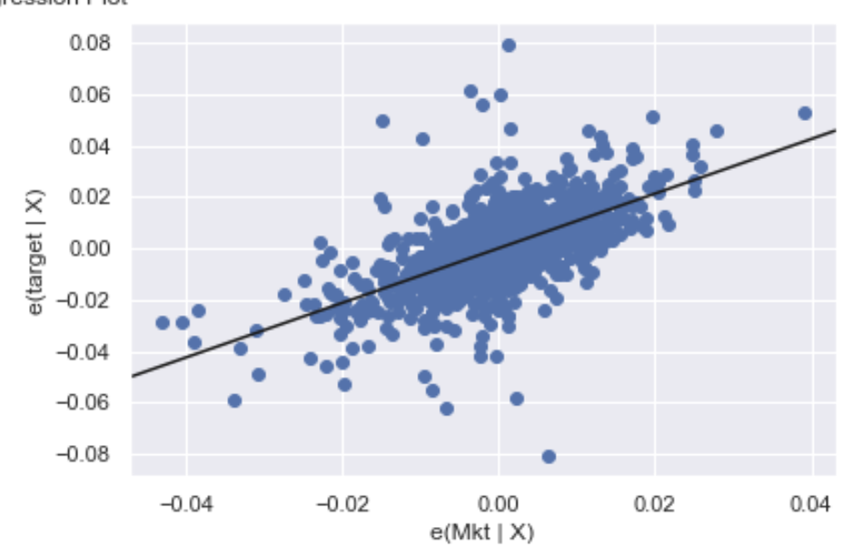
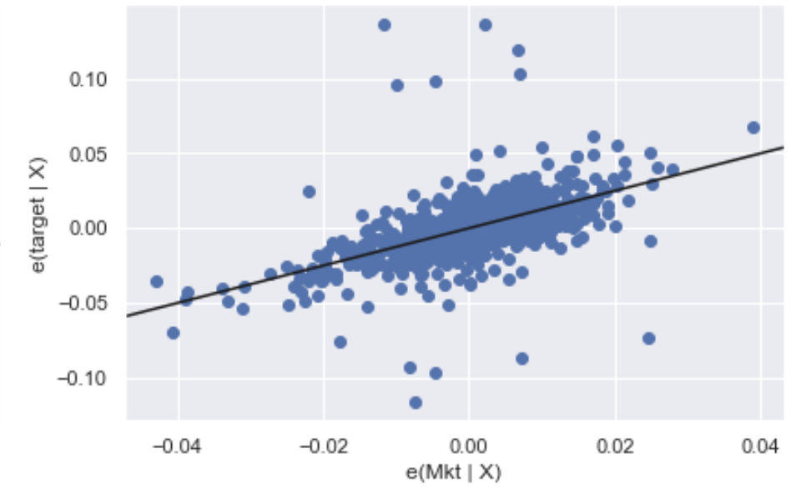
Results
FAANG Stock Return Vs Market Return
S&P500
Google
Facebook
Apple
Amazon
Netflix

Slide 7
R Squared
 | Linear Regression | Lasso Regression
Google | 0.0082 | 0.0024
Facebook | 0.0058 | 0.0007
Amazon | 0.0057 | 0.0036
Apple | 0.6223 | 0.0008
Netflix | 0.0005 | 0.0038

Slide 8
Conclusion
Fama-French analysis on S&P500 testifies our selection of choosing it as representation of market was appropriate.
Out of 5 FAANG stocks, apple seems to be relatively less volatile and correlated with change in market.
Beta reduced and R-square improved slightly when I used Fama-French factors.
Lastly, this can help me choose stocks to build a diversified portfolio of stocks.

Slide 9

Future Work
Analyzing the data more than 5 year.
Using other factors of Fama-French model.
Compare the results with global factors.
Analyzing for more diversified portfolio.

Slide 10

Thank You

Slide 11
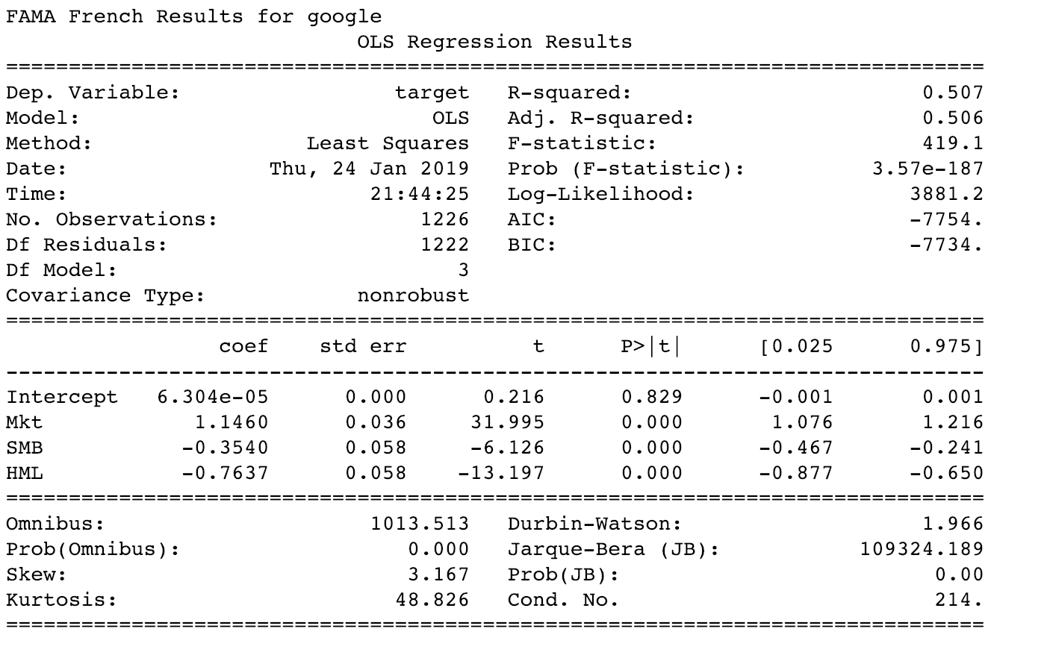
Appendix

Slide 12
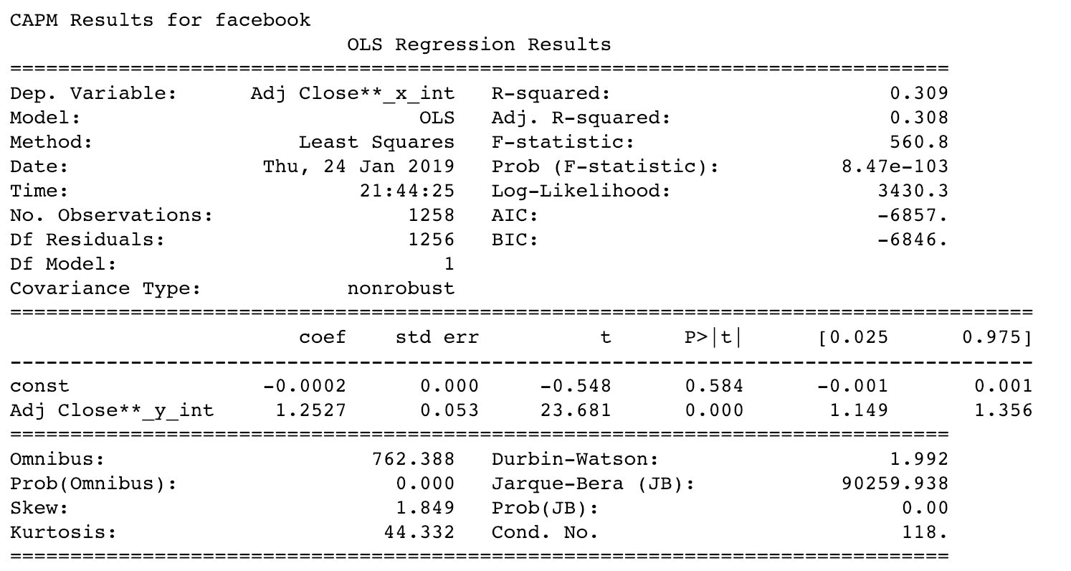
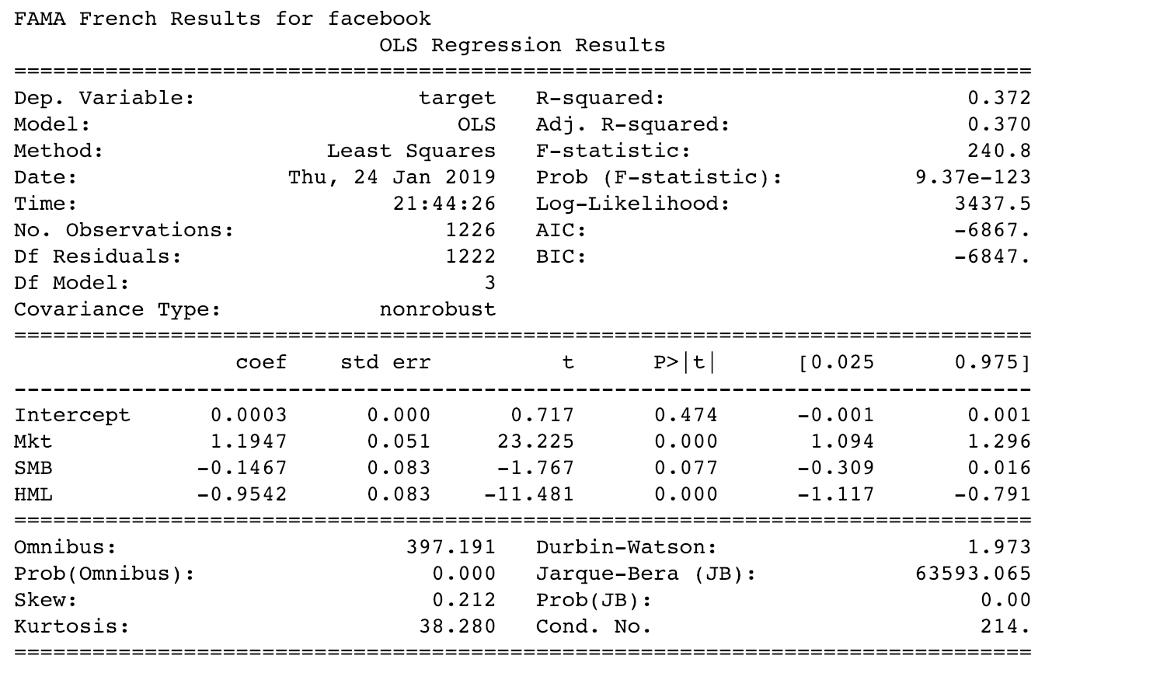

Slide 13
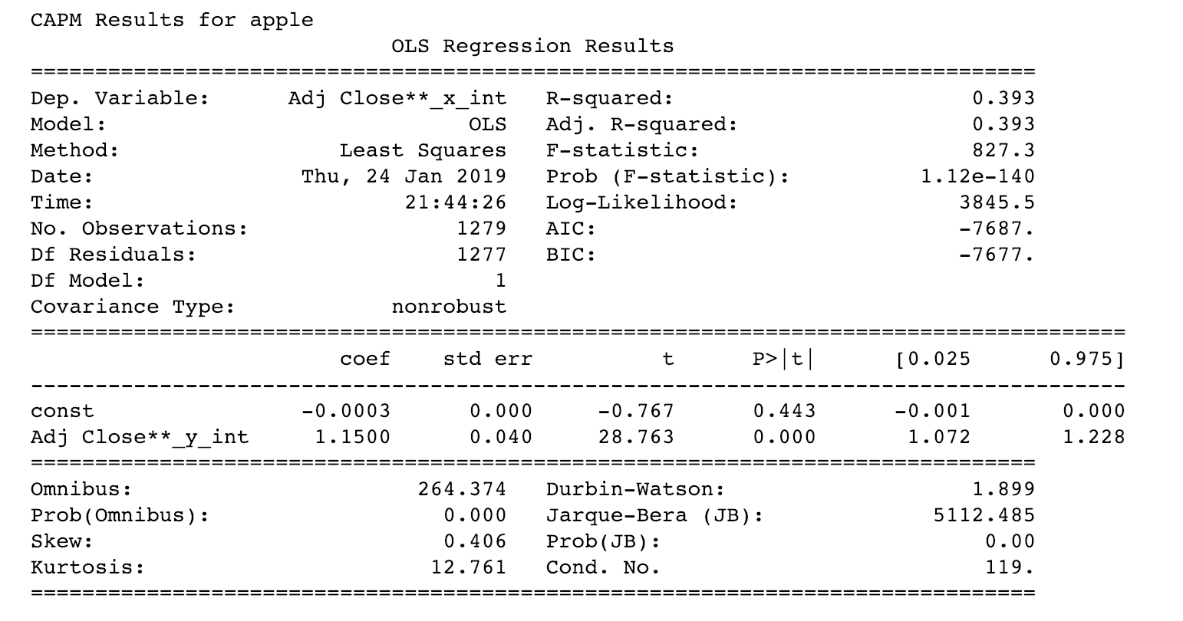
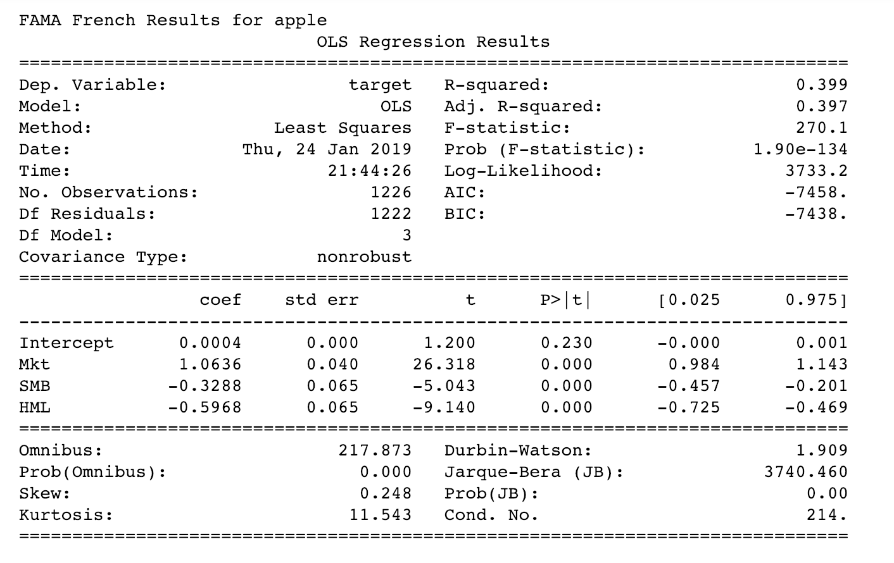

Slide 14

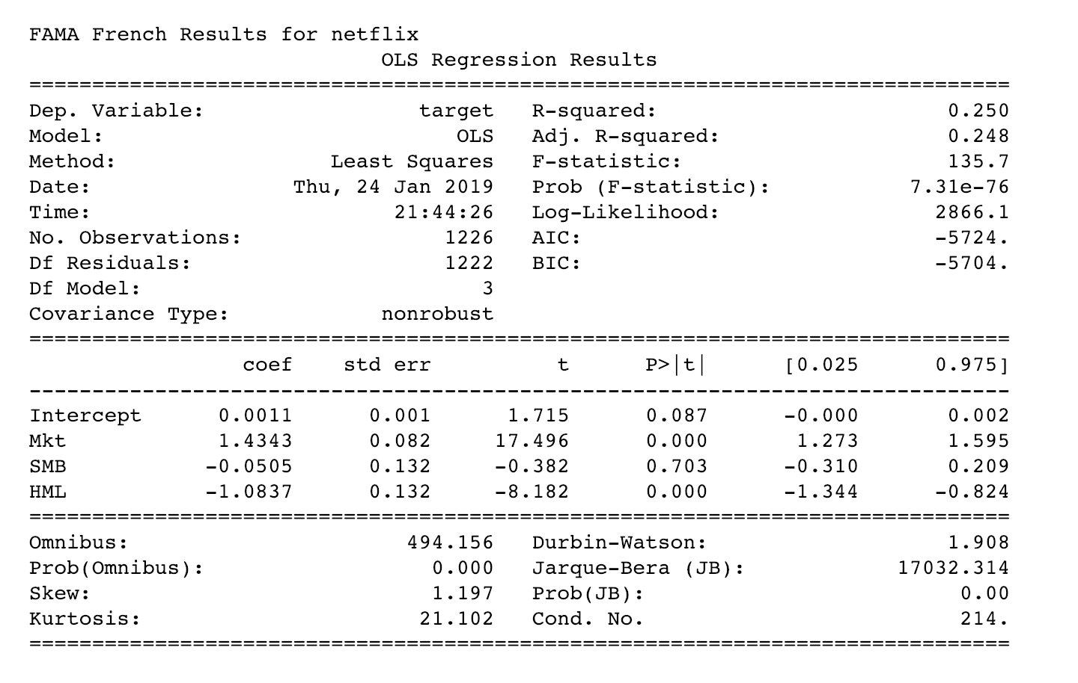

Slide 15
