Slide 1
Data Mining
Final project
Presentors:
Anusha Palisetty
Ivan Escalona
Nikhil Gupta

Slide 2
Background – Lending Club Case Study
https://www.kaggle.com/wendykan/lending-club-loan-data
Background Lending club is the largest peer-to-peer marketplace connecting borrowers with lenders. Borrowers apply through an online platform where they are assigned an internal score. Lenders decide 1) whether to lend and 2) the terms of loan such as interest rate, monthly instalment, tenure etc. Some popular products are credit card loans, debt consolidation loans, house loans, car loans etc.

Slide 3
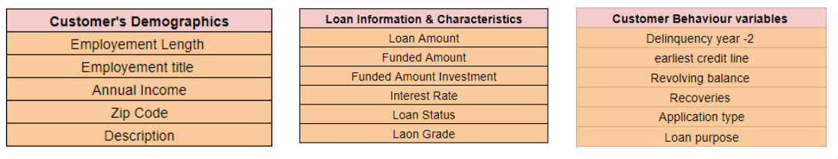
Data understanding
Types of variables
Customer (applicant) demographic
Loan related information & characteristics
Customer behaviour (if the loan is granted)

Slide 4
Data understanding
We have columns like:
Loan Amount, Installment, Int. Rate, DTI, Term, Purpose, Home ownership etc
So, we performed Univariate and Bivariate analysis on the data to understand the data better

Slide 5
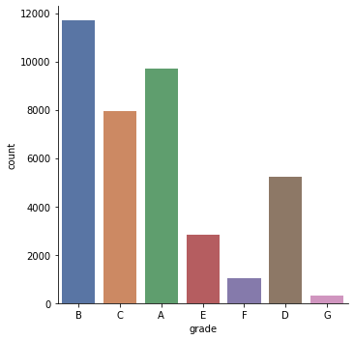
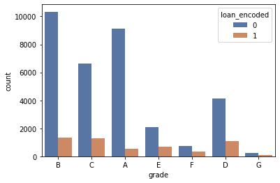
Loans per grade Loan status per grade

Slide 6
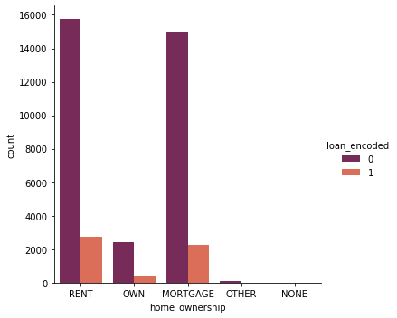
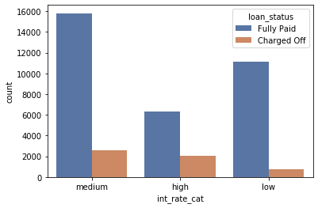
Home ownership vs loan status int. rate(bin) and loan status

Slide 7
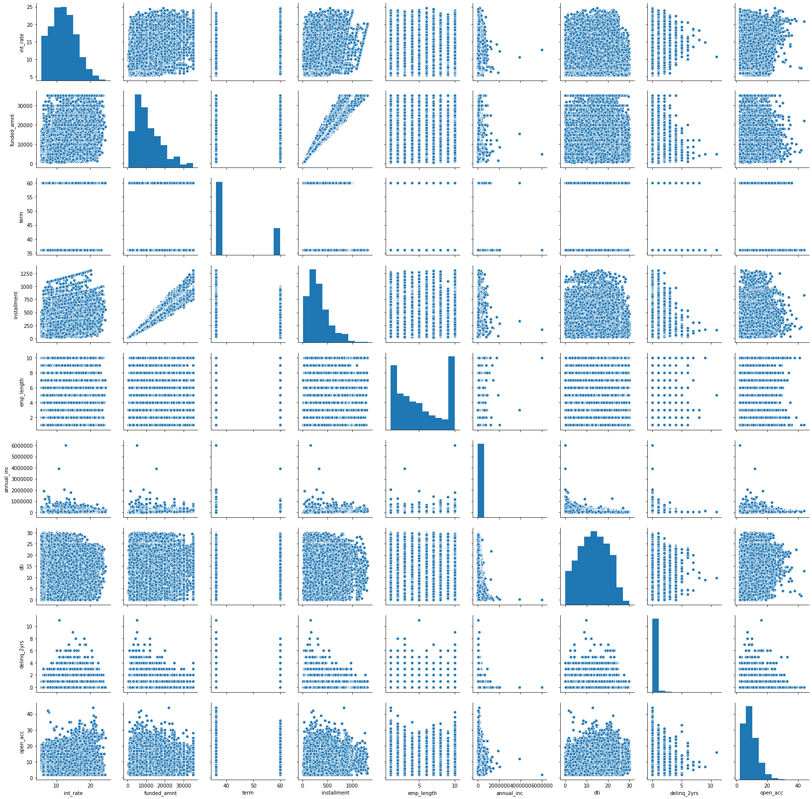
Pair plot

Slide 8
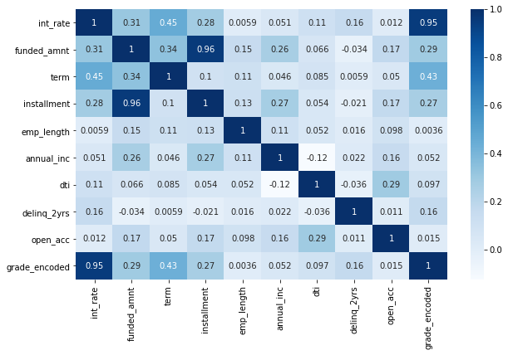
Correlation map

Slide 9
Data Cleaning and Preprocessing
Removal of columns which had more than 60% NA values
Binning of continuous variables like Interest rate & Grade(Target)
Removal of to make columns ‘numeric’ like ‘loan term’.
Converting loan status to binary variables
Pre-processing
Binning
One Hot Encoding

Slide 10
So, what are we predicting?
From a customer point of view, we want to predict the grade a customer is going to get before applying for a loan.
A low grade means a low interest loan
There are 7 grades in the dataset and we categorised them into three:
Low
Medium
High

Slide 11
Modelling and accuracy
We achieved the best accuracy with KNN classifier. So, we tuned it to perform even better
Model | Accuracy
Random Forest Classifier | 63%
Gaussian Naive Bayes | 58%
Support Vector Machines | 53%
Logistic Regression | 55%
KNN | 72%
AdaBoost | 68%

Slide 12
How did we perform better?
MinMaxScaler: Performed range normalization and the score improved to 76% accuracy.
Further, we fine tuned the values in formula:
KNeighborsClassifier(n_neighbors=2,p=1,metric='minkowski',leaf_size=30)

Slide 13
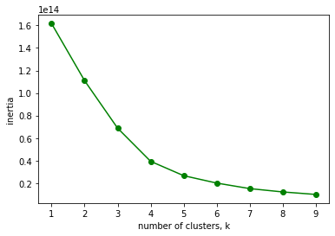
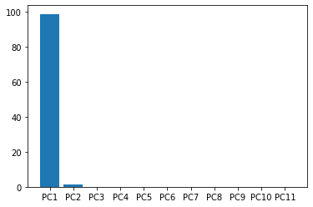
Unsupervised Learning
Implemented PCA and K_Means
Plotted Elbow Point and our K value is 3
Principal Components Elbow Plot

Slide 14
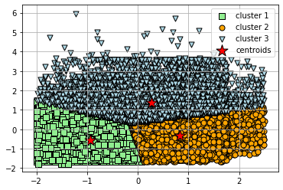
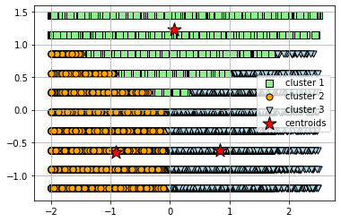
Clustering Plots
DTI and Total Accounts DTI and Employee Length

Slide 15
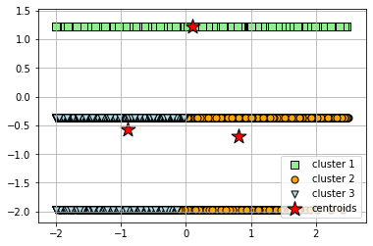
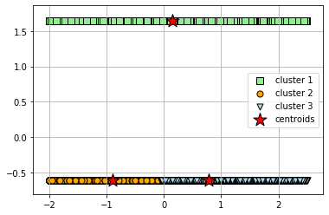
Clustering Plots
Dti and Grade Encoded Dti and Loan Encoded

Slide 16
Multiple Linear Regression
Implemented multiple Linear Regression predicting Interest Rate
Metrics | Value
Mean Absolute Error | 2.516
Mean Squared Error | 9.502
Root Mean Squared Error | 3.082
R2 Score | 0.307

Slide 17
Thank You

