Slide 1
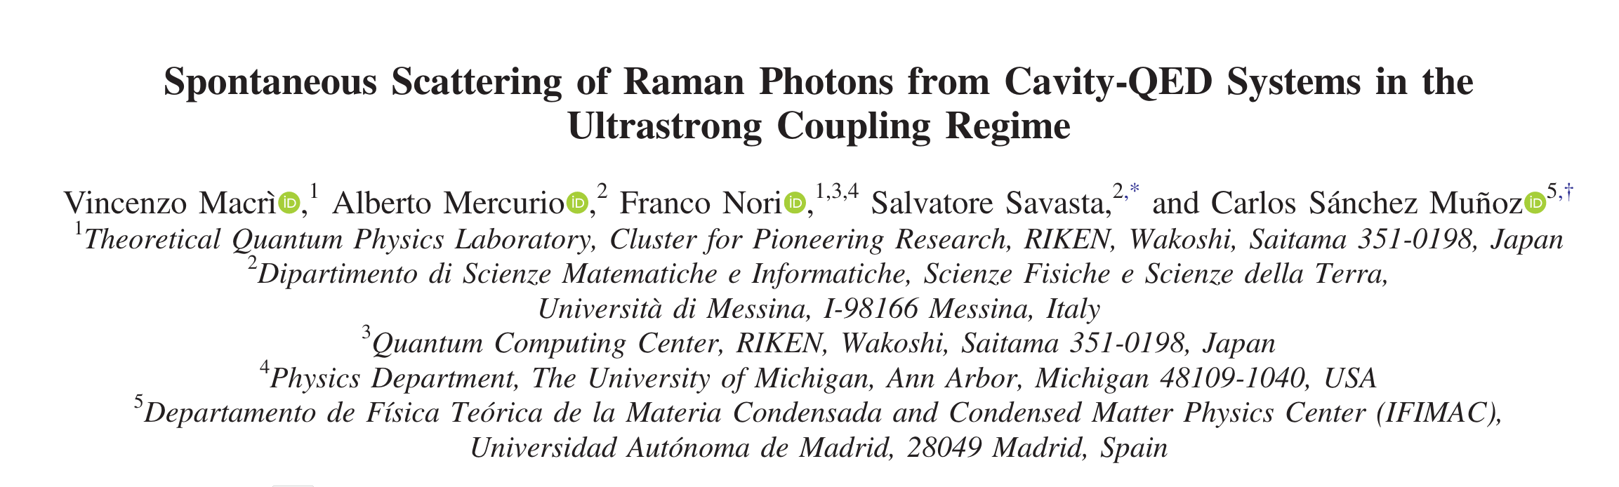
Paper presentation SC
14.03.2024, Carla Becker

Slide 2
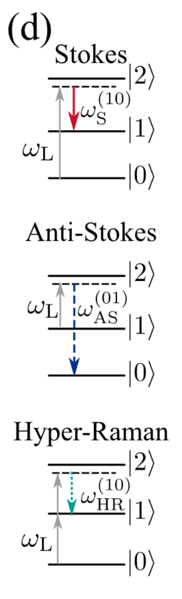
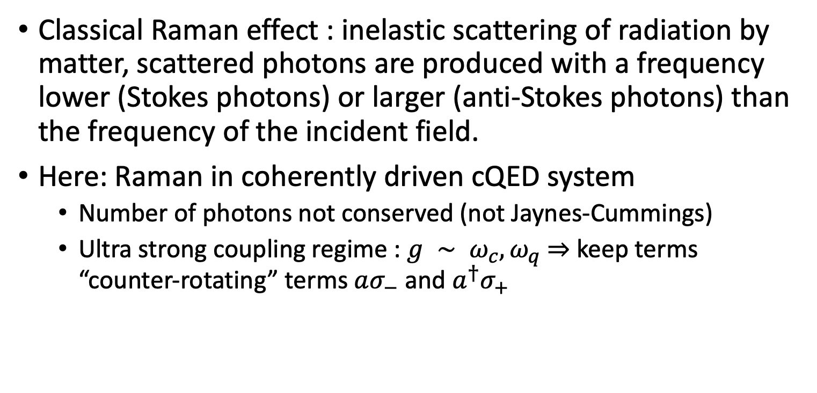
Raman effect
Classical Raman effect : inelastic scattering of radiation by matter, scattered photons are produced with a frequency lower (Stokes photons) or larger (anti-Stokes photons) than the frequency of the incident field.
Here: Raman in coherently driven cQED system
Number of photons not conserved (not Jaynes-Cummings)
Ultra strong coupling regime : $g ∼ ω_{c}, ω_{q}$ ⇒ keep terms “counter-rotating” terms $aσ_{−}$ and ${a^{†}σ}_{+}$

Slide 3
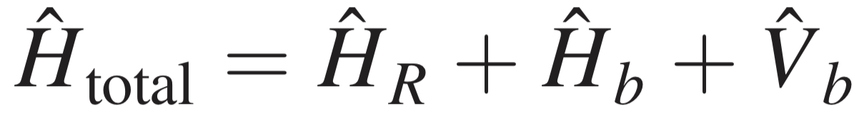
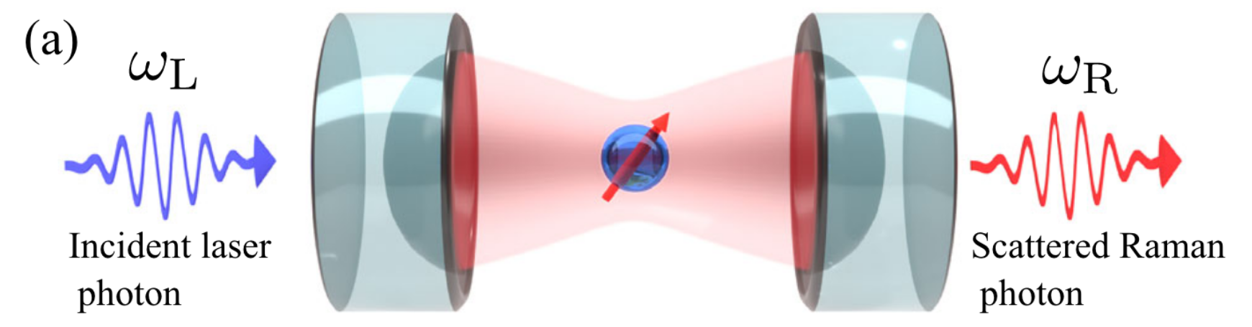
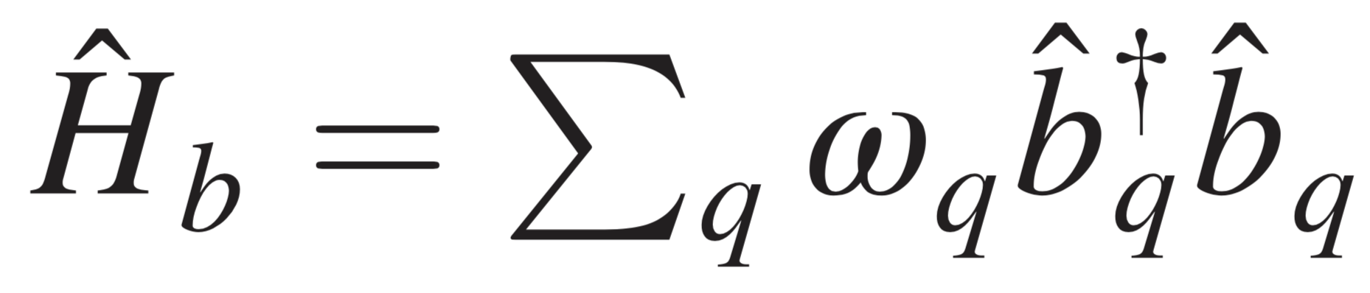
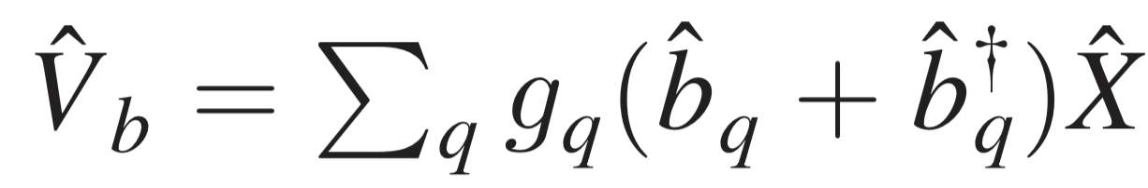
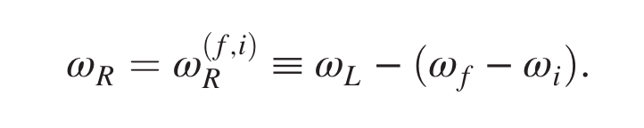
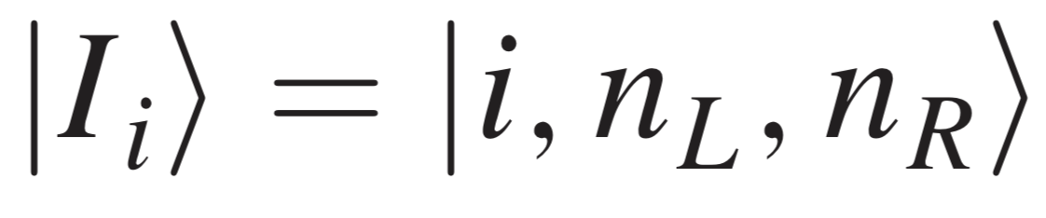
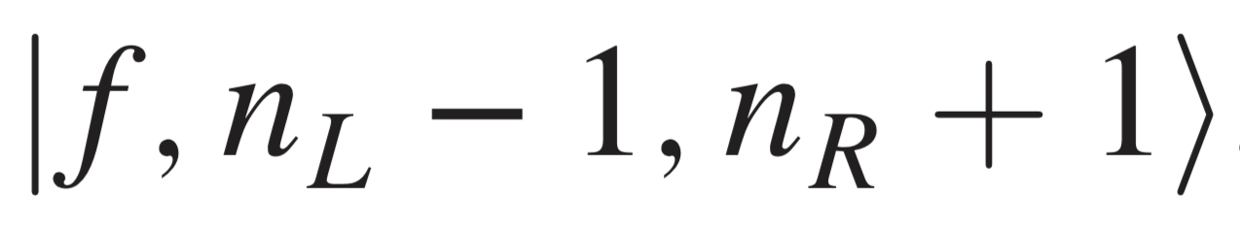
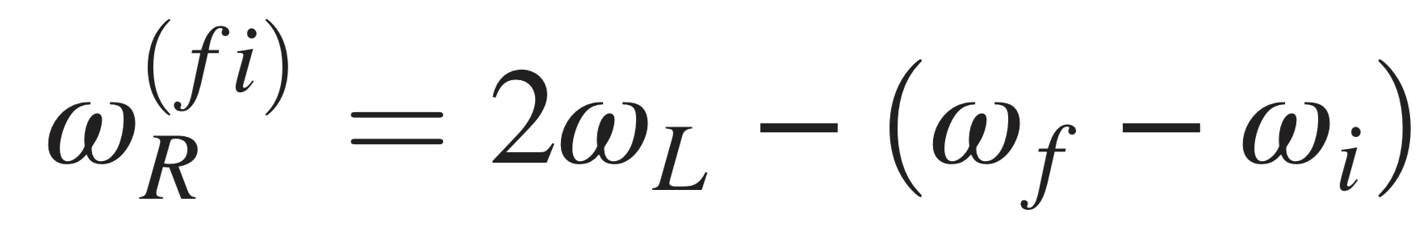




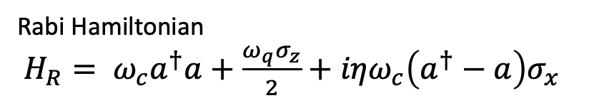

Model
Rabi Hamiltonian
$H_{R}= ω_{c}a^{†}a+\frac{ω_{q}σ_{z}}{2}+iηω_{c}\left(a^{†}−a\right)σ_{x}$
Quasi-continuum of modes : radiation (“laser”) field + scattered photons
$${\hat{σ}}_{z}$$
$$\hat{a}$$
$$\hat{b}$$
$$\hat{b}$$
second-order
perturbation
$$\hat{X}=a^{†}+a$$
→
2-photon processes : hyper Raman

Slide 4
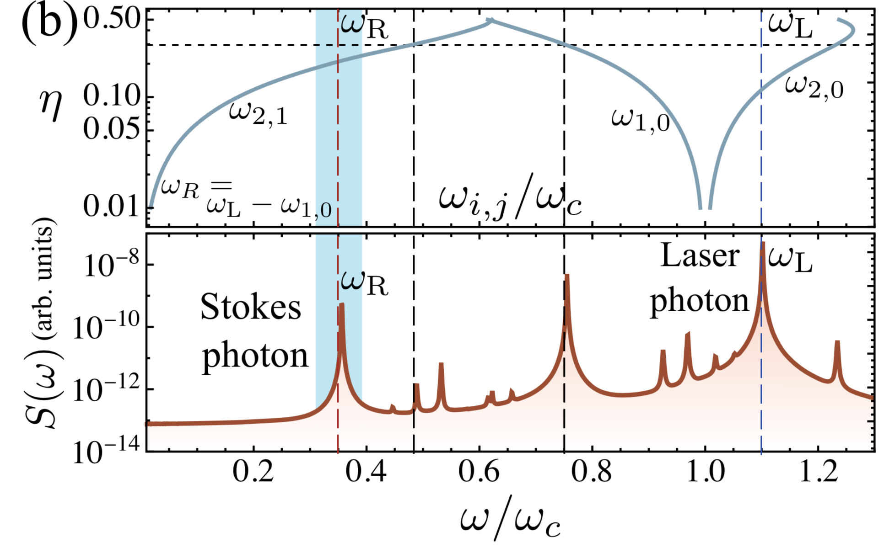
Results
Top: transition energies between the first two excited eigenstates of the light- matter system and the ground state, versus the normalized coupling parameter η.
Bottom: spectrum of emission for η = 0.3. ω_{L} = 1.1 ω_{c}. The red line indicates the frequency at which Stokes photons are emitted.

Slide 5
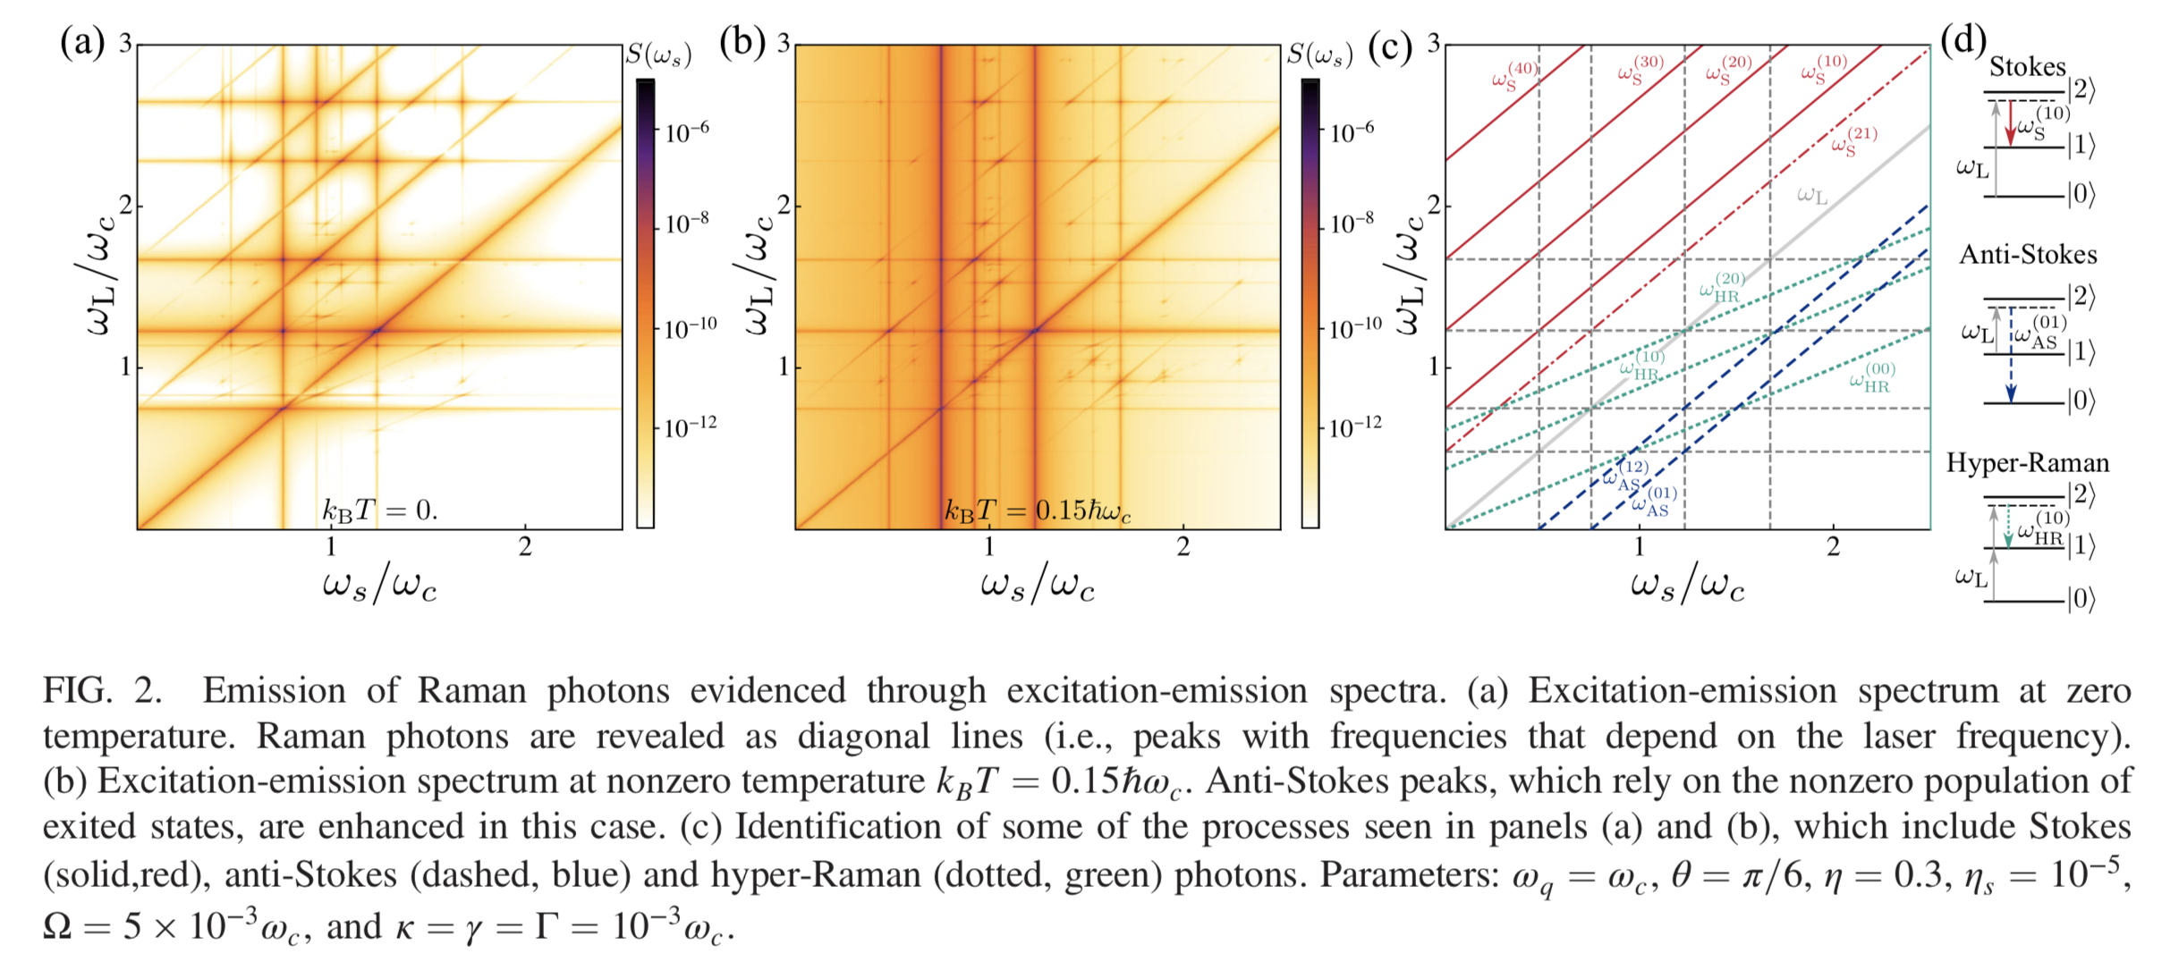

Slide 6
