Slide 1
Shor’s algorithm
Project 8
Nikolai Gusarov

Slide 2
Noise models
Digital error model: Errors happen with certain probabilities from a discrete set of errors
Statistical/continuous noise model: Noise is quantum operations, i.e. a depolarizing/amplitude damping/phase damping channel

Slide 3

Knill-Laflamme condition
$\left\langle ψ_{i} | E_{a}^{†} E_{b} | ψ_{j} \right\rangle = α_{ab} δ_{ij}$
No pair of error operators can take one codeword to two distinguishable states
Recovery operation R exists

Slide 4

Shor’s algorithm outline
$α|0⟩+ β|1⟩ ⟼ α| 0 0 0 ⟩+ β| 1 1 1 ⟩$
$|0L⟩=\frac{1}{2\sqrt{2}}(|000⟩+ |111⟩)(|000⟩+ |111⟩)(|000⟩+ |111⟩)$
$\left|1L\right\rangle =\frac{1}{2\sqrt{2}}(\left|000\right\rangle − |111⟩)(\left|000\right\rangle − |111⟩)(\left|000\right\rangle − |111⟩)$

Slide 5
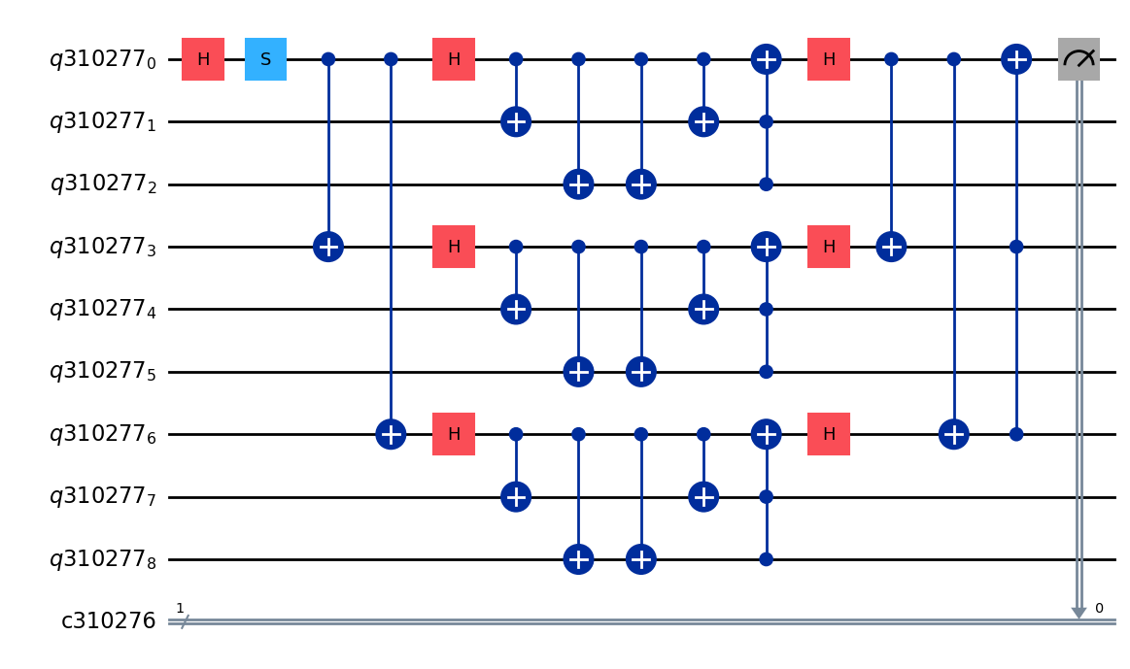
Encoding + Decoding
Repetitive code x3
Majority voting
Arb. state preparation
Encoding
Decoding + Correction

Slide 6
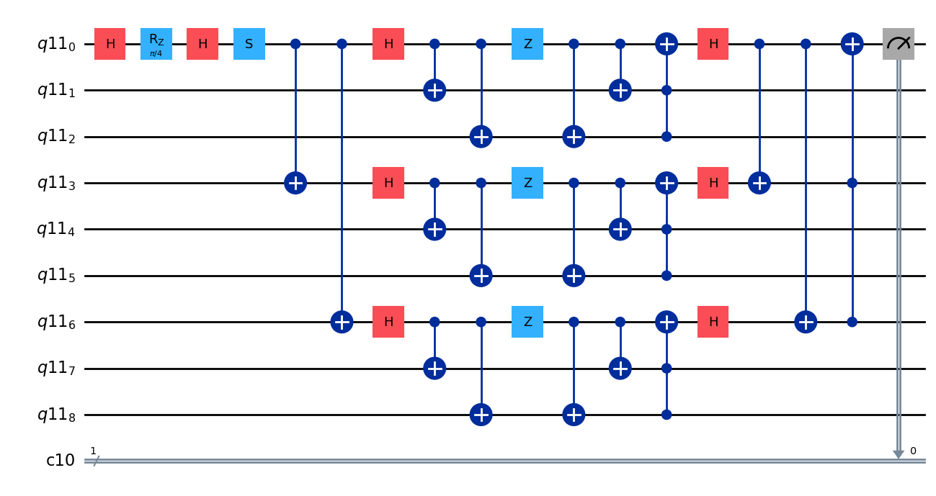
Transversal gates 1/2
X : flipping phase in each group to flip the codewords

Slide 7
Transversal gates 2/2
H : impossible
Asymetry in X- and Z-type stabilizers (|S_{X}| = 6, |S_{Z}| = 2)
H^{⨷9} does not preserve the code space
Needs non-transversal Clifford/ancilla implementation

Slide 8
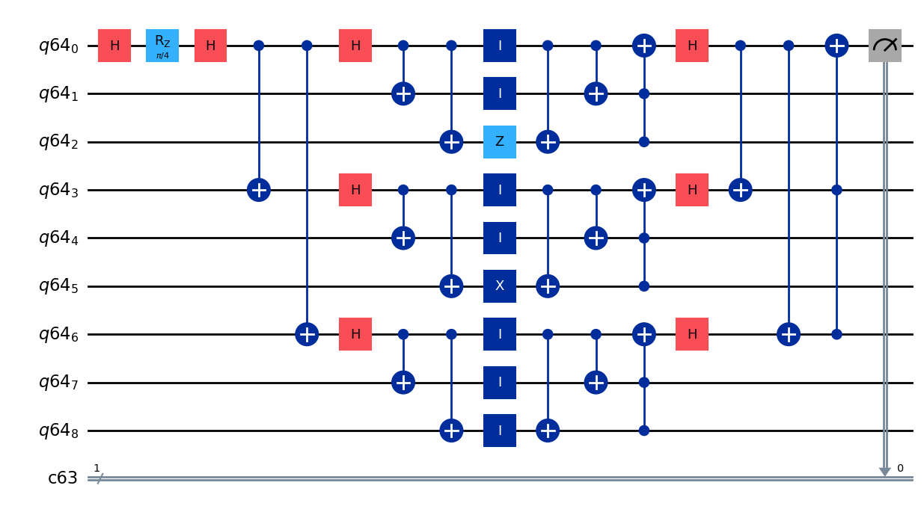
Correctable errors 1/4
Single Z/single X

Slide 9
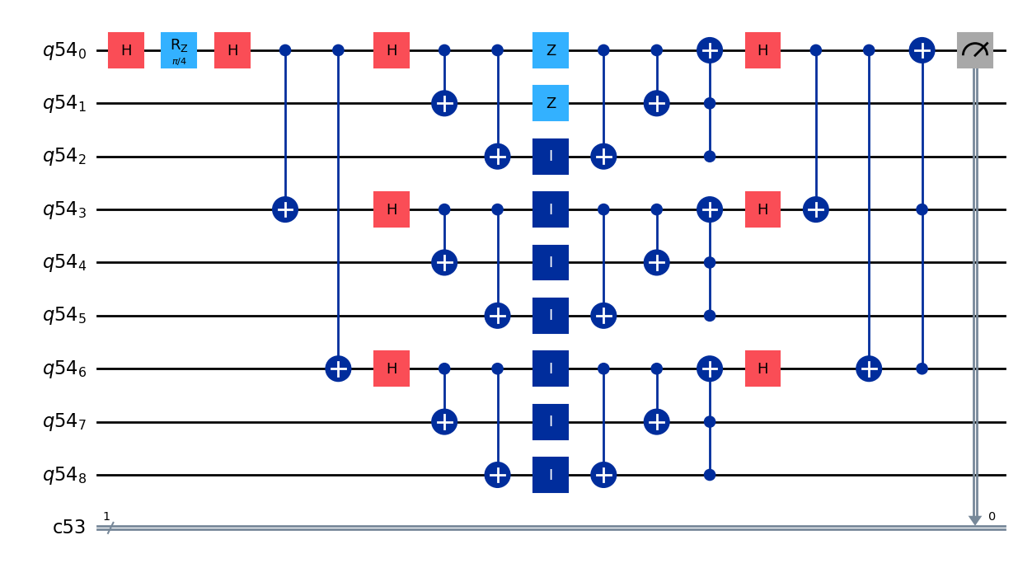
Correctable errors 2/4
Z in one block (up to 3)

Slide 10
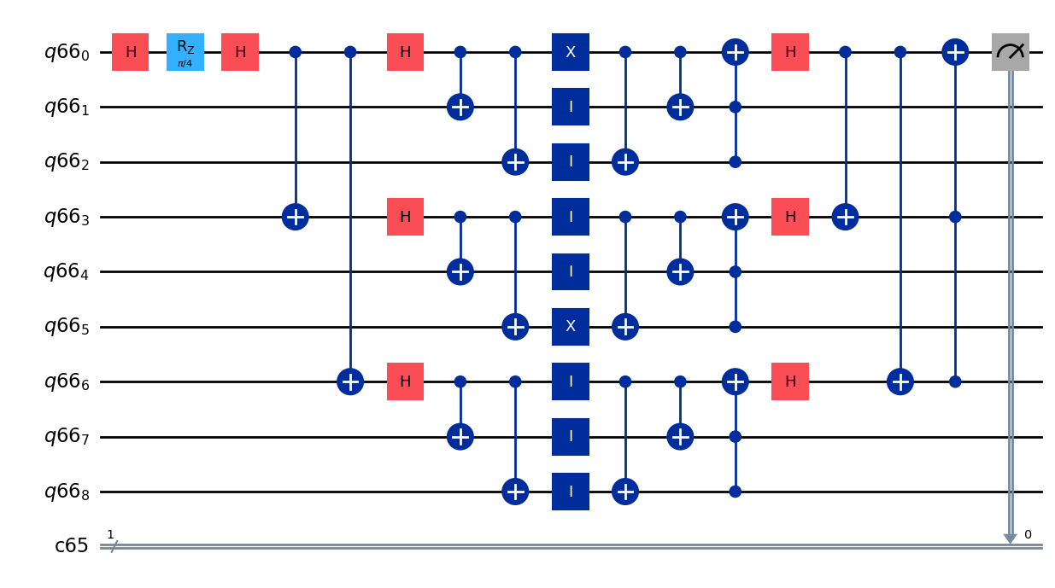
Correctable errors 3/4
X in different blocks (up to 3)

Slide 11
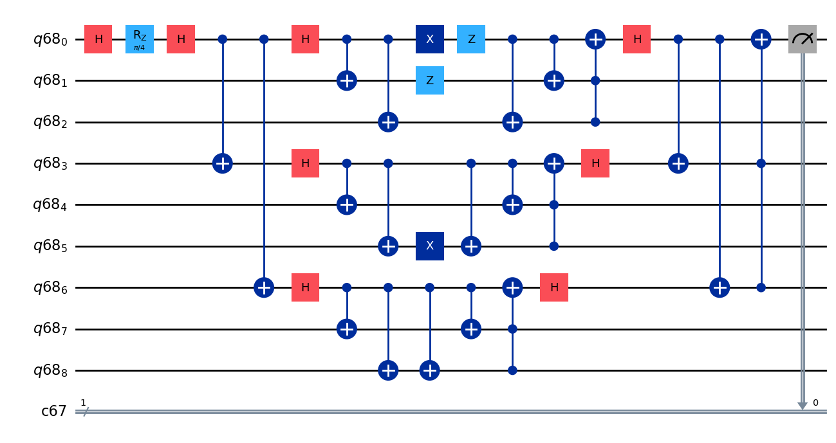
Correctable errors 4/4
Any combination of single X/Z or the above

Slide 12
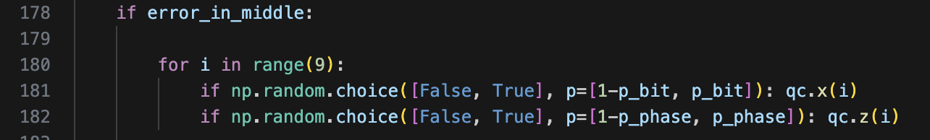
Error implementation

Slide 13
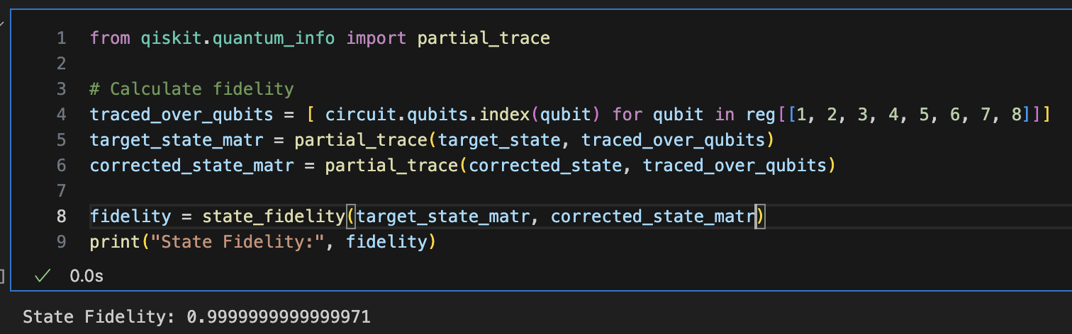
QECorrection Verification

Slide 14
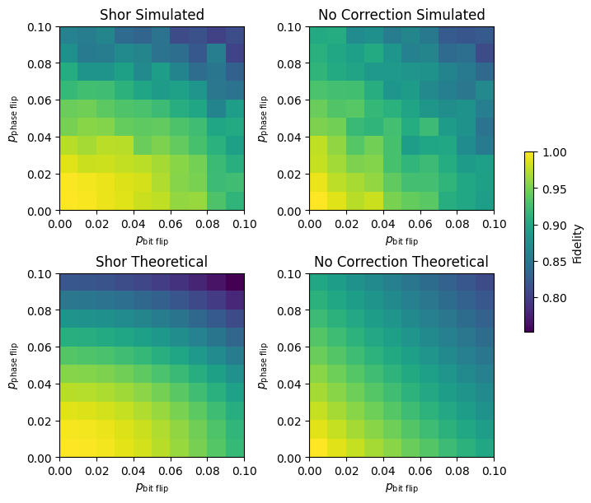
Fidelity : Simulated vs Theoretical
Simulations: fidelity meas repeated 1000 times
Theory: lower boundary estimate, see report for the formulas
Advantage is present
Assymetry due to the asymmetry in the code (3 vs 1)

Slide 15
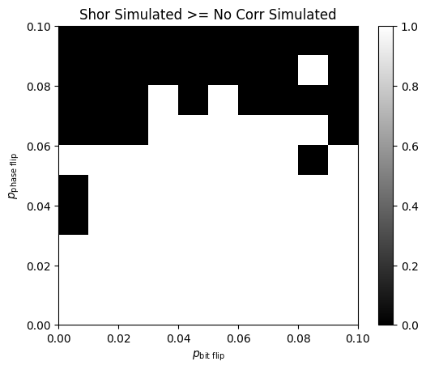
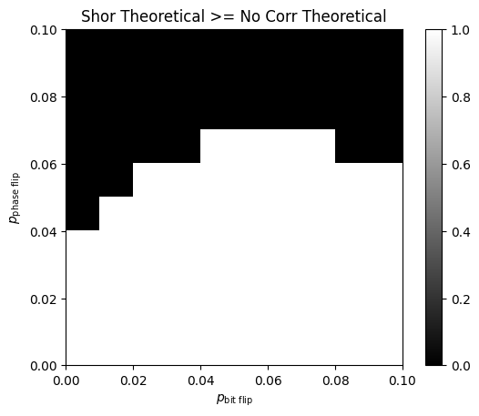
Masks to see advantage

Slide 16
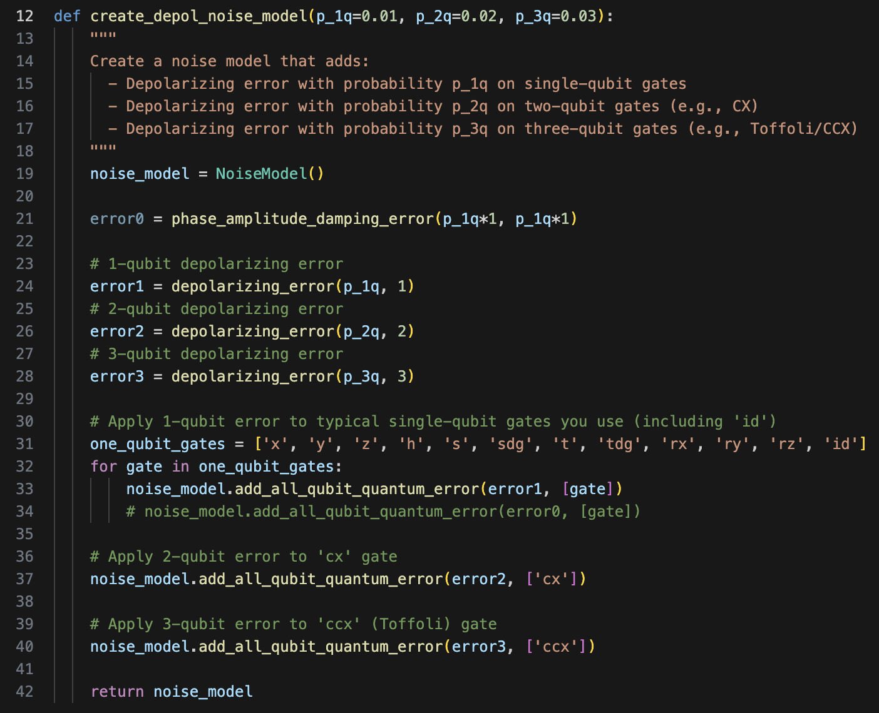
QASM noise : scheme

Slide 17
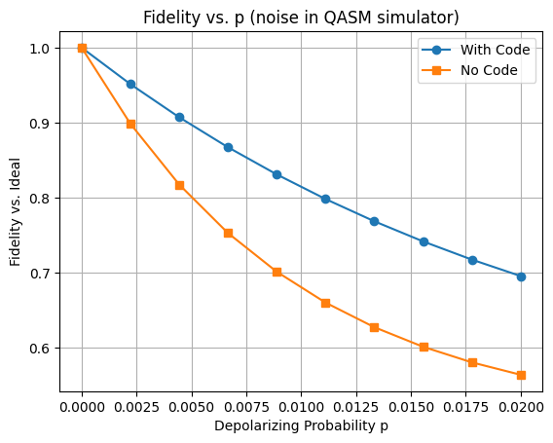
QASM noise : results

