Slide 1

MalAI
Group Number: 20

Slide 2
Title
Project Purposes
Goal Statements:
Malware analysis tool that utilizes reverse engineering and artificial intelligence models to analyze executable files and detect malware
MalAI will reduce the time it takes for a user to reverse engineer an executable by providing an improved decompilation process

Slide 3
Involved People
Project Advisor:
Dr. Abuaitah
Group Members
Long Nguyen
Email: nguye2l6@mail.uc.edu
Luqman Al Hasni
Email: alhasnld@mail.uc.edu

Slide 4
Project Abstract
MalAI is an AI-powered Ghidra plugin that aims to reduce the time taken in reverse engineering by improving the accuracy of existing decompilation processes. This will be achieved by finetuning an LLM on ASM-Source pairs using existing datasets such as Exebench and decompile bench, extending work from LLM4Decompile. MalAI's model will be integrated directly into Ghidra as a decompilation tool to access more human-readible C-Code. Additionally, extra functionalities such as malware analysis will be enabled through these trained models and outputs.

Slide 5
User stories
As a malware analyst, I reverse engineer countless executables through my career. However, the process of reverse engineering can be time-consuming as the current decompilation processes provides hard-to-read c-code. Therefore, I utilize MalAI to speed up my analysis by generating more readable c-code, allowing me to determine whether an executable is malware more quickly.

Slide 6
User Stories: Cont’
As a software developer, I often download many executable files for various reasons (testing applications, downloading coding-related software, etc.). However, this habit opens a lot of doors for my computer to get harmed. Therefore, I utilize MalAI to identify any malware in the executable files I intend to use. Furthermore, I also utilize MalAI to generate and read Assembly and C++ codes to further analyze any suspicious executable files and ensure that the file will only do what it is intended to do.

Slide 7
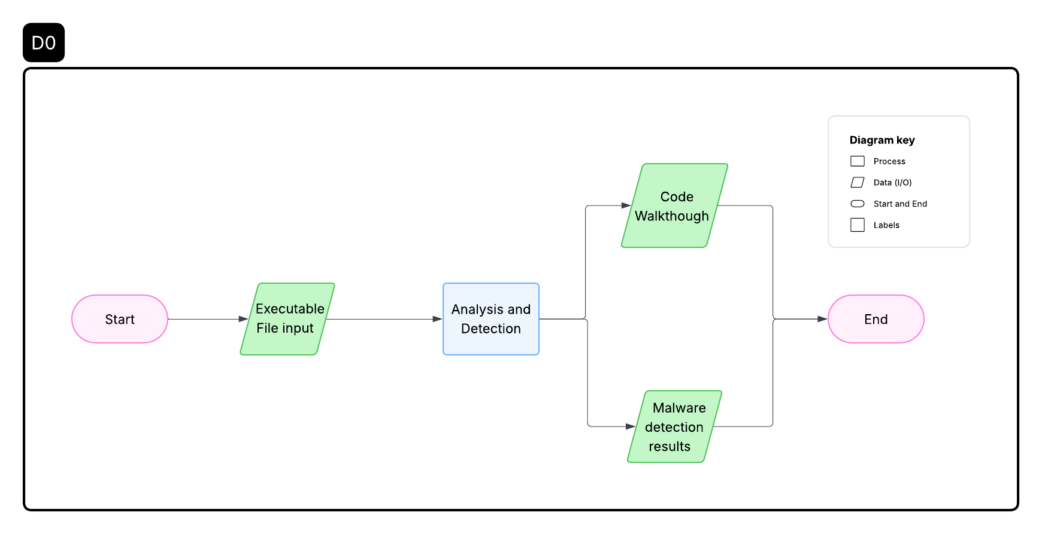
Diagrams:
Simplified Topology

Slide 8
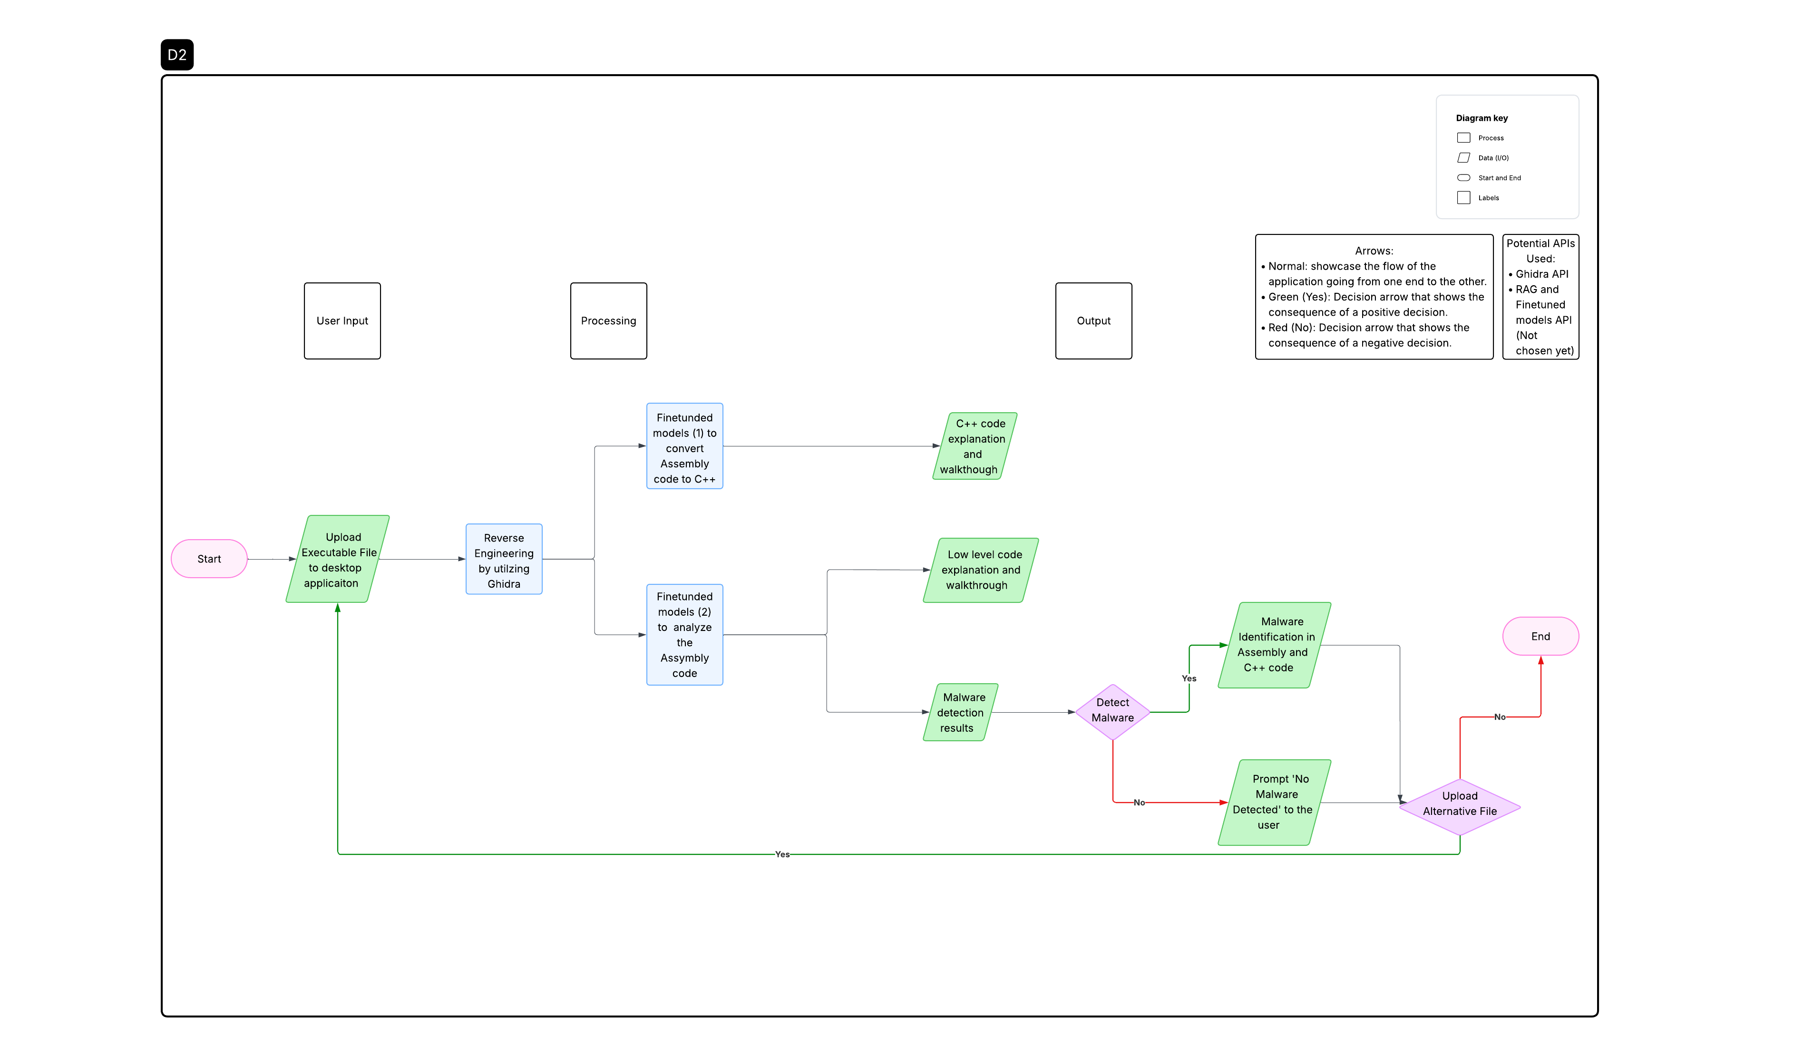
Diagrams: Cont’
Thorough Topology

Slide 9
Major Project Constraints
Ethical
Security
Legal

Slide 10
Review Project Progress
Milestones:
  Research available solutions
  Chose potential datasets
  Explore datasets performance
  Train LLM via chosen datasets
  Build the foundation of Ghidra plugin
  Integrating finetuned LLM with Ghidra plugin
  Demo MalAI
  Provide malware analysis solution via Ghidra plugin
  Provide malware generation solution via Ghidra plugin
  Develop a landing webpage for the MalAI

Slide 11
Expected Accomplishments
Milestones:
  Research available solutions
  Chose potential datasets
  Explore datasets performance
  Train LLM via chosen datasets
  Build the foundation of Ghidra plugin
  Integrating finetuned LLM with Ghidra plugin
  Demo MalAI
  Provide malware analysis solution via Ghidra plugin
  Provide malware generation solution via Ghidra plugin
  Develop a landing webpage for MalAI

Slide 12
Division of Work
Tasks
Number of Hours

Slide 13
Expected Demo at EXPO
MalAI Version | Functionality
0.1 | Able to reverse engineer executable files with results that exceed or reach Ghidra performance on same files.
0.2 | Enable users to analyze potential malware in executable files.
0.5 | Enable users to generate malware
1 | - Ensures all of the above works as expected - Build landing webpage page for MalAI
First Version: December 2025
Final Version: February 2026

Slide 14
End

