Slide 1
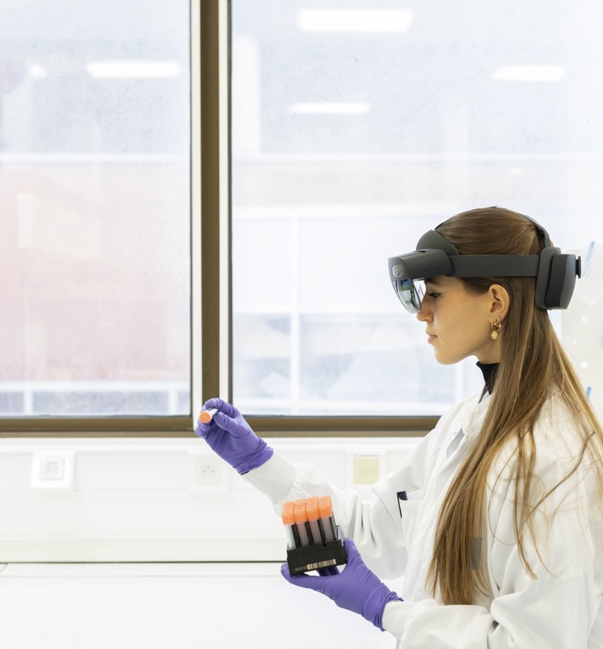
Co-op Training Path
May 2022

Slide 2
May 2 - 31
M
Month of May
Office becomes available
Ensure technology delivery
Soft Office Launch
Send welcome e-mails
Students arrive
iLearns
Data Pillar-Specific Onboarding and Training
First day in office
Formal Office Launch Toronto Team Social /Lunch
Data Pillar-Specific Onboarding and Training
General Sanofi Onboarding
Data Pillar-Specific Onboarding and Training
Thursday “social”
Victoria Day
Student Goals Review
Thursday “social” Micro - Hack Intro Bi-weekly buddy/manager chat
Data Pillar-Specific Onboarding and Training
Micro - Hack Challenge
DSLT Arrives Midday (TBD)
DSLT Town Hall / leaves
Toronto

Slide 3
Data Analyst Training Path
Data Pillar Specific Upskilling and Training
Key Takeaways
Agile Methodology (Jira+Confluence)
PowerBI
Github for version control
SQL foundations
Python foundations with focus on analytics + statistics
Zulfa, Alex, Gavincko, Joanne
Note: training path schedule is recommended and may vary based on your schedule and priorities
Day 1 (May 11) | Day 2 (May 12) | Day 3 (May 13) | Day 4 (May 16)
Remaining general Sanofi onboarding training (i.e., any iLearns that may be assigned or documents that will need to be signed) | Agile NEXT Learning Path – Chapter 1 (estimated time: 3 hours) Agile NEXT Learning Path – Chapter 2 (estimated time: 3.5 hours) In office scavenger hunt In office coffee chats | Agile NEXT Learning Path – Chapter 2 remaining (estimated time: 3.5 hours) Agile NEXT Learning Path – Chapter 3 (estimated time: 4 hours) | SQL Training (estimated time: 5 hours) JIRA & Confluence (requires request for access) - https://sanofi.atlassian.net/jira/your-work
Day 5 (May 17) | Day 6 (May 18) | Day 7 (May 19) | Day 8 (May 20)
SQL Training remaining (estimated time: 5 hours) In office coffee chats | Joanne and Zulfa: Python Intro for DS (estimated time: 6 hours, as required) Alex and Gavincko: Data Quality Management (estimated time: 6 hours) | Joanne and Zulfa: Python Intro for DS remaining (estimated time: 6 hours, as required) Alex and Gavincko: Data Governance (4 hours estimated) In office coffee chats Lunch and Learn – Data Strategy | GitHub Basics Statistics Overview (time permitting)
Day 9 (May 24) | Day 10 (May 25) | Day 11 (May 26) | Day 12 (May 27)
Download PowerBI for Desktop through Microsoft App Store PowerBI Crash Course – (estimated time: 6 hours) In office coffee chats | PowerBI Crash Course - remaining (estimated time: 6 hours) Remaining courses – catch up | Remaining courses – catch up In office μ-Project (Hackathon) Opening Ceremony (1 hour) Lunch and Learn – Indication Pipeline Project | μ–Project Hackathon Begins
Notes:
For python introduction, I am torn between Python A-Z™: Python For Data Science With Real Exercises! | Udemy and Python for Statistical Analysis | Udemy and https://www.udemy.com/course/statistics-for-data-science-and-business-analysis/

Slide 4
Data Engineer Training Path
Data Pillar Specific Upskilling and Training
Key Takeaways
Agile Methodology (Jira+Confluence)
PowerBI
Github for version control
SQL and Python proficiency
Bash Scripting, Docker, and Kubernetes foundations
Anthony & Hien
Note: training path schedule is recommended and may vary based on your schedule and priorities
Day 1 (May 11) | Day 2 (May 12) | Day 3 (May 13) | Day 4 (May 16)
Remaining general Sanofi onboarding training (i.e., any iLearns that may be assigned or documents that will need to be signed) | Agile NEXT Learning Path – Chapter 1 (estimated time: 3 hours) Agile NEXT Learning Path – Chapter 2 (estimated time: 3.5 hours) In office scavenger hunt In office coffee chats | Agile NEXT Learning Path – Chapter 2 remaining (estimated time: 3.5 hours) Agile NEXT Learning Path – Chapter 3 (estimated time: 4 hours) | SQL Training (estimated time: 5 hours) Set up Remote Dev Env (estimated time: 1hrs) JIRA and Confluence (requires request for access) - https://sanofi.atlassian.net/jira/your-work
Day 5 (May 17) | Day 6 (May 18) | Day 7 (May 19) | Day 8 (May 20)
SQL Training remaining (estimated time: 5 hours) [Alternative if comfortable with SQL] Python intermediate (estimated time: 6hrs) In office coffee chats | Python intermediate (estimated time: 6hrs) [Optional] Docker basics (estimated time: 3hrs) [Optional] Kubernetes basics (estimated time: 1.5 hrs) | GitHub Basics (estimated time: 6hrs) In office coffee chats Lunch and Learn – Data Strategy | GitHub Basics remaining (estimated time: 1hrs) Test Driven Development - Python (estimated time: 2hrs) Bash Scripting (estimated time: 3hrs)
Day 9 (May 24) | Day 10 (May 25) | Day 11 (May 26) | Day 12 (May 27)
Download PowerBI for Desktop through Microsoft App Store PowerBI Crash Course – (estimated time: 6 hours) In office coffee chats | PowerBI Crash Course - remaining (estimated time: 6 hours) Remaining courses – catch up | Remaining courses – catch up on Docker & Kubernetes optional courses In office μ-Project (Hackathon) Opening Ceremony (1 hour) Lunch and Learn – Indication Pipeline Project | μ–Project Hackathon Begins

Slide 5
Data Strategy Training Path
Data Pillar Specific Upskilling and Training
Key Takeaways
Agile Methodology and Tools
PowerBI
Data Strategy
Optional Material (Pharma Guide, SQL, etc.)
Jamie
Note: training path schedule is recommended and may vary based on your schedule and priorities
Day 1 (May 11) | Day 2 (May 12) | Day 3 (May 13) | Day 4 (May 16)
Remaining general Sanofi onboarding training (i.e., any iLearns that may be assigned or documents that will need to be signed) | In office scavenger hunt In office coffee chats | Agile NEXT Learning Path – Chapter 1 (estimated time: 3 hours) Agile NEXT Learning Path – Chapter 2 (estimated time: 3 hours) | Agile NEXT Learning Path – Chapter 2 remaining (estimated time: 3.5 hours JIRA & Confluence (requires request for access) - https://sanofi.atlassian.net/jira/your-work
Day 5 (May 17) | Day 6 (May 18) | Day 7 (May 19) | Day 8 (May 20)
Agile NEXT Learning Path – Chapter 3 (estimated time: 4 hours) Data Strategy Course (total time: 4 hours, just start) In office coffee chats | Data Strategy Course (remaining) Virtual Coffee Chats | Download PowerBI for Desktop through Microsoft App Store PowerBI Crash Course – (estimated time: 6 hours) In office coffee chats Lunch and Learn – Data Strategy | PowerBI Crash Course – (estimated time: 6 hours)
Day 9 (May 24) | Day 10 (May 25) | Day 11 (May 26) | Day 12 (May 27)
In office coffee chats Optional: Guide to the Pharma Industry (Udemy - 1 hour) Remaining courses: ensure completion; seek other Agile courses if desired | Optional Udemy course of choosing (e.g. SQL Training (estimated time: 5 hours)) | Remaining courses – catch up In office μ-Project Hackathon Opening Ceremony (1 hour) Lunch and Learn – Indication Pipeline Project | μ–Project Hackathon Begins
Notes:
For python introduction, I am torn between Python A-Z™: Python For Data Science With Real Exercises! | Udemy and Python for Statistical Analysis | Udemy and https://www.udemy.com/course/statistics-for-data-science-and-business-analysis/

