Slide 1
GHOST FRAMES
Recovering the satellite packets ground stations throw away
MATLAB in Space Hackathon · Track 1: Deep-Space Communication & Signal Intelligence
Katie Nguyen · Wisena Joseph · jha-ruch
Notes:
Far from Earth, nobody can hand-tune a radio. Signals arrive weak, drift, and fade. When a few bits flip, the packet is thrown away. We built a receiver that handles this on its own, and tested it in two stages: on benchmark data, then on a real satellite.

Slide 2
Weak signals lose packets, and nobody can retune
Weak
Drifting
Fading
Signals arrive buried in noise, especially near the horizon
Doppler shifts the frequency throughout the pass
The link drops out and comes back mid-pass
A couple of flipped bits break the checksum, and the whole packet is discarded.
Our question: can a receiver find, decode and repair these signals with no human tuning?
Notes:
When a spacecraft is far away, nobody on the ground can fix a problem in time. Signals arrive weak, drift with Doppler, and fade. A ground station that sees a failed checksum throws the packet away.

Slide 3
Two stages: benchmark data, then a real satellite
1 · In the lab
2 · In the sky
RadioML 2016.10A
SatNOGS: SONATE-2 CubeSat
220,000 synthetic radio signals (DeepSig)
11 modulation types
SNR from −20 dB to +18 dB
Used to train a modulation classifier
Real recordings: 3 passes, 2 ground stations
9600-baud GMSK telemetry, 437.025 MHz
2,508 frames SatNOGS decoded, used as the answer key
Used to build and test the decoder
RadioML teaches us what signals look like. SONATE-2 tests whether we can actually decode one, with an answer key to check against.
Notes:
We started with RadioML, a benchmark of 220,000 synthetic signals. Then we moved to real recordings of SONATE-2, a German CubeSat, from SatNOGS volunteer ground stations. SatNOGS also publishes what their own decoders received, which we used as the answer key.

Slide 4
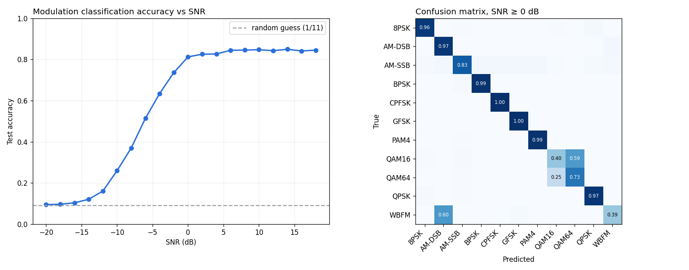
RadioML: a CNN recognises 11 modulations
84%
accuracy at SNR ≥ 0 dB
57%
overall, −20 to +18 dB
4-layer 1-D CNN on raw 2×128 I/Q samples, 50/50 train/test split
Matches published baselines; below −10 dB everything blurs into noise, which is where deep-space signals live
Known dataset quirks show up: QAM16 vs QAM64, WBFM vs AM-DSB
Notes:
We trained a small convolutional network on RadioML to recognise the modulation from raw samples. 84% at good signal levels, 57% overall, matching published results. Exploring the data we also found AM-SSB is essentially noise, a known error in the dataset.

Slide 5
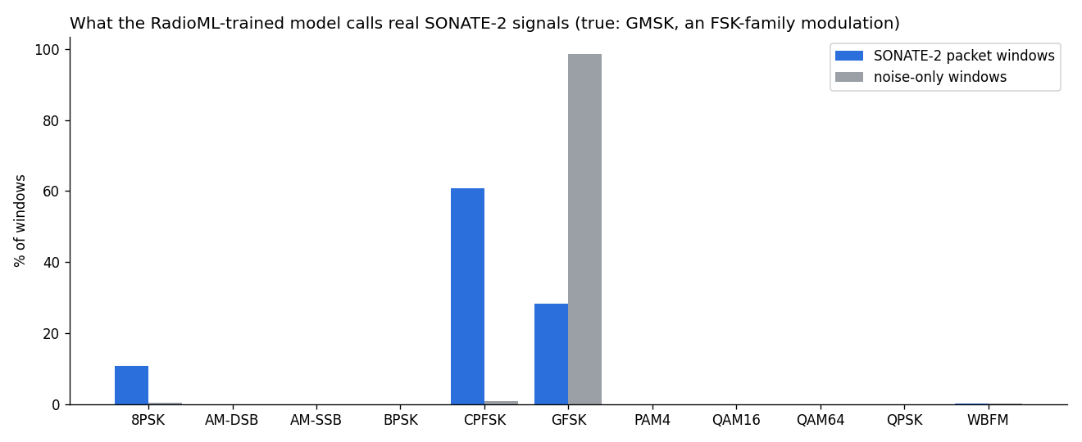
Does it transfer to a real satellite? Promising, not proven
88–95% of real SONATE-2 windows classified FSK-family (correct: GMSK)
Caveat: noise also looks FSK-like after rebuilding I/Q from audio
The model does separate signal (CPFSK) from noise (GFSK)
Takeaway: recognising a signal isn't enough. To get telemetry we have to decode it, so we built a decoder.
Notes:
We asked the RadioML model what it sees in real SONATE-2 recordings. It says FSK family 88 to 95 percent of the time, which is correct. But noise also looks FSK-like after our audio-to-I/Q conversion, so this is promising, not proof. It told us classifying isn't enough: to get telemetry we have to decode.

Slide 6
A zero-tuning decoder for real SONATE-2 recordings
1
2
3
4
5
6
Clean
Find timing
Unscramble
Find packets
Repair
Log
Remove Doppler drift with a 0.2 s moving average
Try 10 timing offsets per bit, keep what decodes
G3RUH descramble + NRZI; polarity doesn't matter
Flags, bit unstuffing, CRC-16 checksum
If the CRC fails, flip the least-confident bits
Verified packets to a telemetry CSV
No settings. Drift, timing and polarity come from the recording itself; the same code ran unchanged on every pass and station.
Re-acquires automatically. It searches for packet flags continuously, so it picks the signal back up after every fade.
Never trusts a bad packet. Every packet passes CRC-16 plus a callsign check against false accepts.
Notes:
Start the live demo now: python decoder.py data/satnogs/sonate2_15104225/audio.ogg. Then walk through the steps. Like tapping along to a song, we try several timings and keep whichever lines up. The checksum is like the last digit of a credit card. The key idea is repair: when a checksum fails, we know which bits we were least sure about, so we flip those and check again.

Slide 7
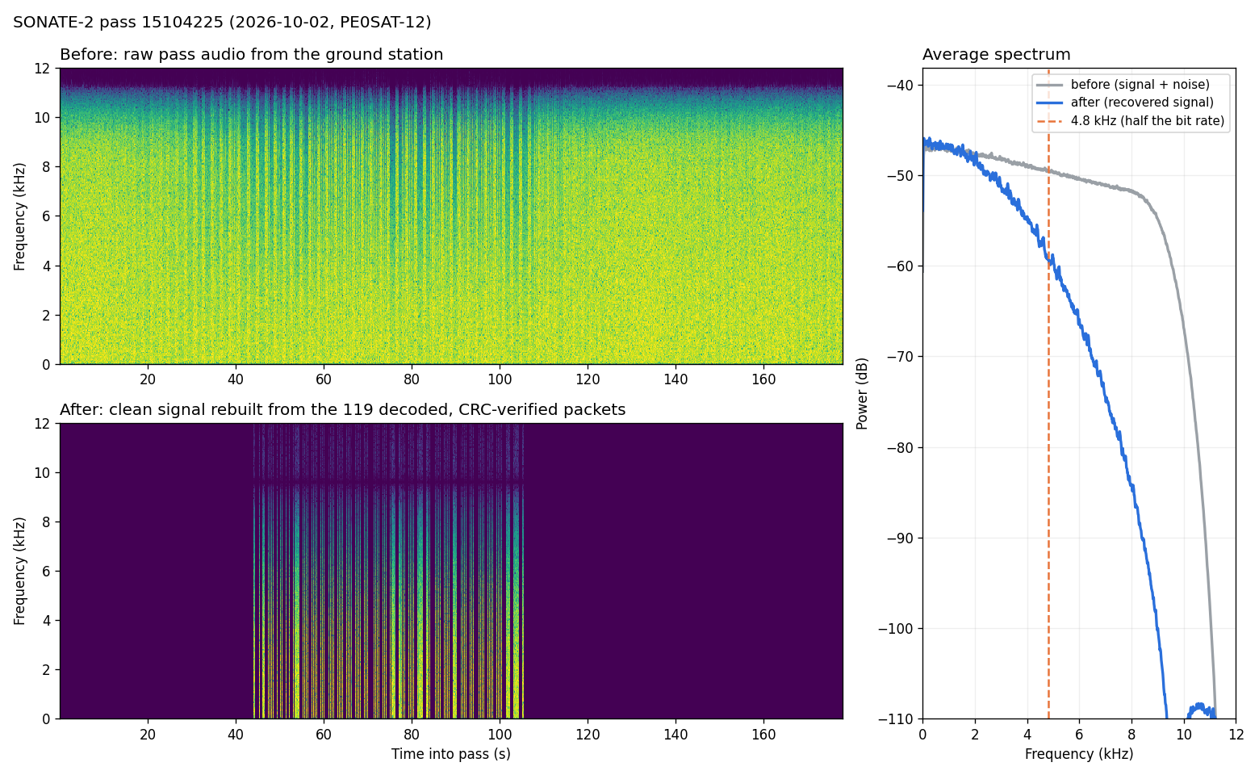
Before/after: noisy recording to verified signal
Before: raw ground-station audio. Packet bursts are faint stripes in the noise
After: the signal rebuilt from our 119 CRC-verified packets
The recovered spectrum rolls off near 4.8 kHz, as 9600-baud GMSK should
Pass 15104225, PE0SAT-12 ground station, 2026-10-02. Plots for all 3 passes are in results/.
Notes:
Top is what the ground station heard: mostly noise, with packet bursts faintly visible. Bottom is the clean signal we rebuilt from the verified packets.

Slide 8
Telemetry log: 780 checksum-verified packets
Pass | UTC (approx.) | From → To | Bytes | Bits repaired | Payload (start)
15039241 | 2026-09-21 16:10:45 | DP0SNX → CQ | 146 | 0 | 2700ba4618000864eb5b…
15039241 | 2026-09-21 16:10:48 | DP0SNX → CQ | 82 | 1 | 2702bc37180008c8c032…
15039241 | 2026-09-21 16:10:50 | DP0SNX → CQ | 63 | 0 | 2702bf39180008d3e0e7…
15039241 | 2026-09-21 16:10:51 | DP0SNX → CQ | 146 | 1 | 2700c04918000864eb5e…
15039241 | 2026-09-21 16:11:03 | DP0SNX → CQ | 146 | 2 | 2700ca4f18000864eb64…
780
2
1 counter
verified packets in results/telemetry_log.csv
packet types: 146 B and 271 B (byte 1 of payload)
byte 2 numbers every packet, so gaps = missed packets
DP0SNX is SONATE-2's callsign. Payload layout inferred from the data; SatNOGS has no public field decoder for SONATE-2 either.
Notes:
Every row is a packet that passed its checksum. Most are 146 or 271 bytes. Lining up payloads, we found a packet-type byte and a packet counter, which lets the receiver measure its own losses.

Slide 9
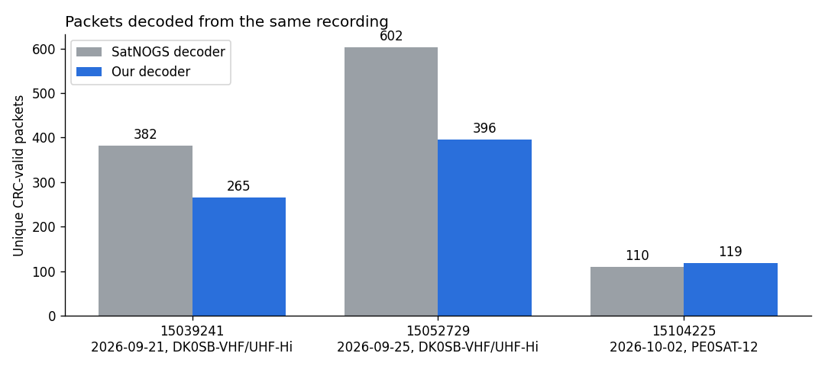
10 ghost frames: packets SatNOGS's decoder missed
10
ghost frames, all CRC-valid; 7 confirmed by other ground stations
41%
of our packets rescued by bit repair (8 of the 10 ghosts)
Strong pass (PE0SAT-12): every packet SatNOGS got, plus 9 more
Weaker passes (DK0SB): about two thirds of SatNOGS's count; we lose the weak start and end of each pass
770 packets match SatNOGS byte for byte
Notes:
Both decoders ran on the same recording. On the strong pass we got every packet SatNOGS did plus 9 more, and 7 of those were independently received by other stations, so they are real. On weaker passes we get about two thirds. 41 percent of our packets would have been lost without bit repair.

Slide 10
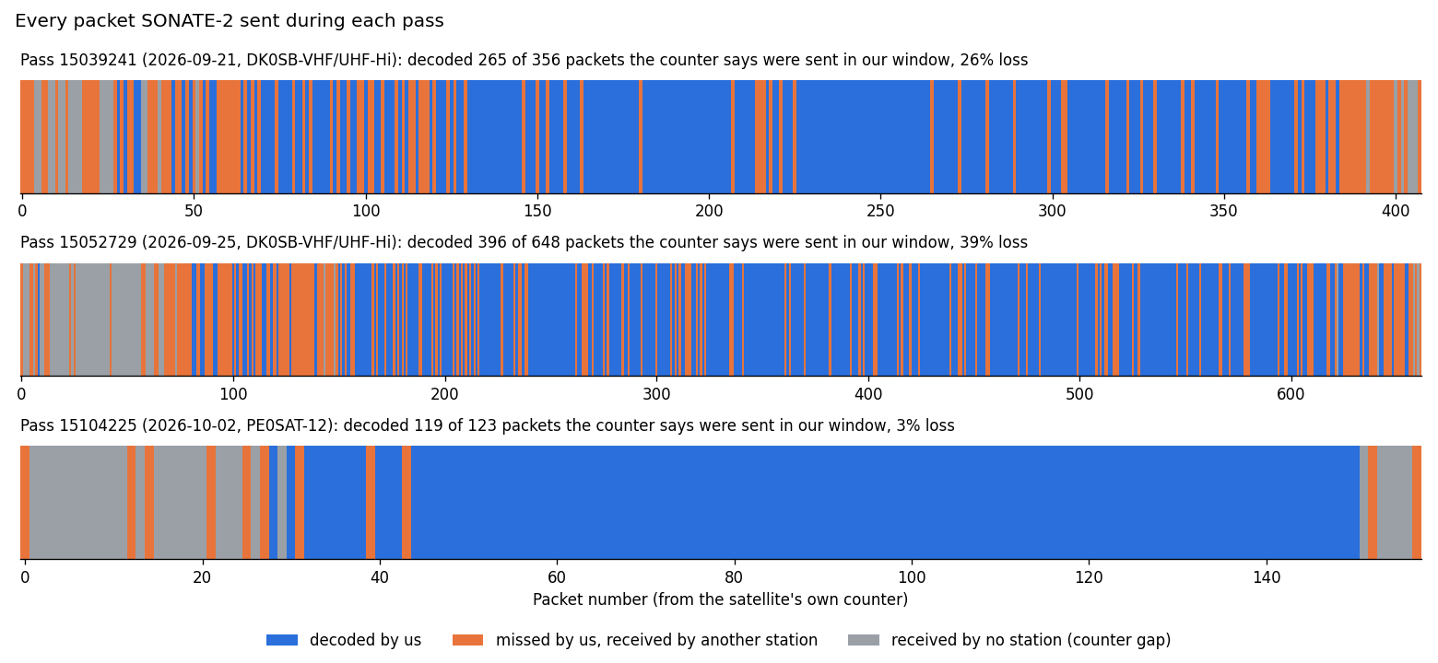
The receiver measures its own packet loss
Gaps in the satellite's packet counter = packets we missed
3% loss on the strongest pass
Checked against all SatNOGS stations: counters matched on every shared packet
Also reveals packets no station received (gray)
Notes:
A real deep-space station has no SatNOGS to check against. But the satellite numbers its packets, so every gap is a packet we missed. On the strongest pass we lost only 3 percent. The counters lined up perfectly with other stations on every shared packet.

Slide 11
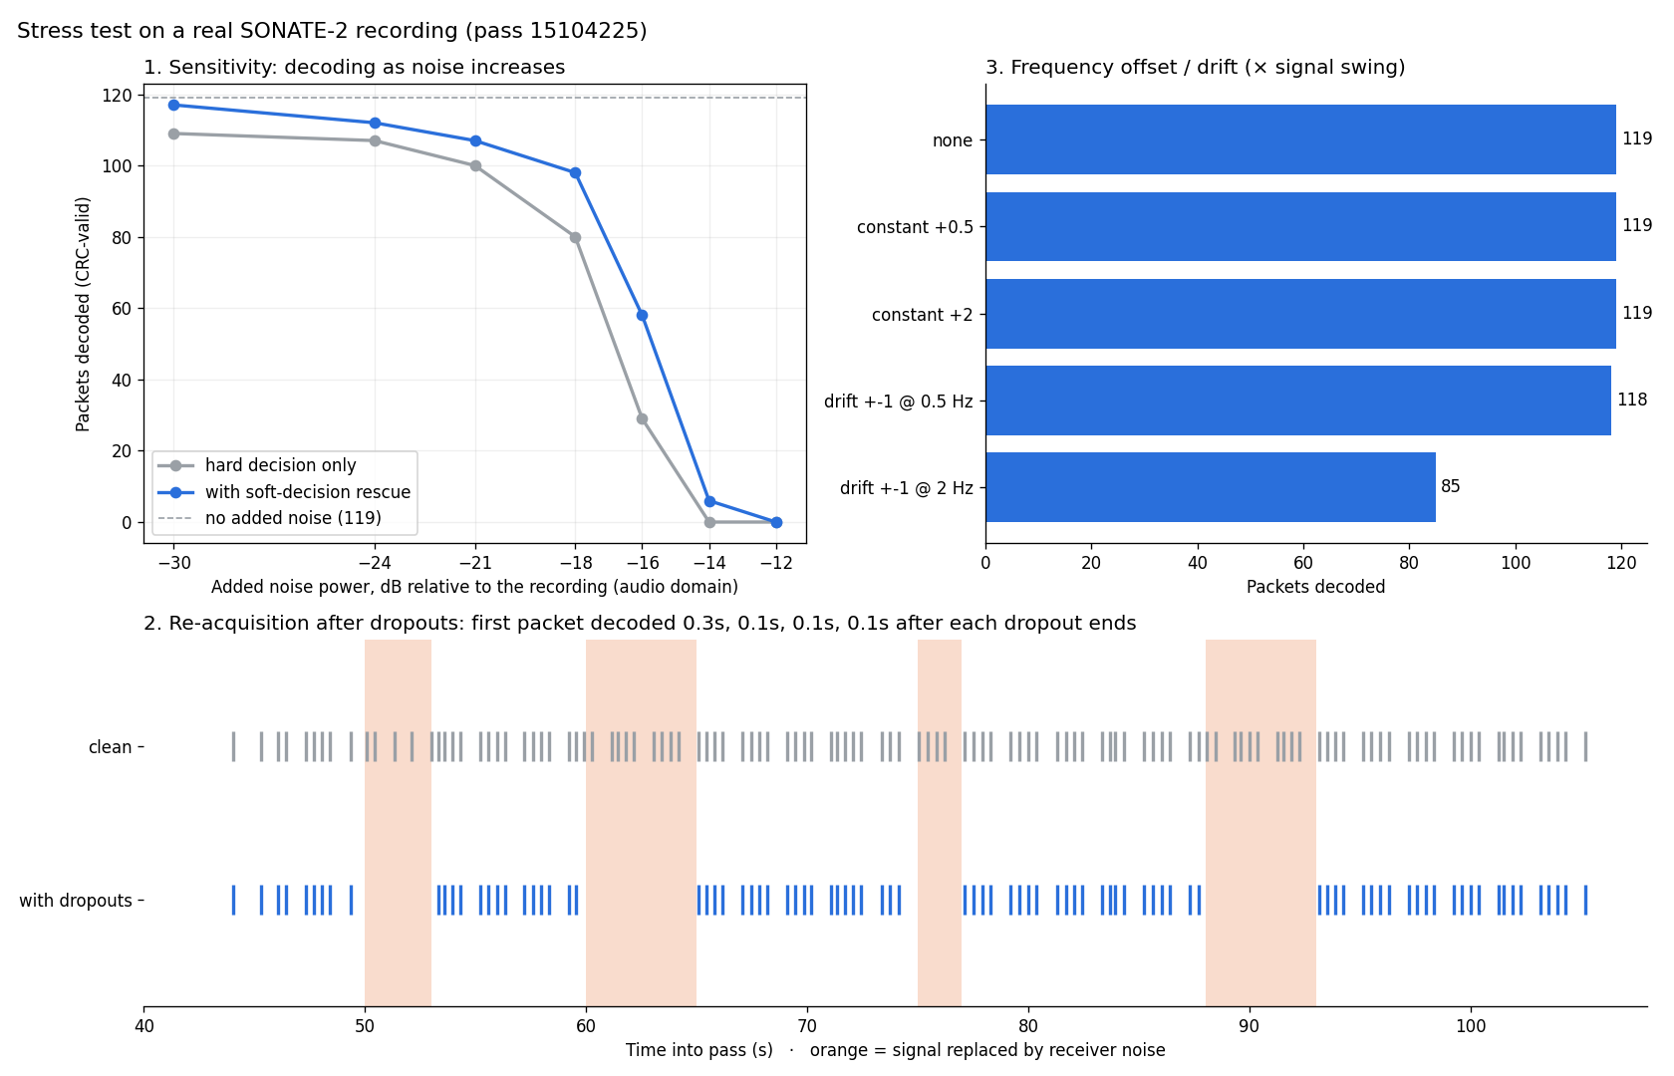
Autonomy: we broke the signal, it kept decoding
≤ 0.4 s
to re-acquire after each of 4 signal dropouts, no reset
2×
packets near the noise limit with bit repair (~1 dB gain)
119 / 119
decoded with constant frequency offsets up to 2×
Notes:
We cut the signal out four times: it picked back up within 0.4 seconds every time, same packets as the clean run. We added noise: bit repair decodes twice as many packets near the limit, about one decibel. We shifted and drifted the frequency: constant offsets cost nothing; only very fast drift, beyond real Doppler, costs packets.

Slide 12
Reproducible in a few commands
Everything is on GitHub: code, README, results and plots
fetch_data.py downloads the passes and checks each one really is SONATE-2
No tuning between passes: one command decodes them all and opens a summary graph
Live demo: python decoder.py <audio.ogg>
pip install -r requirements.txt
python fetch_data.py
python clean_frames.py
python run_pipeline.py
python stress_test.py
python radioml_classifier.py train
python radioml_classifier.py transfer
Notes:
Judges can reproduce every plot. Data downloads automatically; ground truth needs a free SatNOGS token.

Slide 13
Limitations and next steps
Limitations
Next steps
We lose packets at the weak start and end of each pass
Input is ground-station audio, not raw I/Q, so the station did the carrier tracking
Payload fields (voltages, temperatures) aren't public, for us or SatNOGS
RadioML transfer test is inconclusive on audio-derived I/Q
Tracking timing loop (Gardner) instead of the offset search: faster and more sensitive
Decode raw I/Q recordings and track the carrier ourselves
Rerun the RadioML transfer test on raw I/Q
Try 3-bit repairs, with the false-accept rate measured
Notes:
Being upfront: we lose the weakest packets, we work from audio not raw radio data, and nobody can decode SONATE-2's fields because the format isn't public.

Slide 14
Thank you
780
10
≤ 0.4 s
0
verified packets
ghost frames
re-acquisition
settings to tune
Team: Katie Nguyen · Wisena Joseph · jha-ruch
Data: SatNOGS (Libre Space Foundation) · SONATE-2 · RadioML 2016.10A (DeepSig, CC BY-NC-SA 4.0); O'Shea & West, GNU Radio Conference 2016
Notes:
Close: everything is on GitHub, reproducible. Thank you, happy to take questions.

