Slide 1
Alfresco Community Present
(for developer)

Slide 2
About Alfresco
Wiki
“Alfresco is a collection of information management software products for Microsoft Windows and Unix-like operating systems developed using Java technology”

Slide 3
Features
Document management
Records management
Image management
Digital asset management
Learning content management support for learning management systems (e.g. Moodle)
Integrated publishing
Repository access via CIFS/SMB, FTP, WebDAV, NFS and CMIS
Automating business processes with the embedded Activiti BPM engine
Solr search
Multi-language support
Clustering support[4]
Reference : https://www.alfresco.com/customers

Slide 4
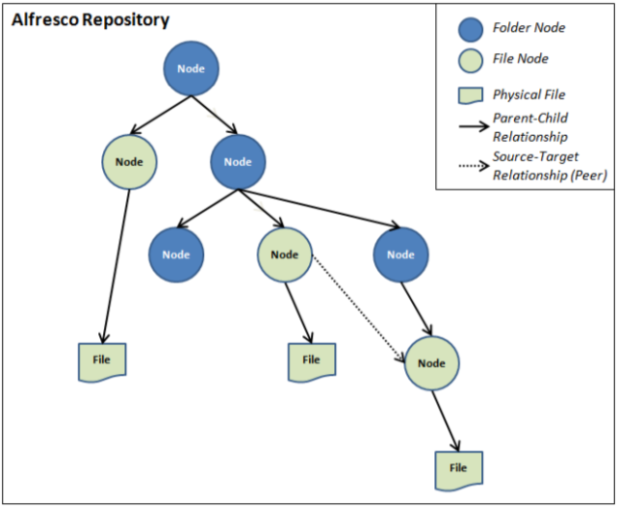
Repository

Slide 5
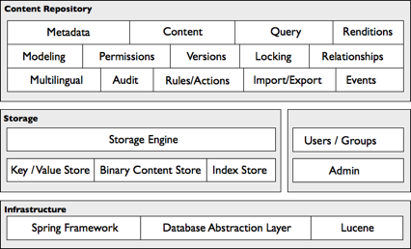
Alfresco Content Repository

Slide 6
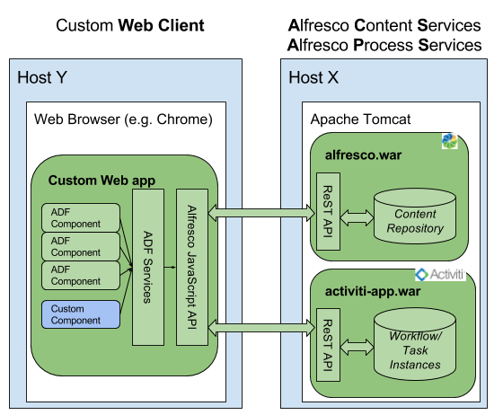
Application Development Framework

Slide 7
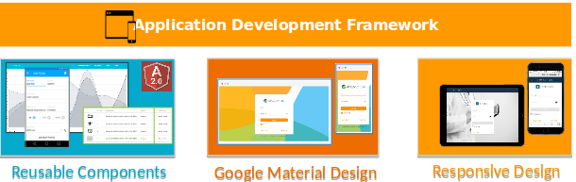
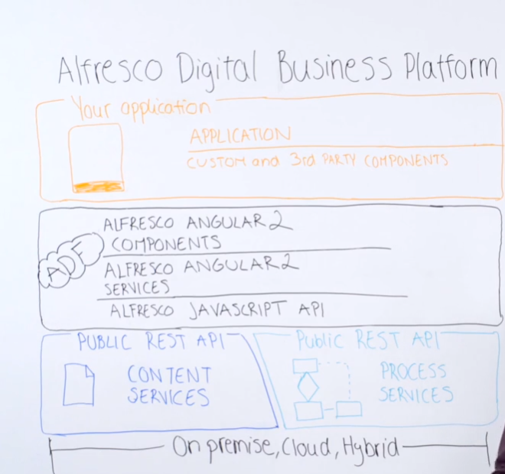
ADF(cont)

Slide 8
Example
http://my.metadata.vn/share/page/repository

Slide 9
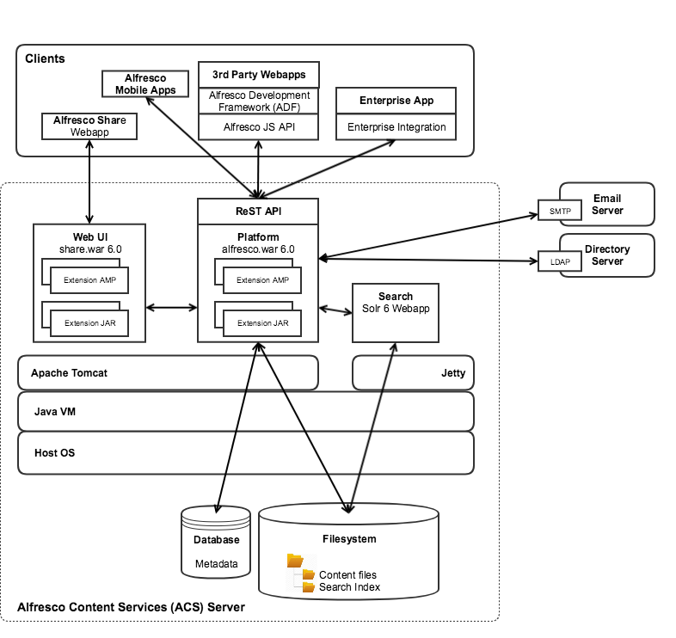
Your place (Dev)

Slide 10
Reference
https://github.com/thomnv/alfresco-document
https://github.com/thomnv/adf-content-simple

