Slide 1
From Classic to Agentic DSS:
A Conceptual Model for Autonomous Decision-Making in Logistics
Tao Zixian (24-9001-501-10)
Supervisor: Professor Nguyen Phuc Huu
2026/5/31

Slide 2
Response to Comments
The range is too broad?

Slide 3
Research Objectives
Understand the role evolution
Design conceptual architecture
Develop a conceptual Framework for Agentic DSS in SME’s Logistics

Slide 4
Research Schedule
Research Items | 2024 |  |  | 2025
 | Oct. | Nov. | Dec. | Jan. | Feb. | Mar. | Apr. | May. | Jun. | July | Aug.
Research Proposal Development
Research Presentation
Literature Review
Conceptual Modeling
Prototype Development
Interim Presentation
Thesis Completion
Final Defense
Final Correction and Submission

Slide 5
Limitations of Traditional DSS
DSS: Information systems designed to support organizational decision-making, particularly for semi-structured and unstructured problems.
The limits of traditional DSS:
Passive Operation
Static Logic
Limited Reasoning Ability
Isolated Structure

Slide 6
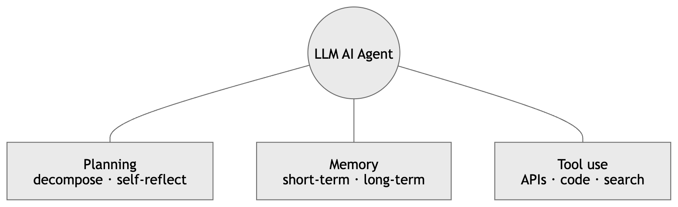
What are AI Agents?
Agentic AI refers to AI systems capable of autonomous reasoning, planning, memory management, and tool integration.

Slide 7
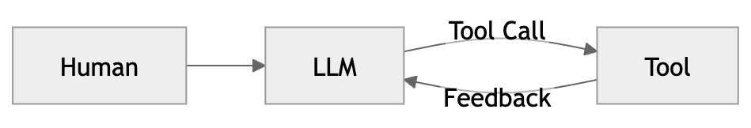
Tool-Use Loop
Tool：Executable function or external capability that the AI agent can request as.
Example:
Database
ERP system access
Web search
Weather APIs
…
Every agent is the same loop: LLM → tool call → feedback → LLM → … until it finds the final answer.

Slide 8
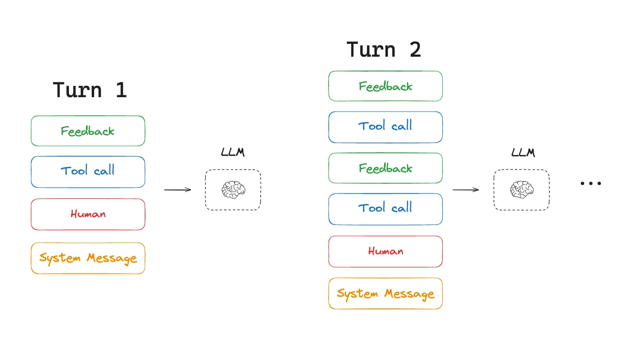
Tool-Use Loop
Tool：Executable function or external capability that the AI agent can request as.
Example:
Database
ERP system access
Web search
Weather APIs
…

Slide 9
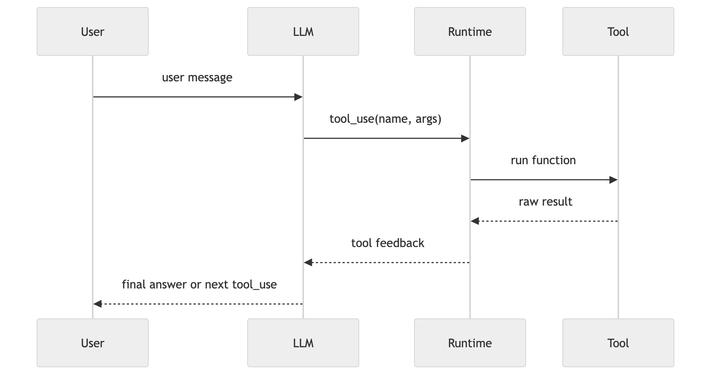
Runtime Architecture
Runtime: the program around the LLM (python script, CLI, web server that sends prompts…). The LLM is a function inside the Runtime.
the LLM's "tool call" is just a request. The real API / function call happens in the runtime.

Slide 10
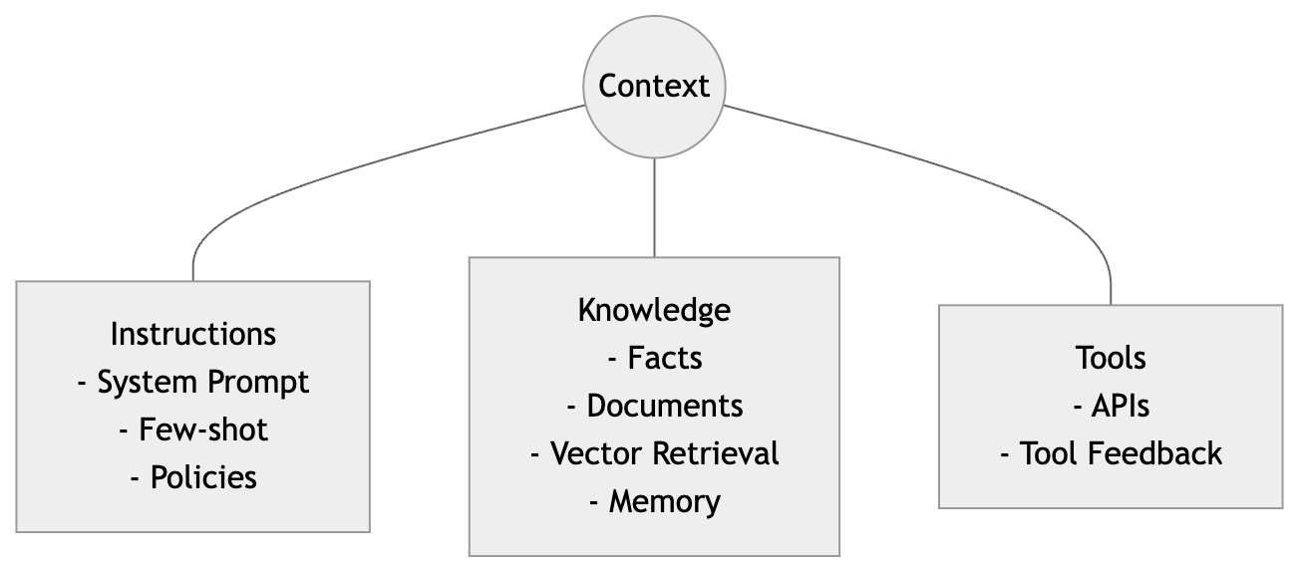
Context Engineering
What is context?
Everything the LLM sees on a given turn:
the system prompt and instructions
prior messages and tool results
documents retrieved from memory or the web
available tool definitions
Context is the working memory of the model — everything inside the context window, nothing outside.

Slide 11
Context Engineering
Context Engineering: The delicate art and science of filling the c context window with just the right information for the next step.
However, context window is limited due to cost and latency. It need context engineering. Using tools can get the real-time information, also enable AI agent to act based on the “right information”.

Slide 12
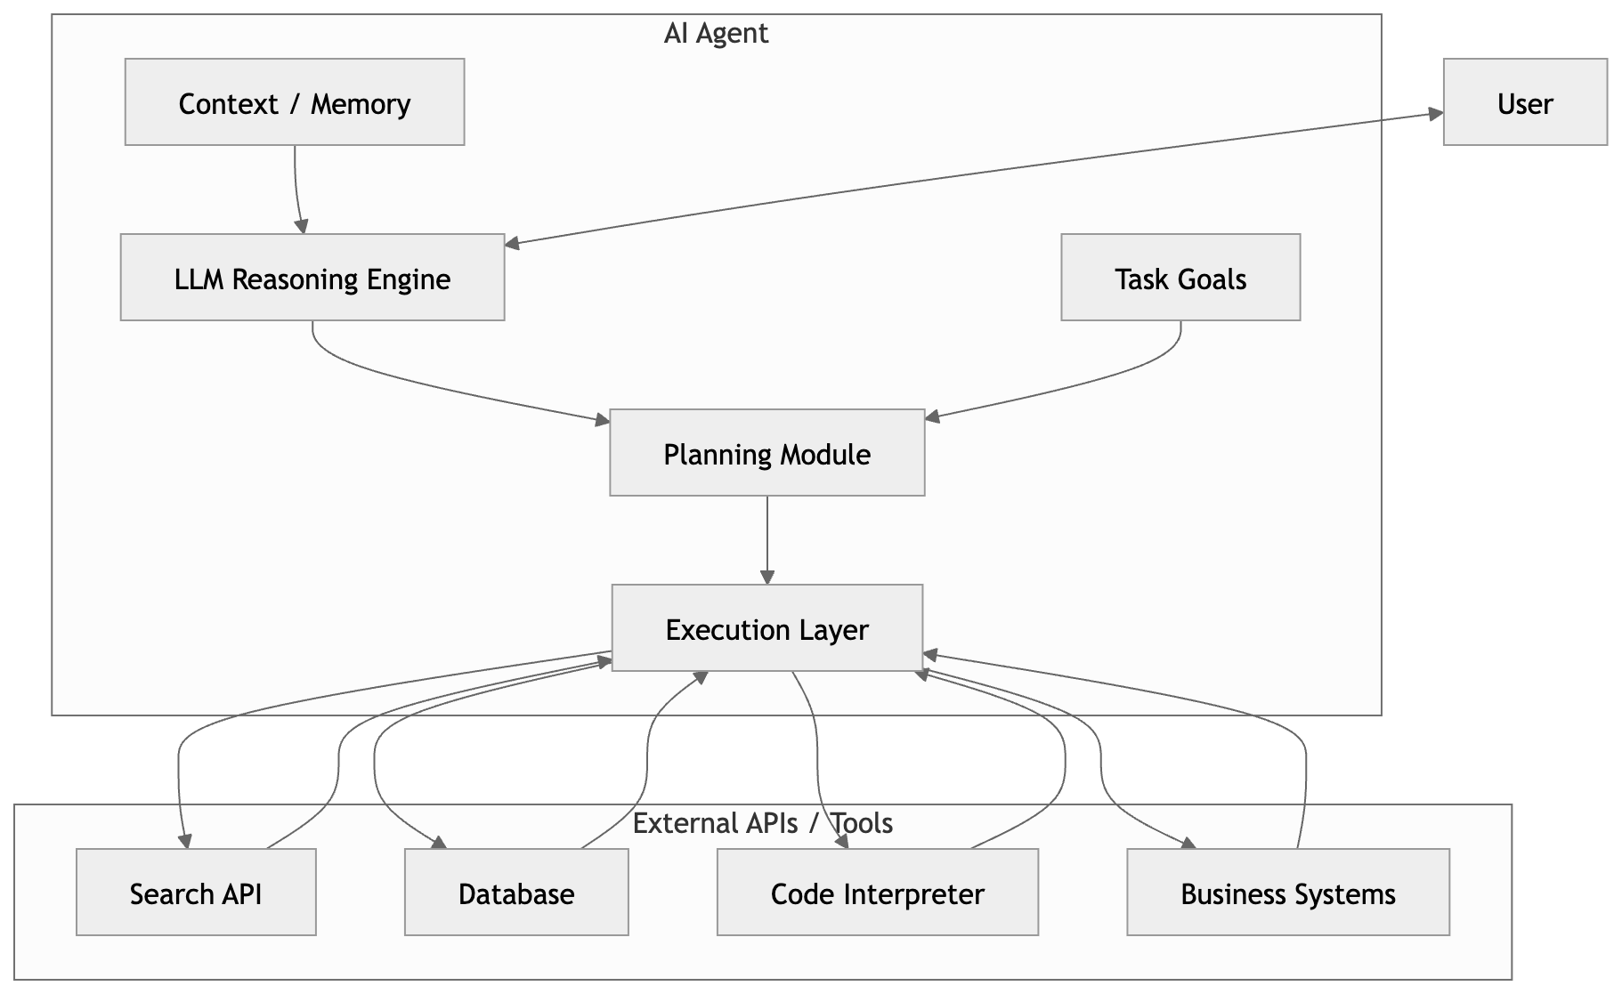
Single-agent Architecture
However, Single-agent is not enough:
Specialization
Coordination
Orchestration

Slide 13
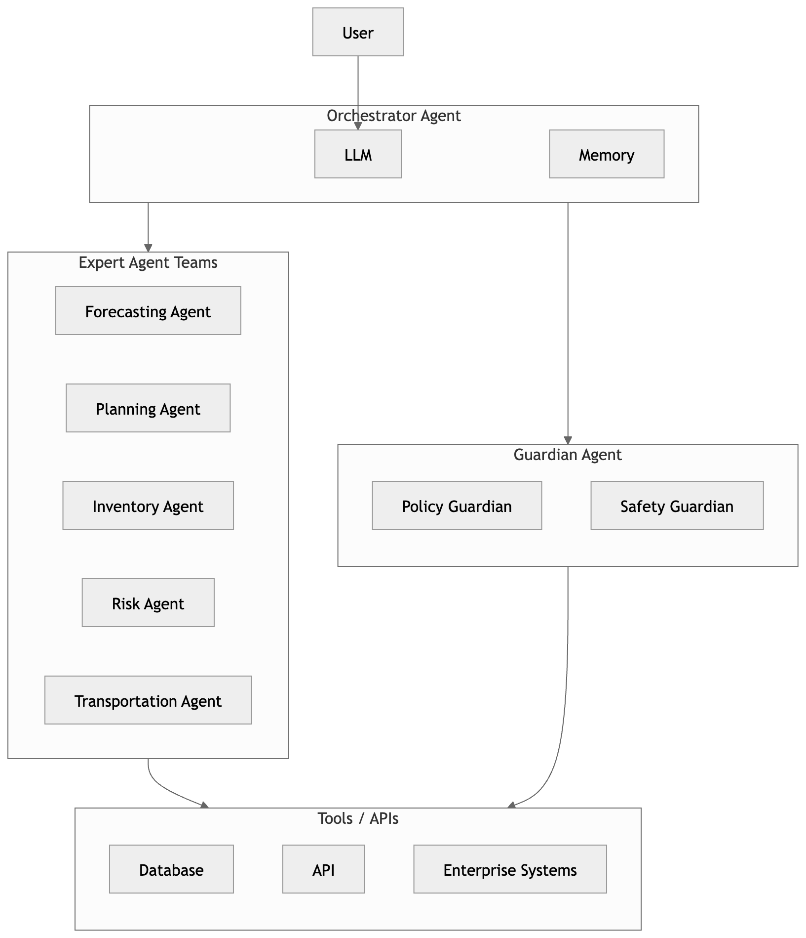
Multi-agent Architecture
Compared with single-agent systems, multi-agent systems provide:
Better Scalability
Parallel Processing
Specialized Reasoning
Flexible Orchestration
Challenge:
Context Synchronization
Coordination Overhead
Shared-state conflicts

Slide 14
Proposed Architecture of Agentic DSS in Logistics
Three Layers:
People & Application Layer
Customers
Managers
Operator Consoles
…
Agent Brain Layer
LLMs
Memory Systems
Policies & constraints
…
System Layer
WMS
TMS
ERP
…
Bridge Protocols:
MCP(Model Context Protocol): tool/resource access for LLMs
A2A (Agent-to-agent): Protocol for cross-system inter-agent messaging.

Slide 15
Logistics Scenario: Multi-Agent Risk Decision Intelligence Hub
Background
Domain | Mid-to-Large Third-Party Logistics/Freight Forwarder
Challenge | Thousands of active shipments, hundreds of risk events daily, complexed tasks planning.
Limits | Traditional DSS cannot autonomously coordinate responses across multiple operational domains.
Goal | One unified risk picture with appropriate automation for each decision type
System Name | Multi-Agent Risk Decision Intelligence Hub (DIH)

Slide 16
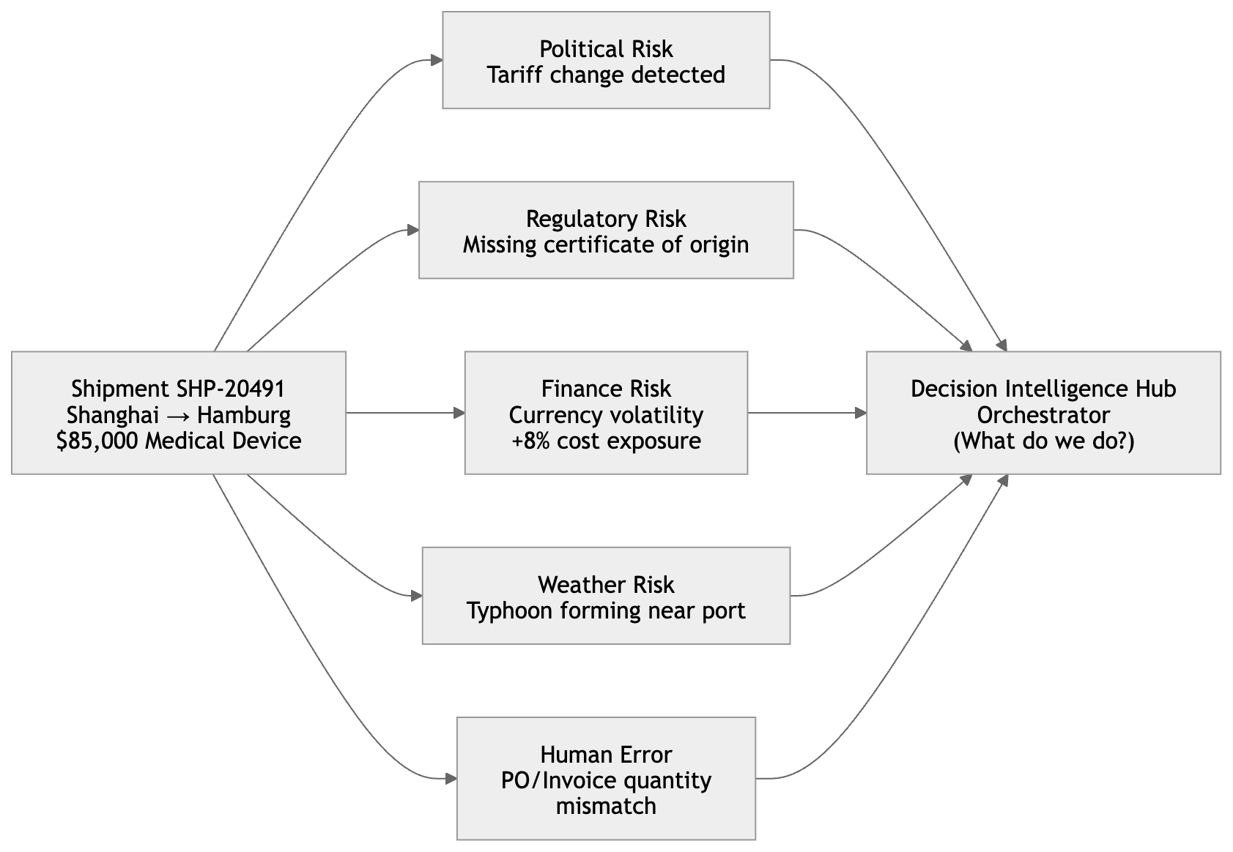
Logistics Scenario: Multi-Agent Risk Decision Intelligence Hub
Risk Detection Process
In this scenario, multi-agent system can:
Detect Risks (Tariff, regulatory, financial, weather, human operational errors…)
Prioritize Actions ()
Support Decisions

Slide 17
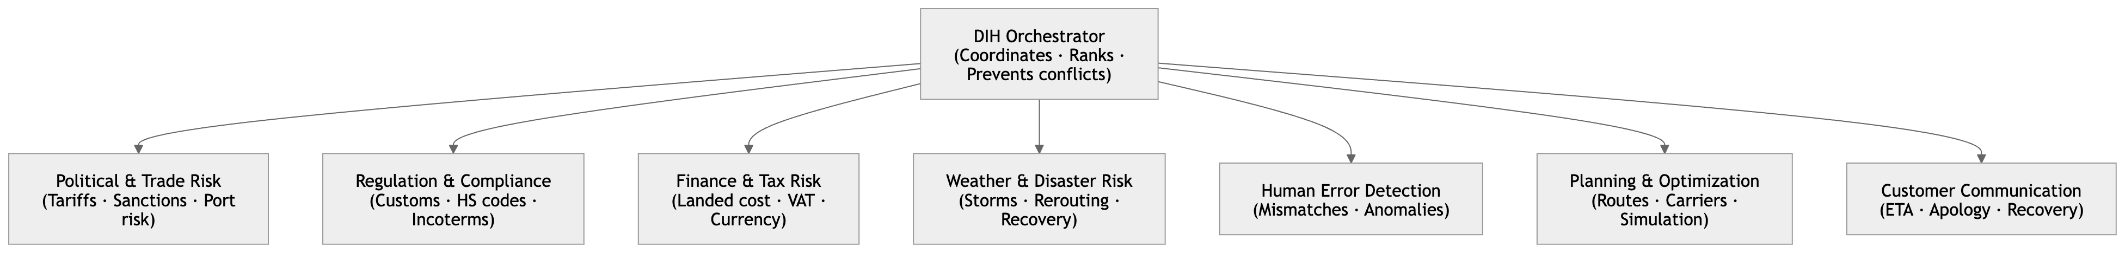
Logistics Scenario: Multi-Agent Risk Decision Intelligence Hub
DIH: The 8 Agent Teams

Slide 18
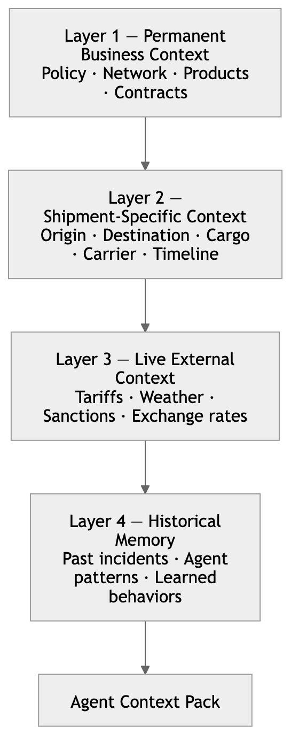
Logistics Scenario: Multi-Agent Risk Decision Intelligence Hub
The 4-Layer Context Architecture

Slide 19
Expected Outcomes
Conceptual Framework of Agentic DSS in logistics
An architecture blueprint and PoC Prototype
Strategic Insights for logistics decision systems

Slide 20
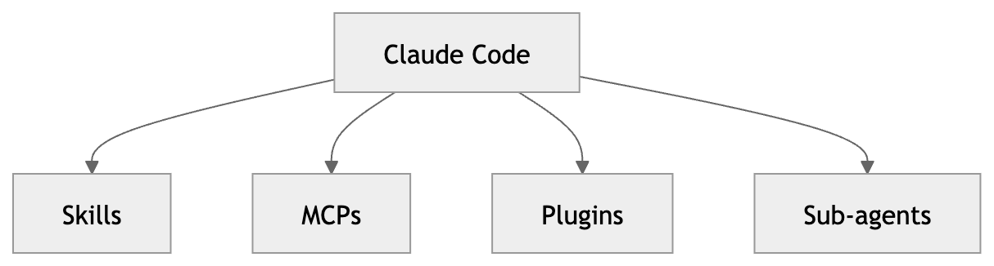
PoC Implementation: Claude Code Stack
Claude Code’s primitives map directly onto the DIH architecture
Sub-agents: one Claude Code sub-agent per DIH team
Skills: reusable workflows (e.g., classify-tariff-event, draft-customer-apolopgy)
MCPs: Liveconnections to external systems (WMS, TMS, Weather API, Currency Feed)
Plugins: Optional capability extensions
Hooks: Safety enforcement before any autonomous action

Slide 21
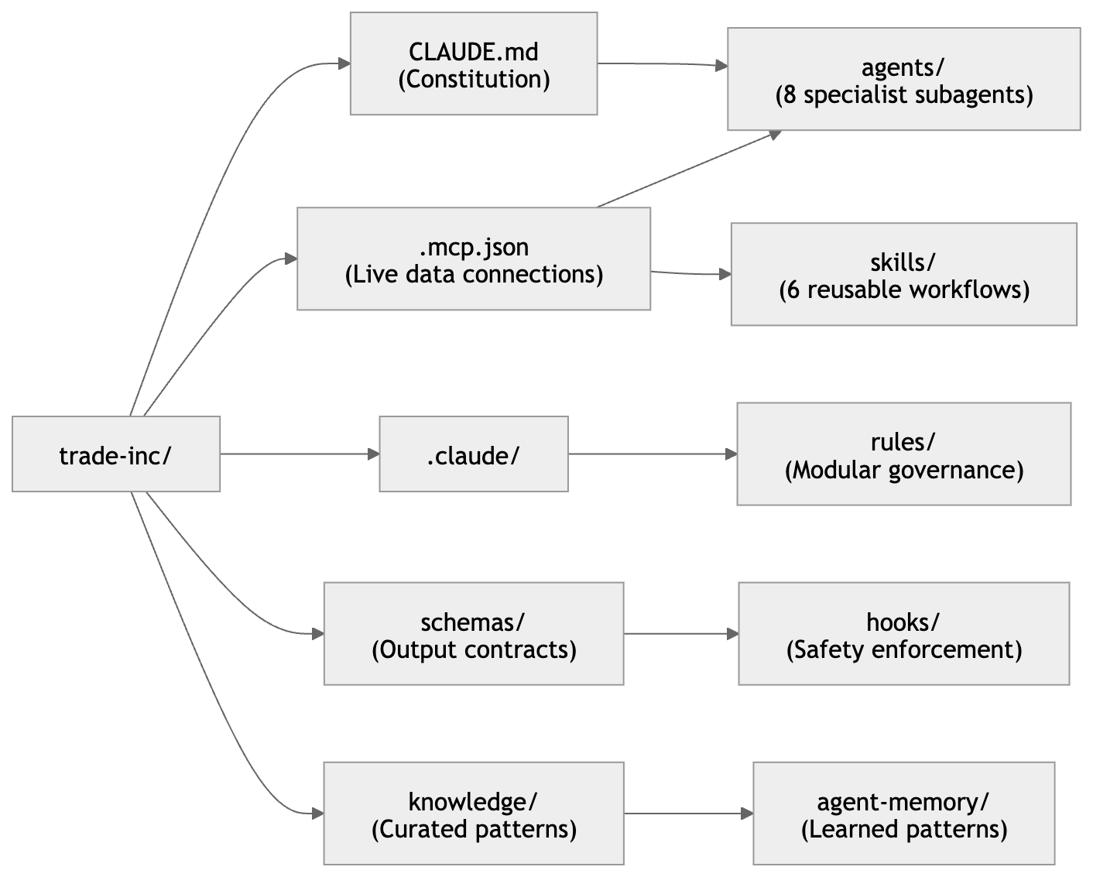
Claude Code File Structure

Slide 22
Q & A

