Slide 1
SQL & NoSQL
Trainer: Khanh Dao

Slide 2
Introduction
Your role
Your background and experience in the subject
What is your expectation from this course?

Slide 3
Course Objectives
At the end of the course, you will have acquired sufficient knowledge to:
Understand what NoSQL is
Understand different between SQL vs NoSQL
Understand types of NoSQL
Use XML, JSON in storing NoSQL data
Use MongoDB

Slide 4
Agenda
What is NoSQL
SQL vs NoSQL
MongoDB

Slide 5
Course Audience and Prerequisite
The course is for fresher program
The following are prerequisites to the course:
RDBMS background

Slide 6
Assessment Disciplines
Class Participation: 30%
Final Exam: 70%
Passing Scores: 70%

Slide 7
Duration and Course Timetable
Course Duration: 3 hrs
Course Timetable:
From 9:00 AM -12:00 AM
Break 15 minutes from 11:00 – 11:15 AM

Slide 8
Further References
https://docs.mongodb.com/
https://www.sitepoint.com/sql-vs-nosql-differences/
https://www.tutorialspoint.com/mongodb/mongodb_java.htm
http://www.jsoneditoronline.org/

Slide 9
Set Up Environment
To complete the course, your PC must install:
MongoDB for Windows 64-bit
Eclipse
Maven

Slide 10
Course Administration
In order to complete the course you must:
Sign in the Class Attendance List
Participate in the course
Provide your feedback in the End of Course Evaluation

Slide 11
NoSQL

Slide 12
What is NoSQL?
To encompasses database technologies in modern apps
Massive volumes of data
Rapidly changing data types - structured, semi-structured, unstructured and polymorphic data
Short time development cycle - agile sprints, iterating quickly and pushing code rapidly
Database architecture
Non-relational data model
No standard model
No schema - dynamic schema
Often uses aggregates
Asynchronous inserts and updates

Slide 13
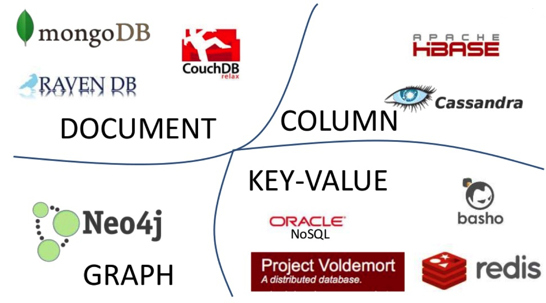
Storage types

Slide 14
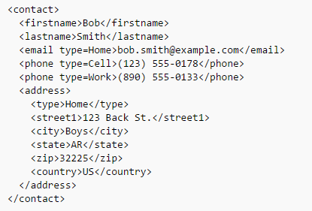
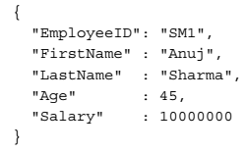
Document store database
Using XML, JSON, BSON, YAML, other semi-structured formats

Slide 15
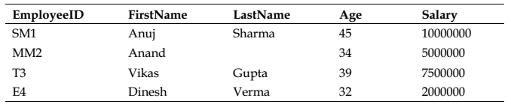

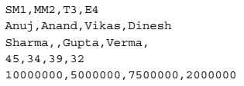
Column store database
Row-Oriented
Column-Oriented

Slide 16
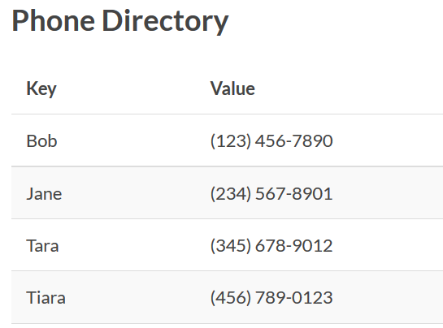
Key – Value store database

Slide 17
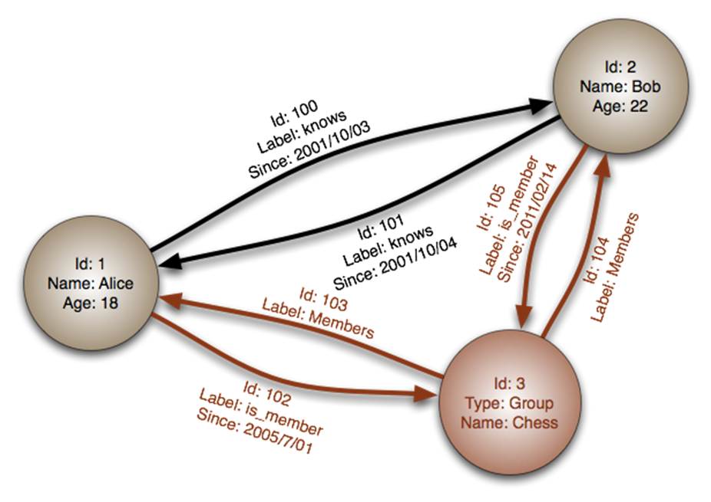
Graph store database
A special category of NoSQL databases where relationships are represented as graphs
Notes:
Nodes represent entities or instances such as people, businesses, accounts, or any other item to be tracked. They are roughly the equivalent of the record, relation or row in a relational database, or the document in a document-store database.
Edges, also termed graphs or relationships, are the lines that connect nodes to other nodes; representing the relationship between them. Meaningful patterns emerge when examining the connections and interconnections of nodes, properties and edges. The edges can either be directed or undirected. In an undirected graph, an edge from a point to another has one meaning. In a directed graph, the edges connecting two different points have different meanings depending on their direction. Edges are the key concept in graph databases, representing an abstraction that is not directly implemented in a relational model or a document-store model.
Properties are germane information to nodes. For example, if Wikipedia were one of the nodes, it might be tied to properties such as website, reference material, or words that starts with the letter w, depending on which aspects of Wikipedia are germane to a given database

Slide 18
Why NoSQL?
Schema-less
Performance
Development time
Scaling out/scaling up
High availability

Slide 19
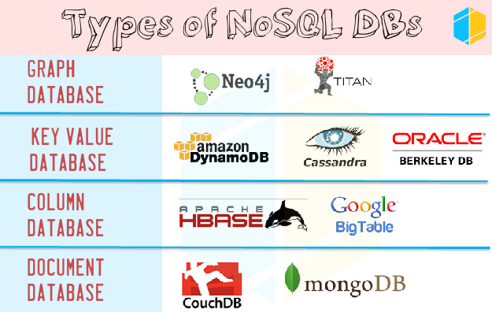
NoSQL Databases

Slide 20
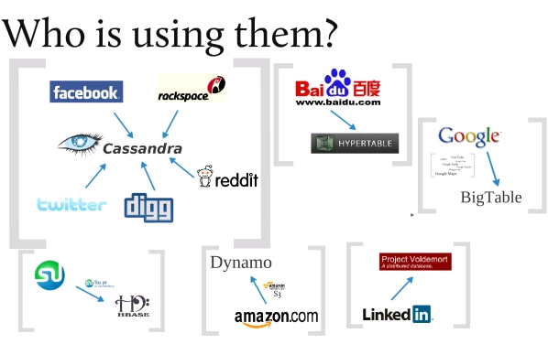
Who is using NoSQL?

Slide 21
SQL vs NoSQL

Slide 22
SQL vs NoSQL Comparation
SQL | NoSQL
Relationship | Embedded/linking document
Table based | Document based, Key-Value, Column based, Graph
Pre-defined schema | Schema-less
Vertical scale (increasing CPU, RAM, SSD …) | Horizontal scale (adding more machine)
Using SQL (structured query language) to manipulate data | Using UnQL (un-structured query language) and depends on database
Complex queries | Un-complex queries
Best fix for heavy duty transactional type application | Not comparable and stable enough for complex transactional application
ACID | BASE
Normalization | Denormalization
Notes:
ACID:
- Atomicity
- Consistency
- Isolation
-Durability
BASE:
-Basic availability
-Soft state
-Eventual consistency

Slide 23
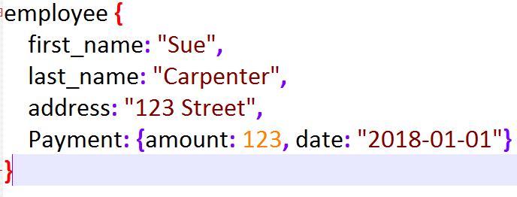
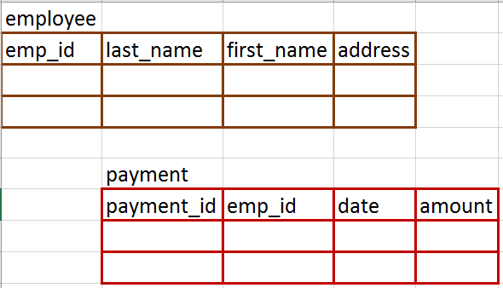
Relational vs Non-relational data model
emp_id
last_name
employee
first_name
address
has
amount
payment
date

Slide 24
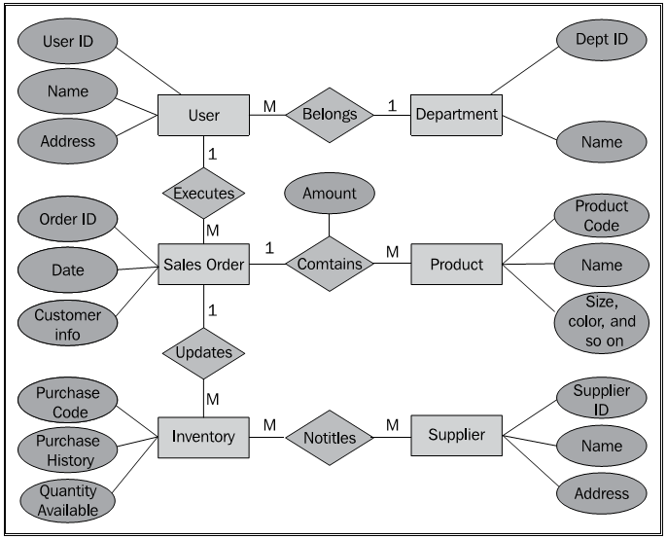
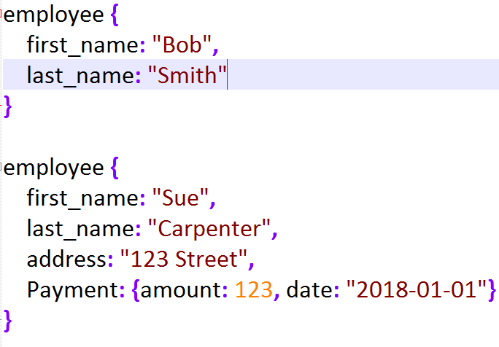
Pre-defined schema vs Schema-less

Slide 25
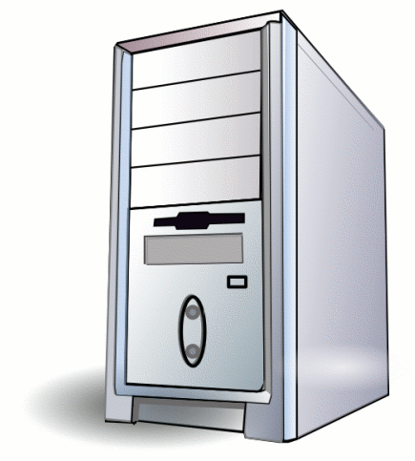
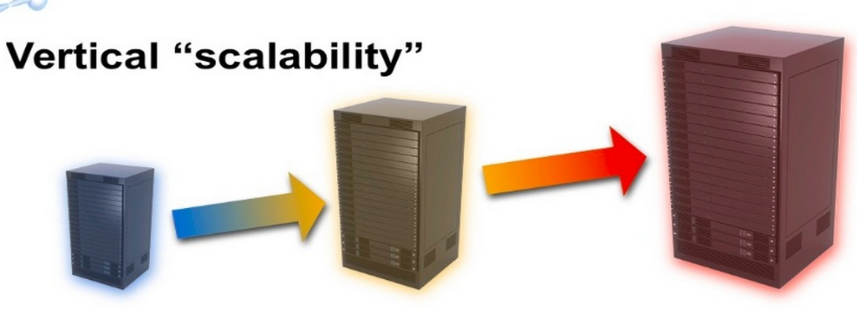
Vertical vs Horizontal scale

Slide 26
ACID
Atomicity: all operations in transaction either fully completed, or every operation is rolled back.
Consistency: at the end of any transaction, the system is in a valid state.
Isolation: a transaction in process and not yet committed must remain isolated from any other transaction.
Durability: Committed data is saved by the system such that, even in the event of a failure and system restart, the data is available in its correct state

Slide 27
BASE
Basic availability:
the database appears to work most of the time.
Soft state:
the state of the system may change over time, at times without any input (because of eventual consistency).
Eventual consistency:
the database may be momentarily inconsistent but will be consistent eventually.

Slide 28
Benchmark Table
Data Model | Performance | Scalability | Flexibility | Complexity | Functionality
Key–Value Store | high | high | high | none | variable (none)
Column-Oriented Store | high | high | moderate | low | minimal
Document-Oriented Store | high | variable (high) | high | low | variable (low)
Graph Database | variable | variable | high | high | graph theory
Relational Database | variable | variable | low | moderate | relational algebra

Slide 29
SQL or NoSQL

Slide 30
SQL
Tightly data structure
Data integrity/consistency is the main concern
No orphan, no duplicate, normalization
Complex transactional processes
Complex queries
Security

Slide 31
NoSQL
Lager data with flexible data structure
(text, images, social media data, videos etc.)
Horizontal scaling
Fast deployment
Eventually consistency
Uncomplex transactional process
High-performance

Slide 32
Conclusion
NoSQL is not a replacement to relational databases, it’s just another useful technique
Just use the right tools for the right job

Slide 33
MongoDB

Slide 34
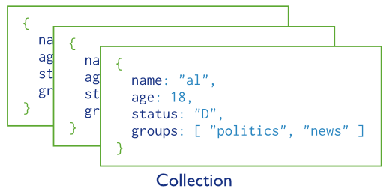
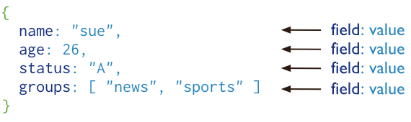
What is MongoDB?
MongoDB is a document database
Stores data in flexible, JSON-like documents
The document model maps to the objects in application code
Ad hoc queries, Geospatial indexing , and real time aggregation
Free and open-source
Document

Slide 35
MongoDB Key features
High Performance
Embedded data models reduces I/O activity on database system.
Indexes for faster queries
Rich Query Language
CRUD
Data aggregation
Text Search and Geospatial Queries .
High Availability
Replica set, provide automatic failover and data redundancy.

Slide 36
MongoDB Key features cont.
Horizontal Scalability
Sharding distributes data across across multiple machines.
Multiple Storage Engines
WiredTiger
uses document-level concurrency control for write operations
creates one journaling record for each client initiated write operation. The journal record includes any internal write operations caused by the initial write
In-Memory
not maintain any on-disk data, including configuration data, indexes, user credentials, etc. Excluding some metadata and diagnostic data
not persist data after process shutdown
Notes:
The storage engine is the component of the database that is responsible for managing how data is stored, both in memory and on disk. MongoDB supports multiple storage engines, as different engines perform better for specific workloads
WiredTiger is the default storage engine starting in MongoDB 3.2. It is well-suited for most workloads and is recommended for new deployments. WiredTiger provides a document-level concurrency model, checkpointing, and compression, among other features
In-Memory Storage Engine is available in MongoDB Enterprise. Rather than storing documents on-disk, it retains them in-memory for more predictable data latencies.

Slide 37









Who's using MongoDB?
Education
Financial Services

Slide 38








Who's using MongoDB?
Government

Slide 39








Who's using MongoDB?
Healthcare

Slide 40








Who's using MongoDB?
Media and Entertainment

Slide 41





Who's using MongoDB?
Retail

Slide 42









Who's using MongoDB?
Technology

Slide 43








Who's using MongoDB?
Telecommunications
Travel and Hospitality

Slide 44
RDBMS vs MongoDB
RDBMS | MongoDB
Database | Database
Table, View | Collection
Row | Document
Column | Field
Index | Index
Primary key | ObjectId (specific field _id)
Partition | Shard
Table joins | $lookup, embedded documents
Aggregation | Aggregation pipeline

Slide 45
Advantages of MongoDB over RDBMS
Schema less
One collection holds different documents.
Number of fields, content and size of the document can differ from another one.
Structure of a single object is clear.
No complex joins.
Deep query-ability.
Supports dynamic queries on documents that's nearly as powerful as SQL.
Ease of scale-out
No need to convert/map application objects to database objects.
Uses internal memory for storing the (windowed) working set
Enabling faster access of data.

Slide 46
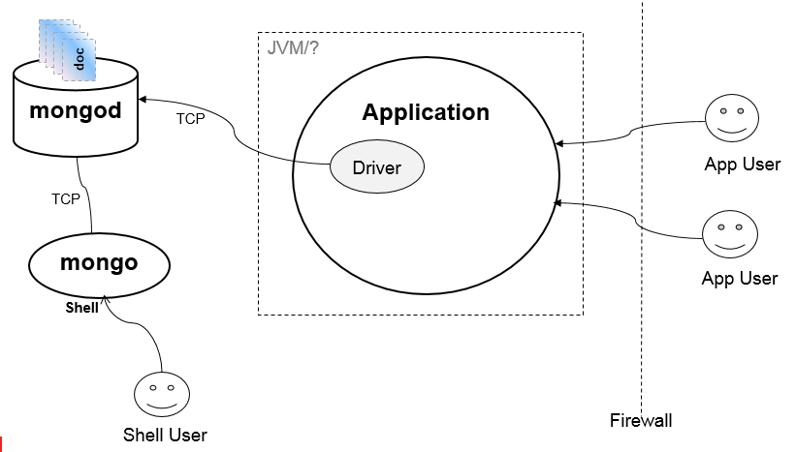
Mongo DB Usage
Access MongoDB
By way of a client library - driver.
Or using mongo shell

Slide 47
Getting started

Slide 48
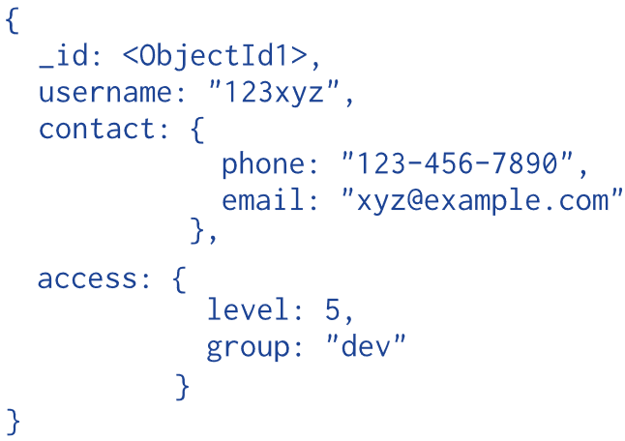
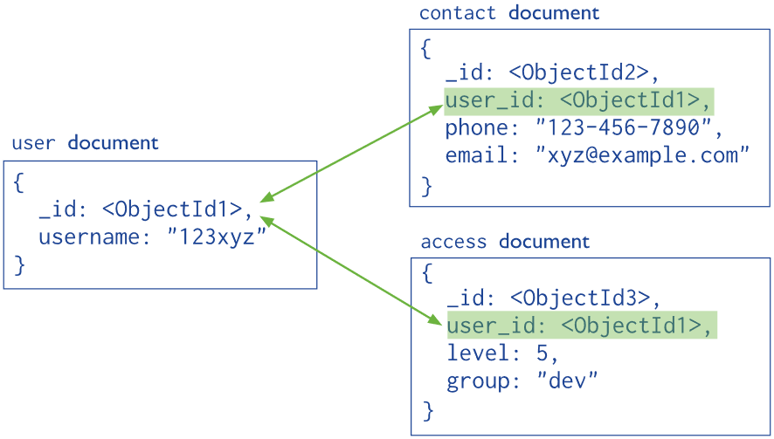
Structure data for MongoDB
Embedded data
References/linking

Slide 49
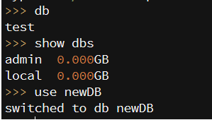
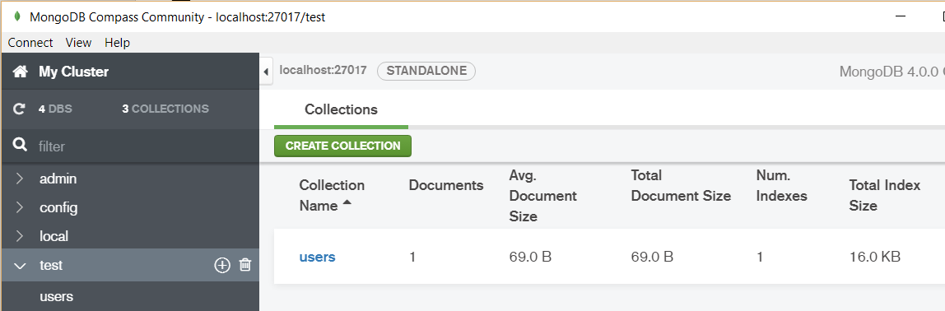
Connect to MongoDB
MongoDB drivers
Java, C#, PHP, Python…
mongo shell

Slide 50
CRUD operations

Slide 51
CRUD
{multi:true}
Create
db.<collection name>.insert( <document> )
Read
db.<collection name>.find( <query>, <projection> )
db.<collection name>.findOne( <query>, <projection> )
Update
db.<collection name>.update( <query>, <update>, <options> )
<option> like {multi:true}
Delete
db.<collection name>.remove( <query>, <justOne> )
Replace
db.<collection name>.save( , {_id:ObjectId(), <new data>)

Slide 52
Statements
SQL Statement | Mongo Statement
CREATE TABLE USERS (a Number, b Number) | db.users.insert({a:3, b:8}) db.createColllection("users")
DROP TABLE USERS | db.users.drop()
ALTER TABLE users ADD newColumn datatype | db.users.insert({a:3,b:8,newColumn:’test’})
INSERT INTO USERS VALUES(3,5) | db.users.insert({a:3,b:5})
SELECT a,b FROM users | db.users.find({}, {a:1,b:1})
SELECT * FROM users | db.users.find()
SELECT * FROM users WHERE age=33 | db.users.find({age:33})
SELECT a,b FROM users WHERE age=33 | db.users.find({age:33}, {a:1,b:1})
SELECT * FROM users WHERE age=33 ORDER BY name | db.users.find({age:33}).sort({name:1})
SELECT * FROM users WHERE age>33 | db.users.find({age:{$gt:33}})
SELECT COUNT(*) FROM users WHERE age >33 | db.users.count({age:{$gt:33}})

Slide 53
Statements cont.
SELECT * FROM users WHERE age!=33 | db.users.find({age:{$ne:33}})
SELECT * FROM users WHERE name LIKE "%Joe%" | db.users.find({name:/Joe/})
SELECT * FROM users WHERE name LIKE "Joe%" | db.users.find({name:/^Joe/})
SELECT * FROM users WHERE age>33 AND age<=40 | db.users.find({'age':{$gt:33,$lte:40}})
SELECT customer.name FROM customer user WHERE id="q179“ AND name=“an” | $and: [ {_id:"q179"}, {"name":"an"} ]
CREATE INDEX indName ON users(name,ts DESC) | db.users.ensureIndex({name:1,ts:-1})
UPDATE users SET a=1 WHERE b='q' | db.users.updateOne({b:'q'}, {$set:{a:1}})
UPDATE users SET a=a+2 WHERE b='q' | db.users.updateMany({b:'q'}, {$inc:{a:2}})
ALTER TABLE book DROP COLUMN tags | db.book.update({_id:1}, {$unset: {tags:1 }})

Slide 54
Other operators
Types | Operators | Description
Comparison | $eq $ne | equal to not equal to
 | $gt $gte | greater than greater than or equal to
 | $in $nin | in an array not in an array
 | $lt $lte | less than less than or equal to
Logical | $and $not $nor $or | match the conditions of both clauses do not match fail to match both clauses match the conditions of either clause

Slide 55
Aggregation

Slide 56
Aggregation
Aggregation operations
group values from multiple documents together to return a single result
3 ways to perform
Aggregation Pipeline
Map-Reduce
use custom JavaScript functions to map, or associate, values to a key
if a key has multiple mapped values, the operation reduces the values to a single object
Single Purpose Aggregation Operations

Slide 57
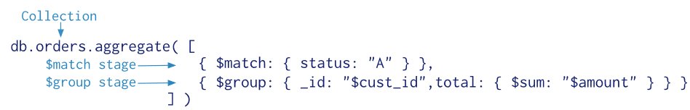
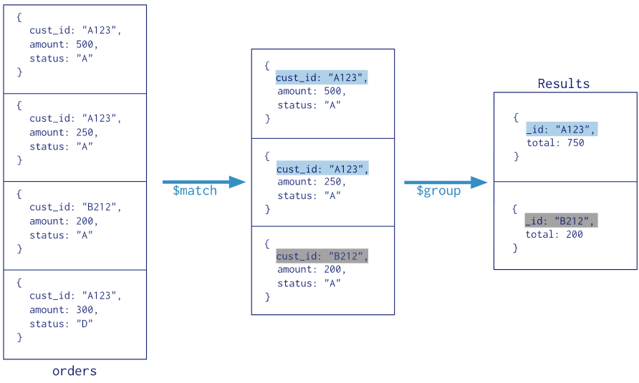
Aggregation pipeline

Slide 58
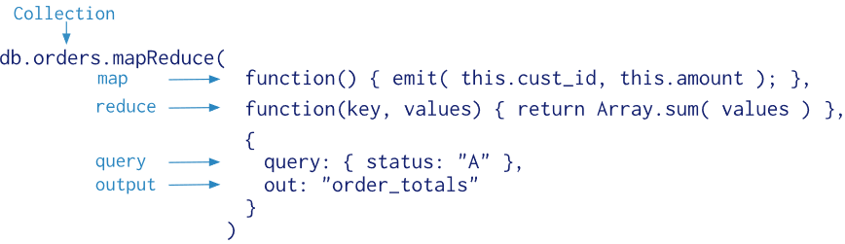
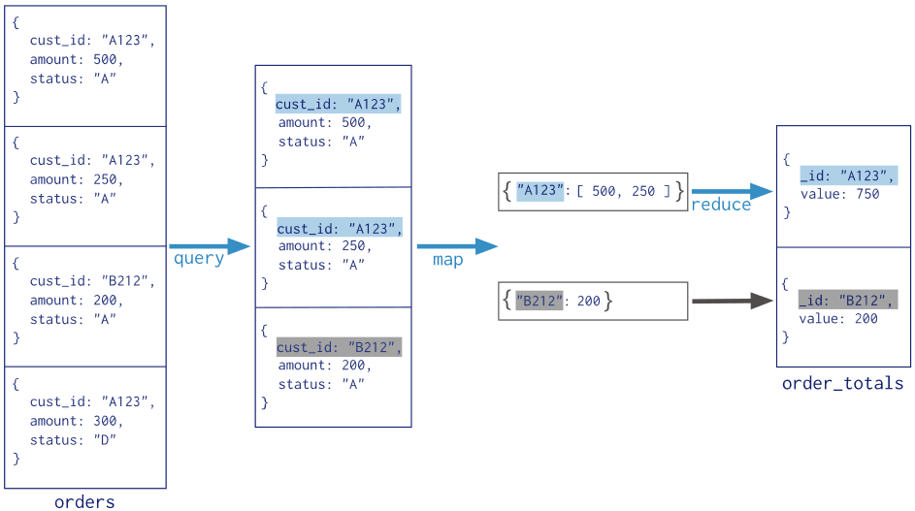
Map - Reduce

Slide 59
Single purpose aggregation
db.collection.distinct()
db.collection.count()

Slide 60
Aggregation expressions
Expression | Description | Example
$sum | Sums up the defined value from all documents in the collection. | db.mycol.aggregate([{$group : {_id : "$by_user", num_tutorial : {$sum : "$likes"}}}])
$avg | Calculates the average of all given values from all documents in the collection. | db.mycol.aggregate([{$group : {_id : "$by_user", num_tutorial : {$avg : "$likes"}}}])
$min | Gets the minimum of the corresponding values from all documents in the collection. | db.mycol.aggregate([{$group : {_id : "$by_user", num_tutorial : {$min : "$likes"}}}])
$max | Gets the maximum of the corresponding values from all documents in the collection. | db.mycol.aggregate([{$group : {_id : "$by_user", num_tutorial : {$max : "$likes"}}}])
$push | Inserts the value to an array in the resulting document. | db.mycol.aggregate([{$group : {_id : "$by_user", url : {$push: "$url"}}}])
$addToSet | Inserts the value to an array in the resulting document but does not create duplicates. | db.mycol.aggregate([{$group : {_id : "$by_user", url : {$addToSet : "$url"}}}])
$first | Gets the first document from the source documents according to the grouping. Typically this makes only sense together with some previously applied “$sort”-stage. | db.mycol.aggregate([{$group : {_id : "$by_user", first_url : {$first : "$url"}}}])
$last | Gets the last document from the source documents according to the grouping. Typically this makes only sense together with some previously applied “$sort”-stage. | db.mycol.aggregate([{$group : {_id : "$by_user", last_url : {$last : "$url"}}}])
$unwind | Deconstructs an array field from the input documents to output a document for each element. Each output document is the input document with the value of the array field replaced by the element. | db.inventory.aggregate( [ { $unwind : "$sizes" } ] )

Slide 61
MongoDB Replication

Slide 62
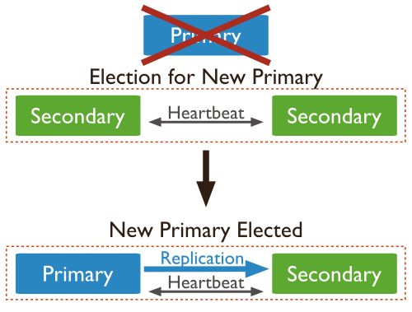
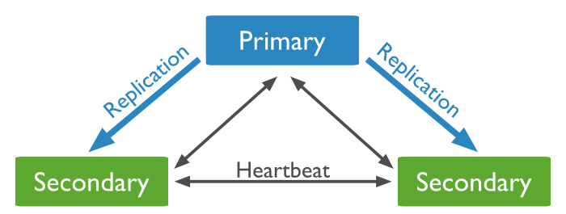
Replication
Synchronizing data across multiple servers
Redundancy and data high availability
Automatic Failover

Slide 63
Why Replication?
To keep your data safe
High (24*7) availability of data
Disaster recovery
No downtime for maintenance (like backups, index rebuilds, compaction)
Read scaling (extra copies to read from)
Replica set is transparent to the application

Slide 64
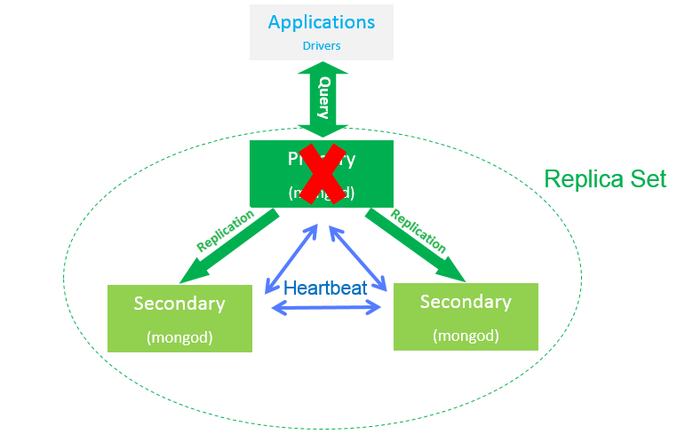
Replica Set

Slide 65
MongoDB Sharding

Slide 66
Sharding
Supports
Large data sets
working set sizes larger than the system’s RAM stress the I/O capacity of disk drives
HDD, CPU or RAM limits are reached
High throughput operations
Horizontal scaling
Storing data across multiple machines
Advantages
Read/Write
Storage Capacity
High Availability

Slide 67
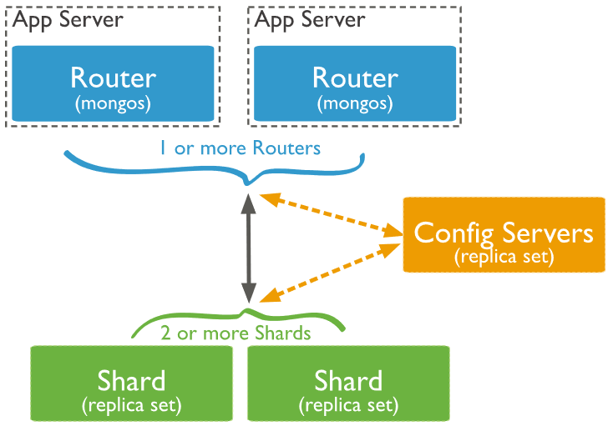
Sharding cluster
Shard - subset of the sharded data
Mongos - query router, interface with client apps to shards.
Config servers - metadata and configuration
Notes:
sharded cluster: The set of nodes comprising a sharded MongoDB deployment. A sharded cluster consists of three config processes, one or more replica sets, and one or more mongos routing processes. See Sharded Cluster Components.
Shards store the data. To provide high availability and data consistency, in a production sharded cluster, each shard is a replica set [1]. For more information on replica sets, see Replica Sets.
Query Routers, or mongos instances, interface with client applications and direct operations to the appropriate shard or shards. The query router processes and targets operations to shards and then returns results to the clients. A sharded cluster can contain more than one query router to divide the client request load. A client sends requests to one query router. Most sharded cluster have many query routers.
Config servers store the cluster’s metadata. This data contains a mapping of the cluster’s data set to the shards. The query router uses this metadata to target operations to specific shards. Production sharded clusters have exactly 3 config servers.

Slide 68
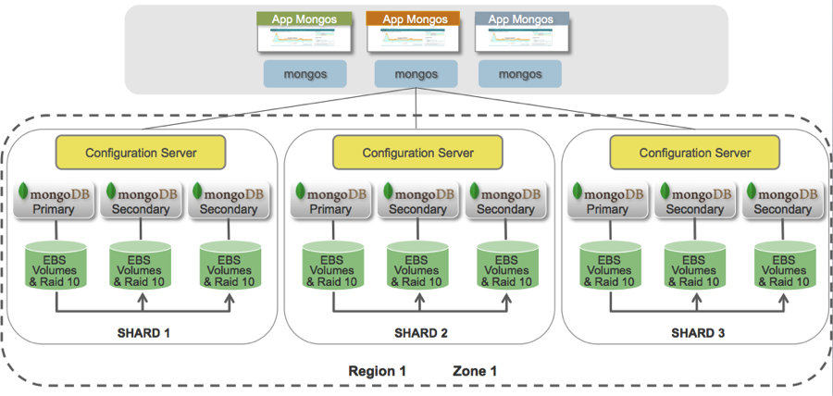
Shard Example

Slide 69
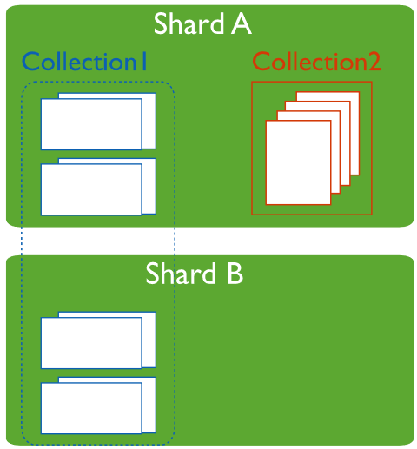
Sharded vs Non-Sharded Collections

Slide 70
Question & Answer

Slide 71
Thank you!

Slide 72
Revision History
Date | Version | Description | Updated by | Reviewed and Approved By
11/11/2015 | 1.0 | Initial document | Kien Tran
12/1/2015 | 1.1 | Adding Sections : Introduction to XML Introduction to JSON | Phu Nguyen
11/03/2016 | 1.2 | Update slides to: Follow the training’s template (slide 1 – slide 10 ) Update content for chapters: SQL, NoSQL, NoSQL Storage Type, JSON | Trang Nguyen Phu Nguyen | Quang Tran
Aug 2017 | 2.0 | Rebrand with DXC Template |  | Quang Tran

