Slide 1
OBJECT ORIENTED PROGRAMING - INHERITANCE
Trainer: Duc Le Gia

Slide 2
Content
Introduction
Structured programming
Concept of OOP
Classes & Objects
Features of OOP
Abstraction & Encapsulation
Inheritance
Multiple inheritance
Abstract class
Interface
Polymorphism

Slide 3
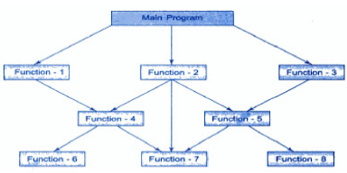
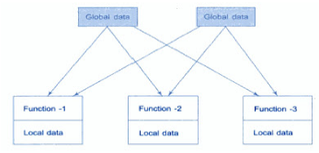
Procedure Oriented Programming
Set of subroutines” or a “set of functions”
Global data can be accessed from anywhere.
Less reusable.
Separate the data structures (variables) and algorithms (functions)
COBOL, FORTRAN and C
Notes:
http://www.programmingsimplified.com/c-program-find-palindrome
http://www.tutorialspoint.com/cprogramming/c_structures.htm

Slide 4
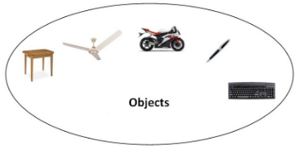
Object Oriented Programming
Object means a real word entity
The basic unit of OOP is a class which encapsulates both the properties and operations
Easier to reuse these classes
Combines the data structures and algorithms
Data Hiding so provides more security
Some concept:
Object
Class
Inheritance
Polymorphism
Abstraction
Encapsulation
Notes:
http://www.javatpoint.com/java-oops-concepts

Slide 5
CLASSES & OBJECTS
Class
Is blueprint from which objects are created.
Define data and action of objects.
Object
Consist of data and actions.
Objects are instances of classes.
In most cases we interact with object through its methods.

Slide 6
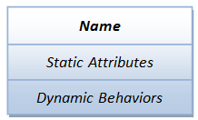
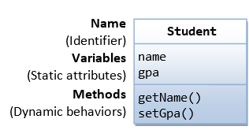
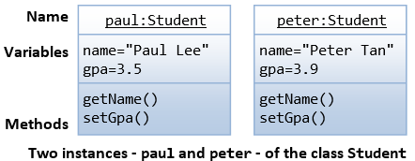
A Class is a 3-Compartment Box Encapsulating Data and Operations

Slide 7
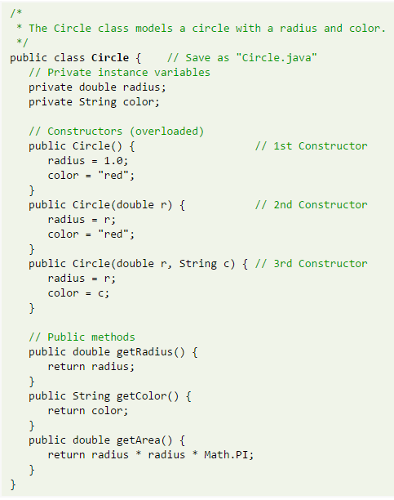
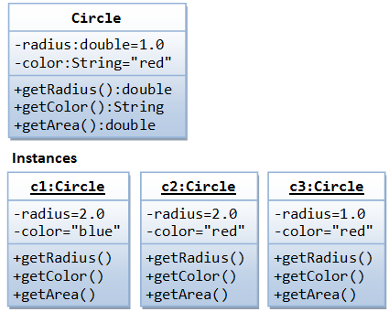

Slide 8
CLASSES & OBJECTS
Access modifier:
This is the way to specify the accessibility of a class and its members with respective to other classes.
Access modifiers support for OOP features
Used at 2 levels:
Top – level for Class & Interface.
Member – level

Slide 9
CLASSES & OBJECTS
Top – level for Class & Interface:
Public
Package/Default modifiers
Access modifier | Scope
Public | Inside and outside the package
Package/default | Just inside the package

Slide 10
CLASSES & OBJECTS
Object member - Level
Access | public | protected | private
Same class (base) | Yes | Yes | Yes
Derived class | Yes | Yes | No
Outside classes | Yes | No | No

Slide 11
INHERITANCE
There are many cases that an object acquires some/all properties/methods of another object.
classB
classA
classA
classB
C

Slide 12
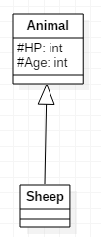
INHERITANCE
Define a new class base on existing classes.
Existing class: base class
New class: derived class

Slide 13
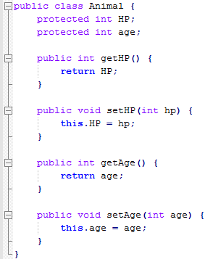

INHERITANCE

Slide 14

INHERITANCE
The final keyword in Java
Sometime we don’t want a specific class to be a super class.
Authors control the use of their code.

Slide 15
ACCESS SCOPE
Access | public | protected | private
Same class (base) | Yes | Yes | Yes
Derived class | Yes | Yes | No
Outside classes | Yes | No | No

Slide 16
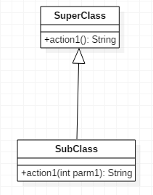
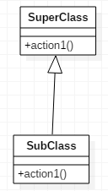
METHOD OVERLOADING
same name but not the parameter list, type of parameters or return type.
How about overriding???

Slide 17
METHOD OVERLOADING
Rules for Method Overloading
Overloading can take place in the same class or in its sub-class
Constructor in Java can be overloaded
Overloaded methods must have a different argument list.
Overloaded method should always be the part of the same class(can also take place in sub class), with same name but different parameters.
The parameters may differ in their type or number, or in both.
They may have the same or different return types.
It is also known as compile time polymorphism.

Slide 18
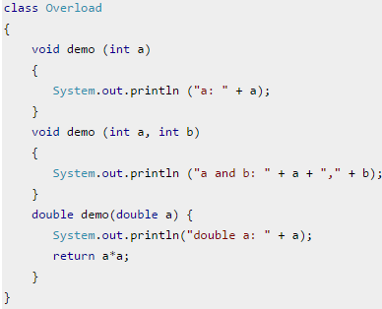
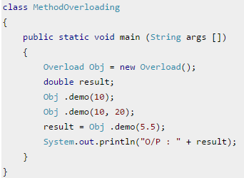
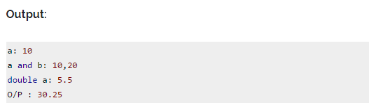
METHOD OVERLOADING

Slide 19
Method Overriding
Child class has the same method as of base class
Rules for Method Overriding:
applies only to inherited methods
object type (NOT reference variable type) determines which overridden method will be used at runtime
Overriding method can have different return type
Overriding method must not have more restrictive access modifier
Abstract methods must be overridden
Static and final methods cannot be overridden
Constructors cannot be overridden
It is also known as Runtime polymorphism.

Slide 20
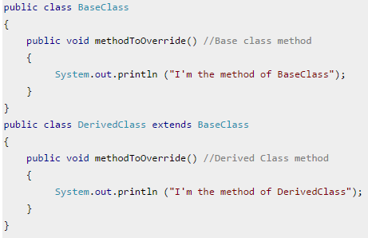
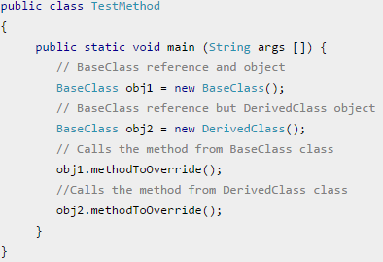

Method Overriding

Slide 21
MULTIPLE INHERITANCE
A class can inherit from more than one class.
Some languages those support multiple inheritance:
C++
Common Lisp
Perl
Java does not support multiple inheritance, but we can overcome this by using interface.

Slide 22
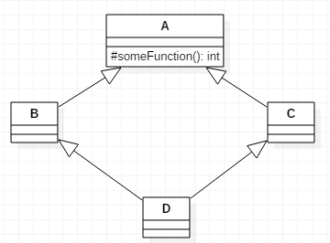
DIAMOND PROBLEM
Java does not allow multiple inheritance → we will not face this problem.
For C++, we solve this problem by virtual inheritance.

Slide 23
Abstraction
In java, we use abstract class and interface to achieve abstraction.
Abstract class
Abstract classes may or may not contain abstract methods ie., methods with out body ( public void get(); )
But, if a class have at least one abstract method, then the class must be declared abstract.
If a class is declared abstract it cannot be instantiated.
To use an abstract class you have to inherit it from another class, provide implementations to the abstract methods in it.
If you inherit an abstract class you have to provide implementations to all the abstract methods in it.
An abstract class can have data member, abstract method, method body, constructor and even main() method

Slide 24
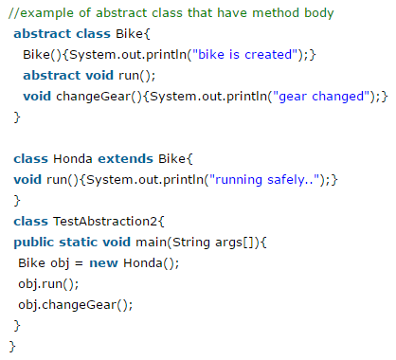

Abstract class

Slide 25
Interface
You cannot instantiate an interface.
An interface does not contain any constructors.
All of the methods in an interface are abstract.
An interface cannot contain instance fields. The only fields that can appear in an interface must be declared both static and final.
An interface is not extended by a class; it is implemented by a class.
An interface can extend multiple interfaces.
The java compiler adds public and abstract keywords before the interface method and public, static and final keywords before data members.

Slide 26
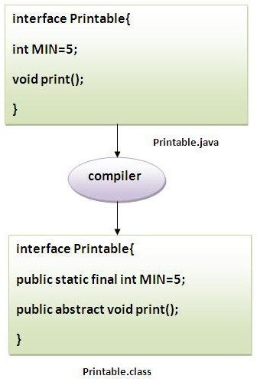
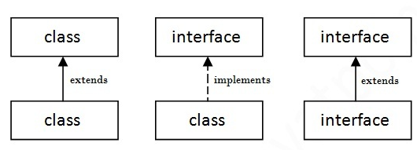
Interface
An interface can extend multiple interfaces.
A class can implement multiple interfaces.
However, a class can only extend a single class.

Slide 27
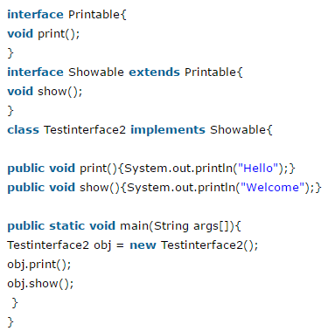
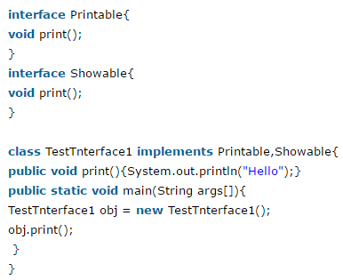

Interface

Slide 28
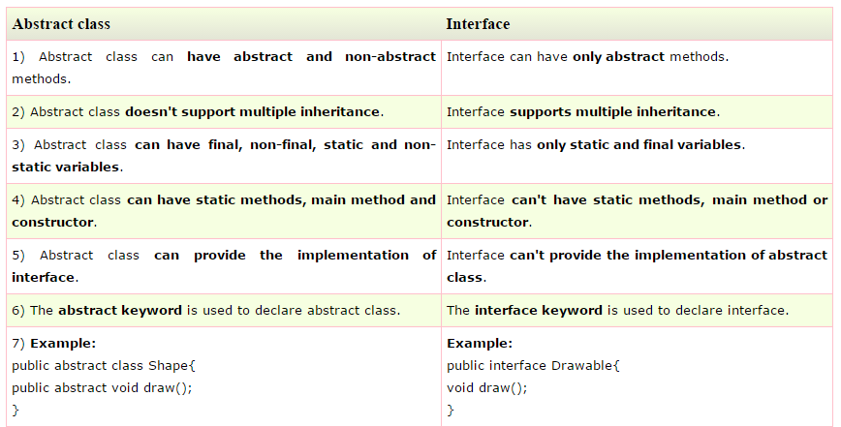
Difference between abstract class and interface

Slide 29
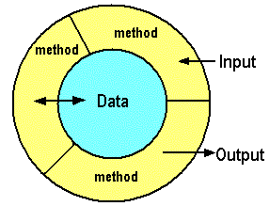
Encapsulation
Just methods of an object can access its own data.
This is used to enforce the principle of data hiding.
Handle with the visibility of object’s members.
Implement “Abstraction”.

Slide 30
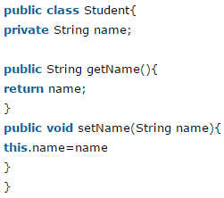
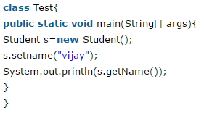
Encapsulation

Slide 31
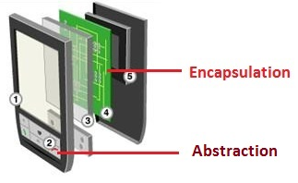
Encapsulation vs Abstraction

Slide 32
Abstract Classes
May or may not include abstract methods.
Cannot be instantiated

Slide 33
Interfaces
A reference type in Java.
Interfaces are not classes.
Can contain only constant and method signatures.
Cannot be instantiated.

Slide 34
Polymorphism
Object can be represented in many forms.
A powerful mechanism in OOP to separate the interface and implementation
Occurs when a parent class reference is used to refer to a child class object
Notes:
Polymorphism is a powerful mechanism in OOP to separate the interface and implementation so as to allow the programmer to program at the interface in the design of a complex system. For example, in our game app, we have many types of monsters that can attack. We shall design a superclass called Monster and define the method attack() in the superclass. The subclasses shall then provides their actual implementation. In the main program, we declare instances of superclass, substituted with actual subclass; and invoke method defined in the superclass.

Slide 35


Polymorphism
A Deer IS-A Animal
A Deer IS-A Vegetarian
A Deer IS-A Deer
A Deer IS-A Object
Notes:
http://www.tutorialspoint.com/java/java_polymorphism.htm

Slide 36
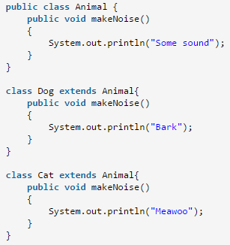
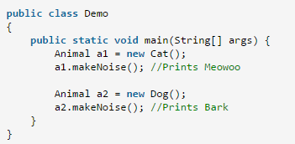
Exercises

Slide 37
References
Stephen Prata, C++ Primer Plus, 4thEdition, Sams, 2004.
Bjarne Stroustrup, The C++ Programming Language, 4thEdition, Addison-Wesley, 2013
Marshall Cline, C++ FAQ Lite, 2ndEdition, Addison-Wesley, 2000
Robert L. Kruse, Alexander J. RybaData, Data Structures and Program Design in C++, Prentice-Hall, Inc., 2000
Bruce Eckel, Thinking in C++,Prentice Hall, 1998
http://faculty.orangecoastcollege.edu/sgilbert/book/03-4-ObjectOrientedConcepts-B/index.html

Slide 38
Revision History
Date | Version | Description | Updated by | Reviewed and Approved By
Aug 2017 | 2.0 | Retheme with DXC template |  | Quang Tran

