Slide 1
Unified Modeling Language (UML)
Trainer: Duc LE GIA

Slide 2

Agenda
Objectives
Introduction to UML
Basic Notations
Modelling Types
Diagrams
Exercises
Final Project
Notes:
Explain the session objectives to the students.
Bring about the need of UML by providing the analogy of an architect who has acquired the contract of a building. Compare the analogy with designing software systems using UML.

Slide 3
Introduction
Unified Modeling Language (UML) is a standard language for creating blueprints that depicts structure and design of the software system.
A general-purpose, developmental, modeling language in the field of software engineering, that is intended to provide a standard way to visualize the design of a system – Wikipedia.

Slide 4
Introduction
Rational Software Corporation defines UML as follows: “The Unified Modeling Language (UML) is a language for specifying, constructing, visualizing, and documenting the artifacts of a software-intensive system.”
UML can be defined as a language for:
Specifying artifacts
Visualizing artifacts
Constructing artifacts
Documenting artifacts

Slide 5
History
In late 1980s, object-oriented modeling languages were developed for analysis and design of the software.
1994 – 1995: Booch’s Booch’93 , Jacobson’s Object Oriented Software Engineering (OOSE) and Rumbaugh’s Object Modeling Technique-2 (OMT) were developed at Rational Software.
In October 1994, the unification of Booch’93, OMT, and OOSE led to the release of version 0.9 and 0.91 of UML.
In 1997, UML 1.0 was adopted as a standard by OMG.
In 2005, UML 2.0 was introduced as the next standard by OMG.

Slide 6
Building Blocks
UML building blocks include:
Basic UML constituents: Include the static, dynamic, grouping, and annotational constituents of UML.
Relationships: Depict the relations between various constituents of a UML model.
Diagrams: Represent the various artifacts of a system graphically.

Slide 7
Standard diagrams
Use case diagrams
Class diagrams
Object diagrams
Communication diagrams
Sequence diagrams
State chart diagrams
Activity diagrams
Package Diagrams
Component diagrams
Deployment diagrams
Timing Diagrams
Composite Structure Diagrams
Interaction Overview Diagrams

Slide 8
Modeling types
Structural modeling
Classes diagrams
Objects diagrams
Deployment diagrams
Package diagrams
Composite structure diagram
Component diagram
Behavioral Modeling
Activity diagrams
Interaction diagrams
Use case diagrams
Architectural Modeling
Structural modeling
Behavioral modeling

Slide 9
UML Diagrams
Notes:
Use the use case diagram given on the slide to explain the meaning and notations for actor, use case, and relationship.

Slide 10
Use case diagram
A use case diagram
Present the usage requirements of the system.
It is the “means” of communicating with user and other stakeholders what the system is intended to do.
Use case diagram consists of:
Actors: entities those are external to the system
Use cases: A use case is a single unit of meaningful work. It provides a high-level view of behavior observable to someone or something outside the system. The notation for a use case is an ellipse
Relationships: Associations between actors and use cases

Slide 11


Use case Diagrams - Notations
Actors: entities those are external to the system
Use cases: A use case is a single unit of meaningful work. It provides a high-level view of behavior observable to someone or something outside the system.
Associations between actors and use cases
<<extend>>
Extend
<<include>>
Include
Generalization
Notes:
Actors
Human
Peripheral device (hardware)
External system or subsystem
Time or time-based event
Finding Actors: Useful Questions

Slide 12
Finding Actors: Useful Questions
Who is interested in a certain requirement?
Where in the organization is the system used?
Who will supply the system with this information, use this information, remove this information?
Who will use this function?
Who will support and maintain the system?
Does the system use an external resource?
What actors do the use cases need?
Does one actor play several different roles? Do several actors play the same role?

Slide 13
Finding Actors: Useful Questions
Who is interested in a certain requirement?
Where in the organization is the system used?
Who will supply the system with this information, use this information, remove this information?
Who will use this function?
Who will support and maintain the system?
Does the system use an external resource?
What actors do the use cases need?
Does one actor play several different roles? Do several actors play the same role?

Slide 14
Use case diagram - Notations
System boundary boxes: define the scope of the use case (optional).
Packages are used to group together use cases (Optional)

Slide 15
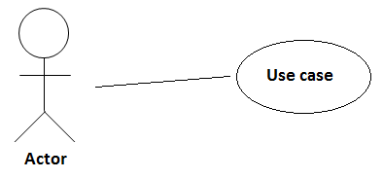
Use case diagram
Actor - use case associations:
An association between an actor and a use case indicates that the actor and the use case somehow interact or communicate with each other.
Only binary associations are allowed between actors and use cases.
An actor could be associated to one or several use cases.

Slide 16
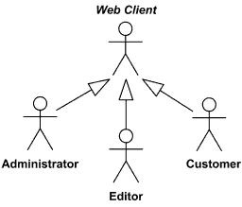
Use case diagram – Relationship between actors
Actor generalization:

Slide 17
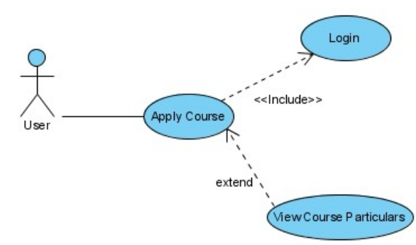
Use case diagram – Include
Include dependency
A base use case is dependent on the included use case(s).
Without them the base use case is incomplete as the included use case(s) represent sub-sequences of the interaction.

Slide 18
Use case diagram – Extend
Extend dependency
Extends the base use case by inserting additional action sequence the base use case.
The base use case should be a fully functional use case in its own right without the extending use case’s additional functionality.

Slide 19
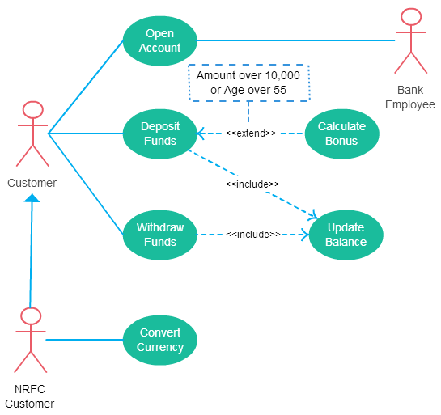
Use case diagram - Example

Slide 20
Use case diagram - Specification
Writing a specification is the final step in defining a use case.
This document outlines the actors, preconditions, flow of events of a use case.

Slide 21
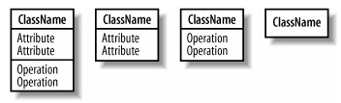
Class diagram
A class is a type of something. You can think of a class as a blueprint out of which objects can be constructed
Class in UML is represented as a rectangle split into up to three sections. The top section contains the name of the class, the middle section contains the attributes of the class and the final section contains the operations (behaviors) of the class.

Slide 22
Class diagram
There are four types of visibility characteristics to apply to the elements of a UML model.
Public visibility: accessible by any class
Protected visibility: more restricted than public, accessible by inherited classes
Package visibility: only accessible by classes reside in the same package
Private visibility: only accessible by the classes contain the element
Name
Public
Protected
Package
Private
(Notation)
(+)
(#)
(~)
(-)
More accessible to the other parts of the system
Less accessible to the other parts of the system

Slide 23
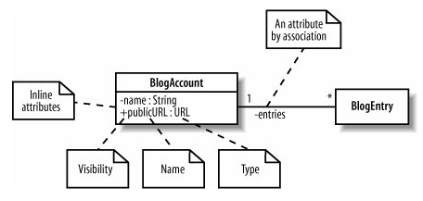
Class diagram
Attributes (class states) are pieces of information that represent the state of an object. They can be represented by placing them inside the 2nd section of the class UML model or by association with another class.
No two attributes in the same class can have the same name. The attribute type depends on how the class will be implemented.
Syntax: <visibility > <attribute_name> : <attribute_type>

Slide 24

Class diagram
Attribute can represents more than one object. Multiplicity used to specify that an attribute represents a collection of objects.
Operation describes what a class can do but not necessarily how.
Syntax: <visibility> <operation_name> () : <return_type>
Constructor doesn’t need to specify return type

Slide 25
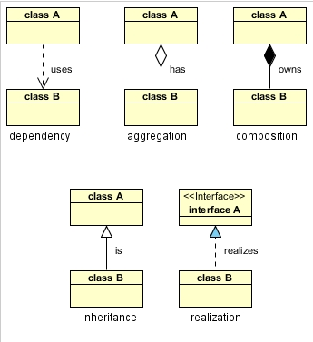
Class diagram
There are five types of
class relationship

Slide 26


Class diagram
Dependency: is represented when a reference to one class is passed in as a method parameter to another class

Slide 27


Class diagram
Aggregation: if class A stored the reference to class B for later use we would have a different relationship

Slide 28


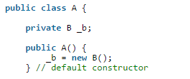
Class diagram
Composition: Stronger than aggregation, the containing object is responsible for the creation and life cycle of the contained object

Slide 29

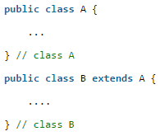
Class diagram
Inheritance: used to describe a class that is a type of another class.
Has-a: association/aggregation/composition
Is-a: inheritance

Slide 30

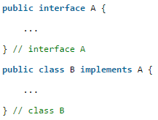
Class diagram
Realization is also straighforward in Java and deals with implementing an interface

Slide 31
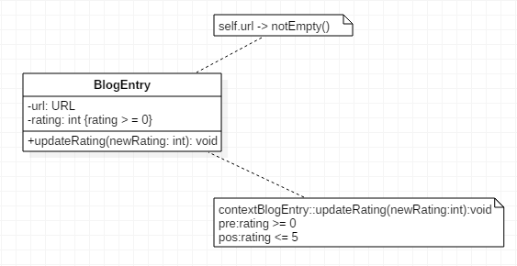
Class diagram
There are 3 types of constraints to restrict the ways in which a class can operate
Invariants: is a constraint that must always be true, else the system is in an invalid state. Used on class attribute
Preconditions: is a defined constraint on a method and checked before method executes. Used to validate input parameters
Postconditions: is a defined constraint on a method and checked after method executes. Used to describe how values were changed by a method

Slide 32
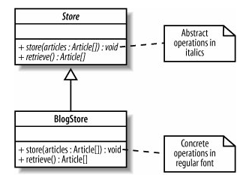
Class diagram
Abstract class: use for inheritance and you won’t be able to implement the behavior of the general class.

Slide 33
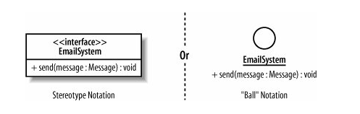
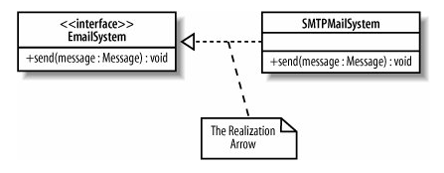
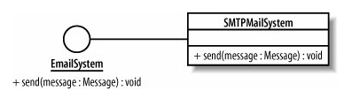
Class diagram
An interface is a collection of operations but doesn’t have an implementation of its. It’s like an abstract class but with only abstract methods.

Slide 34
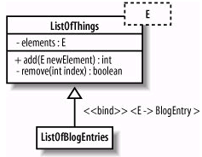
Class diagram
Templates are parameterized class, as you want to postpone the decision as to which classes a class will work it. The binding process is done by subclassing

Slide 35
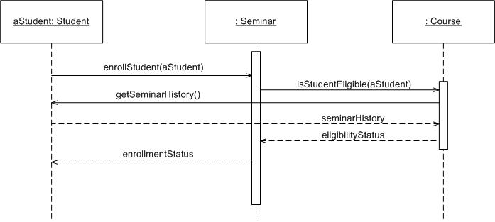
Sequence diagram
A Sequence diagram is an interaction diagram that shows how processes operate with one another and in what order.
Focus on identifying the behavior within the system being built.
Associated with a use case.

Slide 36

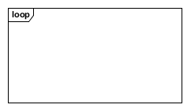
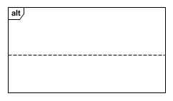
Sequence diagram
A lifeline represents an individual participant in a sequence diagram
Activation or Execution Occurrence
A loop combined fragment represents a loop. The loop operand will be repeated a number of times.
An alternative combined fragment represents a choice of behavior. At most one of the operands will be chosen.
Notes:
Activation or Execution Occurrence Activation boxes represent the time an object needs to complete a task. When an object is busy executing a process or waiting for a reply message, use a thin gray rectangle placed vertically on its lifeline.

Slide 37




Sequence diagram
A message defines a particular communication between Lifelines of an Interaction. In most case, it denotes a method call.
An asynchronous message is one where the sender doesn't wait for the result of the message, instead it processes the result when and if it ever comes back.
A simple message and also used for asynchronous.
Return message is a kind of message that represents the pass of information back to the caller of a corresponded former message.

Slide 38
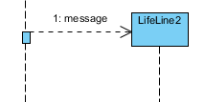




Sequence diagram
Create message is a kind of message that represents the instantiation of (target) lifeline.
Destroy message is a kind of message that represents the request of destroying the lifecycle of taget lifeline.
Recursive message is a kind of message that represents the invocation of message of the same lifeline.
Self message is a kind of message that represents the invocation of message of the same lifeline.
A lost message is a message where the sending event occurrence is known, but there is no receiving event occurrence.

Slide 39





Sequence diagram
A found message is a message where the receiving event occurrence is known, but there is no (known) sending event occurrence.
Duration message shows the distance between two time instants for a message invocation.
A Continuation is a syntactic way to define continuations of different branches of an Alternative Combined Fragment.
A gate is a connection point for connecting a message inside a fragment with a message outside a fragment.
A note (comment) gives the ability to attach various remarks to elements

Slide 40
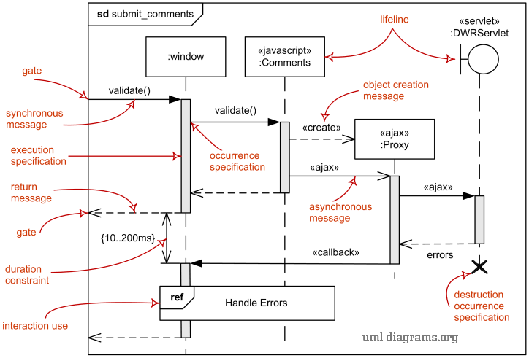
Sequence diagram

Slide 41
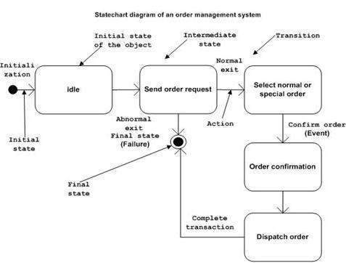
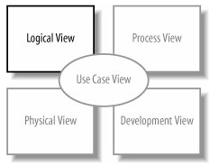
Statechart diagram
Describes different states of a component in a system.
The states are specific to a component/object of a system.
Statechart diagram is one of the five UML diagrams used to model dynamic nature of a system.
They define different states of an object during its lifetime.

Slide 42
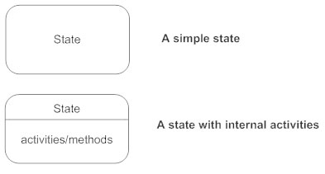


Statechart diagram - Notations

Slide 43
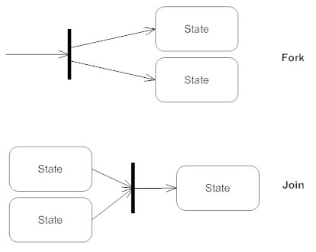

State machine diagram
Choice / Condition
Guard conditions can be used to document that a certain event, depending on the condition, can lead to different transitions

Slide 44
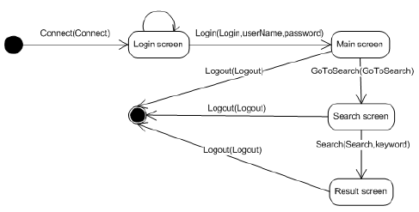
Statechart diagram

Slide 45
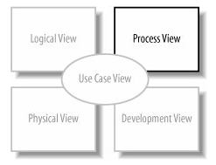
Activity diagram
Activity diagram is basically a flowchart to represent the flow from one activity to another activity.
The activity can be described as an operation of the system.
It captures the dynamic behavior of the system.
Activity diagram consists of:
Activities
Association
Conditions
Constraints

Slide 46
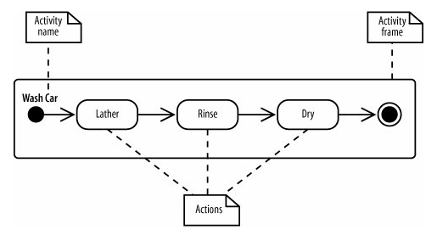
Activity diagram
Activities and actions
Actions are steps in the completion of a process.
The Activity Wash Car is comprise of 3 actions: lather, rinse, dry

Slide 47
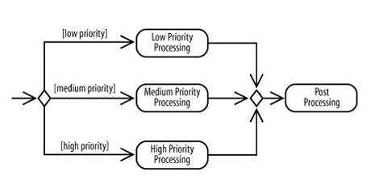
Activity diagram
Decisions and Merges
Decisions are used when you want to execute a different sequence of actions depending on a condition. Decisions are drawn as diamond-shaped nodes with one incoming edge and multiple outgoing edges

Slide 48

Activity diagram
Time Events
Time events are drawn with an hourglass symbol.

Slide 49
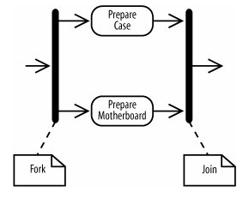
Folks and joins
Used to split and join actions that can be processed in parallel at the same time

Slide 50
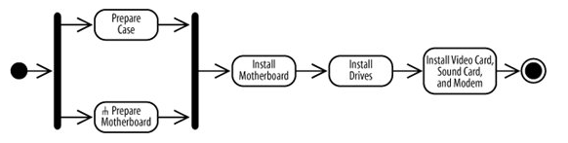
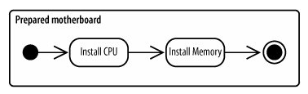
Activity diagram
Calling other activities:
You can simplify your diagram by making your activity diagram a call activity node which has an upside down pitch fork symbol
And the gives the detail of the call activity node as below

Slide 51

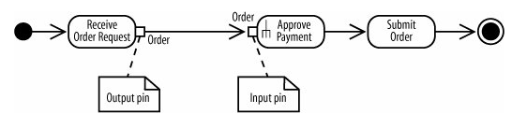
Activity diagram
Passing object:
An object is drawn as a rectangle, can include its status, to present that it’s available at a particular point in the activity
You can show input and output as below:

Slide 52
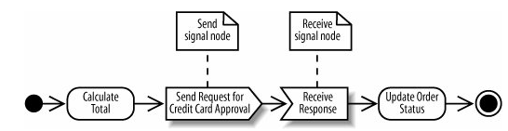
Activity diagram
Sending and Receiving Signals
Activities may interact with external people, systems or processes. Can be demonstrated as below

Slide 53
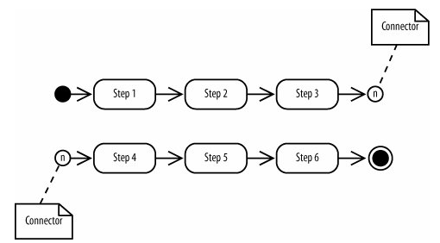
Connectors
Used to manage the complexity of the activity diagram (by fragmentation)

Slide 54
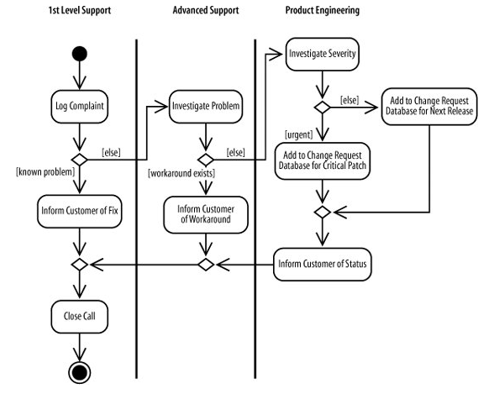
Activity diagram
Partitions (Swimlanes)
Activities may involve with different participants, thus the diagram requires multiple participants to be completed.

Slide 55
Questions & Answer

Slide 56
Thank You!

Slide 57
Revision History
Date | Version | Description | Updated by | Reviewed and Approved By
Aug 2017 | 2.0 | Retheme with DXC template |  | Quang Tran

