Slide 1
jQuery

Slide 2
INTRODUCTION
Your role
Your background and experience in the subject – HTML, CSS, JavaScript, jQuery
What do you want from this course

Slide 3
OBJECTIVES
jQuery and its features
- Basic knowledge
- $.ajax, Defer and Promise

Slide 4
PREREQUISITE
Have knowledge
– Html(5), Css(3), JavaScript
– Editor: VS, Eclipse, Notepad++, Brackets, …
– Developer tool: Firebug (Firefox), Chrome developer tool…

Slide 5
ASSESSMENT DISCIPLINES & TIMETABLE
Assessment Disciplines
– Class Participation : Required
– Assignment Completion : 100%
– Pass Criteria: >=70%
• Course Timetable
– Lecture Duration: 3 hours
Assignment Duration : One week

Slide 6
Further Reference
https://api.jquery.com/
https://www.w3schools.com/jquery/

Slide 7

Agenda
jQuery Overview
jQuery Syntax
jQuery Selector
jQuery Event & Effect
DOM (Document Object Model) Manipulation
$.ajax()
Defer and Promise
Notes:
https://www.quackit.com/javascript/examples/

Slide 8
jQuery Overview

Slide 9
What is jQuery?
jQuery is just a JavaScript library
jQuery is a lightweight library.
"write less, do more” - The purpose of jQuery is to make it much easier to use JavaScript
Awesome features:
– HTML element selections
– HTML/ DOM element manipulation
– CSS manipulation
– HTML event functions
– Effects and animations
– AJAX

Slide 10
jQuery - How to add?
The jQuery library is stored as a single JavaScript file, containing all the jQuery methods.
There are several ways to start using jQuery on your web site. You can:
1. Download the jQuery library from jQuery.com
2. Include jQuery from a CDN, like Google, Microsoft

Slide 11

jQuery - How to add?(cont)
Download the jQuery library
There are two versions of jQuery available for downloading:
Production version - this is for your live website because it has been minified and compressed
Development version - this is for testing and development (uncompressed and readable code)
Both versions can be downloaded from jQuery.com.
It can be added to a web page with the following mark-up:

Slide 12
jQuery - How to add?(cont)
2. jQuery CDN (Content Delivery Network).
If you don't want to download and host jQuery yourself, you can include it from a CDN
Both Google and Microsoft host jQuery.
For example, To use jQuery from Google
For more information, you can access http://jquery.com/download/
Notes:
<head> <script src="https://ajax.googleapis.com/ajax/libs/jquery/3.3.1/jquery.min.js"></script> </head>

Slide 13
jQuery Syntax

Slide 14
Basics
Basic syntax is: $(selector).action()
A dollar sign ($) to define jQuery
A (selector) to query (or find) elements
A jQuery action() to be performed on the element(s)
To be noted with utility method
Examples:
$(this).hide() - hides the current element.
$("p").hide() - hides all <p> elements.
$(".test").hide() - hides all elements with class="test".
$("#test").hide() - hides the element with id="test".

Slide 15
Avoiding Conflicts with Other Libraries
There are several ways to avoid conflicts with Other Libraries. You can
Putting jQuery Into No-Conflict Mode
Including jQuery Before Other Libraries

Slide 16
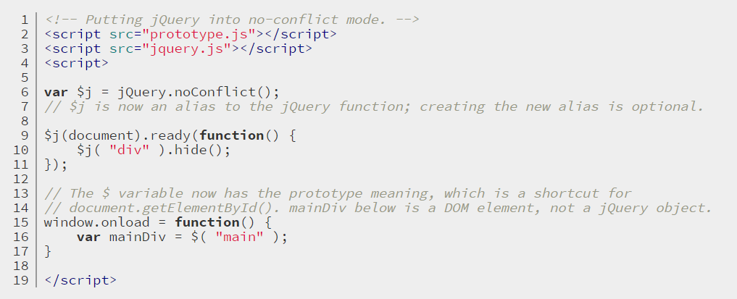
Avoiding Conflicts with Other Libraries (cont)
Putting jQuery Into No-Conflict Mode
- Assign a new variable name to replace the $ alias.
Notes:
<!-- Putting jQuery into no-conflict mode. -->
<script src="prototype.js"></script>
<script src="jquery.js"></script>
<script>
var $j = jQuery.noConflict();
// $j is now an alias to the jQuery function; creating the new alias is optional.
$j(document).ready(function() {
$j( "div" ).hide();
});
// The $ variable now has the prototype meaning, which is a shortcut for
// document.getElementById(). mainDiv below is a DOM element, not a jQuery object.
window.onload = function() {
var mainDiv = $( "main" );
}
</script>

Slide 17
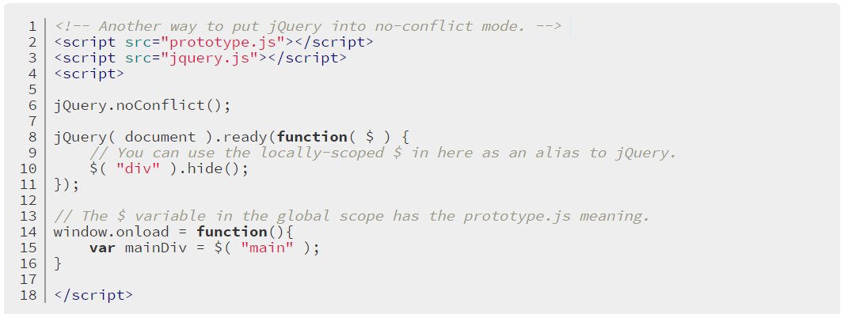
Avoiding Conflicts with Other Libraries (cont)
Putting jQuery Into No-Conflict Mode (cont)
- Add the $ as an argument passed to your
jQuery( document ).ready() function
Notes:
<!-- Another way to put jQuery into no-conflict mode. -->
<script src="prototype.js"></script>
<script src="jquery.js"></script>
<script>
jQuery.noConflict();
jQuery( document ).ready(function( $ ) {
// You can use the locally-scoped $ in here as an alias to jQuery.
$( "div" ).hide();
});
// The $ variable in the global scope has the prototype.js meaning.
window.onload = function(){
var mainDiv = $( "main" );
}
</script>

Slide 18
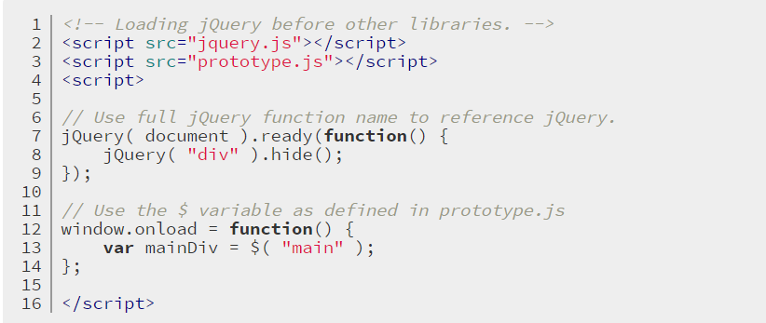
Avoiding Conflicts with Other Libraries(cont)
2. Including jQuery Before Other Libraries

Slide 19
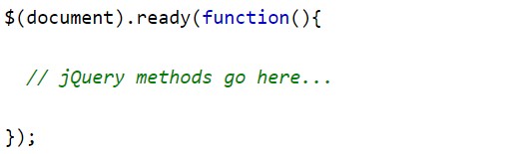
The Document Ready Event
Situation: if methods are run before the document is fully loaded, action can be failed:
Trying to hide an element that is not created yet
Trying to get the size of an image that is not loaded yet
Solution: put all jQuery methods are inside a document ready event:
Notes:
$(document).ready(function(){ // jQuery methods go here... });

Slide 20
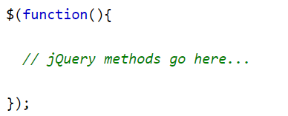
The Document Ready Event(cont)
A page can't be manipulated safely until the document is "ready.“
jQuery detects this state of readiness for you. Code included inside Document Ready Event will only run once the page Document Object Model (DOM) is ready for JavaScript code to execute.
The jQuery team has also created an even shorter method for the document ready event:

Slide 21
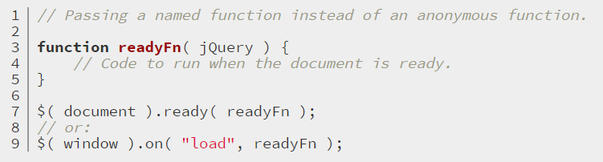
Document Ready Event vs window.onload
Code included inside $( window ).on( "load", function() { ... }) will run once the entire page (images or iframes), not just the DOM, is ready.
You can also pass a named function to $( document ).ready()
$( window ).on( "load" )
instead of passing an anonymous function.
Notes:
<html>
<head>
<script src="https://code.jquery.com/jquery-1.9.1.min.js"></script>
<script>
$( document ).ready(function() {
console.log( "document loaded" );
});
$( window ).on( "load", function() {
console.log( "window loaded" );
});
</script>
</head>
<body>
<iframe src="http://techcrunch.com"></iframe>
</body>
</html>

Slide 22
jQuery Selector

Slide 23
jQuery - Selectors
jQuery selectors are used to "find" (or select) HTML elements based on their name, id, classes, types, attributes, values of attributes and much more
It's based on the existing CSS Selectors, and in addition, it has some own custom selectors.
For a complete selector reference, visit the Selectors documentation on api.jquery.com.
All selectors in jQuery start with the dollar sign and parentheses: $().
$(this) select the current element.
$("p") select all <p> elements.
$(".test") select all elements with class="test".
$("#test") select the element with id="test".

Slide 24
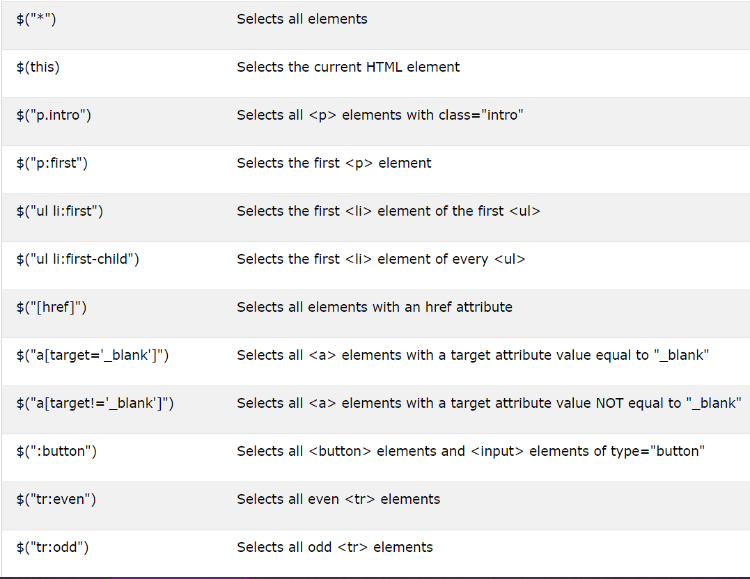
jQuery – Selectors (cont)

Slide 25
jQuery Event and Effect

Slide 26
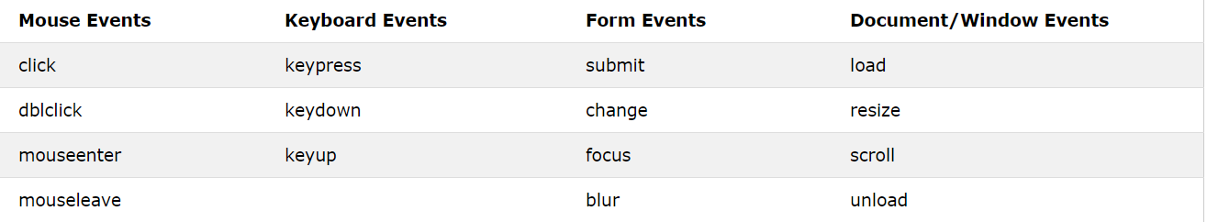
jQuery – Event
All the different visitors' actions that a web page can respond to are called events.
An event represents the precise moment when something happens: moving a mouse over an element, selecting a radio button, clicking on an element

Slide 27

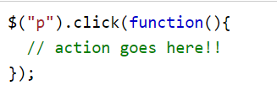
jQuery – Event (cont)
In jQuery, most DOM events have an equivalent jQuery method.
To assign a click event to all paragraphs on a page, you can do this:
The next step is to define what should happen when the event fires. You must pass a function to the event:
Notes:
http://api.jquery.com/category/events/
https://www.w3schools.com/jquery/jquery_ref_events.asp

Slide 28
jQuery – Effect
jQuery makes it trivial to add simple effects to your page.
Effects can use the built-in settings, or provide a customized duration. You can also create custom animations of arbitrary CSS properties.
For complete details on jQuery effects, visit the Effects documentation on api.jquery.com.
Hide() and show()
– $(selector).hide(speed, callback)
– $(selector).show(speed, callback)
The toggle()
– $(selector).toggle(speed,callback)
Slide methods (slideDown, slideUp, slideToggle)
– $(selector).slideUp(speed,callback)
– $(selector).slideDown(speed,callback)
– $(selector).slideToggle(speed,callback)

Slide 29
Document Object Model Manipulation

Slide 30
HTML DOM
When a web page is loaded, the browser creates a Document Object Model of the page.
The HTML DOM is a standard object model and programming interface for HTML.
It defines:
The HTML elements as objects
The properties of all HTML elements
The methods to access all HTML elements
The events for all HTML elements
For complete details on jQuery DOM manipulation, visit the http://api.jquery.com/category/manipulation/

Slide 31
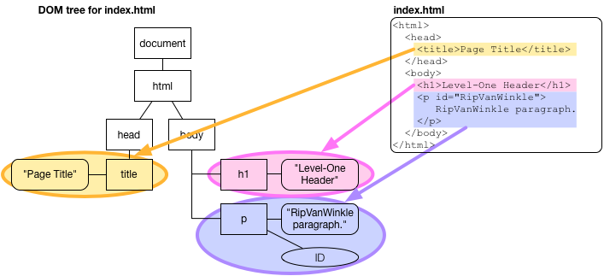
HTML DOM

Slide 32
jQuery - Get Content and Attributes
Three simple, but useful, jQuery methods for DOM manipulation are:
text() - Sets or returns the text content of selected elements
html() - Sets or returns the content of selected elements (including HTML markup)
val() - Sets or returns the value of form fields
https://www.w3schools.com/jquery/tryit.asp?filename=tryjquery_dom_html_get
https://www.w3schools.com/jquery/tryit.asp?filename=tryjquery_dom_val_get
Notes:
<!DOCTYPE html>
<html>
<head>
<script src="https://ajax.googleapis.com/ajax/libs/jquery/3.3.1/jquery.min.js"></script>
<script>
$(document).ready(function(){
$("#btn1").click(function(){
alert("Text: " + $("#test").text());
});
$("#btn2").click(function(){
alert("HTML: " + $("#test").html());
});
});
</script>
</head>
<body>
<p id="test">This is some <b>bold</b> text in a paragraph.</p>
<button id="btn1">Show Text</button>
<button id="btn2">Show HTML</button>
</body>
</html>
<!DOCTYPE html>
<html>
<head>
<script src="https://ajax.googleapis.com/ajax/libs/jquery/3.3.1/jquery.min.js"></script>
<script>
$(document).ready(function(){
$("button").click(function(){
alert("Value: " + $("#test").val());
});
});
</script>
</head>
<body>
<p>Name: <input type="text" id="test" value="Mickey Mouse"></p>
<button>Show Value</button>
</body>
</html>

Slide 33
jQuery - Set Content and Attributes
We will use the same three methods from the previous page to set content:
text() - Sets or returns the text content of selected elements
html() - Sets or returns the content of selected elements (including HTML markup)
val() - Sets or returns the value of form fields
https://www.w3schools.com/jquery/tryit.asp?filename=tryjquery_dom_html_set
https://www.w3schools.com/jquery/tryit.asp?filename=tryjquery_dom_html_callback
Notes:
<!DOCTYPE html>
<html>
<head>
<script src="https://ajax.googleapis.com/ajax/libs/jquery/3.3.1/jquery.min.js"></script>
<script>
$(document).ready(function(){
$("#btn1").click(function(){
$("#test1").text("Hello world!");
});
$("#btn2").click(function(){
$("#test2").html("<b>Hello world!</b>");
});
$("#btn3").click(function(){
$("#test3").val("Dolly Duck");
});
});
</script>
</head>
<body>
<p id="test1">This is a paragraph.</p>
<p id="test2">This is another paragraph.</p>
<p>Input field: <input type="text" id="test3" value="Mickey Mouse"></p>
<button id="btn1">Set Text</button>
<button id="btn2">Set HTML</button>
<button id="btn3">Set Value</button>
</body>
</html>

Slide 34
jQuery - Set Content and Attributes (cont)
A Callback Function for text(), html(), and val()
Has 2 parameter : current index and original (old) value.
Return a new value which wish to use for the function.
https://www.w3schools.com/jquery/tryit.asp?filename=tryjquery_dom_html_callback
Notes:
<!DOCTYPE html>
<html>
<head>
<script src="https://ajax.googleapis.com/ajax/libs/jquery/3.3.1/jquery.min.js"></script>
<script>
$(document).ready(function(){
$("#btn1").click(function(){
$("#test1").text(function(i, origText){
return "Old text: " + origText + " New text: Hello world! (index: " + i + ")";
});
});
$("#btn2").click(function(){
$("#test2").html(function(i, origText){
return "Old html: " + origText + " New html: Hello <b>world!</b> (index: " + i + ")";
});
});
});
</script>
</head>
<body>
<p id="test1">This is a <b>bold</b> paragraph.</p>
<p id="test2">This is another <b>bold</b> paragraph.</p>
<button id="btn1">Show Old/New Text</button>
<button id="btn2">Show Old/New HTML</button>
</body>
</html>

Slide 35
jQuery - Add / Remove Elements
We will look at four jQuery methods that are used to add new content:
append() - Inserts content at the end of the selected elements
prepend() - Inserts content at the beginning of the selected elements
after() - Inserts content after the selected elements
before() - Inserts content before the selected elements
To remove elements and content, there are mainly two jQuery methods:
remove() - Removes the selected element (and its child elements)
empty() - Removes the child elements from the selected element
Notes:
http://api.jquery.com/category/manipulation/

Slide 36
jQuery - Get and Set CSS Classes
jQuery has several methods for CSS manipulation. We will look at the following methods:
addClass() - Adds one or more classes to the selected elements
removeClass() - Removes one or more classes from the selected elements
toggleClass() - Toggles between adding/removing classes from the selected elements
css() - Sets or returns the style attribute
Notes:
https://www.w3schools.com/jquery/tryit.asp?filename=tryjquery_css_getcolor
https://www.w3schools.com/jquery/tryit.asp?filename=tryjquery_dom_addclass

Slide 37
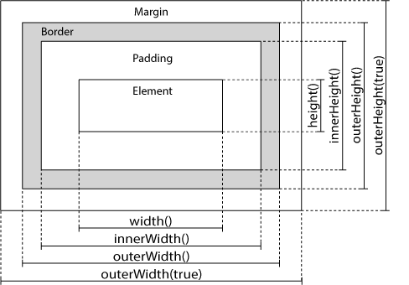
jQuery - Dimensions
jQuery has several important methods for working with dimensions:
width()
height()
innerWidth()
innerHeight()
outerWidth()
outerHeight()
Notes:
https://www.w3schools.com/jquery/tryit.asp?filename=tryjquery_dim_width_height
<!DOCTYPE html>
<html>
<head>
<script src="https://ajax.googleapis.com/ajax/libs/jquery/3.3.1/jquery.min.js"></script>
<script>
$(document).ready(function(){
$("button").click(function(){
var txt = "";
txt += "Width of div: " + $("#div1").width() + "</br>";
txt += "Height of div: " + $("#div1").height();
$("#div1").html(txt);
});
});
</script>
<style>
#div1 {
height: 100px;
width: 300px;
padding: 10px;
margin: 3px;
border: 1px solid blue;
background-color: lightblue;
}
</style>
</head>
<body>
<div id="div1"></div>
<br>
<button>Display dimensions of div</button>
<p>width() - returns the width of an element.</p>
<p>height() - returns the height of an element.</p>
</body>
</html>

Slide 38
$.ajax()

Slide 39
Problem with traditional web?
In traditional web, to get information from server:
Make html form
GET or POST data to the server (like Submit button)
The browser loads a result page.
Traditional web app run slowly and tend to be less user friendly.

Slide 40

Why Ajax come in?
AJAX = Asynchronous JavaScript and XML
Update a web page without reloading the page
Request data from a server - after the page has loaded
Receive data from a server - after the page has loaded
Send data to a server - in the background
Notes:
http://www.w3schools.com/ajax/default.asp

Slide 41

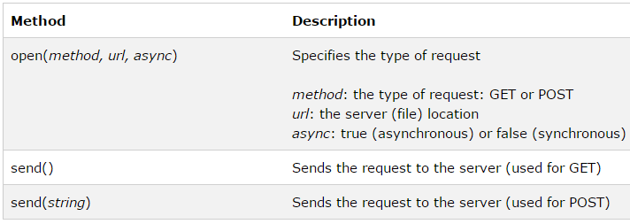
Ajax – send request
Create XmlHttpRequest object
Send request to server
Notes:
Dynamically Modify And Enhance Images By Changing Their URL
URL parameters: http://www.cdnconnect.com/docs/image-api/image-resizing
http://www.cdnconnect.com/docs/foresightjs
Picturefill: http://scottjehl.github.io/picturefill/
http://www.w3.org/community/respimg/wiki/Main_Page

Slide 42

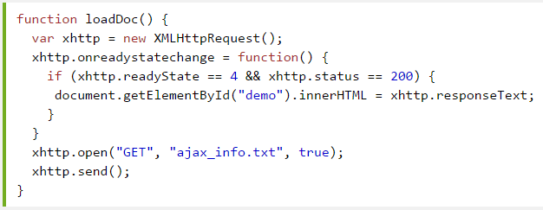
Ajax – example
Notes:
xhttp.open("GET", "ajax_info.txt", false); xhttp.send(); document.getElementById("demo").innerHTML = xhttp.responseText;

Slide 43
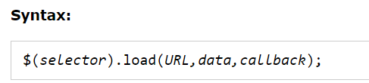
jQuery - AJAX load() Method
For complete details on jQuery - Ajax, visit the http://api.jquery.com/jQuery.ajax
The jQuery load() method is a simple, but powerful AJAX method.
The load() method loads data from a server and puts the returned data into the selected element.
Notes:
https://www.w3schools.com/jquery/tryit.asp?filename=tryjquery_ajax_load

Slide 44
jQuery - AJAX load() Method (cont)
The optional callback parameter specifies a callback function to run when the load() method is completed. The callback function can have different parameters:
responseTxt - contains the resulting content if the call succeeds
statusTxt - contains the status of the call
xhr - contains the XMLHttpRequest object
https://www.w3schools.com/jquery/tryit.asp?filename=tryjquery_ajax_load_callback
https://learn.jquery.com/ajax/jquery-ajax-methods/

Slide 45
jQuery - AJAX get() and post() Methods
Two commonly used methods for a request-response between a client and server are: GET and POST.
GET - Requests data from a specified resource
POST - Submits data to be processed to a specified resource
GET is basically used for just getting (retrieving) some data from the server. Note: The GET method may return cached data.
POST can also be used to get some data from the server. However, the POST method NEVER caches data, and is often used to send data along with the request.

Slide 46
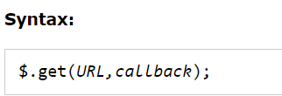
jQuery $.get() Method
The $.get() method requests data from the server with an HTTP GET request.
The required URL parameter specifies the URL you wish to request.
The optional callback parameter is the name of a function to be executed if the request succeeds.
Notes:
https://www.w3schools.com/jquery/tryit.asp?filename=tryjquery_ajax_get

Slide 47
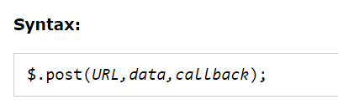
jQuery $.post() Method
The $.post() method requests data from the server using an HTTP POST request.
The required URL parameter specifies the URL you wish to request.
The optional data parameter specifies some data to send along with the request.
The optional callback parameter is the name of a function to be executed if the request succeeds.
Notes:
https://www.w3schools.com/jquery/tryit.asp?filename=tryjquery_ajax_post
<!DOCTYPE html>
<html>
<head>
<script src="https://ajax.googleapis.com/ajax/libs/jquery/3.3.1/jquery.min.js"></script>
<script>
$(document).ready(function(){
$("button").click(function(){
$.post("demo_test_post.asp",
{
name: "Donald Duck",
city: "Duckburg"
},
function(data,status){
alert("Data: " + data + "\nStatus: " + status);
});
});
});
</script>
</head>
<body>
<button>Send an HTTP POST request to a page and get the result back</button>
</body>
</html>

Slide 48
Defer and Promise

Slide 49
jQuery $.DEFERRED
3 important methods
.resolve()
.reject()
.promise()
3 important events to attach a callback
.done()
.fail()
.always()
Notes:
https://www.w3schools.com/jquery/tryit.asp?filename=tryjquery_ajax_post
<!DOCTYPE html>
<html>
<head>
<script src="https://ajax.googleapis.com/ajax/libs/jquery/3.3.1/jquery.min.js"></script>
<script>
$(document).ready(function(){
$("button").click(function(){
$.post("demo_test_post.asp",
{
name: "Donald Duck",
city: "Duckburg"
},
function(data,status){
alert("Data: " + data + "\nStatus: " + status);
});
});
});
</script>
</head>
<body>
<button>Send an HTTP POST request to a page and get the result back</button>
</body>
</html>

Slide 50
jQuery $.DEFERRED(cont)
Once resolve() is called, the .done callback attached will be executed.
Once reject() is called, the .fail callback attached will be executed.
The .always() is executed whether the deferred is resolved or rejected.
Notes:
<!doctype html>
<html lang="en">
<head>
<meta charset="utf-8">
<title>deferred.done demo</title>
<script src="https://code.jquery.com/jquery-1.10.2.js"></script>
</head>
<body>
<button>Go</button>
<p>Ready...</p>
<script>
// 3 functions to call when the Deferred object is resolved
function fn1() {
$( "p" ).append( " 1 " );
}
function fn2() {
$( "p" ).append( " 2 " );
}
function fn3( n ) {
$( "p" ).append( n + " 3 " + n );
}
// Create a deferred object
var dfd = $.Deferred();
// Add handlers to be called when dfd is resolved
dfd
// .done() can take any number of functions or arrays of functions
.done( [ fn1, fn2 ], fn3, [ fn2, fn1 ] )
// We can chain done methods, too
.done(function( n ) {
$( "p" ).append( n + " we're done." );
});
// Resolve the Deferred object when the button is clicked
$( "button" ).on( "click", function() {
dfd.resolve( "and" );
});
</script>
</body>
</html>

Slide 51
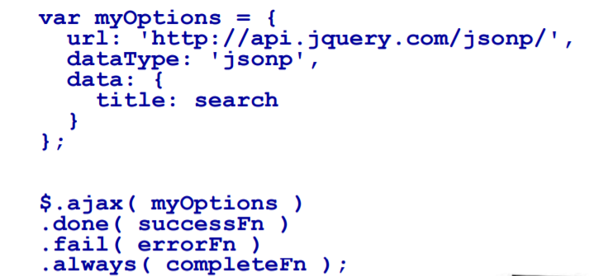
jQuery $.DEFERRED(cont)

Slide 52
jQuery .PROMISE() METHOD
Another important method of deferred object.
Returns an object with almost the same interface than the Deferred, but – it only has then method to attach callbacks – it does not have the methods to resolve and reject.
The $.ajax method in JQuery returns a Promise
Can add as many callbacks as you want
Notes:
<!doctype html>
<html lang="en">
<head>
<meta charset="utf-8">
<title>deferred.done demo</title>
<script src="https://code.jquery.com/jquery-1.10.2.js"></script>
</head>
<body>
<button>Go</button>
<p>Ready...</p>
<script>
// 3 functions to call when the Deferred object is resolved
function fn1() {
$( "p" ).append( " 1 " );
}
function fn2() {
$( "p" ).append( " 2 " );
}
function fn3( n ) {
$( "p" ).append( n + " 3 " + n );
}
// Create a deferred object
var dfd = $.Deferred();
// Add handlers to be called when dfd is resolved
dfd
// .done() can take any number of functions or arrays of functions
.done( [ fn1, fn2 ], fn3, [ fn2, fn1 ] )
// We can chain done methods, too
.done(function( n ) {
$( "p" ).append( n + " we're done." );
});
// Resolve the Deferred object when the button is clicked
$( "button" ).on( "click", function() {
dfd.resolve( "and" );
});
</script>
</body>
</html>

Slide 53
Exercises, Q&A

