Slide 1
Java Fundamentals
Hoan Duong Principle Software Engineer
Jun 2017

Slide 2
Introduction
Your role
Your background and experience in the subject
What do you want from this course

Slide 3
Course Objectives
At the end of the course, you will have acquired sufficient knowledge to:
Confidently write java code
Understand the components that make up a class in java
Get to know and use some basic libraries in java.
How to sue List, Set, Map ....

Slide 4
Agenda
Java Basics And OOP
Overview about OOP and Java
Basic syntax
Operators and flow control
Primitive types and wrapper classes
Component in java (package, class..)
Java Advanced
Collection Framework
Exception Handling
Basic I/O
Serialization
Thread and Concurrency
Properties File
Networking: Socket

Slide 5
Course Audience and Prerequisite
The course is designed as part of the Java Fresher Program
The following are beneficial if you already have knowledge and experiences as:
Created and compiled programs with C/C++/Java

Slide 6
Assessment Disciplines
Assignment: get al least 70/100 score for mini test

Slide 7
Duration and Course Timetable
Course Duration: 9 hours
Course Timetable:
From 9:00 to 12:00
Break 15 minutes from 10:30 to 10:45

Slide 8
Course Administration
In order to complete the course you must:
Sign in the Class Attendance List
Participate in the course
Provide your feedback in the End of Course Evaluation

Slide 9
Java Basics and OOP

Slide 10
Overview
Java programming language was originally developed by Sun Microsystems which was initiated by James Gosling and released in 1995 as core component of Sun Microsystems' Java platform (Java 1.0 [J2SE]).
Java is:
Object Oriented
Platform independent
Simple
Multithreaded
Distributed
Notes:
Object Oriented: In Java, everything is an Object. Java can be easily extended since it is based on the Object model.
Platform independent: Unlike many other programming languages including C and C++, when Java is compiled, it is not compiled into platform specific machine, rather into platform independent byte code. This byte code is distributed over the web and interpreted by virtual Machine (JVM) on whichever platform it is being run.
Simple:Java is designed to be easy to learn. If you understand the basic concept of OOP Java would be easy to master.
Secure: With Java's secure feature it enables to develop virus-free, tamper-free systems. Authentication techniques are based on public-key encryption.
Architectural-neutral :Java compiler generates an architecture-neutral object file format which makes the compiled code to be executable on many processors, with the presence of Java runtime system.
Portable:Being architectural-neutral and having no implementation dependent aspects of the specification makes Java portable. Compiler in Java is written in ANSI C with a clean portability boundary which is a POSIX subset.
Robust:Java makes an effort to eliminate error prone situations by emphasizing mainly on compile time error checking and runtime checking.
Multithreaded: With Java's multithreaded feature it is possible to write programs that can do many tasks simultaneously. This design feature allows developers to construct smoothly running interactive applications.
Interpreted:Java byte code is translated on the fly to native machine instructions and is not stored anywhere. The development process is more rapid and analytical since the linking is an incremental and light weight process.
High Performance: With the use of Just-In-Time compilers, Java enables high performance.
Distributed:Java is designed for the distributed environment of the internet.
Dynamic: Java is considered to be more dynamic than C or C++ since it is designed to adapt to an evolving environment. Java programs can carry extensive amount of run-time information that can be used to verify and resolve accesses to objects on run-time.
10

Slide 11
Learning the Java Language
Object-Oriented
Platform independent
Simple
Multithreaded
Distributed

Slide 12
Object-Oriented Programming Concepts
Object
State -> Field
Behavior -> Method
Class: the blueprint from which individual objects are created.
Package: a namespace that organizes a set of related classes and interfaces
Notes:
- Objects are key to understanding object-oriented technology. Look around right now and you'll find many examples of real-world objects: your dog, your desk, your television set, your bicycle.
Real-world objects share two characteristics: They all have state and behavior. Bicycles also have state (current gear, current pedal cadence, current speed) and behavior (changing gear, changing pedal cadence, applying brakes)
Software objects are conceptually similar to real-world objects: they too consist of state and related behavior. An object stores its state in fields (variables in some programming languages) and exposes its behavior through methods (functions in some programming languages).

Slide 13
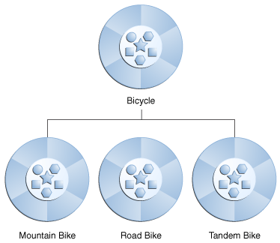
Object-Oriented Programming Concepts
Interface: a group of related methods with empty bodies
Inheritance
Polymorphism
Abstraction
Encapsulation
Superclass
Subclasses
Notes:
Interface
As you've already learned, objects define their interaction with the outside world through the methods that they expose. Methods form the object's interface with the outside world; the buttons on the front of your television set, for example, are the interface between you and the electrical wiring on the other side of its plastic casing. You press the "power" button to turn the television on and off.
Implementing an interface allows a class to become more formal about the behavior it promises to provide. Interfaces form a contract between the class and the outside world, and this contract is enforced at build time by the compiler. If your class claims to implement an interface, all methods defined by that interface must appear in its source code before the class will successfully compile.
- Inheritance
Object-oriented programming allows classes to inherit commonly used state and behavior from other classes. In this example, Bicycle now becomes the superclass of MountainBike, RoadBike, and TandemBike.
Inheritance
When one object acquires all the properties and behaviours of parent object i.e. known as inheritance. It provides code reusability. It is used to achieve runtime polymorphism.
Polymorphism
When one task is performed by different ways i.e. known as polymorphism. For example: to convense the customer differently, to draw something e.g. shape or rectangle etc.
In java, we use method overloading and method overriding to achieve polymorphism.
Another example can be to speak something e.g. cat speaks meaw, dog barks woof etc.
Abstraction
Hiding internal details and showing functionality is known as abstraction. For example: phone call, we don't know the internal processing.
In java, we use abstract class and interface to achieve abstraction.
Encapsulation
Binding (or wrapping) code and data together into a single unit is known as encapsulation. For example: capsule, it is wrapped with different medicines.
A java class is the example of encapsulation. Java bean is the fully encapsulated class because all the data members are private here.

Slide 14
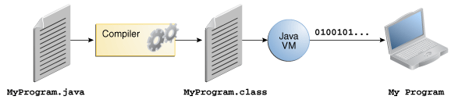
The Java Technology Phenomenon
The Java Programming Language
Notes:
In the Java programming language, all source code is first written in plain text files ending with the .java extension. Those source files are then compiled into .class files by the javac compiler. A .class file does not contain code that is native to your processor; it instead contains bytecodes — the machine language of the Java Virtual Machine¹ (Java VM). The java launcher tool then runs your application with an instance of the Java Virtual Machine.

Slide 15
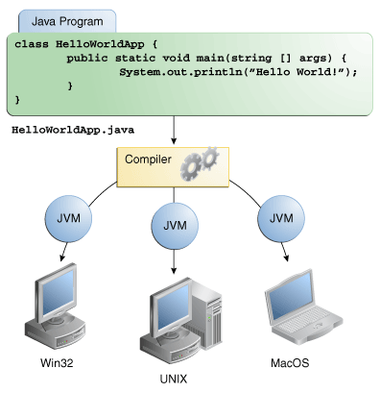
The Java Technology Phenomenon
The Java Programming Language
Notes:
Because the Java VM is available on many different operating systems, the same .class files are capable of running on Microsoft Windows, the Solaris™ Operating System (Solaris OS), Linux, or Mac OS.

Slide 16
Learning the Java Language
Language Basics
Identifiers, Modifiers, Operators , Flow Controls
Primarite and Wapper Primarite
Packages
Classes
Methods
Constructors
Instance variables
Local variables
Class variables
Objects
Comments

Slide 17
Basic Syntax
Identifiers:
All identifiers should begin with a letter (A to Z or a to z), currency character ($) or an underscore (_).
After the first character identifiers can have any combination of characters.
A key word cannot be used as an identifier.
Most importantly identifiers are case sensitive.
Examples of legal identifiers: age, $salary, _value, __1_value
Examples of illegal identifiers: 123abc, -salary
Modifiers
Access Modifiers: default, public, protected, private
Non-access Modifiers: static, final, abstract, synchronized
Notes:
Access Control Modifiers:
Java provides a number of access modifiers to set access levels for classes, variables, methods and constructors. The four access levels are:
Visible to the package, the default. No modifiers are needed.
Visible to the class only (private).
Visible to the world (public).
Visible to the package and all subclasses (protected).
Non Access Modifiers:
Java provides a number of non-access modifiers to achieve many other functionality.
The static modifier for creating class methods and variables
The final modifier for finalizing the implementations of classes, methods, and variables.
The abstract modifier for creating abstract classes and methods.
The synchronized and volatile modifiers, which are used for threads.
17

Slide 18
Basic Operators
Arithmetic Operators: +, -, *, /, %, ++, --
Relational Operators: ==, !=, >, <, >=, <=
Bitwise Operators: &, |, ^…
Logical Operators: &&, ||, !
Assignment Operators: =, +=, -=, *=, /=, %=, <<=, >>=, &=, ^=, |=
Misc Operators:
Conditional operator (?:)
variable x = (expression) ? value if true : value if false
Instance of
( Object reference variable ) instanceof (class/interface type)

Slide 19
Flow Control
Loops:
while Loop
do...while Loop
for Loop
Decision making:
if … else if ….else
switch
continue, break:
Notes:
switch(expression){
case value :
//Statements
break; //optional
case value :
//Statements break;
//optional
//You can have any number of case statements.
default :
//Optional
//Statements
}
The following rules apply to a switch statement:
The variable used in a switch statement can only be a byte, short, int, or char.
You can have any number of case statements within a switch. Each case is followed by the value to be compared to and a colon.
The value for a case must be the same data type as the variable in the switch and it must be a constant or a literal.
When the variable being switched on is equal to a case, the statements following that case will execute until a break statement is reached.
When a break statement is reached, the switch terminates, and the flow of control jumps to the next line following the switch statement.
Not every case needs to contain a break. If no break appears, the flow of control will fall through to subsequent cases until a break is reached.
A switch statement can have an optional default case, which must appear at the end of the switch. The default case can be used for performing a task when none of the cases is true. No break is needed in the default case.
The break Keyword:
The break keyword is used to stop the entire loop. The break keyword must be used inside any loop or a switch statement.
The break keyword will stop the execution of the innermost loop and start executing the next line of code after the block.
The continue Keyword:
The continue keyword can be used in any of the loop control structures. It causes the loop to immediately jump to the next iteration of the loop.
In a for loop, the continue keyword causes flow of control to immediately jump to the update statement.
In a while loop or do/while loop, flow of control immediately jumps to the Boolean expression.
19

Slide 20
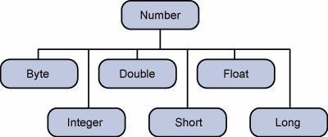
Primitive Types and Wrapper Classes
Logical – boolean
Textual – char
Integral – byte, short, int, and long
Floating – double and float
Wrapping Classes:

Slide 21
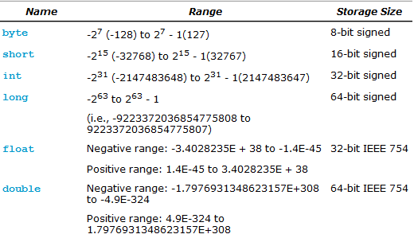

Primitive Types and Wrapper Classes

Slide 22
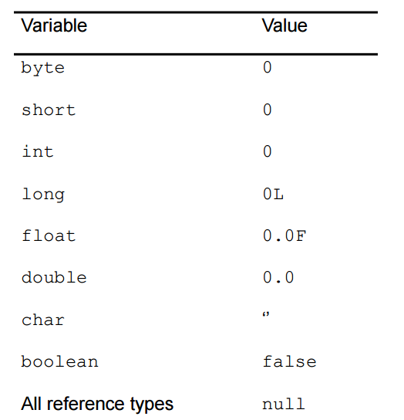
Primitive Types and Wrapper Classes
Notes:
Type Casting
int num1 = 53; // 32 bits of memory
int num2 = 47; // 32 bits of memory
byte num3; // 8 bits of memory reserved
num3 = (byte)(num1 + num2); // no data loss

Slide 23
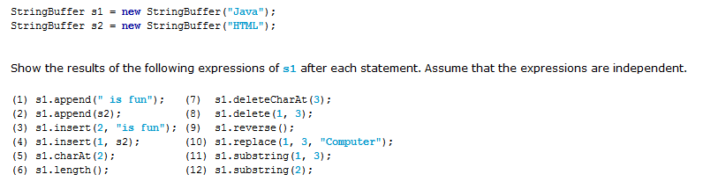
String
String: String greeting = "Hello world!";
StringBuilder
StringBuffer
Notes:
Mutability Difference:
String is immutable, if you try to alter their values, another object gets created, whereas StringBuffer and StringBuilder are mutable so they can change their values.
Thread-Safety Difference:
The difference between StringBuffer and StringBuilder is that StringBuffer is thread-safe. So when the application needs to be run only in a single thread then it is better to use StringBuilder. StringBuilder is more efficient than StringBuffer.
23

Slide 24
Basic Structure Class
Packages
Classes
Methods
Constructors
Instance variables
Local variables
Class variables
Objects
Comments
Notes:
Case Sensitivity - Java is case sensitive, which means identifier Hello and hello would have different meaning in Java.
Class Names - For all class names the first letter should be in Upper Case. If several words are used to form a name of the class, each inner word's first letter should be in Upper Case. Example class MyFirstJavaClass
Method Names - All method names should start with a Lower Case letter. If several words are used to form the name of the method, then each inner word's first letter should be in Upper Case. Example public void myMethodName()
Program File Name - Name of the program file should exactly match the class name. When saving the file, you should save it using the class name (Remember Java is case sensitive) and append '.java' to the end of the name (if the file name and the class name do not match your program will not compile). Example : Assume 'MyFirstJavaProgram' is the class name. Then the file should be saved as 'MyFirstJavaProgram.java'
public static void main(String args[]) - Java program processing starts from the main() method which is a mandatory part of every Java program..
Local variables: Variables defined inside methods, constructors or blocks are called local variables. The variable will be declared and initialized within the method and the variable will be destroyed when the method has completed.
Instance variables: Instance variables are variables within a class but outside any method. These variables are instantiated when the class is loaded. Instance variables can be accessed from inside any method, constructor or blocks of that particular class.
Class variables: Class variables are variables declared with in a class, outside any method, with the static keyword.
24

Slide 25
Classes and Objects - Classes
Modifier class MyClass extends [MySuperClass implements YourInterface ] {
// field, constructor, and
// method declarations
}
Modifiers: public, private, protected, detault.
The class name, with the initial letter capitalized by convention.
The name of the class's parent (superclass), if any, preceded by the keyword extends. A class can only extend (subclass) one parent.
A comma-separated list of interfaces implemented by the class, if any, preceded by the keyword implements. A class can implement more than one interface.
The class body, surrounded by braces, {}.

Slide 26
Classes and Objects - Classes
Variables.
Instance variables
Local variables
Class variables
[Access Modifier [Non-Access Modifier]] Type Variable_Identifier [= Initial Value];

Slide 27
Classes and Objects - Classes
Constructors
Methods.
[Access Modifier [Non-Access Modifiers]] ReturnTypeData Method_Identifier([List Argumants])

Slide 28
Classes and Objects - Classes
Creating an object:
MyClass object = new MyClass();

Slide 29
Classes and Objects – Inner Classes
class OuterClass {
...
class NestedClass {
...
}
}
Static nested classes:
Nested classes that are declared static
OuterClass.StaticNestedClass nestedObject = new OuterClass.StaticNestedClass();
Inner classes:
Non-static nested classes
OuterClass.InnerClass innerObject = outerObject.new InnerClass();
Notes:
It is a way of logically grouping classes that are only used in one place: If a class is useful to only one other class, then it is logical to embed it in that class and keep the two together. Nesting such "helper classes" makes their package more streamlined.
It increases encapsulation: Consider two top-level classes, A and B, where B needs access to members of A that would otherwise be declared private. By hiding class B within class A, A's members can be declared private and B can access them. In addition, B itself can be hidden from the outside world.
It can lead to more readable and maintainable code: Nesting small classes within top-level classes places the code closer to where it is used.

Slide 30
Classes and Objects – Local Classes
You can define a local class inside any block: a method body, a for loop, or an if clause.
Local class is similar to nested class. Use nested class if you want to make the type more widely available, and you don't require access to local variables or method parameters.

Slide 31
Classes and Objects – Anonymous Classes
Anonymous classes enable you to declare and instantiate a class at the same time. They are like local classes except that they do not have a name. Use them if you need to use a local class only
An anonymous class cannot access local variables in its enclosing scope that are not declared as final or effectively final.
HelloWorld frenchGreeting = new HelloWorld() { // HelloWorld is an interface
String name = "tout le monde";
public void greet() {
greetSomeone("tout le monde");
}
public void greetSomeone(String someone) {
name = someone;
System.out.println("Salut " + name);
}
};
Notes:
public class HelloWorldAnonymousClasses {
interface HelloWorld {
public void greet();
public void greetSomeone(String someone);
}
public void sayHello() {
class EnglishGreeting implements HelloWorld {
String name = "world";
public void greet() {
greetSomeone("world");
}
public void greetSomeone(String someone) {
name = someone;
System.out.println("Hello " + name);
}
}
HelloWorld englishGreeting = new EnglishGreeting();
HelloWorld frenchGreeting = new HelloWorld() {
String name = "tout le monde";
public void greet() {
greetSomeone("tout le monde");
}
public void greetSomeone(String someone) {
name = someone;
System.out.println("Salut " + name);
}
};
HelloWorld spanishGreeting = new HelloWorld() {
String name = "mundo";
public void greet() {
greetSomeone("mundo");
}
public void greetSomeone(String someone) {
name = someone;
System.out.println("Hola, " + name);
}
};
englishGreeting.greet();
frenchGreeting.greetSomeone("Fred");
spanishGreeting.greet();
}
public static void main(String... args) {
HelloWorldAnonymousClasses myApp =
new HelloWorldAnonymousClasses();
myApp.sayHello();
}
}

Slide 32
Classes and Objects – Interface
Interfaces are contracts
An interface is a reference type, similar to a class, that can contain only constants, method signatures, default methods, static methods, and nested types.
An interface can extend any number of interfaces.
Modifier interface MyInteface extends [YourInterfaces ] {
// method declarations
}
Notes:
There are a number of situations in software engineering when it is important for disparate groups of programmers to agree to a "contract" that spells out how their software interacts. Each group should be able to write their code without any knowledge of how the other group's code is written. Generally speaking, interfaces are such contracts.
You specify that a method definition in an interface is a default method with the default keyword at the beginning of the method signature. All method declarations in an interface, including default methods, are implicitly public, so you can omit the public modifier.
Like static methods in classes, you specify that a method definition in an interface is a static method with the static keyword at the beginning of the method signature. All method declarations in an interface, including static methods, are implicitly public, so you can omit the public modifier.

Slide 33
Classes and Objects – Inheritance
In the Java language, classes can be derived from other classes, thereby inheriting fields and methods from those classes.
Overriding and Hiding Methods
An instance method in a subclass with the same signature (name, plus the number and the type of its parameters) and return type as an instance method in the superclass overrides the superclass's method.
If a subclass defines a static method with the same signature as a static method in the superclass, then the method in the subclass hides the one in the superclass.
The access specifier for an overriding method can allow more, but not less, access than the overridden method.
Overloading Methods: the same method name with different paramaters
Notes:
There are a number of situations in software engineering when it is important for disparate groups of programmers to agree to a "contract" that spells out how their software interacts. Each group should be able to write their code without any knowledge of how the other group's code is written. Generally speaking, interfaces are such contracts.
You specify that a method definition in an interface is a default method with the default keyword at the beginning of the method signature. All method declarations in an interface, including default methods, are implicitly public, so you can omit the public modifier.
Like static methods in classes, you specify that a method definition in an interface is a static method with the static keyword at the beginning of the method signature. All method declarations in an interface, including static methods, are implicitly public, so you can omit the public modifier.

Slide 34
Classes and Objects – Inheritance
Polymorphism
The dictionary definition of polymorphism refers to a principle in biology in which an organism or species can have many different forms or stages.
Using the Keyword super, this
Final Classes and Methods
Abstract Methods and Classes

Slide 35
Classes and Objects – Annotations
Annotations, a form of metadata, provide data about a program that is not part of the program itself
Annotations have a number of uses, among them:
Information for the compiler
Compile-time and deployment-time processing
Runtime processing
Examples:
@Override
void mySuperMethod() { ... }
Notes:
Information for the compiler — Annotations can be used by the compiler to detect errors or suppress warnings.
Compile-time and deployment-time processing — Software tools can process annotation information to generate code, XML files, and so forth.
Runtime processing — Some annotations are available to be examined at runtime.

Slide 36

Demo 1: Greeting
Points to remember:
Java coding convention
Review: class, constructors, methods, variables, constants …

Slide 37
Java Advance
Collection Framework

Slide 38
Java Collections Framework
A collections framework is a unified architecture for representing and manipulating collections. All collections frameworks contain the following:
Interfaces: Collection, List, Map
Implementations, i.e., Classes: ArrayList, HashSet, HashMap
Algorithms: These are the methods that perform useful computations, such as searching and sorting, on objects that implement collection interfaces

Slide 39
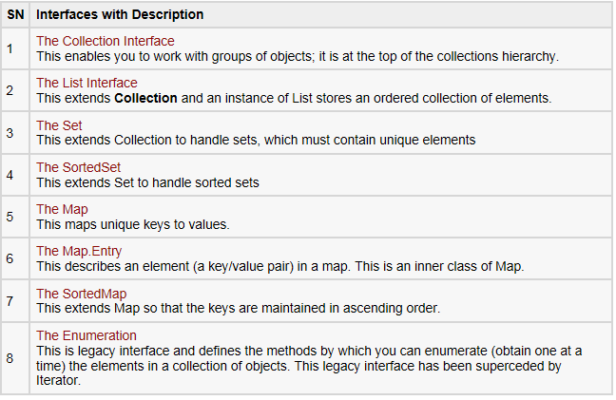
Java Collections Framework

Slide 40
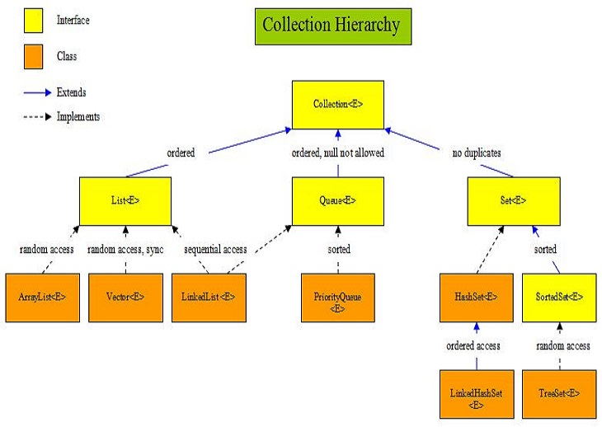
Java Collections Framework
Notes:
Collection<E> The root interface in the Collection hierarchy which the List<E>, Queue<E> and Set<E> interfaces extend. There is no direct implementation of the Collection<E> interface within the JDK.
List<E> Interface for ordered collections of elements.
Queue<E> Interface for holding elements prior to processing.
Set<E> Interface for unique collections of elements.
ArrayList<E> Random access, resizable-array implementation of the List<E> interface that implements all optional list operations and permits all elements, including null.
Vector<E> Synchronized random access resizable-array implementation of the List<E> interface.
LinkedList<E> Sequential access linked implementation of the List<E> interface that implements all optional list operations, and permits all elements, including null. The class also implements the Queue<E> interface, providing first-in-first-out queue operations.
PriorityQueue<E> Unbounded priority queue implementation of the Queue<E> interface based on a priority heap that does not permit null elements.
HashSet<E> Implementation of the Set<E> interface using a HashMap instance.
LinkedHashSet<E> Hash table and linked list implementation of the Set<E> interface that implements all optional set operations and permits all elements, including null.
SortedSet<E> Interface for unique collections of sorted elements.
TreeSet<E> Implementation of the Set<E> interface using a TreeMap instance.
40

Slide 41
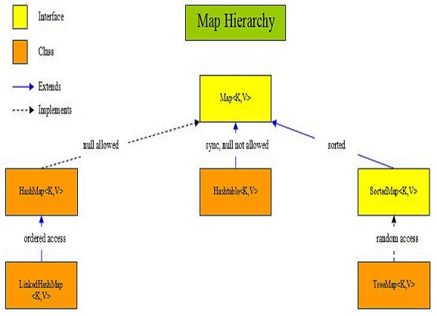
Java Collections Framework
Notes:
Map<K,V> The root interface in the map hierarchy which the SortedMap<K,V> interface extends.
HashMap<K,V> Hash table based implementation of the Map<K,V> interface that implements all optional map operations and permits all elements, including null and the null key.
LinkedHashMap<K,V> Hash table and linked list implementation of the Map<K,V> interface with predictable ordering and permits all elements, including null elements.
Hashtable<K,V> Hash table implementation of the Map<K,V> interface that doesn't allow null elements or null keys.
SortedMap<K,V> Interface for sorted map elements.
TreeMap<K,V> Random access tree based implementation of the SortedMap<K,V> interface.
41

Slide 42
Java Collections Framework
Iterator: In general, to use an iterator to cycle through the contents of a collection, follow these steps:
Obtain an iterator to the start of the collection by calling the collection's iterator() method.
Set up a loop that makes a call to hasNext( ). Have the loop iterate as long as hasNext() returns true.
Within the loop, obtain each element by calling next().

Slide 43
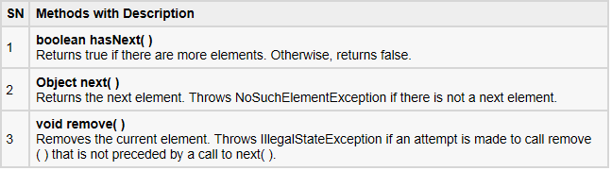
Java Collections Framework
The Methods Declared by Iterator:

Slide 44
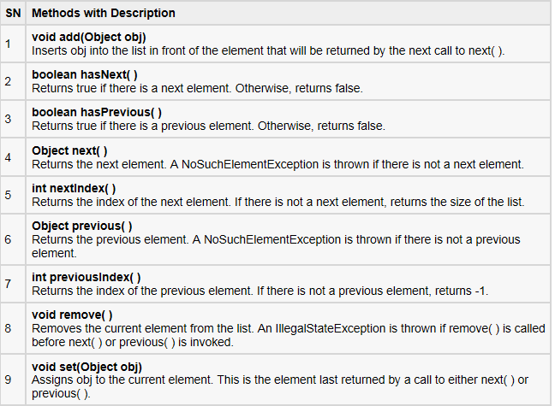
Java Collections Framework
The Methods Declared by ListIterator:
Notes:
Iterator enables you to cycle through a collection, obtaining or removing elements. ListIterator extends Iterator to allow bidirectional traversal of a list, and the modification of elements.
44

Slide 45
Java Collections Framework
Comparator | Comparable
A comparator object is capable of comparing two different objects. The class is not comparing its instances, but some other class’s instances. This comparator class must implement the java.util.Comparator interface | A comparable object is capable of comparing itself with another object. The class itself must implements the java.lang.Comparable interface in order to be able to compare its instances.
int compare(Object o1, Objecto2) | int compareTo(Object o1)
TreeSet(Comparator) java.util.Collections.sort(List, Comparator) | TreeSet() java.util.Collections.sort(List)

Slide 46
Demo 2: Collection Framework
Exercise:
Add Customer class which has: name, memberType (VIP, MEMBER, OTHERS) and list of orders
Sort orders in demo 2 by date, desc.
Display orders in console
Points to remember:
Initialize collections
Manage collections
Order collections
Generic, advanced loop
Notes:
Notes: We have some wrong here. I expect learner can correct them.
Exercise 1:
Tuan has written the code like below. But, it is showing compile time error. Can you identify what mistake he has done?
class X
{
//Class X Members
}
class Y
{
//Class Y Members
}
class Z extends X, Y
{
//Class Z Members
}
Exercise 2: What will be the output of this program?
class A
{
int i = 10;
}
class B extends A
{
int i = 20;
}
public class MainClass
{
public static void main(String[] args)
{
A a = new B();
System.out.println(a.i);
}
}
Exercise 3:What will be the output of the below program?
class A
{
static {
System.out.println(1);
}
}
class B extends A
{
static {
System.out.println(2);
}
}
class C extends B
{
public C(String b){
}
static {
System.out.println(3);
}
}
public class MainClass
{
public static void main(String[] args)
{
C c = new C();
c = new C();
c = new C();
}
}
Exercise 4: Example about pass value in java
public class Student
{
public String name;
public int age;
public static replaceObject(Student needReplace){
needReplace = new Student();
needReplace.name = "Replace";
needReplace.age = age;
return needReplace;
}
public static void main(String[] args)
{
Student hoan = new Student();
Student tuan = new Student();
hoan.name = "Hoan";
hoan.age = 41;
tuan = hoan;
hoan = replaceObject(hoan);
System.out.println("Hoan name: "+hoan.name);
System.out.println("Tuan name: "+tuan.name);
}
}
Exercise 5: Use ArrayList
public class MainClass
{
public static void main(String[] args)
{
List a = new ArrayList();
a.add("Hello All");
a.add("Hello World");
a.add(new Integer(7));
a.add(new Integer(1));
a.add(new Integer(3));
a.add(new Integer(7));
a.add(new Integer(1));
}
}
Q1: How to print all data?
Q2: What are values display?
Q3: How to print only Integer data?
Q4: How to allow only Integer type to add in list?
List<Integer> a = new ArrayList<Integer>();
Exercise 6: Use TreeSet
public class MainClass
{
public static void main(String[] args)
{
List a = new TreeSet();
a.add("Hello All");
a.add("Hello World");
a.add(new Integer(7));
a.add(new Integer(1));
a.add(new Integer(3));
a.add(new Integer(7));
a.add(new Integer(1));
}
}
Q1: How to print all data?
Q2: What are values display?
Q3: How to print only Integer data?
Q4: How to allow only Integer type to add in Set?
Iterator its = a.iterator();
while(its.hasNext()) {
Object obj = its.next();
if(obj instanceof Integer ){
System.out.println(obj);
}
}
Exercise 7: Use HashMap
public class MainClass
{
public static void main(String[] args)
{
Map a = new HashMap();
a.add("HelloAll","Hello All"); // Is it correct?
a.add("HelloWorld", "Hello World");
a.add(7, new Integer(7));
a.add(1, new Integer(1));
a.add(3, new Integer(3));
a.add(7, new Integer(7));
a.add(5, new Integer(1));
}
}
Q1: How to print all data?
Q2: What are values display?
Q3: How to print only Integer data?
Q4: How to allow only Integer type to add in Map?

Slide 47
Java Advance
Generics

Slide 48
Generics
Generics enable types (classes and interfaces) to be parameters when defining classes, interfaces and methods
Benefits:
Stronger type checks at compile time.
Elimination of casts.
Enabling programmers to implement generic algorithms.

Slide 49
Generics – Generic type
Generic type: a generic class or interface that is parameterized over types
// class name<T1, T2, ..., Tn>
public class Box<T> {
private T t;
public void set(T t) { this.t = t; }
public T get() { return t; }
}
…
Box<Integer> integerBox = new Box<Integer>(); //or new Box<>();

Slide 50
Generics – Naming convention
Type parameter names are single, uppercase letters
The most commonly used type parameter names are:
E - Element (used extensively by the Java Collections Framework)
K – Key
N – Number
T – Type
V – Value
S,U,V etc. - 2nd, 3rd, 4th types

Slide 51
Generics – Generic method
Generic methods are methods that introduce their own type parameters
public class Util {
public static <K, V> boolean compare(Pair<K, V> p1, Pair<K, V> p2) {
return p1.getKey().equals(p2.getKey()) &&
p1.getValue().equals(p2.getValue());
}
}
…
Pair<Integer, String> p1 = new Pair<>(1, "apple");
Pair<Integer, String> p2 = new Pair<>(2, "pear");
boolean same = Util.<Integer, String>compare(p1, p2);

Slide 52
Java Advance
Exceptions handling

Slide 53
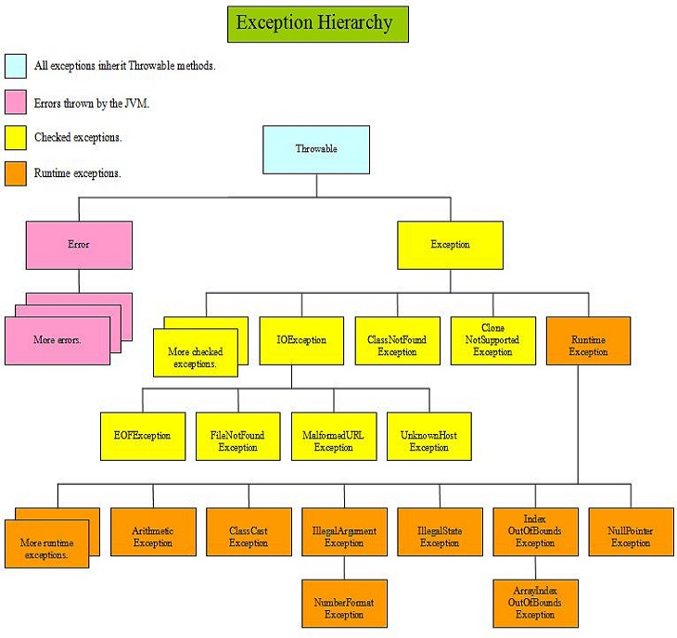
Exception Hierarchy
Notes:
At the top of the exception hierarchy is the Throwable class, which all other error and exception classes inherit from. The Throwable class creates a snapshot of the stack trace for exceptions when they occur and may also contain information about the exception. We can use this information for debugging purposes. Only instances of the Throwable class, or subclasses of it, can be thrown by the JVM or be thrown by us.
Two subclasses inherit from the Throwable class and these are the Error and Exception classes. These classes, and subclasses thereof, are used to create an instance of the appropriate error or exception along with information about the exception:
The Error class and its subclasses handle error situations from within the JVM itself and so are outside our control as programmers. As a general rule we can't recover from an Error situation and because of this we are not expected to handle an Error when it occurs.
The Exception class and its subclasses are what concern us more as programmers and these can be split into two categories:
Runtime exceptions: Are exceptions that are not checked for by the compiler and for this reason are also known as unchecked exceptions. Generally exceptions of type RuntimeException originate from problems in our code, such as an attempt to divide by zero which gives an ArithmeticException . These sorts of errors are within our control and as such should be handled by the code itself.
Checked exceptions: Are exceptions that are checked for by the compiler and if present and not declared, will give a compiler error. An example of this is a FileNotFoundException where a file we want to read may or may not be available. Whether the file is available or not is outside our control. So when we read the file, we need to handle or declare that this exception, or a superclass of it may occur.
53

Slide 54
Java Advance
Basic I/O

Slide 55
Basic I/O
A stream can be thought of as a flow of data from a source or to a sink.
A source stream initiates the flow of data, also called an input stream.
A sink stream terminates the flow of data, also called an output stream.
Sources and sinks are both node streams.
Types of node streams:
Byte streams
Character streams
Buffered streams
Data streams
Object streams

Slide 56
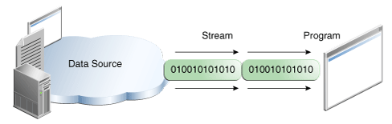
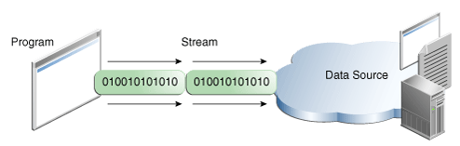
Basic I/O
A stream is a sequence of data
A program uses an input stream to read data from a source, one item at a time
A program uses an output stream to write data to a destination, one item at time

Slide 57
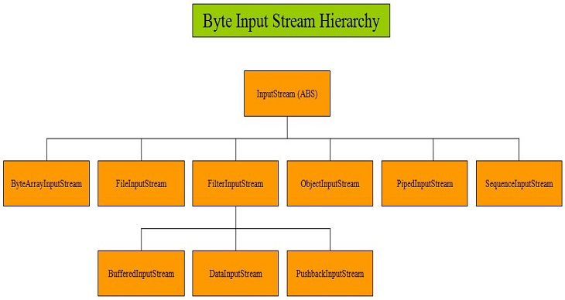
Basic I/O
Notes:
Class Description
InputStream Abstract byte stream superclass which describes this type of input stream.
ByteArrayInputStream Input byte stream that reads bytes from an internal byte array.
FileInputStream Input byte stream that reads bytes from a file in a file system.
FilterInputStream Input byte stream that implements InputStream.
BufferedInputStream Input byte stream that reads bytes into an internal buffer before use.
DataInputStream Input stream to reads Java primitive data types.
PushbackInputStream Input byte stream containing functionality to return bytes to the input stream.
ObjectInputStream Input stream to read and deserialize objects output and serialized using ObjectOutputStream.
PipedInputStream Piped input stream that is connected to a piped output stream to create a communication pipe.
SequenceInputStream Concatenation of two or more input streams read sequentially.
57

Slide 58
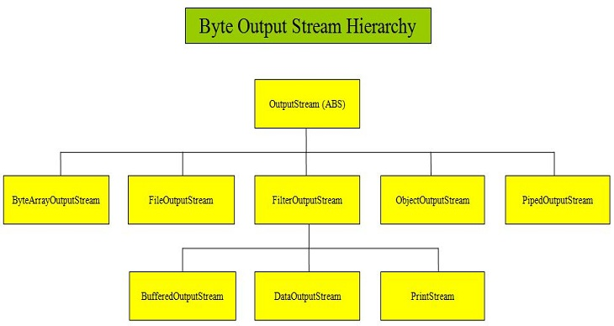
Basic I/O
Notes:
Class Description
OutputStream Abstract byte stream superclass which describes this type of output stream.
ByteArrayOutputStream Output byte stream that writes data to a byte array.
FileOutputStream Output byte stream that writes bytes to a file in a file system.
FilterOutputStream Output byte stream that implements OutputStream.
BufferedOutputStream Output byte stream that writes bytes to a buffered output stream.
DataOutputStream Output stream to write Java primitive data types.
PrintStream Convenience output byte stream to add functionality to another stream, an example being to print to the console using print() and println().
ObjectOutputStream Output stream to write and serialize objects for reading using ObjectInputStream.
PipedOutputStream Piped Output stream that is connected to a piped input stream to create a communication pipe.
58

Slide 59
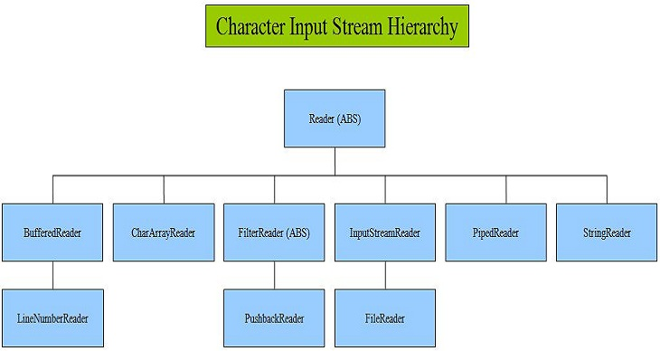
Basic I/O
Notes:
Class Description
Reader Abstract character stream superclass which describes this type of input stream.
BufferedReader Buffered input character stream.
LineNumberReader Input character stream that keeps a count of line numbers.
CharArrayReader Character buffer input stream.
FilterReader Abstract character stream for reading filtered streams.
PushbackReader Character stream reader containing functionality to return characters to the input stream.
InputStreamReader Input Stream that acts as a bridge for decoding byte streams into character streams.
FileReader Input stream for reading characters from a file.
PipedReader Piped character input stream.
StringReader Input stream for reading characters from a string.
59

Slide 60
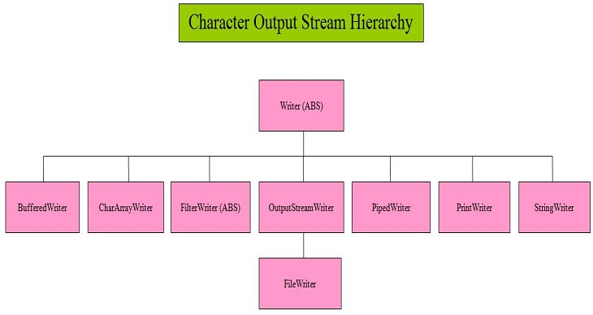
Basic I/O
Notes:
Class Description
Writer Abstract character stream superclass which describes this type of output stream.
BufferedWriter Buffered output character stream.
CharArrayWriter Character buffer output stream.
FilterWriter Abstract character stream for writing filtered streams.
OuputStreamWriter Output Stream that acts as a bridge for encoding byte streams from character streams.
FileWriter Output stream for writing characters to a file.
PipedWriter Piped character output stream.
PrintWriter Convenience output character stream to add functionality to another stream, an example being to print to the console using print() and println().
StringWriter Output stream for writing characters to a string.
60

Slide 61
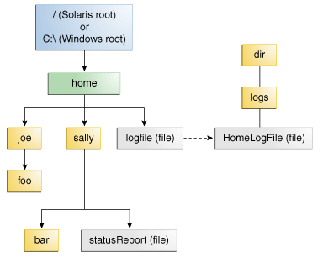
File I/O
Path.
Symbolic links (symlink or a soft link): symbolic links are transparent to applications, and operations on symbolic links are automatically redirected to the target of the link. Exceptions are when a symbolic link is deleted, or renamed in which case the link itself is deleted, or renamed and not the target of the link.
Package: java.nio.file

Slide 62

File I/O
Path class is a programmatic representation of a path in the file system and is used to examine, locate, and manipulate files.
Files: This class consists exclusively of static methods that operate on files, directories, or other types of files.
newBufferedWriter(Path path, Charset cs, OpenOption... options)
newBufferedReader(Path path, Charset cs)
delete(Path path)
copy(Path source, Path target, CopyOption... options)
createDirectory(Path dir, FileAttribute<?>... attrs)
createFile(Path path, FileAttribute<?>... attrs)
isWritable(Path path)
walkFileTree(Path, FileVisitor)
…

Slide 63
Demo 3: Basic I/O
Exercise: Save customer with orders to file
Points to remember:
Use classes provided in I/O package to read and write from/to a file
Handle exception

Slide 64
Java Advance
Serialization

Slide 65
Serialization
Interface Serializable:
A marker interface, when implementing it, it enables classes to serialize/deserialize their state
Use ObjectOutputStream/ObjectInputStream to write/read an object to/from a stream (or file)

Slide 66
Demo 4: Serialization
Exercise:
Serialize customer with orders to a file
Deserialize customer from the file, print out to console and compare
Points to remember:
Usage of Serializable interface and Object Input/Output Stream

Slide 67
Java Advance
Multithreading

Slide 68
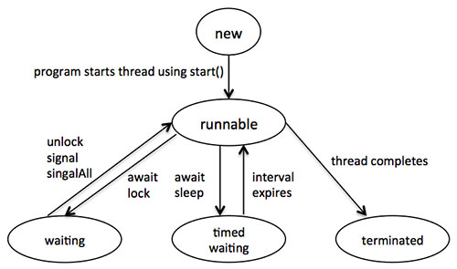
Multithreading – Thread definition
A thread is a thread of execution in a program. The Java Virtual Machine allows an application to have multiple threads of execution running concurrently.
States:
Notes:
New: A new thread begins its life cycle in the new state. It remains in this state until the program starts the thread. It is also referred to as a born thread.
Runnable: After a newly born thread is started, the thread becomes runnable. A thread in this state is considered to be executing its task.
Waiting: Sometimes, a thread transitions to the waiting state while the thread waits for another thread to perform a task.A thread transitions back to the runnable state only when another thread signals the waiting thread to continue executing.
Timed waiting: A runnable thread can enter the timed waiting state for a specified interval of time. A thread in this state transitions back to the runnable state when that time interval expires or when the event it is waiting for occurs.
Terminated: A runnable thread enters the terminated state when it completes its task or otherwise terminates
68

Slide 69
Multithreading – Concurrency
Concurrent software is a software that can do more than one thing at a time.
java.util.concurrent.
Processes:
A process generally has a complete, private set of basic run-time resources; in particular, each process has its own memory space.
To facilitate communication between processes, most operating systems support Inter Process Communication (IPC) resources, such as pipes and sockets. IPC is used not just for communication between processes on the same system, but processes on different systems.
Threads:
lightweight processes
Threads exist within a process — every process has at least one. Threads share the process's resources, including memory and open files
Notes:
Computer users take it for granted that their systems can do more than one thing at a time. They assume that they can continue to work in a word processor, while other applications download files, manage the print queue, and stream audio. Even a single application is often expected to do more than one thing at a time. For example, that streaming audio application must simultaneously read the digital audio off the network, decompress it, manage playback, and update its display. Even the word processor should always be ready to respond to keyboard and mouse events, no matter how busy it is reformatting text or updating the display. Software that can do such things is known as concurrent software.

Slide 70
Multithreading– Concurrency, Threads
Two ways to create a thread:
Implement Runnable
Extend Thread
public class HelloRunnable implements Runnable {
public void run() {
System.out.println("Hello from a thread!");
}
public static void main(String args[]) {
(new Thread(new HelloRunnable())).start();
}
}
Notes:
Computer users take it for granted that their systems can do more than one thing at a time. They assume that they can continue to work in a word processor, while other applications download files, manage the print queue, and stream audio. Even a single application is often expected to do more than one thing at a time. For example, that streaming audio application must simultaneously read the digital audio off the network, decompress it, manage playback, and update its display. Even the word processor should always be ready to respond to keyboard and mouse events, no matter how busy it is reformatting text or updating the display. Software that can do such things is known as concurrent software.

Slide 71
Multithreading – Concurrency, Threads
wait: Causes the current thread to wait until another thread invokes the notify() method or the notifyAll() method for this object
notify, notifyAll: Wakes up a single thread that is waiting on this object's monitor.
sleep: Causes the currently executing thread to sleep (temporarily cease execution) for the specified number of milliseconds, subject to the precision and accuracy of system timers and schedulers.
interrupt: interrupts this thread.
join: waits for this thread to die.

Slide 72
Multithreading– Concurrency, Synchronization
Threads communicate primarily by sharing access to fields and the objects reference fields refer to. This form of communication is extremely efficient, but makes two kinds of errors possible:
Thread interference
Memory consistency errors
However, synchronization can introduce thread contention, which occurs when two or more threads try to access the same resource simultaneously and cause the Java runtime to execute one or more threads more slowly, or even suspend their execution. Two forms of thread contention:
Starvation
livelock

Slide 73
Multithreading– Concurrency, Synchronization
Synchronized methods effects:
First, it is not possible for two invocations of synchronized methods on the same object to interleave. When one thread is executing a synchronized method for an object, all other threads that invoke synchronized methods for the same object block (suspend execution) until the first thread is done with the object.
Second, when a synchronized method exits, it automatically establishes a happens-before relationship with any subsequent invocation of a synchronized method for the same object. This guarantees that changes to the state of the object are visible to all threads.
Synchronized statements
Atomic Variables: AtomicInteger, AtomicLong
Concurrent Collections: ConcurrentMap, BlockingQueue
Notes:
In programming, an atomic action is one that effectively happens all at once. An atomic action cannot stop in the middle: it either happens completely, or it doesn't happen at all. No side effects of an atomic action are visible until the action is complete.
BlockingQueue methods come in four forms, with different ways of handling operations that cannot be satisfied immediately, but may be satisfied at some point in the future: one throws an exception, the second returns a special value (either null or false, depending on the operation), the third blocks the current thread indefinitely until the operation can succeed, and the fourth blocks for only a given maximum time limit before giving up. These methods are summarized in the following table

Slide 74
Multithreading– Concurrency, Liveness
A concurrent application's ability to execute in a timely manner is known as its liveness
Deadlock describes a situation where two or more threads are blocked forever, waiting for each other
Starvation describes a situation where a thread is unable to gain regular access to shared resources and is unable to make progress
As with deadlock, livelocked threads are unable to make further progress. However, the threads are not blocked — they are simply too busy responding to each other to resume work
Notes:
Starvation
Starvation describes a situation where a thread is unable to gain regular access to shared resources and is unable to make progress. This happens when shared resources are made unavailable for long periods by "greedy" threads. For example, suppose an object provides a synchronized method that often takes a long time to return. If one thread invokes this method frequently, other threads that also need frequent synchronized access to the same object will often be blocked.
Livelock
A thread often acts in response to the action of another thread. If the other thread's action is also a response to the action of another thread, then livelock may result. As with deadlock, livelocked threads are unable to make further progress. However, the threads are not blocked — they are simply too busy responding to each other to resume work. This is comparable to two people attempting to pass each other in a corridor: Alphonse moves to his left to let Gaston pass, while Gaston moves to his right to let Alphonse pass. Seeing that they are still blocking each other, Alphone moves to his right, while Gaston moves to his left. They're still blocking each other, so...

Slide 75
Demo 5: Thread
Exercise:
Create two threads accessing and modifying one customer.
Each thread prints the order to console.
Investigate the result
Points to remember:
Create thread
Experience multithreading issues.

Slide 76
Java Advance
Properties Lib

Slide 77
System Properties
System properties are a feature that replaces the concept of environment variables (which are platform-specific).
The System.getProperties method returns a Properties object.
The getProperty method returns a String representing the value of the named property.
Use the -D option to include a new property.

Slide 78
The Properties Class
The Properties class implements a mapping of names to values (a String to String map).
The propertyNames method returns an Enumeration of all property names.
The getProperty method returns a String representing the value of the named property.
You can also read and write a properties collection into a file using load and store.

Slide 79
The Properties Class - Example
Notes:
import java.util.Properties;
import java.util.Enumeration;
public class TestProperties {
public static void main(String[] args) {
Properties props = System.getProperties();
Enumeration propNames = props.propertyNames();
while ( propNames.hasMoreElements() ) {
String propName = (String)propNames.nextElement();
String property = props.getProperty(propName);
System.out.println("property ’" + propName + "’ is ’" + property + "’");
}
}
}

Slide 80
Java Advance
Sockets

Slide 81
Sockets
A socket is one end-point of a two-way communication link between two programs running on the network. Socket classes are used to represent the connection between a client program and a server program
The java.net package provides Socket that implements the client side of the connection
The java.net package provides ServerSocket that implement the server side of the connection

Slide 82
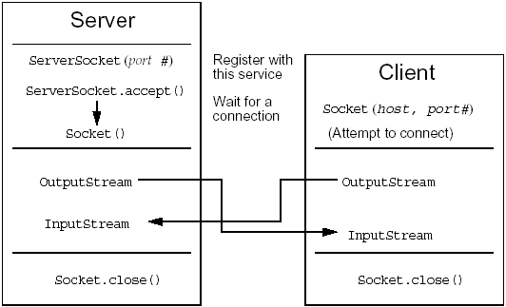
Sockets

Slide 83
Sockets
Open a socket.
Open an input stream and output stream to the socket.
Read from and write to the stream according to the server's protocol.
Close the streams.
Close the socket.

Slide 84
Demo 6: Socket
Exercise:
Create socket client and server.
Server hold an Order object.
When a client connecting, server sends client that order
Client shows order to console
Points to remember:
Create socket
Communication between to sockets.

Slide 85

Final Project
This is a client – server application
Client asks for a customer with a name
If server doesn’t have a customer with that name, it creates new one, otherwise it returns the existing one.
Client can:
add order(s) to customer
print orders to console
send customer back to server to save
Server saves (serializes) customer to file
One customer has a list of orders, sorting by date (desc)
Depending on customer type (VIP, MEMBER, OTHERS) customer receives different discount percentage

Slide 86
Questions & Answer

Slide 87
Thank You!

Slide 88
Revision History
Date | Version | Description | Updated by | Reviewed and Approved By
Jun 06 2017 | Draft | Reconduct Java Core course | Hoan Duong
Aug 1 2017 | 2.0 | Rebrand using DXC Template |  | Quang Tran

