Slide 1
Web Browse
Python
Batch
Lo gin
Input
Dashboard 1
Dashboard 2
….
Full raw data
Function EP2:
Separate data to raman and operation (check SA if SA can do…ignor this step)
Clean data, transform data, recalculate,…
Model ANN
Data :
Raman
Operation
Read every 1 or …5s for one line of Phama dataset
For train model part, data includes targets/ for predict, don’t have targets
Databrick
Function EP1:
Separate data to raman and operation (check SA if SA can do…ignor this step)
Clean raman (remove columns), remove noise with savgol_filter.
Model _pls_cv for raman (don’t need CV)
Batch
Silve database
Gold database
Blob
SQL DB
Time & ranman & predicted resuls (???)
Time & operation & predicted resuls
Streaming
Wave length (reduce 5 times) & predicted resuls
Dashboard 1
Full raw data
Streaming
EP1
Function EP2:
Separate data to raman and operation (check SA if SA can do…ignor this step)
Clean data, transform data, recalculate,…
Model ANN (train full wave length of interval)
Output -> reduce full wave length (for SQLDB) + results
EP2
Ramman
Operation
Eventhub
Azure ML
Stream Analytics
Function EP1:
Separate data to raman and operation (check SA if SA can do…ignor this step)
Clean raman (remove columns), remove noise with savgol_filter.
Model _pls_cv for raman (don’t need CV)

Slide 2
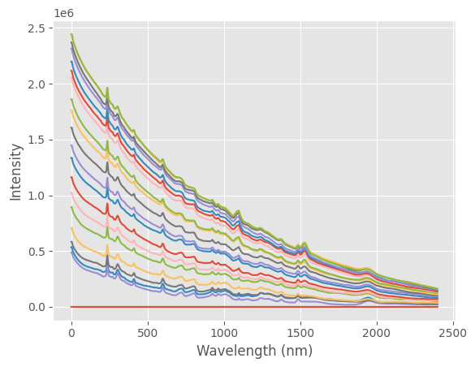
Cust
Project ID
Test
Dashboard 2
Power BI
Operation
As-Is (the same previous verions)
Batch
Ranman
Ranman spectra
Cust
Project ID
Test
time
Wl1
Wl2
Wln
Time
Time 1
Time n
SQL DB
Option 1
Cust
Project ID
Test
Time 1
Cust
Project ID
Test
time
Wl-id
Wl-value
Time 2
xxx
Wl1
(100)
xxx
Time n
xxx
Wl2
105
xxxx
Wl2
110
xxx
Wln
XXX
Ranman
Option 2
Ranman – result (time – predicted result: similar operation)
Cust
Project ID
Test
Time
Time 1
Time n
Cust
Project ID
Test
time
Wl1
Wl2 …
Wln

