Slide 1
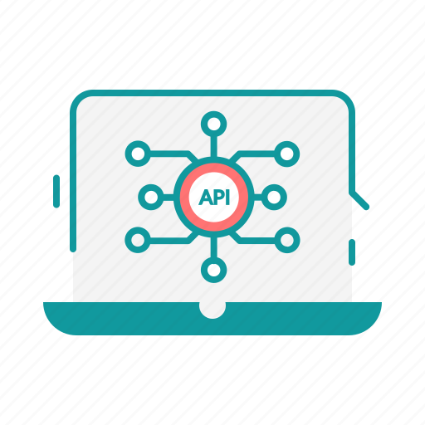




Operation
Raman

Slide 2
Todo List
Operation:
Create API
Write PySpark
Create Postgre
Create Grafana
Raman:
Create API
Write PySpark
Create Postgre
Create Grafana

Slide 3
24/1 | 25/1 | 26/1 | 27/1 | 28/1 | 29/1 | 30/1
- Create API Operation | - Create API Operation | - Write Job PySpark | - Write Job PySpark
31/1 | 1/2 | 2/2 | 3/2 | 4/2 | 5/2 | 6/2
- Write Job PySpark | - Write Job PySpark | - Write Job PySpark | - Write Job PySpark | - Write Job PySpark | - Write Job PySpark | - Write Job PySpark
8/2 | 9/2 | 10/2 | 11/2 | 12/2 | 13/2 | 14/2
- Write Job PySpark | - Write Job PySpark

