Slide 1



Defensive Driving
Part I

Slide 2
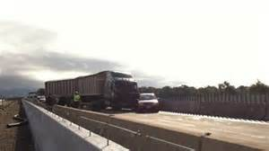
Defensive Driving Leads To Crash Prevention

Slide 3
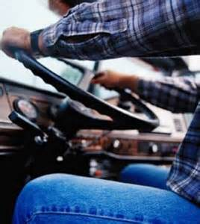
What is Defensive Driving?
As defined in the National Safety Council’s Defensive Driving Course ‘Defensive Driving’ is: “Driving to save lives, time and money, in spite of the conditions around you and the actions of others.”
As professional drivers you must be prepared to compensate for changing road conditions, weather and other drivers’ bad driving decisions.

Slide 4
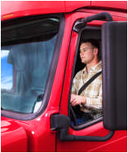
Defensive Driving Techniques
#1 Seat Belt
Number one on the list of defensive driver techniques is the use of your own seat belt
A high percentage of truck driver fatalities involve a driver being ejected from the vehicle
In order to drive defensively, you must remain behind the wheel of your vehicle to better control any type of driving situation

Slide 5
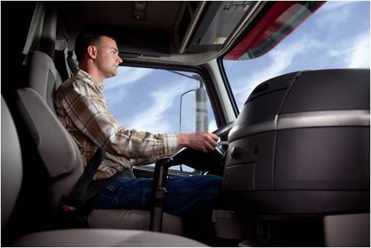
Center for Disease Control (CDC)
Recent Report
Morbidity and Mortality Weekly Report Findings March 3, 2015
In a recent report released by the CDC, the following findings were outlined:
  Non-use of seat belts by long-haul-truck-drivers (LHTDs), continues to be the leading cause of occupational fatalities in the United States
  It accounts for 25% of all occupational fatalities
  It adversely affects the United States economy

Slide 6
CDC Report Findings
Seat Belt Usage
Morbidity and Mortality Weekly Report Findings
Everyone acknowledges that seat belts save lives
However, statistics gathered from the reported accidents indicated that one out of every three truck drivers who died in a crash were not wearing their seat belts
For many of these drivers, simply buckling up would have saved their lives
There were over 317,000 motor vehicle crashes involving large trucks in 2012
Cost estimates for these truck and bus crashes will have affected our economy here in the U. S. by nearly $99 billion dollars

Slide 7
CDC Report Findings
As part of the preliminary findings used in the CDC report, a Long-haul-truck-driver survey was completed involving 1,265 drivers
The survey consisted of an interview study wherein drivers spoke directly to the interviewer
Results of the interview study:
  Roughly 86% of the drivers reported using a seat belt
  A little over 7% of the drivers used their seat belts sometimes
  While 6% of the drivers stated they never used their seat belts

Slide 8
CDC Report Findings
Driver’s who reported never using their seat belts also stated that they:
  Worked for a company that had no written safety program
  Often drove more than 10 mph over the posted speed limit
  Had received two or more citations for moving violations in the previous 12 month period
  Lived in a state which had no primary seat belt law

Slide 9
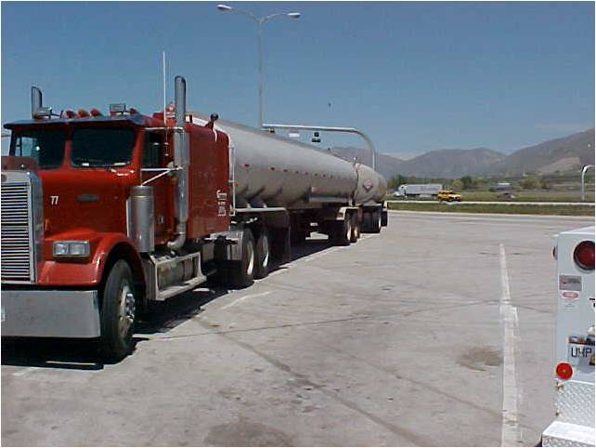
Defensive Driving Techniques –
#2 Safety Culture & Practices
Statistics indicate that truck drivers operate in a relatively safe manner
As truck drivers you need to be aware of the capabilities of the vehicle we are driving
A larger vehicle requires:
  A greater turning radius
  A greater distance to stop
  More space within its lane of travel

Slide 10
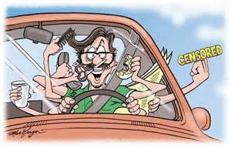
#2 Safety Culture & Practices
Most passenger vehicle drivers spend a short period of their day behind the wheel of a motor vehicle and are considered recreational drivers
Professional drivers spend most of their day on the road
As professional drivers, you need to be aware of changing weather conditions, traffic congestion, and must remain diligent while driving

Slide 11
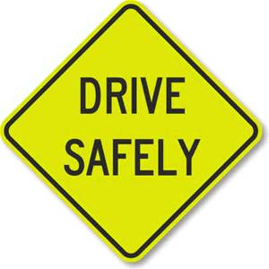
#2 Safety Culture & Practices
There is no room in the trucking industry for drivers who do not respect laws, safe driving practices or the ability to respect other drivers
Drivers must be satisfied that the commercial motor vehicle they are driving is in a safe condition

Slide 12
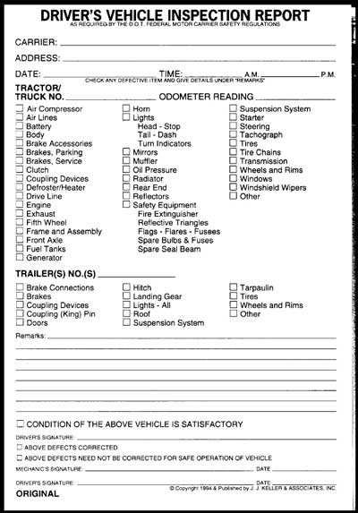
#2 Safety Culture & Practices
A complete and thorough Pre and Post-Trip inspection are a must
A driver must review the vehicle’s previous post-trip inspection
Sign the previous report to acknowledge that any repairs indicated have taken place as required

Slide 13
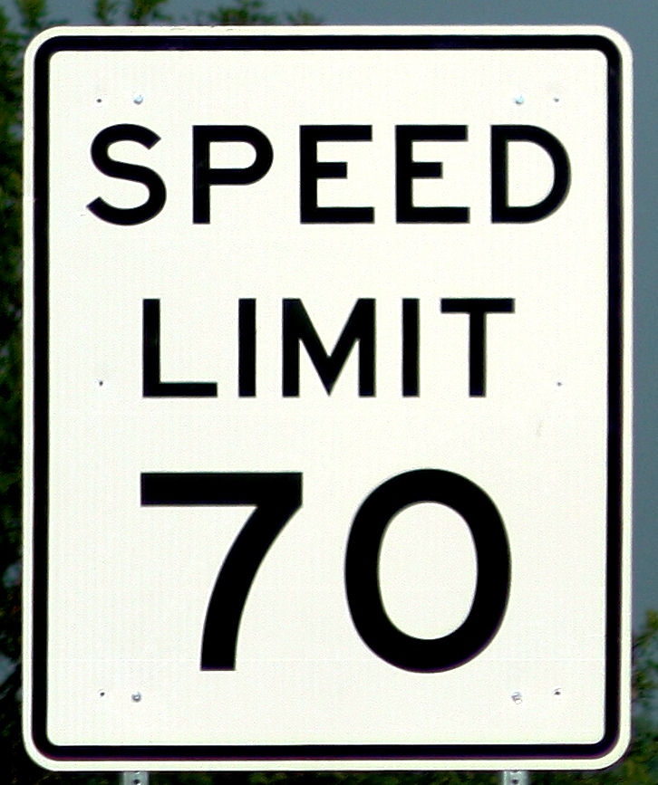
Defensive Driving Techniques
#3 Speeding
Speeding continues to be a factor in Crash Involvement
In inclement weather or any adverse driving situation slow down
Speed on wet roads should be reduced by 1/3 of the posted speed limit

Slide 14
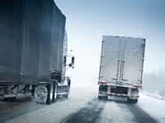
#3 Speeding
Remember, as it first begins to rain, that water mixes with the oil on the roadway and decreases your vehicles traction and stopping capability
Reduce your speed by 1/2 or more on snow packed roads
When you encounter icy and slick roads drive with caution, reduce your speed even more and pull off the road in a safe location when it is no longer safe to drive

Slide 15

Defensive Driving Techniques
#4 Fatigue
Even the best drivers battle fatigue issues
Signs of fatigue include:
  Constant yawning
  Seeing objects on the roadway that aren’t there
  Involuntary closing of eyes
  Not remembering how you arrived at your current location
  Blurred vision

Slide 16



Defensive Driving Techniques
#4 Fatigue
Fatigue prevention
Short term solutions:
  Coffee
  Energy drinks
Long term solutions:
  As a driver you must obtain quality sleep
  Take a short break
  A short break provides a great opportunity to walk around your vehicle to ensure it’s continued safe operation

Slide 17
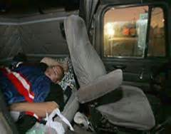
Defensive Driving Techniques
#4 Fatigue
Most important factor is to properly manage fatigue
Pull off the road in a safe location, stop driving and obtain the rest your body needs
There is no substitute for quality sleep

Slide 18
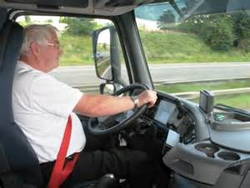
Defensive Driving Techniques
#5 Driving Behaviors
  Two types of Driving Behaviors
  Planned behaviors
    Control speed in one of three ways
      Acceleration
      Deceleration
      Maintain a steady speed rate

Slide 19
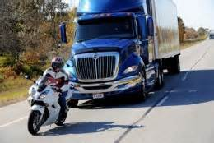
Defensive Driving Techniques
#5 Driving Behaviors
Two types of Driving Behaviors
1. Planned behaviors
  Direction control
  Stop behind solid white line at intersections, don’t block pedestrian lane
  Allow a four-second following distance

Slide 20
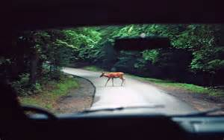
Defensive Driving Techniques
#5 Driving Behaviors
  Two types of Driving Behaviors
  Unplanned behaviors
    Those not recognized prior to actual behavior
    Unplanned responses to changing driving situations
    Animals on roadway
    Unprepared driving responses

Slide 21
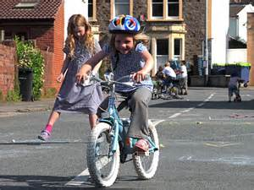
Defensive Driving Techniques
#6 Searching as You Drive
Observe the roadway in front of your vehicle looking for all sources of fixed and potential hazards
Watch for brake lights – they may signal hazards ahead
Search determines what must be seen, where the risk may be and where interactions with traffic will occur

Slide 22
Defensive Driving Techniques
#6 Searching as You Drive
Searching as you drive provides what we need to know so we can respond and not react to the traffic situation (situational awareness)
Situational awareness provides numerous bits of information to process so we know what is going on around us
We must:
  Perceive what the risks are
  Analyze the risk
  Formulate a response
  And we must initiate that response all within a matter of a split second
If you don’t see it, you can’t respond to it

Slide 23
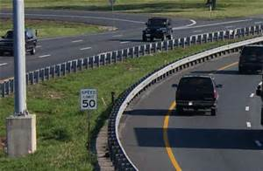
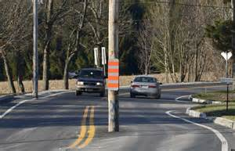
Defensive Driving Techniques
#6 Searching as You Drive
Examples of fixed hazards:
  Utility poles
  Curves in the road
  Guardrails
  Bridge abutments
  Railroad tracks (etc.)

Slide 24
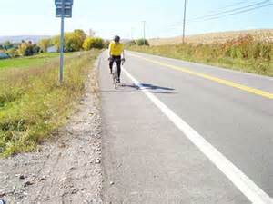
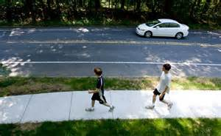
Defensive Driving Techniques
#6 Searching as You Drive
Examples of potential hazards
  Driveways
  Pedestrians
  Cyclists
  Other vehicles
  Parked cars
Be aware of your surroundings and plan your driving behavior appropriately

Slide 25
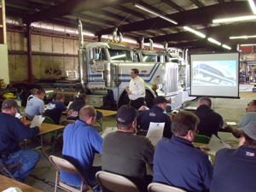



Defensive Driving Techniques
There are many other defensive driving techniques and more will be included in the Defensive Driving Part II presentation
These driver safety presentations have been developed through the Commercial Vehicle Safety Alliance (CVSA) “Operation Safe Driver” Program provided through a grant by FMCSA

Slide 26
Operation Safe Driver
Mission
  Improve commercial and non-commercial driver behavior and performance through effective enforcement, education and awareness strategies.
Message
  Improving highway safety for commercial vehicle operations starts with the driver.
  Highway crashes related to large trucks and buses account for 12 percent of the total highway fatal crashes.
  Focusing more attention on commercial and non-commercial drivers operating in an unsafe manner around commercial vehicles will save lives.

Slide 27

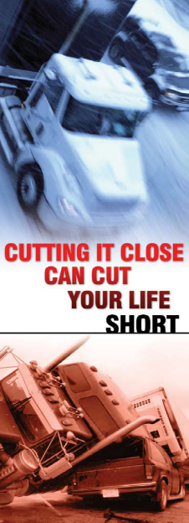
Outreach
Training program(s); which include five
Train-the-Trainer Kits that contain five separate
PowerPoint presentations, between 25 to 35
minutes each on the following
subjects
Defeating Distracted Driving
Beyond Distracted Driving
Following the Rules of the Road
Defensive Driving/Driver Review I
Defensive Driving/Driver Review II

Slide 28
Web Site
    www.operationsafedriver.com
Access to files for downloading Train-the-Trainer Kits (5)
  Defeating Distracted Driving
  Beyond Distracted Driving
  Following the Rules of the Road
  Defensive Driving/Driver Review Part I
  Defensive Driving/Driver Review Part II
  DVDs (2)
  Defeating Distracted Driving
  New Entrant Drivers
    All training materials provided at no cost and available to meet your individual training needs

Slide 29

Thanks for your time!
www.operationsafedriver.com

