Slide 1







TECHNOLOGY TREND ANALYSIS
Nguyen Anh Duc
13/6/2022

Slide 2



OUTLINE
Executive Summary
Introduction
Methodology
Results
Visualization – Charts
Dashboard
Discussion
Findings & Implications
Conclusion
Appendix

Slide 3

EXECUTIVE SUMMARY
JavaScript, Python, HTML/CSS, SQL, and TypeScript are the most desirable programming languages for next year.
PostgreSQL, MongoDB, Redis, MySQL, and ElasticSearch are the most desirable databases for next year.
Gender gap in the IT industry.
Male = 93.5%
Female = 6.5%

Slide 4

INTRODUCTION
What is this report about?
This report is about the trend of technology in this year and next year
The distribution of gender in IT industry
Purpose of this analysis:
Determine what languages, databases, platforms, and web frames are being used most at the moment
Determine which fields that IT companies need at the moment and in the future
Analyze the distribution of the gender in IT industry
Which style of the audience that this presentation aims to reach?
Recruiter from IT companies
Programmers
Student who is going to IT schools

Slide 5

METHODOLOGY
Where to get the data?
Stack overflow developer 2019 survey
GitHub job postings
Programming languages annual salary
Data Wraling
Data Exploration
Data Cleaning
Data Visualization
Presentation

Slide 6
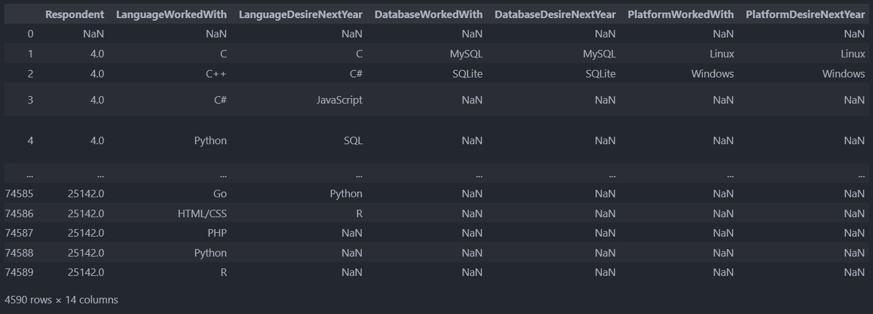
RESULTS

Slide 7
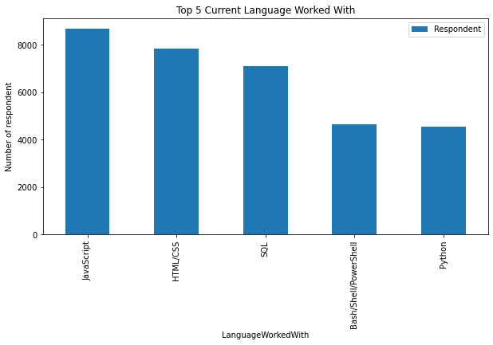
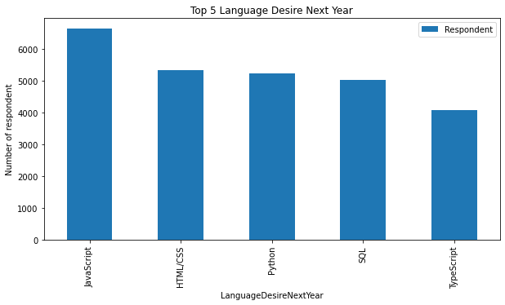
PROGRAMMING LANGUAGE TRENDS
Current Year
Next Year

Slide 8
PROGRAMMING LANGUAGE TRENDS - FINDINGS & IMPLICATIONS
Findings
JavaScript is top trending language in the world
Python and TypeScript are becoming more and more popular
HTML/CSS and SQL still has great portion in language usage trend
Implications
SQL is still important to technology
TypeScript is becoming more and more important
Python is the new trending language, especially popular in AI fields

Slide 9
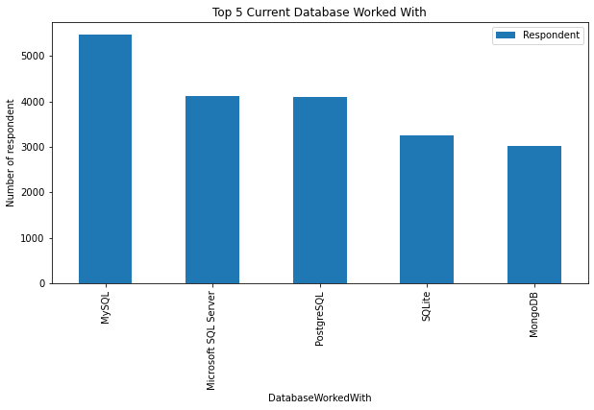
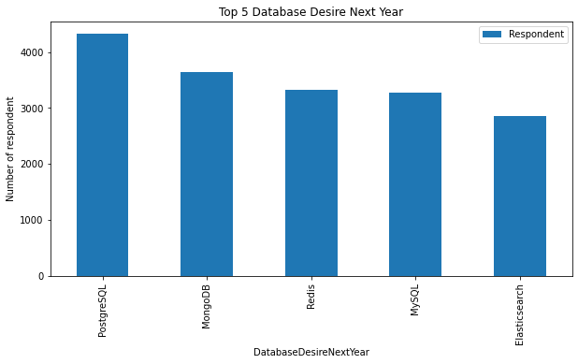
DATABASE TRENDS
Current Year
Next Year

Slide 10
DATABASE TRENDS - FINDINGS & IMPLICATIONS
Findings
MySQL is still the most popular
MongoDB is the most favorable NoSQL database
Redis is becoming more preferable
Implications
More companies are changing their database
NoSQL data is getting more important in data industry
Open-source databases like MySQL are still preferable

Slide 11

DASHBOARD
https://jp-tok.dataplatform.cloud.ibm.com/dashboards/af70da43-8f7e-4418-9ae5-c2278446eec3/view/552add08268d2be16ff3b5e407cd78057564205bbabb875189d17b4907347597f03c47c4c87c4f5fdd100432f4ba4459cc

Slide 12
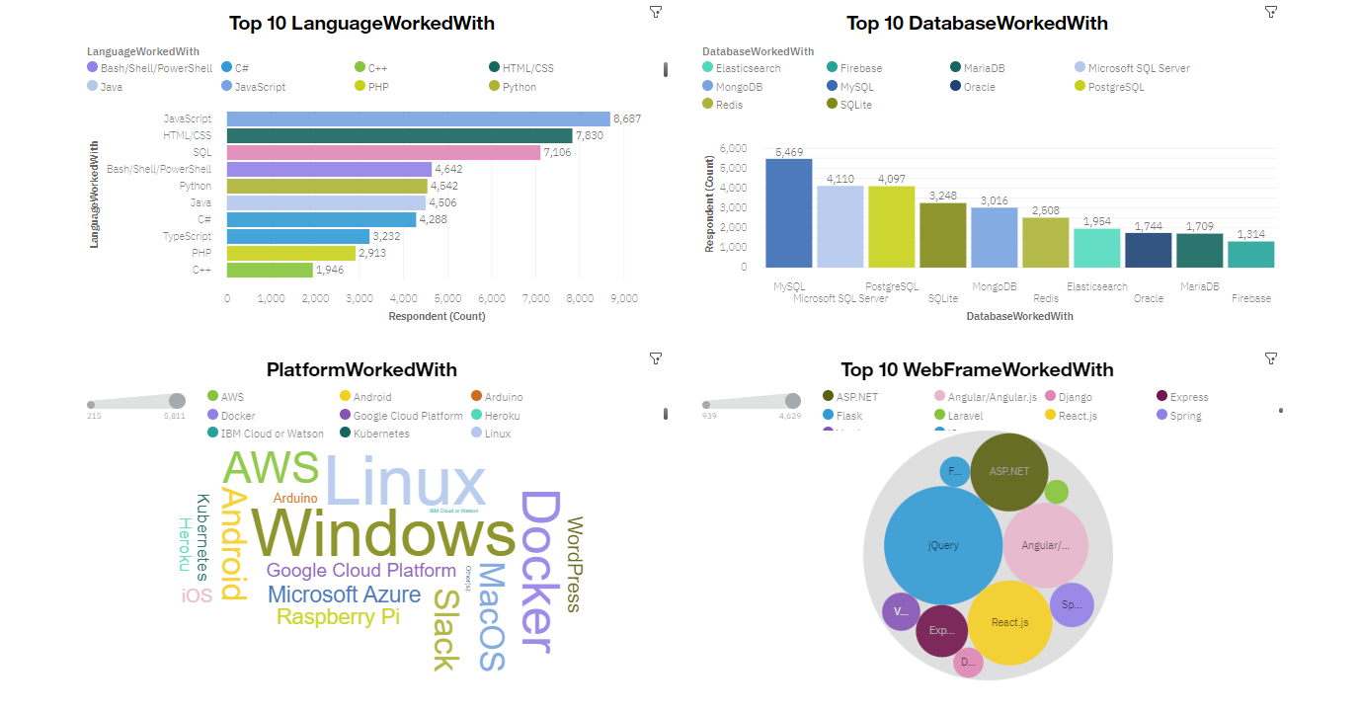
DASHBOARD TAB 1

Slide 13
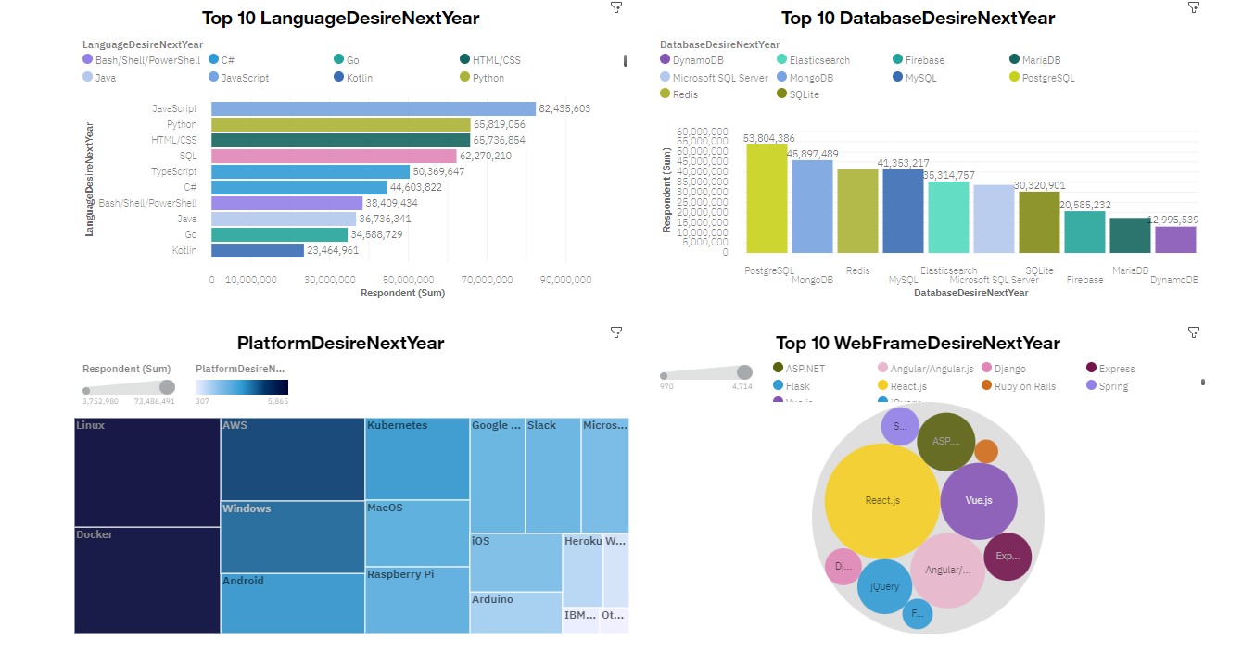
DASHBOARD TAB 2

Slide 14
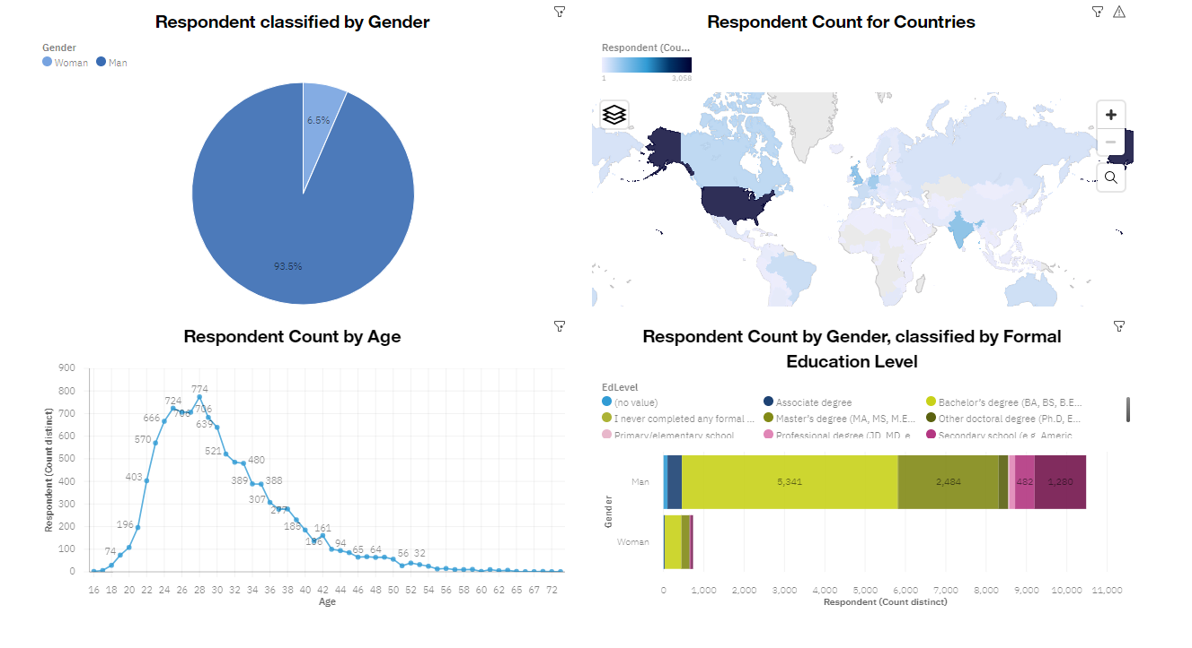
DASHBOARD TAB 3

Slide 15
DISCUSSION
Technology Usage Trend Now and Future
Gender, Age and Education discrimination in IT Industry

Slide 16
OVERALL FINDINGS & IMPLICATIONS
Findings
Technology trend changes every year
There is big difference between numbers of woman IT and man IT
Some language, database, web frame, platform remain its position every year
Implications
Programmers should know what language, platform,… is on trend
Make more advantages for women to approach technology.
Recruiters from IT companies should not pay attention on gender and age

Slide 17

CONCLUSION
New technology constantly emerges leading to changes in demand.
The IT industry needs to diversify in order to eliminate gender gap.
New technology leads to different trends and demands.
JavaScript and Python are the most popular programming languages.
PostgreSQL is the most popular database

Slide 18
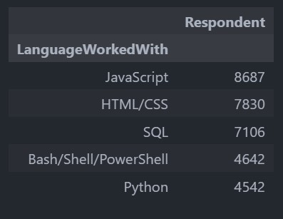
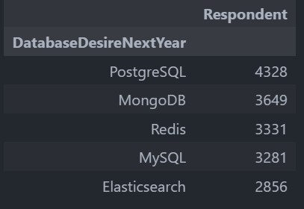

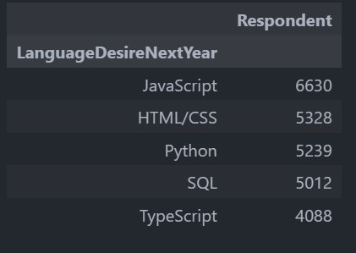
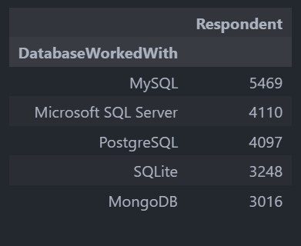
APPENDIX

Slide 19
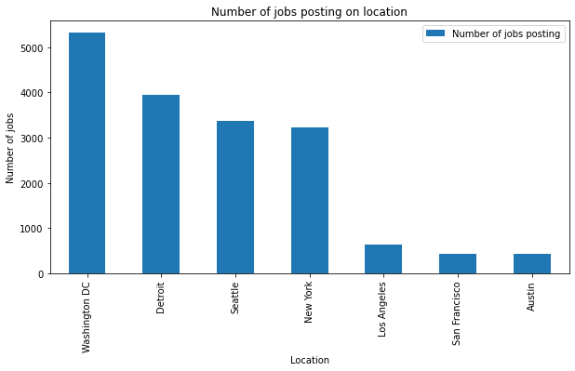
JOB POSTINGS

Slide 20
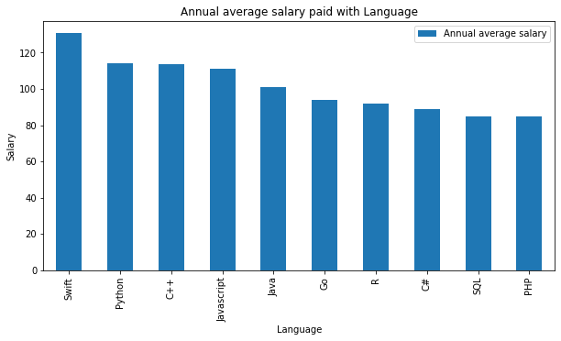
POPULAR LANGUAGES

