Slide 1
Game demo
2048
Data structure and algorithm

Slide 2
Members & Contribution
Nguyễn Anh Dũng: 100%

Slide 3
contents
What this project is about
How to do it
ERD
Schema
Querying Tables
Java program demo

Slide 4
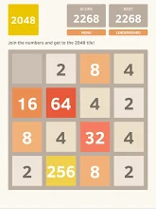
1. Overview
The project is about trying to re-creating a game name “2048” where you move the numbers around and combine them into bigger numbers .
Add extra features of undo and redo

Slide 5
2. Ideas
The design of the game is basically a 2D array (or matrix).
We will try to work around a matrix , adding numbers to it and making them move and stop when they reach the border or a different number.
Each time a move is taken, a number is generated at a blank space.
If a number is moving in a certain direction an encounter another number with similar value, then combine them to make a bigger number.

Slide 6
3. Encountered Problems
By making the numbers move one by one, when they merge into a bigger number, they merge everything at the same time.
When you try to move in certain direction but it’s not movable ,the program still generate a random number.
When you can merge, move, win or lose.

Slide 7
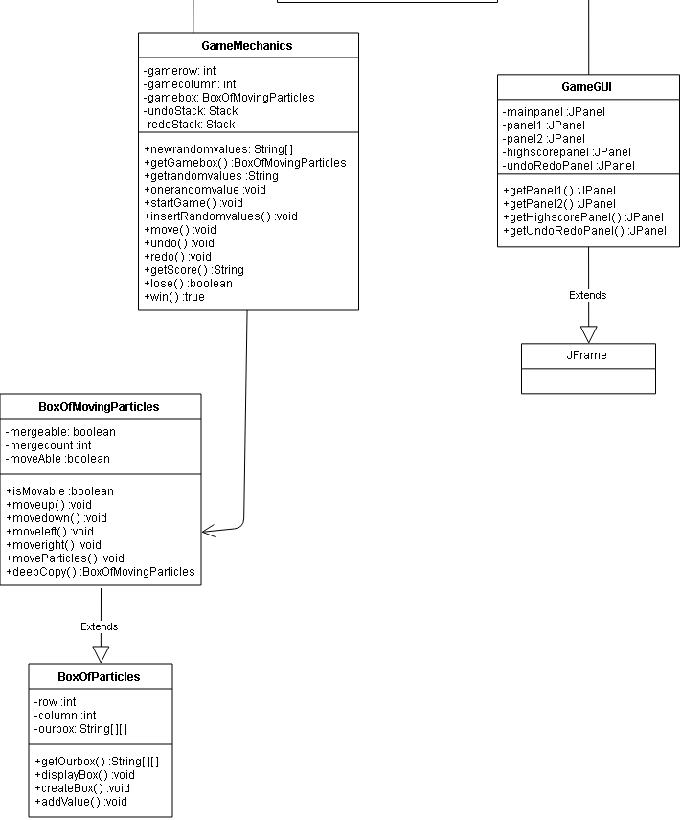
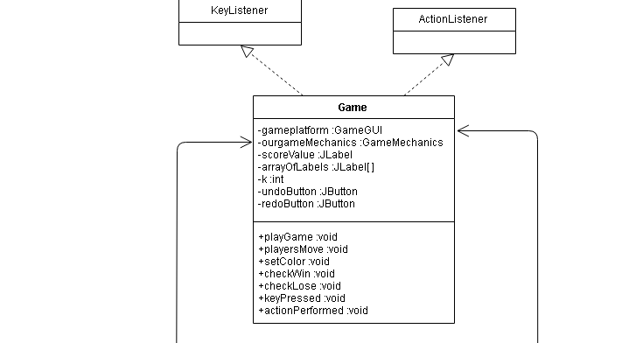
4. Class diagram:

Slide 8

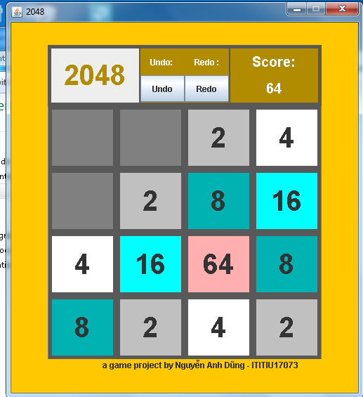
5. Preview:

Slide 9
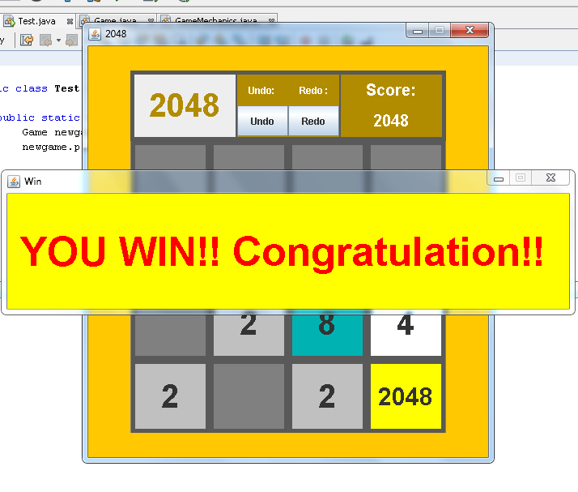
5. Preview:

Slide 10
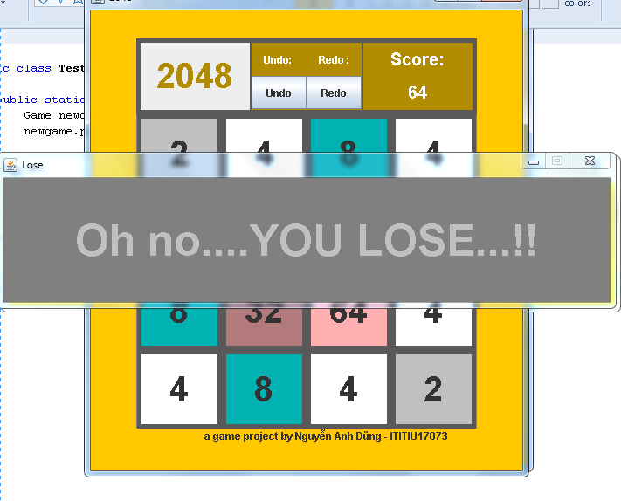
5. Preview:

Slide 11
6. Code:
https://github.com/nguyenanhdung1206/2048-game

Slide 12
7. Demo:

Slide 13
Thank you for listening

