Slide 1
Online Retail Application
Principles of database management

Slide 2
Members & Contribution
Nguyễn Anh Dũng: 60%
Nguyễn Hà Văn: 40%

Slide 3
contents
What this project is about
How to do it
ERD
Schema
Querying Tables
Java program demo

Slide 4
1. What this project is about
A system that Allows :
Customers TO register (with 1 or more bank accounts) to purchase items , each customer will have a unique customerid, userid and password.
customers to purchase one or more item in different quantities AND The items can of different classes based upon their prices.
Based on the quantity, price of the item and discount (if any) on the purchased items, the bill will be generated. A bank account is required to settle the bill.
The items to be ordered to one or more suppliers.

Slide 5
2. How to do it
We will create a database called “retailApp” with Three main entities for our database :
A customer entity with id, login , password, name and bank account ( one or multiple).
A item entity consist of item's id, name ,price ,discount ,actual price which can be computed and a class according to it's price.
A supplier entity with the supplier's id, name a several location

Slide 6
2. How to do it
Along with the 3 entities, some relationships are:
A customer can purchase many items and an item can be purchased by many people.
An item can be ordered from one or many supplier and a supplier can supply many items.

Slide 7
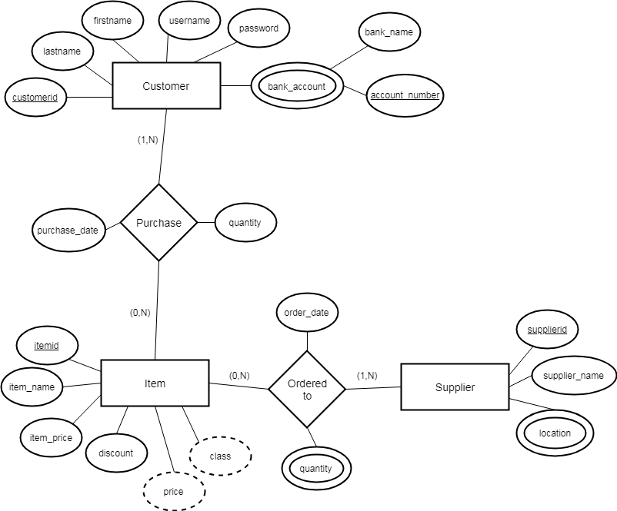
3. ERD

Slide 8

4. Schema
Customer(customerid,firstname,lastname,username,password)
Customer_bank(customerid,account_number,bank_name)
Item(itemid,item_name,item_price,discount,price,class)
Supplier(supplierid,supplier_name)
Supplier_location(supplierid,location)
Purchase(customerid,itemid,quantity,purchase_date)
Ordered_to(itemid,supplierid,quantity,order_date)

Slide 9
5. Querying Tables
Here is the query use to create the tables in the database.

Slide 10
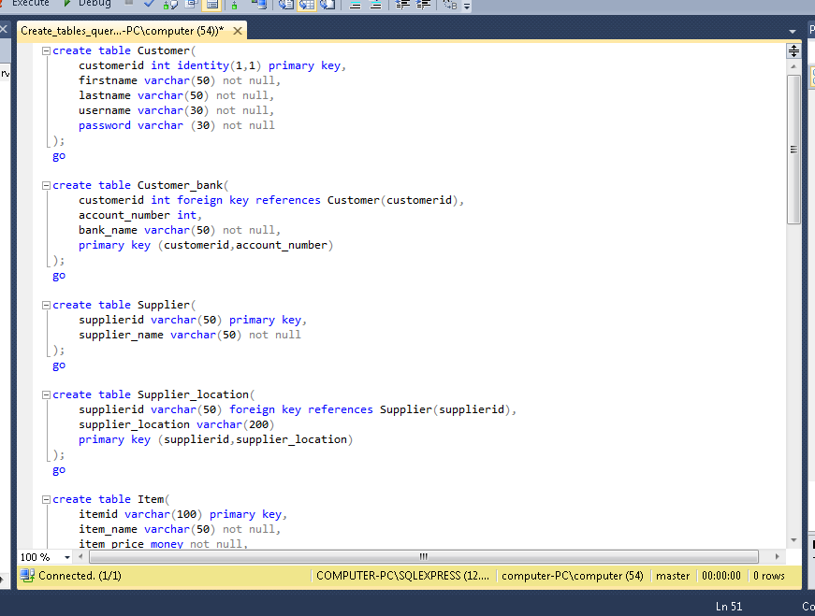

Slide 11
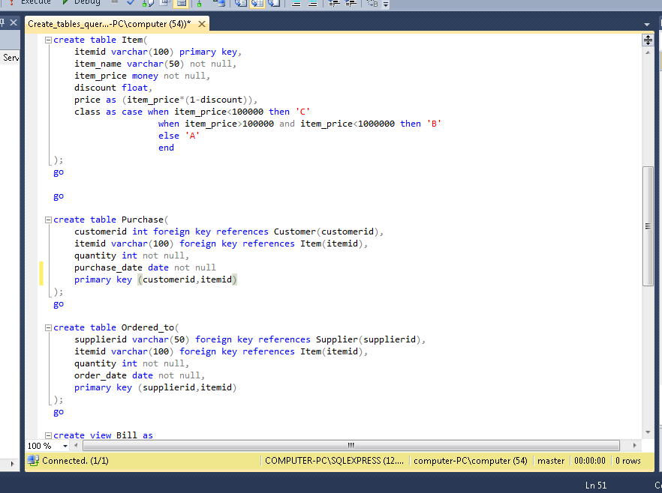

Slide 12
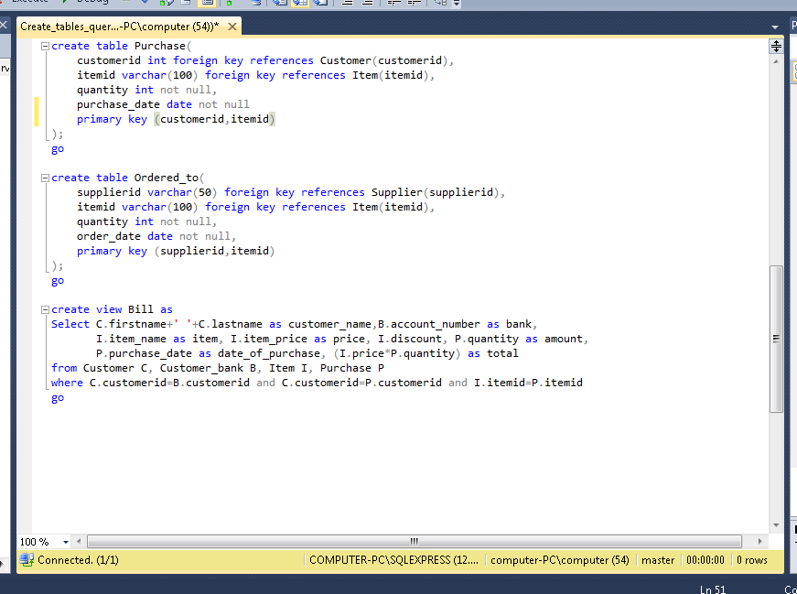

Slide 13
6. Java program demo

Slide 14
Thank you for listening

