Slide 1
Wine Quality
Anh Nguyen

Slide 2
Data set summary
This data set is related to the red variants of the Portuguese “Vintho Verde” wine
Variables:
Fixed acidity – most acids in wine are fixed
Volatile acidity – too high of acetic acid levels can lead to unpleasant, vinegar tatse
Citric acid – add ‘freshness’ and flavor to wine
Residual sugar – amount of sugar remained after fermentation stops
Chlorides – amount of salt in wine
Free sulfur dioxide – prevents microbial growth and oxidation of wine
Total sulfur dioxide – at free SO2 concentration over 50ppm, SO2 becomes evident in the nose and taste of wine
Density – close to density of water depending on the percent alcohol and sugar content
pH – how acidic or basic on a scale from 0 (very acidic) to 14 (very basic)
Sulphates – can contribute to SO2, acts as antimicrobial and antioxidant
Alcohol – percent of alcohol content of the wine
Quality - output variable, score 0-10

Slide 3
Goal
Build a model with good predictors to best predict the wine quality score

Slide 4
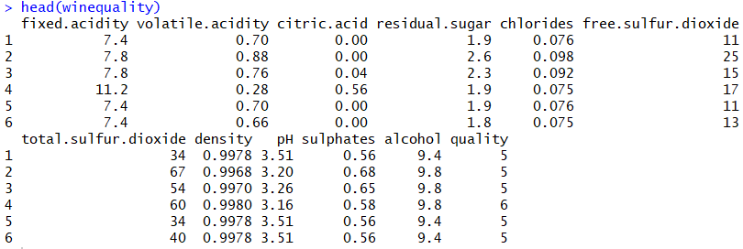
Access the data set
winequality <- read.csv(file.choose())
head(winequality)

Slide 5
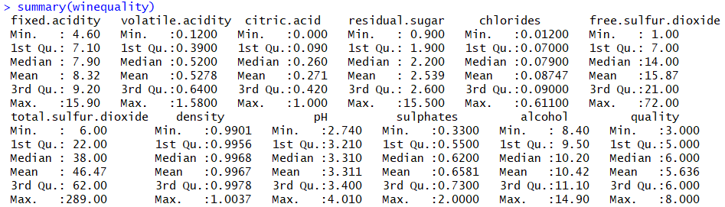
summary(winequality)

Slide 6
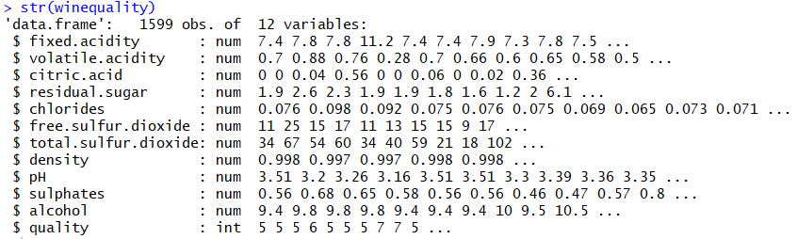
str(winequality)

Slide 7
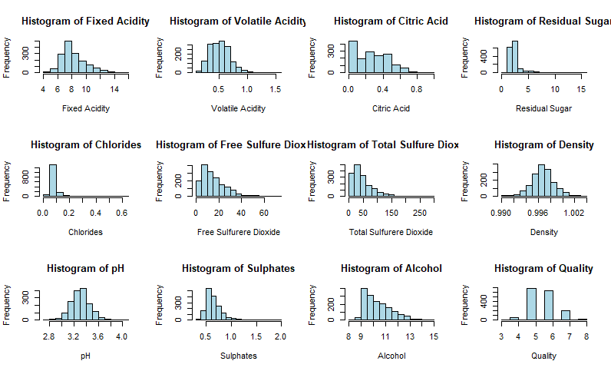
Data visualization

Slide 8
Notes on Histograms
Residual sugar: there is no wine with less than 1 gram/liter. Because wines with greater than 45 grams/liter are considered sweet, and there is no wines with residual sugar >45, these wines are not sweet → residual sugar might not significantly affect quality score
Free sulfur dioxide: there is one column at 50-55, and one at 65-70, which means these wines have free SO2 that contributes to total SO2, which in turn inferes with the taste of wine
Total sulfur dioxide: has similar shape with that of free SO2
Sulphates: has similar shape with that of free SO2; note that it contributes to total SO2 level

Slide 9
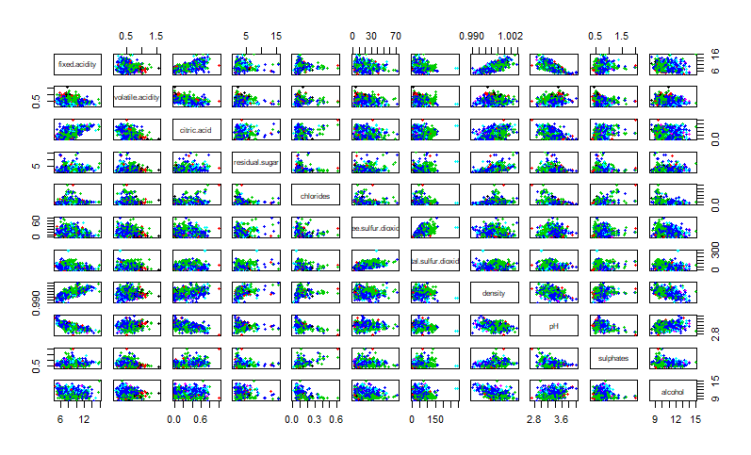
pairs(winequality[,c(1:11)],col=as.factor(winequality[,12]),pch=20)

Slide 10
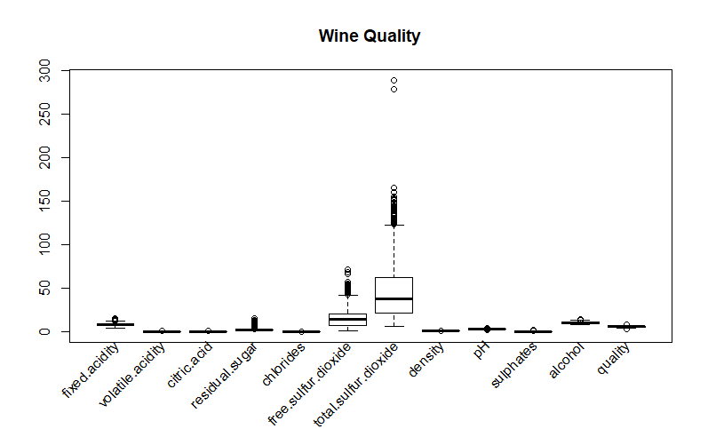
boxplot(winequality, main="Wine Quality", xaxt='n', xlab = '')
text(x = seq_along(colnames(winequality)), y = par("usr")[3] - 1, srt = 45, adj = 1,
labels = colnames(winequality), xpd = TRUE)

Slide 11
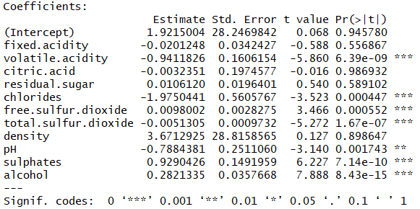
Multiple linear regression
Predict quality using all variables as predictors
lm1 <- lm(quality~., data=train_wq)

Slide 12
Notes on summary(lm1)
variables that are statistically significant(***): volatile acidity, chlorides, free sulfur dioxide, total sulfur dioxide, sulphates, alcohol
predict1 <- predict(lm1, newdata = test_wq)
cor(predict1, test_wq$quality)
correlation is 0.5964699
Let's try to improve the correlation by using with only staisticallt significant variables as predictors

Slide 13
lm2 <- lm(quality ~volatile.acidity + chlorides + free.sulfur.dioxide +
total.sulfur.dioxide + sulphates + alcohol, data=train_wq)
predict2 <- predict(lm2, newdata = test_wq)
cor(predict2, test_wq$quality)
0.6012814
Only a little bit better
We observed that free SO2 and total SO2 might be interdependent, and thus may add extra errors to the model → use only SO2

Slide 14
lm3 <- lm(quality ~volatile.acidity + chlorides +
total.sulfur.dioxide + sulphates + alcohol, data=train_wq)
predict3 <- predict(lm3, newdata = test_wq)
cor(predict3, test_wq$quality)
0.611427
This is better than the one with lm1

Slide 15
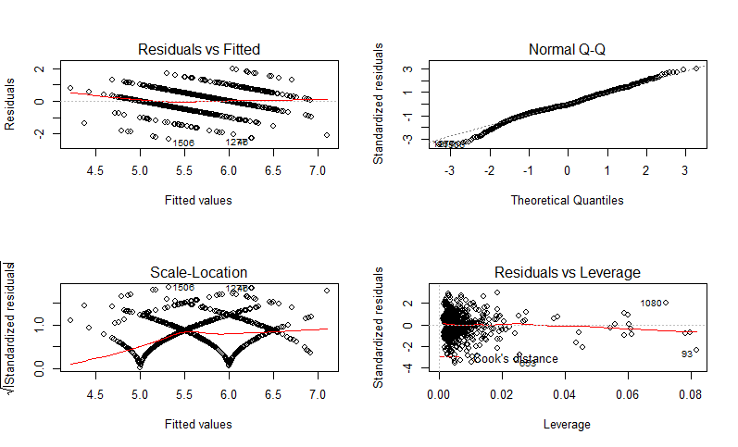
plot(lm3)
Diagnostic plot analysis
Normal Q-Q: residuals are normally distributed
Residuals vs. Leverage: no influential case
Residuals vs Fitted: linear relationship
Scale-Location: line is not horizontal, so residuals is not equally spread → might be a problem

Slide 16
Evaluating model performance
rmse_train
#[1] 0.6682245
rmse_test
#[1] 0.6426347
rsme for test set and training sets are quite similar.
rmse of train > rmse of test → means that we underfitted the data a little bit

Slide 17
y_hat <- lm3$fitted.values #r-squared for training set
y <- train_wq$quality
rsquared(y_hat,y)
#[1] 32.14369
y_hat <- predict(lm3, newdata = test_wq) #r-squared for test set
y <- test_wq$quality
rsquared(y_hat,y)
#[1] 35.70131
training set's R2 is quite similar to test set's R2
However, both R2 are low, which is undesirable

Slide 18
Data set source
https://www.kaggle.com/uciml/red-wine-quality-cortez-et-al-2009

