Slide 1
Networking Overview

Slide 2
Outline
Introduction to Networking
OSI Model
TCP/IP Protocol
LAN
WAN
Exercises

Slide 3
What is networking?
In the world of computers, networking is the practice of linking two or more computing devices together for the purpose of sharing data. Networks are built with a mix of computer hardware and computer software.

Slide 4
What is a network?
A network can consist of two computers connected together on a desk or it can consist of many smaller network connected together to form a bigger network across a continent.
Networks can be categorized in several different ways
  The geographic area it spans (LAN, WAN, …)‏
  The protocol it uses (ATM, VPN, …)‏
Backbone
  The main wire that connects nodes. The term is often used to describe the main network connections
Notes:
A node can be a computer or some other device, such as a printer. Every node has a unique network address, sometimes called a Data Link Control (DLC) address or Media Access Control (MAC) address.
DLC:
MAC: a hardware address that uniquely identifies each node of a network

Slide 5



Communication Process
Packets
Protocols
Source
Address
Medium
Destination
Address

Slide 6
Communication Process (cont.)‏
Addresses
  Who are the source and the destination of a communication process?
  Source Address, Destination Address
Media
  Where is the communication take place?
  Cable, Fiber, Air
Protocols
  How to make the communication process effectively?
  Format, Procedure

Slide 7

Evolution of networking standards
SNA
Standard
Interconnection
Development
Simplification
Proprietary
TCP/IP
DECNET
Notes:
SNA (Systems Network Architecture) is a set of network protocols developed by IBM

Slide 8
OSI Model
Researched and developed by the ISO - International Organization for Standardizations.
1977: establish a subcommittee to develop a communications architecture.
1984: publish ISO-7498, the Open System Interconnection (OSI) reference model.

Slide 9
OSI model (cont.)‏
A framework within which networking standards can be developed.
  It provided vendors with a set of standards that ensured greater compatibility and interoperability between the various types of network technologies that were produced by the many companies around the world.
Notes:
The OSI model provides a conceptual framework for communication between computers, but the model itself is not a method of communication. Actual communication is made possible by using communication protocols

Slide 10
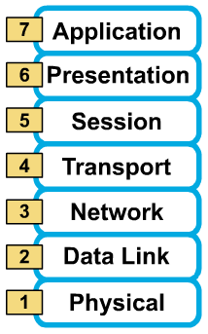


A layered model
The communications functions are partitioned into a hierarchical set of layers
Each layer performs a related subset of the functions required to communicate
Each layer relies on the next lower layer to perform more primitive functions and provides services to the next higher layer
→The OSI Model define a set of layers and the services performed by each layer
Provide services
Request services
Notes:
OSI is a standard set of rules describing the transfer of data between each layer in a network operating system. Each layer has a specific function.
The OSI Model clearly defines the interfaces between each layer. This allows different network operating systems and protocols to work together by having each manufacturer adhere to the standard interfaces. The application of the ISO OSI model has allowed the modern multi­protocol networks that exist today

Slide 11
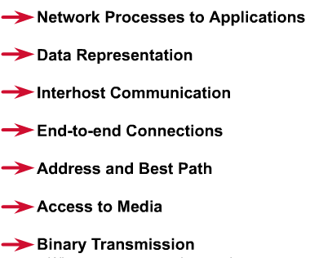
7 layers of the OSI reference model
Layer 7: Application
Layer 6: Presentation
Layer 5: Session
Layer 4: Transport
Layer 3: Network
Layer 2: Data Link
Layer 1: Physical

Slide 12
Why a layered model?
Reduces complexity.
Standardizes interfaces.
Facilitates modular engineering.
Ensures interoperable technology.
Accelerates evolution.
Simplifies teaching and learning.

Slide 13
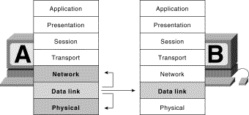
OSI Model and Communication between systems
Notes:
Information being transferred from a software application in one computer system to a software application in another must pass through the OSI layers. For example, if a software application in System A has information to transmit to a software application in System B, the application program in System A will pass its information to the application layer (Layer 7) of System A. The application layer then passes the information to the presentation layer (Layer 6), which relays the data to the session layer (Layer 5), and so on down to the physical layer (Layer 1). At the physical layer, the information is placed on the physical network medium and is sent across the medium to System B. The physical layer of System B removes the information from the physical medium, and then its physical layer passes the information up to the data link layer (Layer 2), which passes it to the network layer (Layer 3), and so on, until it reaches the application layer (Layer 7) of System B. Finally, the application layer of System B passes the information to the recipient application program to complete the communication process.

Slide 14
The physical layer
The physical layer defines the electrical, mechanical, procedural, and functional specifications for activating, maintaining, and deactivating the physical link between communicating network systems
Physical layer specifications define characteristics such as voltage levels, timing of voltage changes, physical data rates, maximum transmission distances, and physical connectors
  Physical connector
    Twisted Pair, Baseband Coaxial Cable, Broadband Coaxial Cable, Fiber Optical, Line-of-Sight Transmission, Communication Satellites.
Notes:
Cable
Higher data rates are possible on shorter cables.
Used for LAN and for long distance transmission within the telephone system
Fiber Optics
Transmit data by pulses of light
Fiber optic links are being installed for long-distance telephone lines in many countries
Line-of-Sight Transmission
Transmit data out into the air
Transmission by lasers, microwave and radio …
Communication Satellites
As a big microwave repeater in the sky
Contains one or more transponders, each of which listens to some portion of the spectrum, amplifies the coming signal, and then rebroadcasts it at another frequency.

Slide 15
The data-link layer
The data link layer provides for the reliable transfer of data cross a physical link.
Data link layer specifications define different network and protocol characteristics, including physical addressing, network topology, error notification, sequencing of frames, and flow control
  Framing
    Breaking the bit steam up into discrete frames, Character count
    Starting and ending characters, with character stuffing (DLE STX, DLE ETX)‏
    Starting and ending flags, with bit stuffing (01111110)‏
  Error control
    Alerts upper-layer that a transmission error has occurred and the sequencing of data frames reorders frames that are transmitted out of sequence
  Flow control
    Moderates the transmission of data so that the receiving device is not overwhelmed with more traffic than it can handle at one time
  Link management
    Manage the connections in case of connectionless services
Notes:
Error control: the physical layer does is accept a raw bit stream and attempt to deliver it to the destination. This bit stream is not guaranteed to be error free. The number of bits received can be less than, equal to, or more than the number of bits transmitted, and they have different values. It is up to the data link layer to detect, and if necessary , correct errors.
Uses acknowledgement s about the incoming frames. If the sender receives a positive acknowledgement about a frame, it knows the frame has arrived safety.
Flow control is necessary when the sender and the receiver are running on the computer, which have different rate.

Slide 16
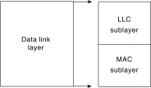
The data-link layer (cont.)‏
Data link layer is subdivided into two sublayers
  Logical Link Control (LLC) - manages communications between devices over a single link of a network
  Media Access Control (MAC) - manages protocol access to the physical network medium
Services Provided to the Network Layer
  Unacknowledged connectionless service
  Acknowledged connectionless service
  Connection-oriented service
Communication between the network layer and the data link layer
  Request primitives
  Indication primitives
  Response primitives
  Confirm primitives
Notes:
The data link layer has a number of specific functions to carry out. These functions include providing a well defined service interface to the network layer, determining how the bits of the physical layer are grouped into frames, dealing with transmission errors, regulating the flow of frames so that slow receivers are not swamped by fast senders. The communication between the network layer and the data link layer uses the standard OSI service primitives:
Request primitives are used by the network layer to ask the data link to do something (for example, establish or release a connection or send a frame) (L-CONNECT. request, L-DISCONNECT.request, L-DATA-CONNECT. Request, L-RESET.request, L-CONNECTION_FLOWCONTROL.request)‏
Indication primitives are used to indicate to the network layer that an event has happened, for example, another machine wishes to establish or release a connection, or a frame has arrived (….indication)‏
Response primitives are used on the receiving side by the network layer to rely to a previous indication (…response)‏
Confirm primitives provide a way for the data link layer on the requesting side to learn whether the request was successfully carried out and if not, why not (…confirm).

Slide 17
The data-link layer (cont.)‏
Two different representations of the service primitives
Request
Request
Confirm
Response
Indication
Indication
Network layer
Response
Data link layer
Confirm
Physical layer
Service provider (data link)‏
Service user (network layer)‏
Service user (network layer)‏
A
B

Slide 18
The network layer
Provides connectivity and path selection between two host systems that may be located on geographically separated networks.
  Virtual circuits used for connection services
    Inflexible, wastes resources
  Datagram services - is used for connectionless services
    Flexible, robust, but can suffer from congestion
  Route, routing table, routing protocol
    Shortest path routing, multipath routing, centralized routing, isolated routing, flooding, broadcast routing
  Logical address - Network Service Access Point Addresses
Communication between Network layer and Transport layer
  N-CONNECT (.request, .indication, .response, .confirm)‏
  N-DISCONNECT (.request, .indication)‏
  N-DATA (.request, .indication)‏
  N-RESET (.request, .indication, .response, .confirm)‏
Notes:
A host is a computer system that is accessed by a user working at a remote location, while the computer at which the user sits is called the remote terminal.
This layer defines the addressing and routing structure of the Internet.
A connection is called a Virtual circuit is called a connection, in analogy with the physical circuits set up by the telephone system. Virtual circuits are generally used un subnets whose primary service is connection-oriented. The idea behind virtual circuits is to avoid having to make routing decisions for every packet sent.
There is a table with one entry for each open virtual circuit. Each packet contains the circuit number.
The independent packets of the connectionless organization are called datagrams. With this system no routes are worked out in advance, even if the services is connection-oriented. Each packet sent is routed independently of its predecessors. Successive packets may follow different routes. While datagram subnets have to do more work, they are also more robust and adapt to failures and congestion more easily than virtual circuit system.
Each datagram must contain the full destination address
Routing table have one entry for each host of network.
When the connection request comes in from above, the access sublayer construct a CALL REQUEST packet containing the NSAP (Network Service Address Point, which specifies machine and access point within that machine to which a transport process can attach itself) addresses and gives it to the data link for transmission.
NSAP addresses do not specify where a network terminal is located. Routing equipment must translate NSAP addresses to NSPAs (Network Service Point Addresses) to route OSI packets; VCI (Virtual Circuit Identifier) numbers are an example of a datalink layer NSPAs in ATM; when OSI packets are sent encapsulated in IP packets the IP address is considered an NSPA.
NSAP addresses are used in the following OSI-based network technologies:
ATM switched virtual circuit networks
X.25
Frame relay
Fragmentation: the transport layer takes messages and breaks them up into datagrams of up to 64K bytes. Each datagram is transmitted through the Internet, possibly being fragmented into smaller units as it goes

Slide 19
The network layer (cont.)‏
Two network layer protocols
  X.25 (Packet Layer Protocol)‏
    Connection-oriented services: Virtual calls, Permanent virtual circuits
    Packet format: Call request format, Control packet format, Data packet format
  IP (Internet protocol)‏
    Connectionless services
    Datagram format (Version, IHL, Type of service, Total length, Identification, DF, MF, Fragment offset, Time to live, Protocol, Header checksum, Source address, Destination address, Options)‏
Notes:
IP is used in conjunction with the transport protocol TCP. With IP, the network layer does not support the reliable connection. However, by putting all the reliability mechanisms into the transport layer, it was possible to have reliable end-to-end connections even when some of underlying networks were not very dependable.
Version field keeps track of which version of the protocol the datagram belongs to (4 bits).
IHL is provided to tell how long the header is, in the 32-bits words. The minimum value is 5. (4 bits)‏
Type of service allows the host to tell the subnet what kind of service it wants (file transfer – accurate transmission is far more important than speedy delivery, digitized voice – fast delivery is far more important than correcting transmission errors). (8 bits)‏
Total length includes everything in the datagram – both header and data. The maximum length is 65,536 bytes. (16 bits)‏
Identification allows the destination host to determine which datagram a newly arrived fragment belongs to. All the fragments of a datagram contain the same identification value. (16 bits)‏
DF (1 bit) Don’t Fragment
MF (1 bit) More Fragment
Fragment offset (13 bits) tells where in the the current datagram this fragment belongs
Time to Live (8 bits) is a counter used to limit packet lifetimes. The maximum lifetime of 255 sec.
Protocol (8 bits) tells which of the various transport processes the datagram belongs to (TCP, UDP).
Header checksum (16 bits) verifies the header only
Source Address, Destination Address (32 bits) indicate the network number and the host number
Options (32 bits) is used for security, source routing, error reporting, debugging, time stamping, and other information.
ICMP is used to test the Internet or reports the errors. Each ICMP message type is encapsulated in an IP packet.
DESTINATION UNREACHABLE message
TIME EXCEEDED message
PARAMETER PROBLEM message indicates that an illegal value has been detected in a header field

Slide 20
The transport layer
The transport layer accepts data from the session layer and segments the data for transport across the network
Provides reliable, transparent transfer of data over networks
  End-to-end flow control
  Error detection and recovery
  Segmentation & reassembly
Transport Layer Services
  Quality of Service
  Services Provided to the Session Layer
    Connectionless and Connection-oriented services
    T-CONNECT(.request, .indication, .response, .confirm)‏
    T-DISCONNECT ( .request, .indication)‏
    T-DATA (.request, .indication)‏
    T-EXPEDITED-DATA (.request, .indication)‏
    T-UNITDATA (. request, .indication) – use the QoS
Transport Layer protocol
  TCP (Transmission Control Protocol)‏
  UDP (User Datagram Protocol)‏
T-CONNECT .resquest
T-CONNECT .indication
T-CONNECT .response
T-CONNECT .confirm
Notes:
Quality of Service Parameters:
Connection establishment delay: time elapsing between a transport connection being requested and the confirm being received by the user of the transport service.
Connection establishment failure probability: is the chance of a connection not being established within the maximum establishment delay time (caused by network congestion, table space)‏
Throughput measures the number of bytes of user data transferred per second
Transit delay measures the time between a message being sent by the transport user on the source machine and its being received by the transport user on the destination machine.
Residual error rate measures the number of lost or garbled messages as a fraction of the total sent in the sampling period.
Transfer failure probability measures how well the transport service is living up to its promises.
Connection release delay is the amount of time elapsing between a transport user initiating a release of a connection, and the actual release happening at the delay interval.
Connection release failure probability is the fraction of connection release attempts that did not complete within the agreed upon connection release delay interval
Protection provides a way for the transport user to specify interest in having the transport layer provide protection against unauthorized reading or modifying the transmitted data
Priority indicate some of connections are more important than other ones
Resilience gives the probability of the transport layer itself spontaneously terminating a connection due to internal problems or congestion.

Slide 21
The session layer
The session layer establishes, manages, and terminates sessions between two communicating hosts.
  Sessions
  Dialog management
    Full duplex
    Half-duplex
  Data exchange
  Synchronization
Session service primitives
  Connection establishment – S-CONNECT (.request,.indication,.response,.confirm)‏
  Connection release – S-RELEASE (.request,.indication,.response,.confirm)‏
  Synchronization – S-SYNC-MAJOR or S-SYNC-MINO (.request, .indication, .response, .confirm)‏
  Data transfer – S-DATA or S-UNITDATA (connectionless) (. request,.indication)
RPC (Remote procedure call)‏
  Used in Client-Server Model
  Error control based on the connectionless model
Notes:
The session layer provides a way for the session users to establish connections, called sessions. A session, like a transport connection, goes through tree phases: establishment, use, and release.
A session might be used for a remote login from terminal to a distant computer, or for a file transfer, or for any of many other purposes.
Dialog management is keeping track of whose turn it is to talk in case of half-duplex connection. There are two type of connection
Full duplex: PDUs can move in both directions over the same connection simultaneously
Half-duplex: the user holding the token may transmit data, the other one must remain silent. When the token holder has finished transmitting, it passes the token to its peer using the S-TOKEN-GIVE.request primitive. If the user not holding the token wants to transmit some data. It can ask for the token using the S-TOKEN-PLEASE.request primitive.
Data Exchange is the most important feature of session layer. The primitives provided to the presentation layer for establishing, using and releasing sessions are very similar to the primitives provided to the session layer from transport layer.
Synchronization is used to move the session entities back to a know state in the event of an error or disagreement.

Slide 22
The presentation layer
Ensures that information sent from the application layer of one system would be readable by the application layer of another system by using common data representation formats
  Data structure – depending on the application
  Format of data – define all the data structure types needed by each application in ASN.1 and package them together in a module
  Data conversion
  Data compression
  Data encryption
Presentation Service Primitives
  Connection establishment – P-CONNECT (.request,.indication,.response,.confirm)‏
  Connection release – P-RELEASE (.request,.indication,.response,.confirm)‏
  Synchronization – P-SYNC-MAJOR or S-SYNC-MINO (.request, .indication, .response, .confirm)‏
  Data transfer – P-DATA or P-UNITDATA (connectionless) (. request,.indication)
  …
Notes:
ASN .1 (Abstract Syntax Notation 1) – the first one standardized used in representing, encoding, transmitting, and decoding data structures to have a way of describing the data structures.
Data structures – each application has some collection of data structures that are relevant to its operation and which must be transmitted over the network. For example, a structure used to transfer money in a banking application might contain the names, addresses, and branch numbers of the debiting and crediting banks, the account numbers, the amount of money,… So, the system might be necessary to maintain and exchange a large number of different kinds of data structures. The basic idea is to define all the data structure types needed by each application in ASN.1 and package them together in a module. When the application wants to transmit a data structure (Appliaction Protocol Data Units – APDU), it can pass the data structure to the representation layer, along with the ASN.1 name of the data structure. Using the ASN.1 definition as a guide, the presentation layer then knows what the types and sizes of the fields are, and thus knows how to encode them for transmission.
Data conversion – different computers have different internal representation for data. All the large IBM mainframes use EBCDIC as the character code, whereas practically all other computers use ASCII. To solve this problem, a conversion to or from a network standard format will have to be made somewhere.
Data Compression – the cost of using network depends on the amount of data sent. So data compression is widely used to save space in memory, on disk, and on magnetic tape. For example, one way to transmit a 32-bit integer is to simply encode it as four bytes in some representation and send it on its way. However, if it is know that 95% of the integers transmitted are between 0 and 250, it may be better to transmit these integers in a single unsigned byte.
Data encryption – is needed to make the data unintelligible to all but their intended recipient. The encryption can be done in the physical, transport or presentation layer.

Slide 23
The application layer
Is the OSI layer that is closest to the end user; it provides network services to the user’s applications.
  File transfer
  Electronic mail
  Terminal access
  Word processing
  Intended communication partners
Notes:
File transfer
People who are working together on a project commonly need to share files.
Students can log into any workstation and access their files over the network.
Remote file access – the files are located on file server machines, the users on client machines wanting to transfer these files in whole or in part for reading and writing. This is similar to file transfer.
Electronic mail – A special case of file transfer
Terminal access – nbvds

Slide 24
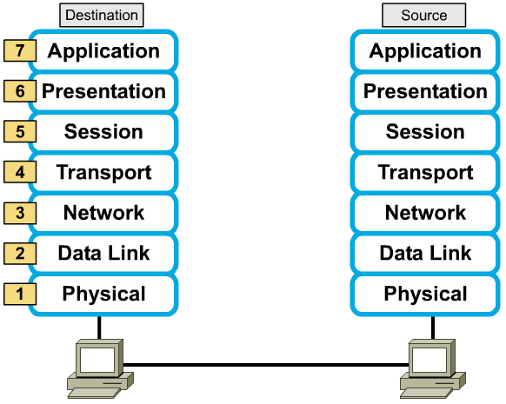
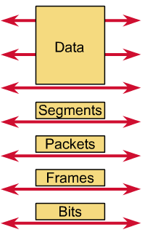
Peer-to-peer communications
Notes:
If System A has data from a software application to send to System B, the data is passed to the application layer. The application layer in System A then communicates any control information required by the application layer in System B by prepending a header to the data. The resulting information unit (a header and the data) is passed to the presentation layer, which prepends its own header containing control information intended for the presentation layer in System B. The information unit grows in size as each layer prepends its own header (and, in some cases, a trailer) that contains control information to be used by its peer layer in System B. At the physical layer, the entire information unit is placed onto the network medium.
The physical layer in System B receives the information unit and passes it to the data link layer. The data link layer in System B then reads the control information contained in the header prepended by the data link layer in System A. The header is then removed, and the remainder of the information unit is passed to the network layer. Each layer performs the same actions: The layer reads the header from its peer layer, strips it off, and passes the remaining information unit to the next highest layer. After the application layer performs these actions, the data is passed to the recipient software application in System B, in exactly the form in which it was transmitted by the application in System A.

Slide 25
Example
File transfer
Source
Destination
Application
1
20
11
10
Presentation
2
19
12
9
Session
3
18
13
8
Transport
4
17
14
7
Network
5
16
15
6
Data link
Physical

Slide 26
Example (cont.)‏
Establish the connection
  P-CONNECT.request(caller-P-addr, called-P-addr, …)‏
  S-CONNECT.request(caller-S-addrr, called-S-addr, …)‏
  T-CONNECT.request(caller-T-addr, called-T-addr, …)‏
  N-CONNECT.request(caller-N-addr, called-N-addr, …)‏
  D-CONNECT.request(caller-MAC-addr, called-MAC-addr, …)‏
  D-CONNECT.indication(caller-MAC-addr, called-MAC-addr, …)‏
  N-CONNECT.indication (caller-N-addr, called-N-addr, …)‏
  T-CONNECT.indication (caller-T-addr, called-T-addr, …)‏
  S-CONNECT.indication(caller-S-addrr, called-S-addr, …)‏
  P-CONNECT.indication(caller-P-addr, called-P-addr, …)‏
  P-CONNECT.request(caller-P-addr, called-P-addr, …)‏
  S-CONNECT.request(caller-S-addrr, called-S-addr, …)‏
  T-CONNECT.request(caller-T-addr, called-T-addr, …)‏
  N-CONNECT.request(caller-N-addr, called-N-addr, …)‏
  D-CONNECT.request(caller-MAC-addr, called-MAC-addr, …)‏
  D-CONNECT.indication(caller-MAC-addr, called-MAC-addr, …)‏
  N-CONNECT.indication (caller-N-addr, called-N-addr, …)‏
  T-CONNECT.indication (caller-T-addr, called-T-addr, …)‏
  S-CONNECT.indication(caller-S-addrr, called-S-addr, …)‏
  P-CONNECT.indication(caller-P-addr, called-P-addr, …)‏

Slide 27
Example (cont.)‏
Send data
  P-DATA.request(caller-P-addr, called-P-addr, data)‏
  S-DATA.request(caller-S-addr, called-S-addr, data)‏
  T-DATA.request(caller-T-addr, called-T-addr, data)‏
  N-DATA.request(caller-N-addr, called-N-addr, data-segment)‏
  ………
  D-DATA.request(caller-MAC-addr, called-MAC-addr, data-packet)‏
  ………..
  D-DATA.indication(caller-MAC-addr, called-MAC-addr, data-packet)‏
  N-DATA.indication (caller-N-addr, called-N-addr, data-segment)‏
  T-DATA.indication (caller-T-addr, called-T-addr, data)‏
  S-DATA.indication(caller-S-addr, called-S-addr, data)‏
  P-DATA.indication(caller-P-addr, called-P-addr, data)‏

Slide 28
Example (cont.)‏
Release connection
  P-DISCONNECT.request(caller-P-addr, called-P-addr)‏
  S-DISCONNECT.request(caller-S-addr, called-S-addr)‏
  T-DISCONNECT.request(caller-S-addr, called-S-addr)‏
  N-DISCONNECT.request(session)‏
  D-DISCONNECT.request(connection)‏
  D-DICONNECT.indication(connection)‏
  N-DISCONNECT.indication (session)‏
  T-DISCONNECT.indication (caller-T-addr, called-T-addr)‏
  S-DISCONNECT.indication(caller-S-addr, called-S-addr)‏
  P-DISCONNECT.indication(caller-P-addr, called-P-addr)‏

Slide 29
Protocols implemented in OSI model
Protocol is a formal set of rules and conventions that governs how computers exchange information over a network medium.
Protocol implements the functions of one or more of the OSI layers.
A communication protocol is concerned with exchanging data between two peer layers.
Protocols in
  Data link layer – PPP, MLPPP, PAP (Password Authentication Protocol), L2F, L2TP, PPTP, SDCP (Serial Data Control Protocol), VLAN …
  Network layer –BGP, IS-IS, OSPF, ICMP, RIP, MPLS, IP, IPSEC, VRPN, VoIP, ….
  Transport layer – TCP, UDP, …
  Session layer – ZIP, SCP, …
  Application layer – File Transfer Protocol (FTP), and Simple Mail Transfer Protocol (SMTP), Telnet, SNMP, …
Notes:
References: http://www.protocols.com/pbook/lan.htm, http://www.protocols.com/pbook/ppp.htm
A wide variety of communication protocols exist. Some of these protocols include LAN protocols, WAN protocols, network protocols, and routing protocols. LAN protocols operate at the physical and data link layers of the OSI model and define communication over the various LAN media. WAN protocols operate at the lowest three layers of the OSI model and define communication over the various wide-area media. Routing protocols are network layer protocols that are responsible for exchanging information between routers so that the routers can select the proper path for network traffic. Finally, network protocols are the various upper-layer protocols that exist in a given protocol suite
Zone Information Protocol (ZIP), the AppleTalk protocol that coordinates the name binding process; and Session Control Protocol (SCP), the DECnet Phase IV session layer protocol.

Slide 30

TCP/IP MODEL

Slide 31
TCP/IP Protocol
Transmission Control Protocol/Internet Protocol
The suite of communication protocols used to connect hosts on the Internet
TCP/IP uses several protocols, the two main ones being TCP and IP
TCP (Transmission Control Protocol)‏
  Enables two hosts to establish a connection and exchange streams of data
  Guarantees delivery of data and also guarantees that packets will be delivered in the same order in which they were sent
UDP (User Datagram Protocol)‏
  Connectionless protocol
  Used primarily for broadcasting messages over a network
IP (Internet Protocol)‏
  Specifies the format of packet and the addressing scheme

Slide 32
TCP/IP model development
The late-60s The Defense Advance Research Projects Agency (DARPA) originally developed TCP/IP to interconnect various defense department computer networks.
The Internet, an International Wide Area Network, uses TCP/IP to connect networks across the world.

Slide 33
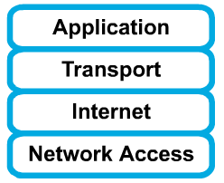
4 layers of the TCP/IP model
Layer 4: Application
Layer 3: Transport
Layer 2: Internet
Layer 1: Network access
It is important to note that some of the layers in the TCP/IP model have the same name as layers in the OSI model.
Do not confuse the layers of the two models.

Slide 34
The network access layer
Concerned with all of the issues that an IP packet requires to actually make the physical link. All the details in the OSI physical and data link layers.
  Electrical, mechanical, procedural and functional specifications.
  Data rate, Distances, Physical connector.
  Frames, physical addressing.
  Synchronization, flow control, error control.
Notes:
Network Access - This is where the specifications for Ethernet, Token ring, PPP etc fit. Definitions such as how the Internet layer protocols operate over Ethernet, Token Ring etc work fit into this layer. Protocols operating at this layer allow information to be passed between two nodes on the same network segment ie. nodes can see each other directly (electronically or optically).

Slide 35
The internet layer
Send source packets from any network on the internetwork and have them arrive at the destination independent of the path and networks they took to get there.
  Packets, Logical addressing.
  Internet Protocol (IP).
  Route, routing table, routing protocol.
Notes:
Internet - The Internet layer performs two functions; discovering how the various network segments are interconnected, and selecting the best path through the various network segments to deliver data from the utimate source machine, to the ultimate destination machine. (A group of interconnected network segments is called an internetwork or internet (notice the lower-case "i")).

Slide 36
The transport layer
The transport layer deals with the quality-of-service issues of reliability, flow control, and error correction.
  Segments, data stream, datagram.
  Connection oriented and connectionless.
  Transmission control protocol (TCP).
  User datagram protocol (UDP).
  End-to-end flow control.
  Error detection and recovery.
Notes:
Transport - The Transport layer is the "end-to-end" layer ie. protocols and functions operating at this layer work between the ultimate source and ultimate destination machines. The Transport layer protocols can provide a reliable, flow controlled connection between the end-nodes, or an unreliable, faster connection between the end-nodes. The Transport layer protocols do not interact with any devices performing Internet or Link layer functions - in fact, the Transport layer is not aware whether the two source and destination machines are on the same Link segment, or are separated by 20 different Link segments.

Slide 37
The application layer
Handles high-level protocols, issues of representation, encoding, and dialog control.
The TCP/IP combines all application-related issues into one layer, and assures this data is properly packaged for the next layer.
  FTP, HTTP, SMNP, DNS ...
  Format of data, data structure, encode …
  Dialog control, session management …
Notes:
Application - The Application layer protocols specify how applications running on the end-nodes interoperate eg. a WWW client interacting with a WWW server.

Slide 38
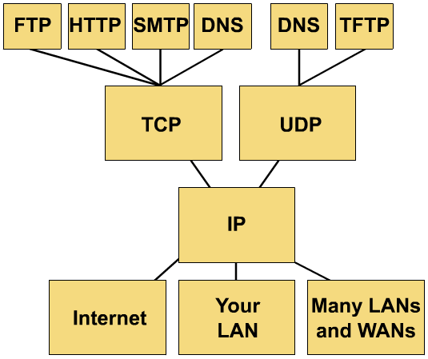
TCP/IP protocol stack

Slide 39
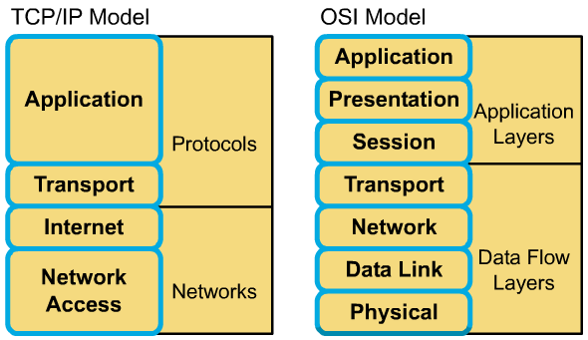
Mapping TCP/IP into OSI model

Slide 40
Local Area Networks

Slide 41
What is a LAN?
A LAN is a high-speed data network that covers a relatively small geographic area
It connects workstations, personal computers, printers, and other devices
LANs offers computer users
  Shared access to devices and applications
  File exchange between connected users
  Communication between users via electronic mail and other applications
Notes:
LANs offer computer users many advantages, including shared access to devices and applications, file exchange between connected users, and communication between users via electronic mail and other applications

Slide 42
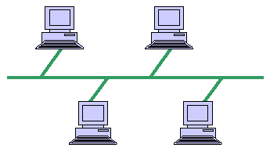
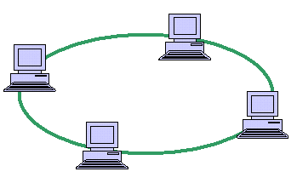
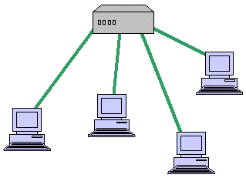
Topologies
LAN topologies define the manner in which network devices are organized.
Four common LAN topologies : bus, ring, star, and tree.
These topologies are logical architectures, but the actual devices need not be physically organized in these configurations.
Bus
Ring
Star
Notes:
A bus topology has one long branch onto which branches are used to interconnect each station on the network. Of the three most widely used LAN implementations, Ethernet/IEEE 802.3 networks—including 100BaseT—implement a bus topology.
A ring topology is a LAN architecture that consists of a series of devices connected to one another by unidirectional transmission links to form a single closed loop. Both Token Ring/IEEE 802.5 and FDDI networks implement a ring topology
A star topology is a LAN architecture in which the endpoints on a network are connected to a common central hub, or switch, by dedicated links. Logical bus and ring topologies are often implemented physically in a star topology.
A tree topology is a LAN architecture that is identical to the bus topology, except that branches with multiple nodes are possible in this case.

Slide 43
Access method
The set of rules that enable data from one workstation to successfully reach its destination
LAN protocols typically use one of two methods to access the physical network medium
  CSMA/CD (Carrier-Sense Multiple Access with Collision Detection)‏
  CSMA/CA (Carrier-Sense Multiple Access with Collision Avoidance)‏
  Token passing
  Switch-based, connection-oriented
Notes:
CSMA/CD is categorized as a listen the send access method. This technique is used in Ethernet. When a station has data to send it first listens to determine if any other station on the network is talking.
CSMA/CA represents a modified version of the CSMA/CD access technique. Each of the hardware devices attached to the talkers on the network estimates when a collision is likely to occur and avoids transmission during those times.
Token is a bit pattern. When a free token is seized by a station having data to transmit, this token will be transformed to indicate that it is in use, and information is added which represents data being transmitted from one station to another. Once the transmission is completed the token is converted back into its original form by the workstation that transmitted the frame and becomes available for use by the next station on the network.
Switch-based, connection-oriented access protocol requires the establishment of a route or path through one or more switches to the recipient. The most popular form of switch-based, connection-oriented access protocol is the one used by the Asynchronous Transfer Mode protocol. ATM is a switch based LAN and WAN that support both permanent and switched virtual circuits (PVC, SVC) for the routing of data.
SVC represents a logical connection established for the routing of data between two endpoints for a transmission session.
PVC represents a similar connection that is established by a network administrator and remains intact until the administrator removes or tears down the connection.

Slide 44
LAN Transmission Methods
LAN data transmissions fall into three classifications:
  Unicast: a single packet is sent from the source to a destination on a network
  Multicast: a single data packet that is copied and sent to a specific group of nodes on the network.
  Broadcast: a single data packet that is copied and sent to all nodes on the network.
In each type of transmission, a single packet is sent to one or more nodes.

Slide 45
LAN Devices
Repeaters
LAN extenders
Bridges
LAN switches
Routers
Gateway

Slide 46
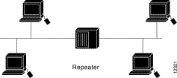
LAN Devices (cont)‏
A repeater is a physical layer device used to interconnect the media segments of an extended network or enlarge the LAN networks
Repeater is restricted to linking similar LANs (Ethernet, Fast Ethernet or Token ring)
Repeaters receive signals from one network segment and amplify, retime, and retransmit those signals to another network segment.
Notes:
There are two basic types of repeaters
+ An electrical repeater – simply receives an electrical signal and then regenerates the signal
+ An electrical-optical device – converts an electrical signal into an optical signal for transmission and performs a reverse function when receiving a light signal

Slide 47
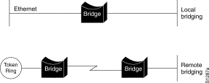
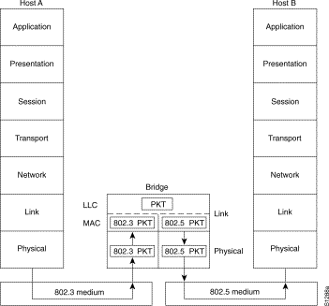
LAN Devices (cont)‏
Bridges are data communications devices at link layer
Bridges can connect similar or dissimilar LANs
Types of Bridges
  Transparent bridge
  Provides a connection between two LANs that employ the same protocol at the data link layer
  Translating bridge
  Provides a connection capability between two LANs that employ different protocols at the data link layer
Notes:
When a bridge begins to operate, it examines each frame transmitted on connected LANs at the data link layer. By reading the source address included in each frame, the bridge assembles a table of local addresses for each network. In addition to reading each source address, the bridge also reads the destination address contained in the frame. If the destination address is not contained in the local address table that the bridge constructs, this fact indicates that the frame’s destination is not on the current network or network segment. In this situation, the bridge transmits the frame onto the other network or network segment.
One of the problems associated with the use of a translating bridge is the conversation of frames from their format on one network to the format required for use on another network. For example, an Ethernet frame can vary from 64 to 1500 bytes, while a Token –Ring can have a maximum information field size of 4500 bytes when the ring operates at 4 Mbps and 18000 bytes when the ring operates at 4Mbps and 18000 bytes when the ring operates at 16 Mbps. If a station on a Token-Ring network length, the bridging of that frame onto an Ethernet network cannot occur.

Slide 48
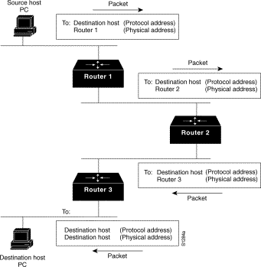
LAN Devices (cont)‏
Routers operate at the Network Layer
Purpose of a router is to connect nodes across an Internetwork
Advantages of use
  Multiple path transmission and routing control
  Flow control
  Frame fragmentation
Notes:
A router examines network addresses and makes decisions about whether or not data on a LAN should remain on the network or should be transmitted to a different network.
Similar to bridges, routers make forwarding decisions using tables. Unlike a bridge that may employ a simple table look-up procedure to determine the forwarding decision. A router may be configured to analyze several paths based upon an algorithm and dynamically select a path based upon the results of the algorithm.
Multiple path transmission and routing control – there are several paths between source network and destination one. This is necessary in case of failure.
Flow control – they will inhibit transmission onto a link as well as notify other routers to inhibit data flow until there is an available level of bandwidth for traffic.
Frame fragmentation – can break a frame into a series of frames when transmission occurs between networks with different frame sizes.

Slide 49
LAN Devices (cont)‏
A gateway operates at all seven layers of OSI model
Store and forward packets between dissimilar networks
Translating each source layer protocol into the appropriate destination layer protocol
Connection-Oriented Gateways
  Table space required in the gateways for each open connection
Connectionless Gateways
  Potential for congestion
Gateway software
  Manages the packet queue
Notes:
A major advantage of gateways over bridges is that they can connect networks with incompatible addressing formats, for example, an 802 LAN using 48-bits binary addresses and an X.25 network using 14 decimal digit X.121 addresses.
At the transport layer and above, gateways are known as Protocol converters.

Slide 50
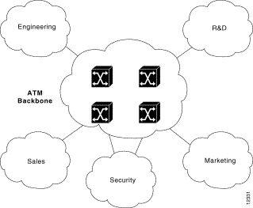
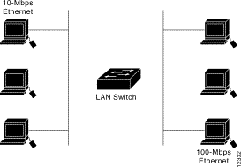
LAN Devices (cont)‏
ATM Switch
Switches are used in the higher operating rate switches
Advantages of use
  Parallel switching
  Higher bandwidth
Types of Switches
  Cross-point switching – the switch uses the destination from a look-up table as soon as the destination address in the frame is read
  Store-and-forward – the switch first stores an entire frame in memory, then operating on the data fields within the frame to check the error and last one is switching occur.
LAN Switch
Notes:
Switching operations – the switches having buffer memory to store address tables, frames flowing o LANs connected to different ports can be simultaneously read and forwarded via the switch fabric to ports connected to other networks.
Like a bridge that reads frames flowing on a network to construct a table of source addresses, the tables in a LAN switch can be created through a self-learning process. This allows the destination address in frames flowing on LANs connected to a switch port to be compared to a table of destination addresses and associated port numbers. When a match occurs between the destination address of a frame flowing on a network connected to a port and the address in the port’s address table, the frame is copied into the switch and routed through the switch fabric to the destination port and send it the the next component.
In case of store-and-forward: if the frame is considered to have one or more bits in error and will be discarded.

Slide 51
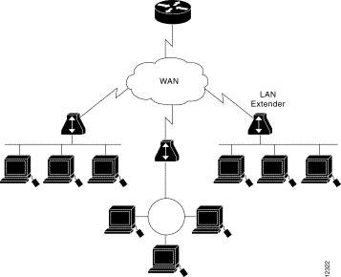
LAN Devices (cont)‏
A LAN extender is a remote-access multilayer switch that connects to a host router.

Slide 52
Popular Types of LANs
Ethernet
Fast Ethernet
FDDI

Slide 53
Ethernet LAN
Uses the CSMA/CD access protocol on a bus structure
Ethernet frame format
bytes
8
6
6
2
from 46 to 1500
4
Data
Frame Check Sequence
Type
Source Address
Preamble
Destination Address
IEEE 802.3 frame format
bytes
7
1
6
6
2
from 46 to 1500
4
Data
Length
Frame Check Sequence
Source Address
Preamble
Destination Address
Start of Frame Delimiter
Notes:
The 802.3 standard is a result of several modifications of Ethernet. Today, when we talk about Ethernet, we typically refer to the IEEE 802.3 standard.
The two-byte type field specifies how the data is to be interpreted by the receiver.

Slide 54
Ethernet LAN (cont.)‏
IEEE 802.3 specifications
Feature
10BASE-5
10BASE-2
10BROAD-36
1BASE-5
10BASE-T
Medium
Thick 50 Ω coaxial
Thin coaxial cable
CATV coaxial cable
Twisted pair wire cable
Twisted pair wire
Topology
Bus
Bus
Bus
Star
Star
Segment distance
500m
200m
3.6km
500m
100m
Data rate
10Mbps
10Mbps
10Mbps
1Mbps
10Mbps
Notes:
The term BASE indicates Baseband, which is a type of data transmission in which digital or analog data is sent over a single unmultiplexed channel (data rate of 10 Mbps).
The term BROAD indicates Broadband, which is a type of data transmission in which a single medium (wire) can carry several channels at once. Cable TV, for example, uses broadband transmission. In contrast, baseband transmission allows only one signal at a time.

Slide 55
Fast Ethernet
A term commonly used to reference a series of three 100 Mbps physical layer LAN specifications
1
7
1
6
6
2
Data 46 to 1500 bytes
1
1
Length (IEEE802.3)/Type (Ethernet)‏
FCS
ESD
Source address
Destination address
SFD: Start of frame delimiter
Preamble
SSD:Start of stream delimiter
Notes:
100 Mbps physical layer LAN specifications include 100BASE-TX, 100BASE-FX, 100BASE-T4. Each specification maintains the use of the Media Access Control (MAC) protocol used by CSMA/CD.
Frame format
SSD: is used to align a received frame for subsequent decoding
ESD (End of stream delimiter): is used as an indicator that data transmission terminated normally and a properly formed stream was transmitted.

Slide 56
FDDI
Fiber Distributed Data Interface (FDDI) is a local networking standard which provides a 100 Mbps operating rate.
FDDI incorporate counter-rotating rings
Advantages
  Operating rate
  Reliability

Slide 57
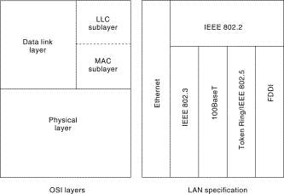
LAN protocols and the OSI model
LAN protocols function at the lowest two layers of the OSI reference model

Slide 58
LAN Protocols
PPP
PPPoE

Slide 59
Wide Area Networks

Slide 60
What is a WAN?
A WAN is a data communications network that covers a relatively broad geographic area.
WAN technologies operate at the lowest levels of the OSI model : the physical layer, the data link layer, and the network layer.
Respect to the flow of information on a transmission, WANs can be grouped into three basic types:
  Circuit switching
  Packet switching
  Leased line

Slide 61
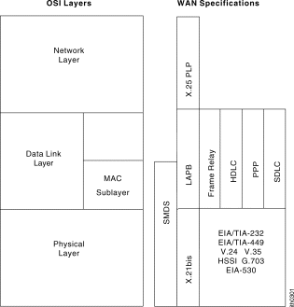
WAN Technologies-OSI Model

Slide 62

Point-to-Point Links
A point-to-point link provides a single, pre-established WAN communications path from the customer premises through a carrier network
It is also known as a leased line.
These links accommodate two types of transmissions: datagram transmissions and data-stream transmissions
Notes:
datagram transmissions, which are composed of individually addressed frames
data-stream transmissions, which are composed of a stream of data for which address checking occurs only once

Slide 63
Circuit Switching
Circuit switching is a WAN switching method in which a dedicated physical circuit (path) is established, maintained, and terminated through a carrier network for each communication session
This connection in which a call is established by switching equipment over a temporary path is known as a switched virtual call (SVC)‏
Circuit switching accommodates two types of transmissions
  Data-stream transmissions (analog)‏
    Used in telephone network, requires the use of modems
    Used by DSL, ADSL technologies
  Datagram transmissions (digital)‏
    Requires DSU (Data Service Unit) in place of a modem
    Used by ISDN technology
Notes:
This works much like a normal telephone line works for voice communication. Integrated Services Digital Network (ISDN) is a good example of circuit switching. When a router has data for a remote site, the switched circuit is initiated with the circuit number of the remote network. In the case of ISDN circuits, the device actually places a call to the telephone number of the remote ISDN circuit. When the two networks are connected and authenticated, they can transfer data. When the data transmission is complete, the call can be terminated.
A modem is a contraction of the term modulator-demodulator and it converts digital data transmitted by business machines and computers into analog tones for transmission on the analog telephone network. The process of converting digital data into analog signals is known as modulation, while the reverse process is called demodulation.
The type of modem refers to the modulation technique used and the data transmission rate (in bit per second). For example, a V.32 type modem provides a data transmission rate of 9600 bps.
DSU is sometimes referred to as a digital modem as it converts unipolar digital signals produced by business machines and computers into bipolar digital signals suitable for transmission over a switched digital network

Slide 64
Circuit Switching (cont.)‏
  Datagram transmissions (analog)‏
Switched
Telephone Network
Mainframe
Computer
PC
Modem
Modem
  Data-stream transmissions (digital)‏
Switched
Digital Service
Mainframe
Computer
PC
DSU
DSU
Notes:
Digital Subscriber Line (DSL) represents a series of technologies developed to enhance the use of copper telephone lines from a communication carrier’s central office to the subscriber. One of the more promising DSL technologies being introduced is ADSL.
Asymmetric Digital Subscriber Line (ADSL) is implemented from the subscriber to the communication carrier’s central official via the use of a pair of ADSL modems. ADSL supports data rates of from 1.5 to 9 Mbps when receiving data (known as the downstream rate) and from 16 to 640 Kbps when sending data (known as the upstream rate).
Integrated Services Digital Network (ISDN) – an international communications standard for sending voice, video, and data over digital telephone lines or normal telephone wires. ISDN supports data transfer rates of 64 Kbps (64,000 bits per second). There are two types of ISDN:
Basic Rate Interface (BRI) -- consists of two 64-Kbps B-channels and one D-channel for transmitting control information.
Primary Rate Interface (PRI) -- consists of 23 B-channels and one D-channel (U.S.) or 30 B-channels and one D-channel (Europe).

Slide 65
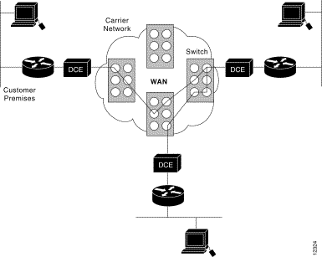
A circuit-switching WAN
Notes:
DCE (Data Communications Equipment) a device that communicates with a Data Terminal Equipment (DTE) device in RS-232C communications. the DCE is usually a modem and the DTE is the computer itself.

Slide 66
WAN Virtual Circuits
A virtual circuit is a logical circuit created to ensure reliable communication between two network devices
There are two types:
  SVCs (switched virtual circuits)‏
  PVCs (permanent virtual circuits)

Slide 67
SVCs
SVCs are virtual circuits that are dynamically established on demand and terminated when transmission is complete
Communication over an SVC consists of three phases
  circuit establishment
  data transfer
  circuit termination
SVCs are used in situations in which data transmission between devices is sporadic, largely
Notes:
Create demand
Transfer data
Tear down

Slide 68
PVCs
PVC is a permanently established virtual circuit that consists of one mode: data transfer
PVCs are used in situations in which data transfer between devices is constant

Slide 69
Leased line networks
Leased line is used to reduce the number of physical lines required to connect telephone company offices to one another, communications carriers implemented a technique called multiplexing
A physical line can be shared for many users at time. However, information in the form of voice or data uses the reserved slot for the duration of the voice call or data transmission session
Two types of multiplexing
  Frequency division multiplexing (FDM)‏
    Uses a communication circuit that has a relatively wide bandwidth. This bandwidth is then divided into subchannels by frequency
    Used for analog leased lines
      Need the multiplexer and demultiplexer
  Time division multiplexing (TDM)‏
    Used for digital leased lines
Mul.
Notes:
In the early days of circuit switching, groups of lines were routed between telephone company offices, with each line used to carry one conversation at a time that was switched onto the line. As the number of telephone subscribers proliferated, the method of switching individual calls onto individual circuits was not economical.
Analog leased line – Instead, the leased line represented a circuit routed from the customer’s premises to the carrier’s nearest office. At that location the circuit was multiplexed through the use of FDM equipment and routes onward towards its destination on a wideband circuit. At the carrier office nearest the customer’s destination premises the wideband line was demultiplexed and the channel on the wideband circuit was connected to a line routed to the customer’s premises.
Time division multiplexing – Voice digitization was accomplished using a technique known as pulse code modulation (PCM) in which an analog voice conversation is encoded into a 64 kbps digital data stream for transmission on telephone company digital transmission facilities.Once a call was digitized and routed to a destination, the 64 kbps digital data stream was converted back into an analog voice signal and passed to the destination.

Slide 70
Packet Switching
Packet switching is a WAN switching method in which network devices share a single point-to-point link to transport packets from a source to a destination across a carrier network
Transmitted data is divided into the packets, that have addressing, sequencing, and error control information
The flow of packets between nodes in a packet network is intermixed with respect to the originator and destination of packets => many users can share large portions of the transmission facilities
The network using the packet switching technique is called as packet network
  Datagram packet networks - each packet is transmitted independently of other packets
  Virtual circuit packet networks – a fixed path is established from the data originator to the recipient at the time a call is established
Notes:
One of the major limitations associated with circuit switching is the permanent assignment of a path for the exclusive use of a communications session during the duration of that session. This means that regardless of whether a full circuit or a channel cannot be used to support other activities until the session in progress is completed.
Although multiplexing is also a mechanism which allows the sharing of transmission facilities, the two techniques are considerably different.
+In multiplexing, bandwidth (FDM) or time (TDM) is used to establish occupancy slots into which individual data sources are assigned the use of those slots. Thereafter, information in the form of voice or data uses the reserved slot for the duration of the voice call or data transmission session.
+ In packet switching, specialized equipment divides data into defined segments that have addressing, sequencing, and error control information added. The resulting unit of data is called a packet and may represent a user message or a very small portion of a user message. The flow of packets between nodes in a packet network is intermixed with respect to the originator and destination of packets.

Slide 71
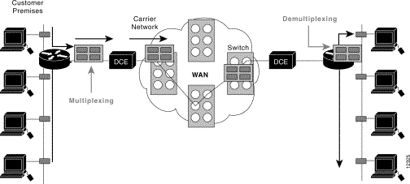
Packet switching (cont.)‏

Slide 72
Packet Switching (cont.)‏
Datagram packet networks
D
C
B
A
Packet
Switch 1
B
A
Packet
Switch 3
D
C
B
A
Computer
A
X
X
Y
C
Y
C
z
y
x
w
Packet
Switch 2
Z
W
Packet
Switch 4
z
y
x
w
Computer
B
Virtual circuit packet networks
D
C
B
A
Packet
Switch 1
Packet
Switch 3
D
C
B
A
Computer
A
D
C
B
A
C
A
D
B
Z
Y
X
W
Packet
Switch 2
Z
Y
X
W
Packet
Switch 4
Z
Y
X
W
Computer
B

Slide 73
WAN Devices
WANs use many types of devices :
  WAN switches
  Access servers
  Modems
  CSU/DSUs
  ISDN terminal adapters

Slide 74
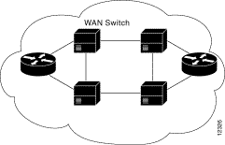
WAN Switch
A WAN switch is a multiport internetworking device used in carrier networks: Frame Relay, X.25,…
A switch operates at the data link layer of the OSI model
It is used to establish a physical path for the duration of a call
Two routers of a WAN are connected by WAN switches
Notes:
Frame Relay, X.25 and SMDS

Slide 75
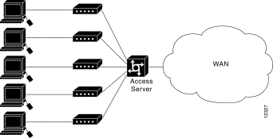
Access Server
An access server acts as a concentration point for dial-in and dial-out connections
An access server concentrates dial-out connections into a WAN

Slide 76

Modem
A modem is a device that interprets digital and analog signals
A Modem Connection Through a WAN Handles Analog and Digital Signals

Slide 77
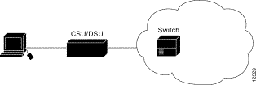
CSU/DSU-channel service unit/digital service unit
CSU/DSU is a digital-interface device (or sometimes two separate digital devices) that adapts the physical interface on a data terminal equipment (DTE) device (such as a terminal) to the interface of a data circuit-terminating (DCE) device (such as a switch) in a switched-carrier network
CSU/DSU is sometimes referred to as a digital modem as it converts unipolar digital signals produced by computers into bipolar digital signals suitable for transmission over a switched digital network
Notes:
DSU is sometimes referred to as a digital modem as it converts unipolar digital signals produced by business machines and computers into bipolar digital signals suitable for transmission over a switched digital network

Slide 78
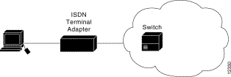
ISDN Terminal Adapter
is a device used to connect ISDN Basic Rate Interface (BRI) connections to other interfaces
The terminal adapter connects to other interfaces
Notes:
A terminal adapter is essentially an ISDN modem

Slide 79
Other Concepts

Slide 80
IP Addresses
Identifies the location to where the packet can be sent
Uses a 32 bit address which is divided into an assigned network number and a host number
The ranges of IP addresses
Bit 0
7 bits
24 bits
Bit 32
Class A
0
Network address
Host address
Bit 0
14 bits
16 bits
Bit 32
Class B
1
0
Network address
Host address
Bit 0
21 bits
8 bits
Bit 32
Class C
1
1
0
Network address
Host address
Bit 0
28 bits
Bit 32
Class D
1
1
1
0
Group of host address
Bit 0
28 bits
Bit 32
Class E
1
1
1
1
Network and host address
Notes:
The IP address 127.0.0.1 is used as the loopback address. This means that it is used by the host computer to send a message back to itself. It is commonly used for troubleshooting and network testing.
Class A addresses are only assigned to large organizations or countries
Class A Identified by the first bit set as 0. The next 7 bits define the network address, and the remaining 24 bits identify hosts. Network number 127 is reserved for loopback testing. The 24-bit host address space identifies 16,777,214 hosts per each of the 126 networks. Most class A network schemes were assigned to U.S. government agencies, educational institutions, research organizations, and large companies in the early days of the Internet.
Class B Identified by the first 2 bits set as 10. The next 14 bits define the network address, and the remaining 16 bits identify hosts. This scheme defines 16,384 networks and 65,534 hosts per network.
Class C Identified by the first 3 bits set as 110. The next 21 bits define the network address, and the remaining 8 bits identify hosts. This scheme defines 2,097,152 networks and 254 hosts per network.
A class D scheme also exists for multicasting. The first 4 bits (1110) identify the class, and the remaining 28 bits refer to a group of hosts, all of which receive the same IP packet.
A class E was also defined for future use, with the first four bits being 1111. The address 255.255.255.255 is used for broadcast

Slide 81
Subnet Mask
Subnets is used to separate groups of hosts for security reasons, for traffic control purposes, or other reasons
A subnet mask is an IP address feature that serves as a sort of template to indicate which bits in the IP address define the network and which bits define the host
All devices on the same IP network must use the same subnet mask.
The standard subnet masks used for the class A, B, and C networks are
  Class A 255.0.0.0 11111111 00000000 00000000 00000000
  Class B 255.255.0.0 11111111 11111111 00000000 00000000
  Class C 255.255.255.0 11111111 11111111 11111111 00000000
Notes:
Note how the binary 1s indicate the bits that are used for the network address portion of the IP address. They essentially "mask out" the network address to reveal the host address.

Slide 82
Subnet Mask (ex.)‏
Consider a network in class B with the network address 192.168.x.x, we can separate the groups of host into 4 groups by adding 2 bits in host address into subnet mask
  192.168.0.0/18 11000000.10101000.00000000.00000000
  192.168.32.0/18 11000000.10101000.01000000.00000000
  192.168.64.0/18 11000000.10101000.10000000.00000000
  192.168.96.0/18 11000000.10101000.11000000.00000000
The subnet groups
  Subnet 0 – 192.168.0.1 through 192.168.63.254
  Subnet 64 – 192.168.64.1 through 192.168.127.254
  Subnet 128 – 192.168.128.1 through 192.168.191.254
  Subnet 192 – 192.168.192.1 through 192.168.255.254
18 leftmost bits are the network address

Slide 83
Encapsulation
Enclosing data using one protocol within messages of another protocol
Example
  The HTTP is used to construct a message requesting a page
  TCP is used to provide the connection management and reliable delivery that HTTP requires
  Using IP for relaying a message from one machine to another in order to reach its destination
  Using PPP to transmit the message from one machine to the next
HTTP
TCP
HTTP
IP
TCP
HTTP
PPP
IP
TCP
HTTP
Notes:
When the encapsulating packet arrives at the destination network, the inner packet is removed from the encapsulating packet and then forwarded to the destination network.

Slide 84
Tunneling
A technology that enables one network to send its data via another network's connections
Tunneling works by encapsulating a network protocol within packets carried by the second network
Example
  Microsoft's PPTP technology enables organizations to use the Internet to transmit data across a VPN. It does this by embedding its own network protocol within the TCP/IP packets carried by the Internet.
Tunneling is also called encapsulation
Notes:
PPTP: Point-to-Point Tunneling Protocol
The tunneling process involves encapsulating a packet from the source network within a packet for the intermediate network.

Slide 85
Q&A

