Slide 1


Data Science Level 1
-- Session 2--
Data manipulation with pandas
Hung Nguyen
TIC Data Team Lead
1

Slide 2

high-performance
easy-to-use
data structures and analysis tools

Slide 3
Easier to clean & wrangle Data.
Features of Pandas make it a great choice for Data Science and Analysis.
More useful with Matplotlib & Numpy

Slide 4
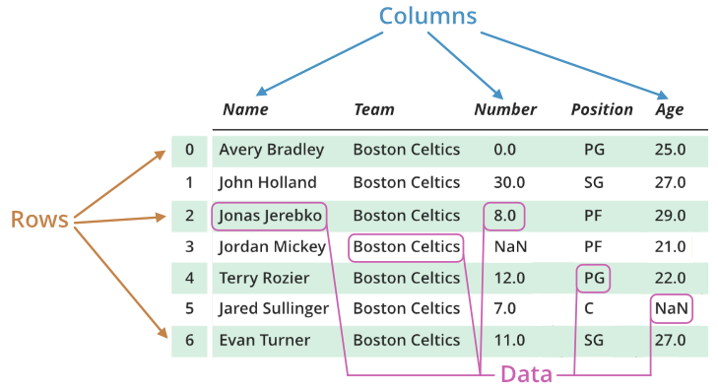
Basic components

Slide 5
Create data frame
pd.DataFrame()
pd.read_*()
List of rows
List of columns
Matrix
…
csv – comma/tab separated value
xls – Excel file
sql - query
…

Slide 6
Reshape and select
Reshape
Select
add: pd.concat()/df.append()
delete: df.drop()
join: df.merge()
column:
df[‘column name’]/df.column_name
row:
df.loc()/df.iloc
df.head()/df.tail()
cell/range of cell
filter:
df[logical expression]

Slide 7
Summarize a data frame
Objective | Command
Get shape | df.shape()
Basic information | df.info()
Descriptive analysis | df.describe()/mean()/sum()/max()/min()…
Counting missing value | df/df[column] .isnull().sum()
Correlation matrix | df.corr()
Duplicate rows | df.duplicated()
Unique values | df[column].unique()/value_counts()

Slide 8
Basic transformations for preprocessing
Objective | Function
Sorting | df. sort_values()
Drop duplicates | df. drop_duplicates()
Dealing with missing value - drop - fill | df.dropna() df.fillna()
Changing a column - map value to value - apply function - normalization - standardization | df[column] = df[column].map() df[column].apply()
Creating new column | df[new column] =
One-hot encoding | pd.get_dummies()

Slide 9
Data Science Level 1
-- Session 2--
Data visualization with matplotlib
Hung Nguyen
TIC Data Team Lead
9

Slide 10
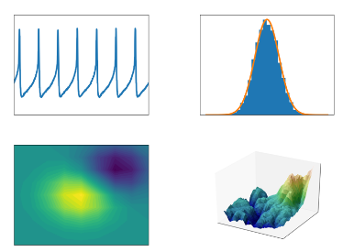
Data visualization
Human brain processes graph faster than texts and tables
Help to:
Convey concepts in a universal manner
Identify areas that need attention or improvement.
Clarify which factors influence customer behavior.
Help you understand which products to place where.
Predict sales volumes.

Slide 11

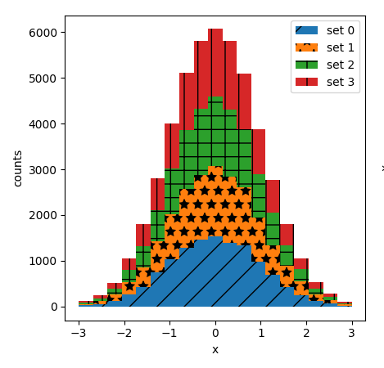
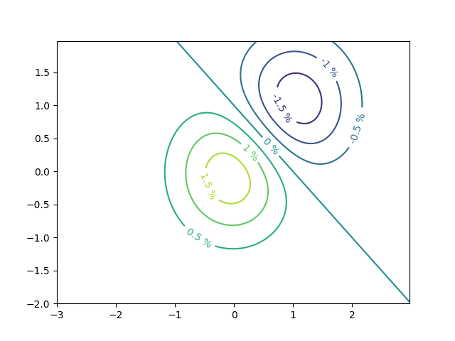
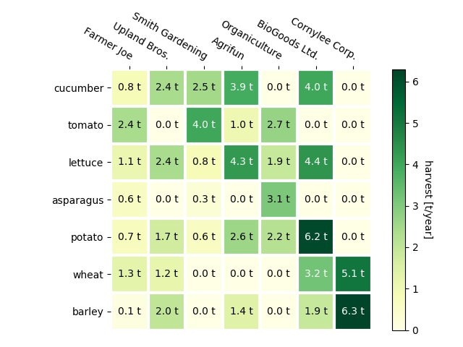
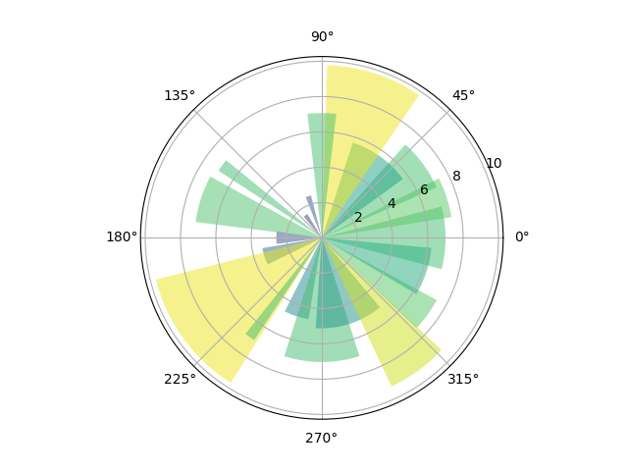
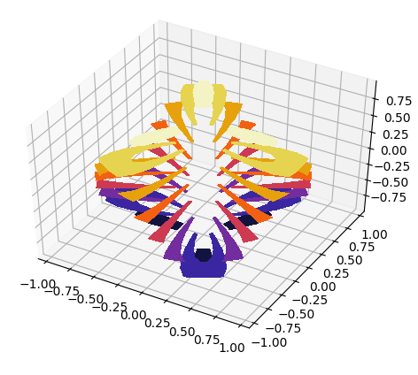
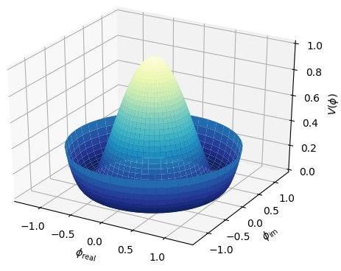
used for plotting the beautiful and attractive Graphs
Uses the numpy to handle large arrays of data sets
Intergrates with pandas

Slide 12
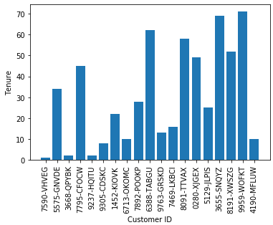
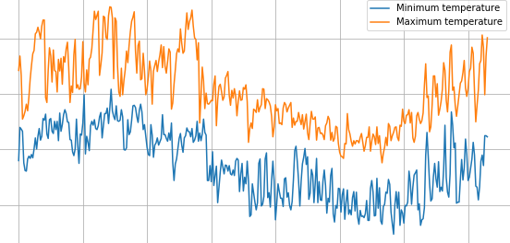
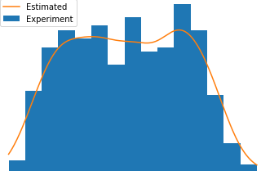
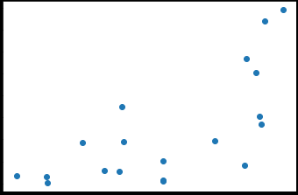
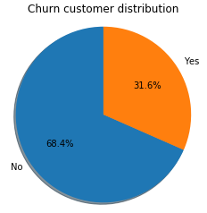
Basic graph types

