Slide 1
Implementation of single precision Floating point multiplier using a pipeline architecture IEEE-754 standard
Architecture of Digital System I
Canh-Trung Nguyen

Slide 2
System requirement
Throughput – 500 ps
Latency – 2 ns
Resource and area constraints are loose
Reusability by splitting up to small projects

Slide 3
Conventional FP multiplier
Critical path locates on Mantissa multiplier
Approach
Using Booth multiplier to reduce the number of partial product (Either radix-4 or radix-8)
Using Carry Save Adder with Wallace tree to minimize number of critical path and ease to pipeline compression stage
Expense latency to achieve better throughput by dividing this architecture into 5 stages

Slide 4
Proposed Architecture
Used 8-radix booth multiplier for unsigned number
Number of partial product = N/3 (N is length of multiplicand and multiplier)
Here, N = 24 bit => 8 partial products
Critical path locates on Booth Multiplier

Slide 5
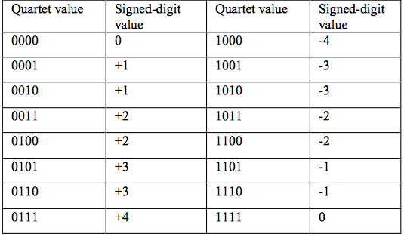
Detail Architecture 8-radix BOoth multiplier
Dx are selected bits extracted from a Mantissa
Based on value of Dx, partial product is chosen from these sources
Problem: Computing 3M is a critical path
3M = 2M + M
Using Carry Select Adder to reduce critical path (block of 8 bits)

Slide 6
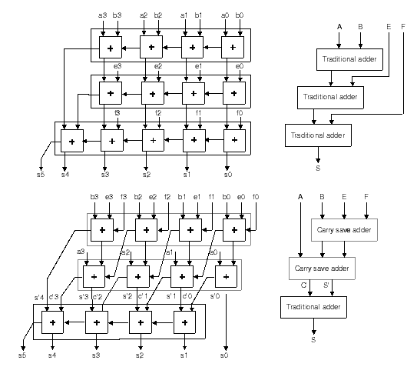
Detail Architecture Carry Save adder
Example: the first stage of CSA (summing 4 partial products)

Slide 7
Some important notes
Using Booth multiplier for unsigned number, we must encode partial product as following
Normalization (MSB = bit 47th of the final product)

