Slide 1
Pipelining
Adding registers along a path
  split combinational logic into multiple cycles
  increase clock rate
  increase throughput
  increase latency

Slide 2
Pipelining
Delay, d, of slowest combinational stage determines performance
  clock period = d
Throughput = 1/d : rate at which outputs are produced
Latency = n•d : number of stages * clock period
Pipelining increases circuit utilization
Registers slow down data, synchronize data paths
Wave-pipelining
  no pipeline registers - waves of data flow through circuit
  relies on equal-delay circuit paths - no short paths

Slide 3
When and How to Pipeline?
Where is the best place to add registers?
  splitting combinational logic
  overhead of registers (propagation delay and setup time requirements)
What about cycles in data path?
Example: 16-bit adder, add 8-bits in each of two cycles

Slide 4
Retiming
Process of optimally distributing registers throughout a circuit
  minimize the clock period
  minimize the number of registers

Slide 5
Retiming (cont’d)
Fast optimal algorithm (Leiserson & Saxe 1983)
Retiming rules:
  remove one register from each input and add one to each output
  remove one register from each output and add one to each input

Slide 6
Optimal Pipelining
Add registers - use retiming to find optimal location
10
13
7
8
6
5

Slide 7
Optimal Pipelining
Add registers - use retiming to find optimal location
10
13
7
8
6
5
10
13
7
8
6
5

Slide 8
Example - Digital Correlator
y_{t} = δ(x_{t}, a₀) + δ(x_{t-1}, a₁) + δ(x_{t-2}, a₂) + δ(x_{t-3}, a₃)
δ(x_{t}, a₀) = 0 if x ≠ a, 1 otherwise (and passes x along to the right)
y_{t}
+
+
+
host
δ
δ
δ
δ
x_{t}
a₀
a₁
a₂
a₃

Slide 9
Example - Digital Correlator (cont’d)
Delays: adder, 7; comparator, 3; host, 0
+
+
+
host
δ
δ
δ
δ
cycle time = 24

Slide 10
Example - Digital Correlator (cont’d)
Delays: adder, 7; comparator, 3; host, 0
+
+
+
host
δ
δ
δ
δ
cycle time = 24
+
+
+
host
δ
δ
δ
δ
cycle time = 13

Slide 11
Retiming: One Step at a Time
0
0
0
7
7
7
0
0
0
0
0
1
1
1
1
3
3
3
3
0
0
0
7
7
7
0
0
0
1
0
1
1
0
2
3
3
3
3
0
0
0
7
7
7
0
0
0
1
1
1
1
0
1
3
3
3
3

Slide 12
Retiming: One Step at a Time (cont’d)
0
1
0
7
7
7
0
0
0
0
0
1
1
0
1
3
3
3
3
0
1
0
7
7
7
0
1
0
0
0
0
2
0
1
3
3
3
3
and after a few more . . .
1
1
0
7
7
7
0
1
0
0
0
0
1
0
1
3
3
3
3

Slide 13
Retiming Algorithm
Representation of circuit as directed graph
  nodes: combinational logic
  edges: connections between logic that may or may not include registers
  weights: propagation delay for nodes, number of registers for edges
  path delay (D): sum of propagation dealys along path nodes
  path weight (W): sum of edge weights along path
    always > 0, no asynchronous feedback
Problem statement
  given: cycle time, T, and a circuit graph
  adjust edge weights (number of registers) so that all path delays < T, unless their path weight ≥ 1, and the outputs to the host are the same (in both function and delay) as in the original graph

Slide 14
Retiming Algorithm Approach
Compute path weights and delays between each pair of nodes
  W and D matrices
Choose a cycle time T
Determine if it is possible to assign new weights so that all paths with delays greater than T have a weight that is 1 or greater (use linear programming)
Choose a smaller cycle time and repeat until the smallest T is found

Slide 15
Computing W and D
W matrix: number of registers on path from u → v
D matrix: total delay along path from u → v
v₇
v₆
v₅
0
0
0
7
7
7
0
0
0
0
0
v_{h}
1
1
1
1
3
3
3
3
v₁
v₂
v₃
v₄
W h 1 2 3 4 5 6 7
h 0 1 2 3 4 3 2 1
1 0 0 1 2 3 2 1 0
2 0 1 0 1 2 1 0 0
3 0 1 2 0 1 0 0 0
4 0 1 2 3 0 0 0 0
5 0 1 2 3 4 0 0 0
6 0 1 2 3 4 3 0 0
7 0 1 2 3 4 3 2 0
D h 1 2 3 4 5 6 7
h 0 3 6 9 12 16 13 10
1 10 3 6 9 12 16 13 10
2 17 20 3 6 9 13 10 17
3 24 27 30 3 6 10 17 24
4 24 27 30 33 3 10 17 24
5 21 24 27 30 33 7 14 21
6 14 17 20 23 26 30 7 14
7 7 10 13 16 19 23 20 7

Slide 16
Computing W and D
W[u,v] = number of registers on the minimum weight path from u → v
  Any retiming changes the weight of all paths by the same constant
  i.e. Retiming cannot change which is the minimum weight path
D[u,v] = maximum delay over all paths with W[u,v] registers
  Retiming does not affect D[u,v]
These matrices contain all the required register and delay information
  If retiming removes all registers from the path u → v,
  then D[u,v] is the largest delay path that results

Slide 17
Retiming: Problem Formulation
r(v): number of registers pushed through a node in the forward direction
  w_{new}(u, v) = w_{old}(u, v) + r(u) - r(v)
Problem statement
  r(v_{h}) = 0 (host is not retimed)
  w_{new}(u, v) = w_{old}(u, v) + r(u) - r(v) ≥ 0, for all u, v
    r(u) - r(v) ≥ - w_{old}(u, v) (no negative registers!)
  For all D[u,v] > Tclk,
  w_{new}(u, v) = w_{old}(u, v) + r(u) - r(v) ≥ 1
    r(u) - r(v) ≥ - w_{old}(u, v) + 1 (every long path has at least 1 reg)
Difference constraints like this can be solved by generating a graph that represents the constraints and using a shortest path algorithm like Bellman-Ford to find a set of r(v) values that meets all the constraints
The value of r(v) returned by the algorithm can be used to generate the new positions of the registers in the retimed circuit

Slide 18
Retimed Correlator
0
0
0
7
7
7
0
0
0
0
0
1
1
1
1
3
3
3
3
r = 0
r = 1
r = 2
1
1
0
7
7
7
0
1
0
0
0
0
r = 2
r = 0
1
0
1
3
3
3
3
r = 1
r = 1
r = 2

Slide 19
Extensions to Retiming
Host interface
  add latency
  multiple hosts
Area considerations
  limit number of registers
  optimize logic across register boundaries
    peripheral retiming
    incremental retiming
    pre-computation
Generality
  different propagation delays for different signals
  widths of interconnections

Slide 20
Retiming examples
Shortening critical paths
Create simplification opportunities
a
D Q
x
a
c
b
d
b
D Q
d
x
D Q
a
D Q
a
b
x
D Q
b
x
D Q
c
D Q
c
D Q
Pipelining and Retiming <number>

Slide 21
Digital Correlator Revisited
Optimally retimed circuit (clock cycle 13)
How do we know this is optimal?
Max-Ratio Theorem: T_{c} ≥ D_{cycle}/R_{cycle} for all cycles in circuit
  D_{cycle} = total delay on cycle, including register t_{pd}, t_{su}
  R_{cycle} = number of registers on cycle
We know we can never do better than this
  Can’t always do this well
+
+
+
host
δ
δ
δ
δ

Slide 22
Going Faster: C-slow’ing a Circuit
Replace every register with C registers
Now retime: (clock cycle now 7)
+
+
+
host
δ
δ
δ
δ
+
+
+
host
δ
δ
δ
δ

Slide 23
C-slow’ing a Circuit
Note that we get one value every c clock cycles
  But clock period decreases
  Throughput remains the same at best
The trick: Interleave data sets
Example: Stereo audio
  Interleave the data for the two channels
  Doubles the throughput!
+
+
+
host
δ
δ
δ
δ

Slide 24
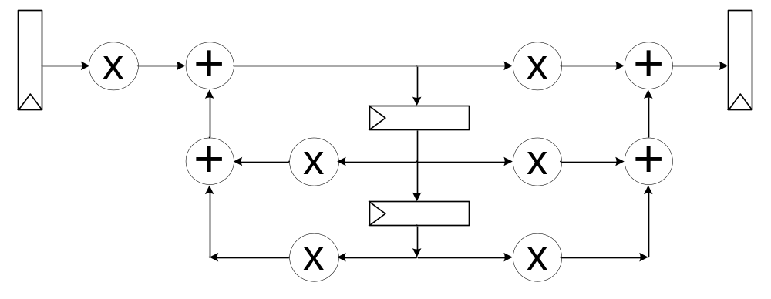
Using C-Slowing For Time-Multiplexing
Clock period is for this circuit is 40 [2+10+5+5+10+5+3]
Min clock period after pipelining/retiming is at best 25
  Max ratio cycle: [2+10+5+5+3]/1
mult: 10, add: 5, Tpd: 2, Tsu: 3, Th: 1

Slide 25
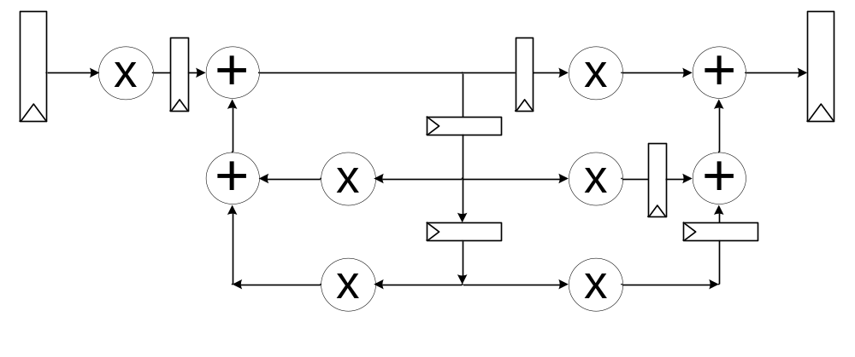
Using C-Slowing For Time-Multiplexing
Pipelined/Retimed Circuit
Let’s reschedule for 2 clock cycles/iteration
mult: 10, add: 5, Tpd: 2, Tsu: 3, Th: 1

Slide 26
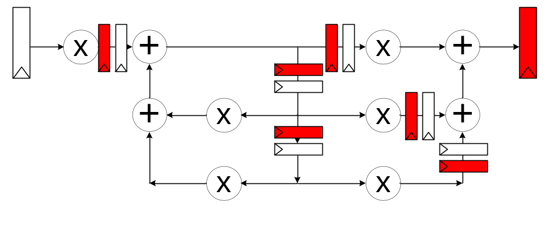
Using C-Slowing For Time-Multiplexing
Start by C-slowing
mult: 10, add: 5, Tpd: 2, Tsu: 3, Th: 1

Slide 27
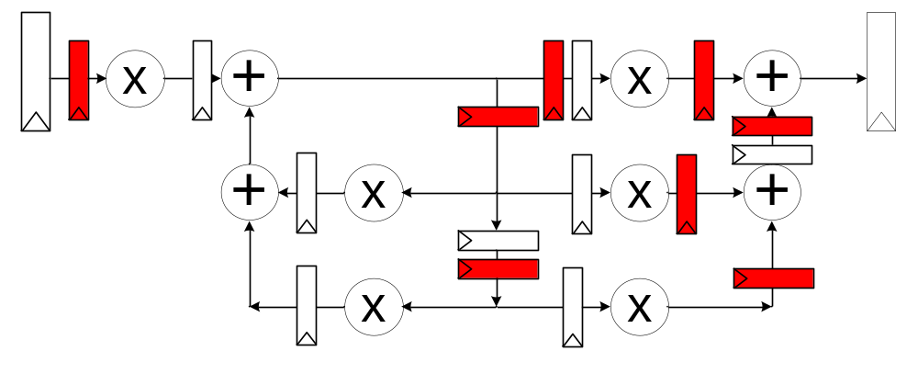
Using C-Slowing For Time-Multiplexing
Now retime
Note: 3 multiplers are red, 3 are white: share
  2 adders are red, 2 are white: share
mult: 10, add: 5, Tpd: 2, Tsu: 3, Th: 1

Slide 28
Using C-Slowing For Time-Multiplexing
Result
  Cost: 1/2
  clock period: 25 -> 15
  Throughput: 1/25 -> 1/30
mult: 10, add: 5, Tpd: 2, Tsu: 3, Th: 1

Slide 29
C-slowing/Retiming for Resource Sharing
FIR Filter
*
*
*
*
0
+
+
+
+

Slide 30
*
*
*
*
+
+
+
+

Slide 31
C-slowed by 4
*
*
*
*
+
+
+
+

Slide 32
Insert Data every 4 cycles (one data set)
*
*
*
*
+
+
+
+

Slide 33
*
*
*
*
+
+
+
+

Slide 34
Computation Active only every 4 Cycles
*
*
*
*
+
+
+
+

Slide 35
*
*
*
*
+
+
+
+

Slide 36
*
*
*
*
+
+
+
+

Slide 37
*
*
*
*
+
+
+
+

Slide 38
*
*
*
*
+
+
+
+

Slide 39
Retime and remove extra Pipelining
*
*
*
*
+
+
+
+

Slide 40
*
*
*
*
+
+
+
+

Slide 41
*
*
*
*
+
+
+
+

Slide 42
*
*
*
*
+
+
+
+

Slide 43
*
*
*
*
+
+
+
+

Slide 44
*
*
*
*
+
+
+
+

Slide 45
*
*
*
*
+
+
+
+

Slide 46
*
*
*
*
+
+
+
+

Slide 47
Computation spread over time
Only need one multiplier and one adder
We can use this method to schedule for any number of resources
*
*
*
*
+
+
+
+

