Slide 1
FPGA Architecture

Slide 2
Presentation Overview
Available choice for digital designer
FPGA – A detailed look
Interconnection Framework
  FPGAs and CPLDs
Field programmability and programming technologies
  SRAM, Anti-fuse, EPROM and EEPROM
Design steps
Commercially available devices
  Xilinx XC4000
  Altera MAX 5000

Slide 3
Designer’s Choice
Digital designer has various options
  SSI (small scale integrated circuits) or MSI (medium scale integrated circuits) components
      Difficulties arises as design size increases
      Interconnections grow with complexity resulting in a prolonged testing phase
  Simple programmable logic devices
    PALs (programmable array logic)
    PLAs (programmable logic array)
      Architecture not scalable; Power consumption and delays play an important role in extending the architecture to complex designs
      Implementation of larger designs leads to same difficulty as that of discrete components

Slide 4
Designer’s Choice
Quest for high capacity; Two choices available
  MPGA (Masked Programmable Logic Devices)
      Customized during fabrication
      Low volume expensive
      Prolonged time-to-market and high financial risk
  FPGA (Field Programmable Logic Devices)
      Customized by end user
      Implements multi-level logic function
      Fast time to market and low risk

Slide 5
FPGA – A Quick Look
Two dimensional array of customizable logic block placed in an interconnect array
Like PLDs programmable at users site
Like MPGAs, implements thousands of gates of logic in a single device
    Employs logic and interconnect structure capable of implementing multi-level logic
    Scalable in proportion with logic removing many of the size limitations of PLD derived two level architecture
FPGAs offer the benefit of both MPGAs and PLDs!

Slide 6
FPGA – A Detailed Look
Based on the principle of functional completeness
FPGA: Functionally complete elements (Logic Blocks) placed in an interconnect framework
Interconnection framework comprises of wire segments and switches; Provide a means to interconnect logic blocks
Circuits are partitioned to logic block size, mapped and routed

Slide 7
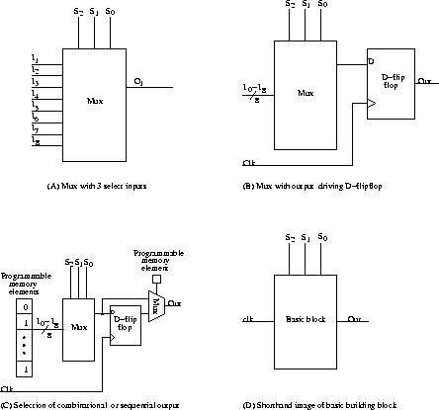
A Fictitious FPGA Architecture
(With Multiplexer As Functionally Complete Cell)
Basic building block

Slide 8
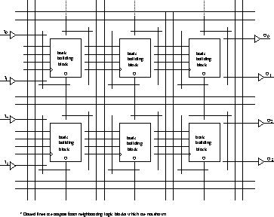
Interconnection Framework
Granularity and interconnection structure has caused a split in the industry
FPGA
  Fine grained
  Variable length interconnect segments
  Timing in general is not predictable; Timing extracted after placement and route

Slide 9
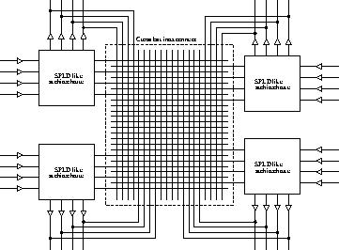
Interconnection Framework
CPLD
  Coarse grained
  (SPLD like blocks)
  Programmable crossbar interconnect structure
  Interconnect structure uses continuous metal lines
  The switch matrix may or may not be fully populated
  Timing predictable if fully populated
  Architecture does not scale well

Slide 10
Field Programmability
Field programmability is achieved through switches (Transistors controlled by memory elements or fuses)
Switches control the following aspects
    Interconnection among wire segments
    Configuration of logic blocks
Distributed memory elements controlling the switches and configuration of logic blocks are together called “Configuration Memory”

Slide 11
Technology of Programmable Elements
Vary from vendor to vendor. All share the common property: Configurable in one of the two positions – ‘ON’ or ‘OFF’
Can be classified into three categories:
  SRAM based
  Fuse based
  EPROM/EEPROM/Flash based
Desired properties:
    Minimum area consumption
    Low on resistance; High off resistance
    Low parasitic capacitance to the attached wire
    Reliability in volume production

Slide 12
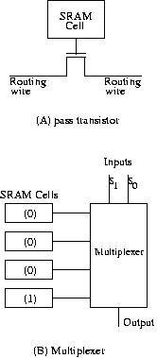
SRAM Programming Technology
Employs SRAM (Static RAM) cells to control pass transistors and/or transmission gates
SRAM cells control the configuration of logic block as well
Volatile
  Needs an external storage
  Needs a power-on configuration mechanism
  In-circuit re-programmable
Lesser configuration time
Occupies relatively larger area

Slide 13
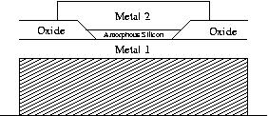
Anti-fuse Programming Technology
Though implementation differ, all anti-fuse programming elements share common property
  Uses materials which normally resides in high impedance state
  But can be fused irreversibly into low impedance state by applying high voltage

Slide 14
Anti-fuse Programming Technology
Very low ON Resistance (Faster implementation of circuits)
Limited size of anti-fuse elements; Interconnects occupy relatively lesser area
  Offset : Larger transistors needed for programming
One Time Programmable
  Cannot be re-programmed
    (Design changes are not possible)
  Retain configuration after power off

Slide 15
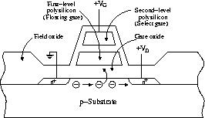
EPROM, EEPROM or Flash Based Programming Technology
EPROM Programming Technology
  Two gates: Floating and Select
  Normal mode:
    No charge on floating gate
    Transistor behaves as normal n-channel transistor
  Floating gate charged by applying high voltage
    Threshold of transistor (as seen by gate) increases
    Transistor turned off permanently
  Re-programmable by exposing to UV radiation

Slide 16
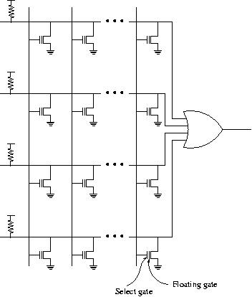
EPROM Programming Technology
Used as pull-down devices
Consumes static power

Slide 17
EPROM Programming Technology
No external storage mechanism
Re-programmable (Not all!)
Not in-system re-programmable
Re-programming is a time consuming task

Slide 18
EEPROM Programming Technology
Two gates: Floating and Select
Functionally equivalent to EPROM; Construction and structure differ
Electrically Erasable: Re-programmable by applying high voltage
(No UV radiation expose!)
When un-programmed, the threshold (as seen by select gate) is negative!

Slide 19
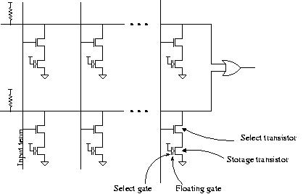
EEPROM Programming Technology

Slide 20
EEPROM Programming Technology
Re-programmable; In general, in-system re-programmable
Re-programming consumes lesser time compared to EPROM technology
Multiple voltage sources may be required
Area occupied is twice that of EPROM!

Slide 21
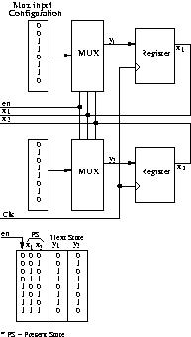
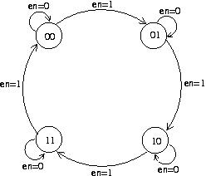
An Example
Modulo-4 counter: Specification
Modulo-4 counter: Logic Implementation

Slide 22
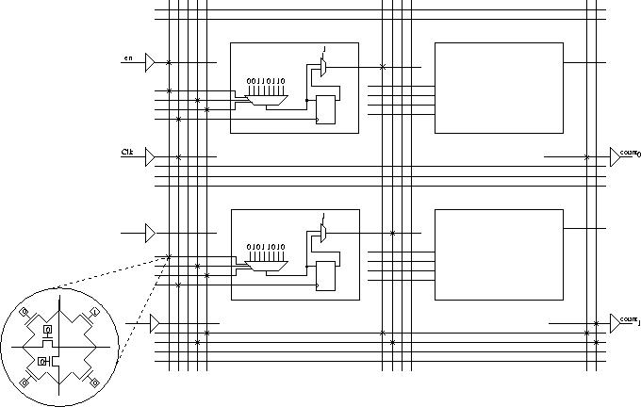
FPGA Implementation of Modulo-4 Counter

Slide 23
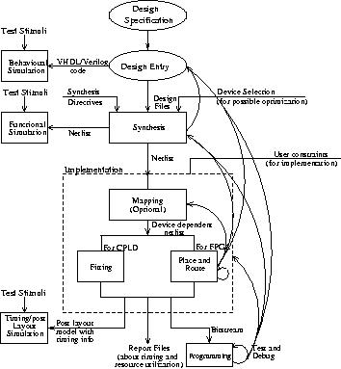
Design Steps Involved in Designing With FPGAs
Understand and define design requirements
Design description
Behavioural simulation (Source code interpretation)
Synthesis
Functional or Gate level simulation
Implementation
  Fitting
  Place and Route
Timing or Post layout simulation
Programming, Test and Debug

Slide 24
Commercially Available Devices
Architecture differs from vendor to vendor
Characterized by
  Structure and content of logic block
  Structure and content of routing resources
To examine, look at some of available devices
  FPGA: Xilinx (XC4000)
  CPLD: Altera (MAX 5K)

Slide 25
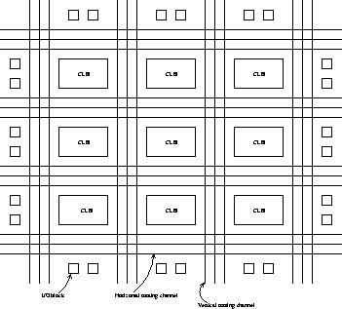
Xilinx FPGAs
Generic Xilinx Architecture
Symmetric Array based; Array consists of CLBs with LUTs and D-Flipflops
N-input LUTs can implement any n-input boolean function
Array embedded within the periphery of IO blocks
Array elements interleaved with routing resources (wire segments, switch matrix and single connection points)
Employs SRAM technology

Slide 26
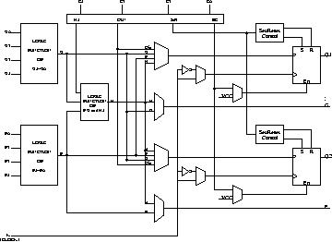
XC 4000
3 LUTs and 2 Flip-flops in a two stage arrangement
2 Outputs: Can be registered or combinational
External signals can also be registered
More of internal signals are available for connections
Can implement any two independent functions of four variables or any single function of five variables
XC4000 CLB

Slide 27
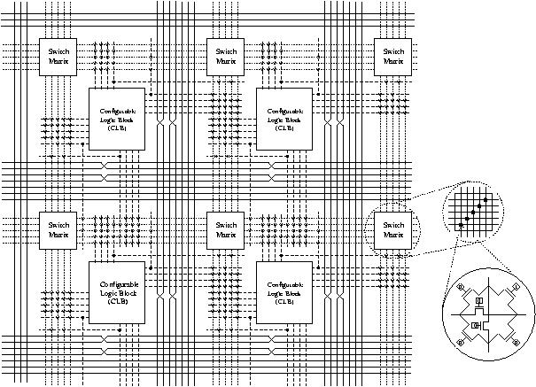
XC4000
XC4000 Routing Architecture

Slide 28
XC 4000
XC4000 Routing Architecture
  Wire segments
    Single length lines
      Spans single CLB
      Connects adjacent CLBs
      Used to connect signals that do not have critical timing requirements
    Double length lines
      Spans two CLBs
      Uses half as much switch as a single length connection
    Long lines
      Low skew; Used for signals such as clock
      Relatively rare resource
  Switch Matrix
    Every line is connected to lines on the other three direction
    Each connection requires six transistors

Slide 29
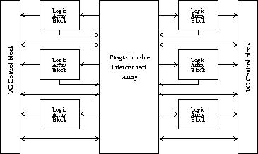
ALTERA CPLDS
Hierarchical PLD structure
  First level: LABs (Functional blocks); LAB is similar to SPLDs
  Second Level: Interconnections among LABs
LAB consists of
  Product term array
  Product term distribution
  Macro-cells
  Expander product terms
Interconnection region: PIA
EPROM/EEPROM based
Example: MAX5K, MAX7K
Altera generic architecture

Slide 30
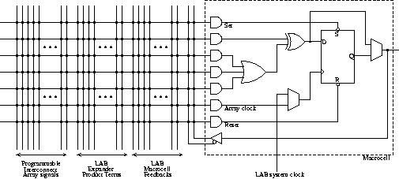
MAX 5000
MAX5K Macrocell
Three wide AND gate feed an OR gate (Sum of products)
XOR gate may be used in arithmetic operations or in polarity selection
One flipflop per macrocell; Outputs may be registered
Flipflop preset and clear are via product terms; Clock may be either system clock or internally generated
Output may be driven out or fedback
Feedback is both local and global; Local feedback is within macrocell and is quicker

Slide 31
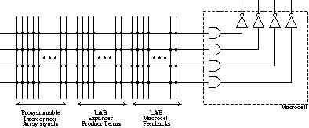
MAX 5000
  MAX5000 Expander Product Term
Number of product terms to macrocell limited
Wider functions implemented via expander product terms
Foldback NAND structure
Inputs are from PIA, expander product term and macrocell feedback
Outputs of expander product term are sent to other macrocell and to itself

Slide 32
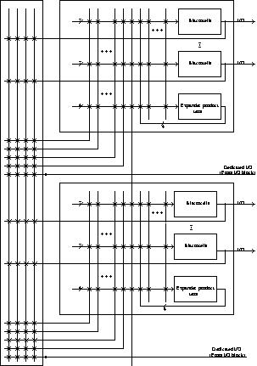
MAX 5000
MAX5000 Architecture
Second level of hierarchy: connections among LABs
LABs are connected via PIA
Interconnections may be global or local; Global interconnects uses PIA
PIA consists of long wiring segments:
  Spans entire length of chip and passes adjacent to each LAB
PIA fully populated
  Predictable timing

Slide 33
SRAM FPGA -- EEPROM FPGA
An FPGA is similar to several other types of devices which have been around for quite a while, the difference being that an FPGA is simply much more expandable and versatile. The devices which FPGAs get compared to most often are CPLDs (Complex Programmable Logic Devices), which are similar in function but typically have way less logic gates inside them; Customizable CPU design is much more feasible with an FPGA. Once upon a time, CPLDs also had the distinct advantage of retaining their configuration even

Slide 34
SRAM FPGA -- EEPROM FPGA
when turned off; When FPGAs first came out, they used simple SRAM to hold their configuration, which of course would be lost when the device lost power. Back then, the FPGA had to be programmed from scratch every time it was turned on, usually from a separate serial ROM chip. But today, FPGAs come in Flash, EPROM, and EEPROM variants, which will retain configuration, and which can also be re-programmed. (Fuse and anti-fuse FPGAs also exist, which act like PROMs in that they are one-time programmable, and cannot be reprogrammed

Slide 35
SRAM FPGA -- EEPROM FPGA
afterward.) Despite this, however, most FPGAs still use SRAM for reasons of simplicity (when you need to reprogram it, it's easier to re-encode a small ROM chip than to reprogram a large FPGA chip), so count on having to use a separate boot ROM for the FPGA.
Use of an FPGA is broadly divided into two main stages: The first is "configuration mode", the mode in which the FPGA is when you first power it up. Configuration mode is, as you may have guessed, where you configure the FPGA; That is,

Slide 36
SRAM FPGA -- EEPROM FPGA
this is when you load your code into it, dictating how the pins behave. Once configuration is complete, the FPGA goes into "user mode", its main mode of operation, where the programmed circuit actually starts functioning.

Slide 37
Product – FPGA vs ASIC
Comparison:
FPGA benefits vs ASICs:
- Design time: 9 month design cycle vs 2-3 years
- Cost: No $3-5 M upfront (NRE) design cost.
No $100-500K mask-set cost
- Volume: High initial ASIC cost recovered only in very high volume products
Due to Moore’s law, many ASIC market requirements now met by FPGAs
- Eg. Virtex II Pro has 4 processors, 10 Mb memory, IO
Resulting Market Shift:
Dramatic decline in number of ASIC design starts:
- 11,000 in ’97
- 1,500 in ’02
FPGAs as a % of Logic market:
- Increase from 10 to 22% in past 3-4 years
FPGAs (or programmable logic) is the fastest growing segment of the semiconductor industry!!

Slide 38
FPGA/ASIC Crossover Changes
90nm / 300mm ASICs
Cost
150nm / 200mm ASICs
90nm / 300mm FPGAs
150nm / 200mm FPGAs
FPGA Cost Advantage
FPGA Cost Advantage
FPGA Cost Advantage
ASIC Cost Advantage
ASIC Cost Advantage
Production Volume
Notes:
This graph shows the impact of the rapid technology evolution… (click)
The significant saving in silicon cost helps closing the gap in unit cost between ASICs and FPGAs, moving the crossover towards higher volume (click)
In addition, the starting cost for each generation of silicon technology skyrockets, which further moves out the crossover.

Slide 39
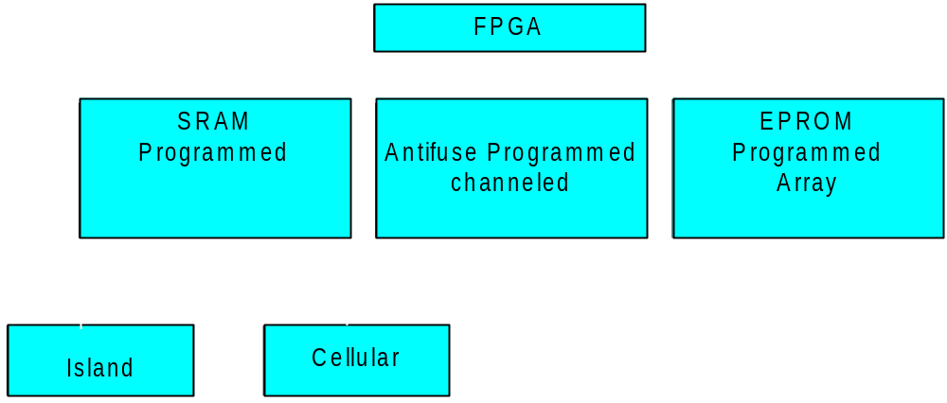
Taxonomy of FPGAs

