Slide 1
Data Science Capstone project
NHAN NGUYEN CAO
28 August 2021

Slide 2

Outline
Executive Summary
Introduction
Methodology
Results
Conclusion
Appendix

Slide 3

Executive Summary
For this Capstone project, the methodologies of Data Collection, Data Preparation (using Data Wrangling), Data Understanding (using some Exploratory Data Analysis (EDA) techniques) as well as Modeling and Evaluation were used to achieve the goals.
Generally speaking, the project was able to draw a complete and general overviewing of the dataset to point out some insights as well as successfully build a predictive model to predict the set problem.

Slide 4

Introduction
Taking the scenario of a newly-created rocket company – Space Y – that is aiming to compete with Space X, the project’s main goal is to draw some beneficial insights from public dataset of Space X about the launches of Falcon on the first stage (focus on Falcon 9) and used those insights to reach the answer to the question.
For this Capstone project, the question to answer is whether the provided dataset can be used to build a good predictive model that predict if the Falcon 9 first stage will land successfully.

Slide 5

Methodology
Data collection methodology:
Using REST API and Web Scraping
Perform data wrangling
Dealing with Null value and build predict labels.
Perform exploratory data analysis (EDA) using visualization and SQL
Perform interactive visual analytics using Folium and Plotly Dash
Perform predictive analysis using classification models
Evaluate on 4 types of models, using GridSearch for hyperparameters tuning.

Slide 6
Methodology

Slide 7
Data collection
Dataset for the Capstone project was gathered using 2 methods from 2 sources:
Gathering data from SpaceX REST API, an open-source API storing data relating to SpaceX. The project focus on the dataset about past launches of rockets of SpaceX.
Gathering data about Falcon 9 and Falcon Heavy launches by using Web Scraping technique from Wikipedia page about “List of Falcon 9 and Falcon Heavy launches”

Slide 8
Data collection – SpaceX API
Flowchart
1. The data is collected by using GET method on the provided static URL using the requests library.
2. The response is then decoded into JSON format using .json() function.
3. Then, the decoded response is converted into a DataFrame using .json_normalize().
4. Finally, we filter the dataframe to only contain rows about Falcon 9 launches.
Collect Data using GET method
Decoded into JSON
Converted into a Dataframe
Filter only Falcon 9
Notebook: https://github.com/nguyencaonhan271201/IBM-Data-Science-Certificate-Capstone-Project/blob/main/Data%20Collection.ipynb

Slide 9
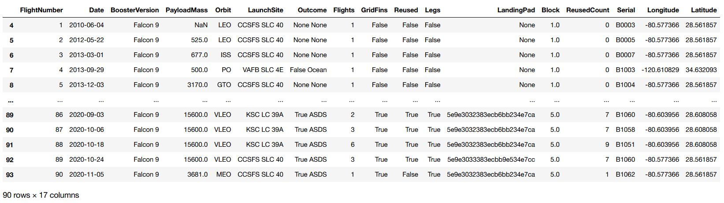
Data collection – SpaceX API
Final Data

Slide 10
Data collection – Web scraping
Flowchart
Collect Data using GET method
Create BeautifulSoup object from response.
Find all “table” elements from BeautifulSoup object.
Fill rows and convert to a DataFrame
1. The data is collected by using GET method on the provided static URL using the requests library.
2. Create a BeautifulSoup object from the received response.
3. Find “table” elements from the BeautifulSoup object then extract column names.
4. Fill a dictionary with rows from the table, then convert to a DataFrame for usage.
Notebook: https://github.com/nguyencaonhan271201/IBM-Data-Science-Certificate-Capstone-Project/blob/main/Data%20Collection%20with%20Web%20Scraping.ipynb

Slide 11
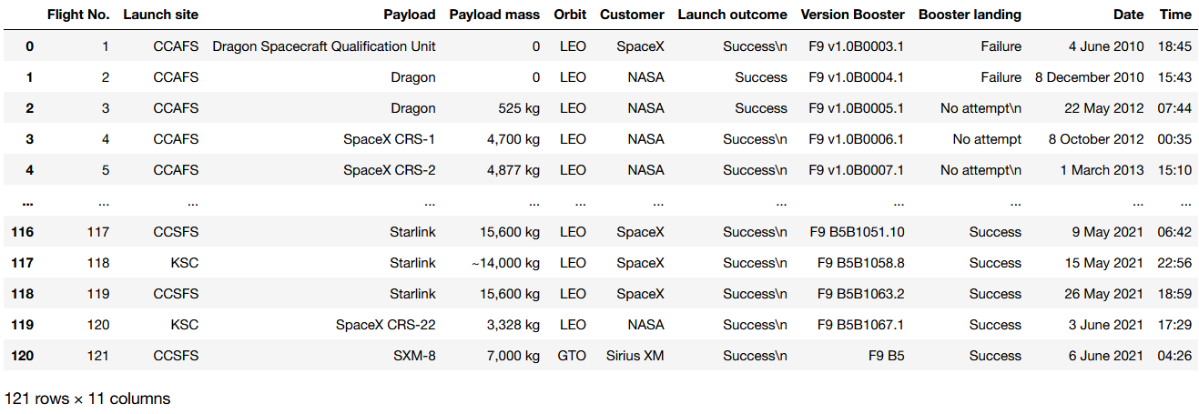
Data collection – Web scraping
Final Data

Slide 12
Data wrangling
After Data Collection, the Data wrangling is performed. The main goals of this process includes dealing with null data and identifying target labels, creating appropriate training labels from that for the model.
Examine null data and data types for each columns
Calculate number of launches on each site and occurrence of each orbit
Determine available labels for Outcome, group into 2 groups (success and failure)
Create Outcome label (0 for failure, 1 for success) as target label for model
Notebook: https://github.com/nguyencaonhan271201/IBM-Data-Science-Certificate-Capstone-Project/blob/main/Data%20Wrangling.ipynb

Slide 13
Data wrangling – Dealing with Null data
Overviewing the description of data, the only column containing Null data is “LandingPad”, which is not a numerical attribute. Therefore, no further action was performed.

Slide 14
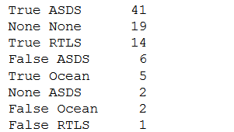

Data wrangling – Creating the target labels
Since the goal of the project is creating a predictive model capable of predicting if each Falcon 9 launch will be successful or not. Therefore, the target labels need to be able to demonstrate this.
Examining the “Outcome” column points out that there are 8 available values for this column, each of which has a clear outcome of either success or failure. Therefore, classifying the 8 labels into 2 groups and encoding each group with an appropriate label (0 for failure and 1 for successful) was the method chose.

Slide 15
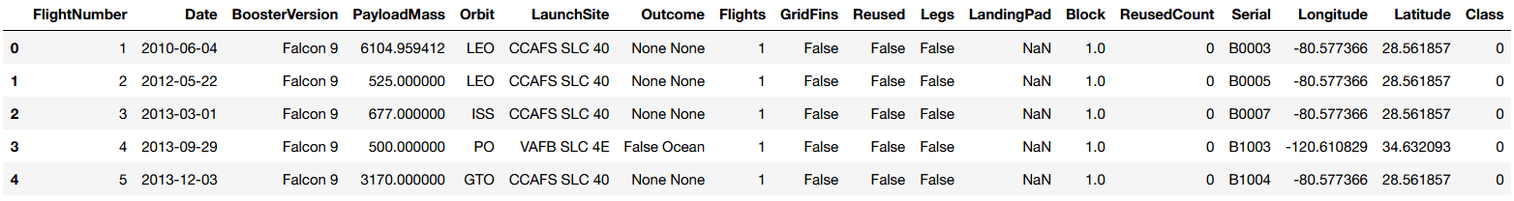
Data wrangling - Result
After Data Wrangling process, the final dataset looks like below. The “Class” column will be used as the target label for the model.

Slide 16
EDA with data visualization
The first method used for Exploratory Data Analysis (EDA) was using Data Visualization.
By using different types of charts and graphs, insights were pointed out from the data as well as the relationships between attributes inside data.
Notebook: https://github.com/nguyencaonhan271201/IBM-Data-Science-Certificate-Capstone-Project/blob/main/EDA%20with%20Visualization.ipynb

Slide 17
EDA with data visualization
6 charts were created to draw insights from data, including
Flight Number vs. Launch Site: use scatter plot to find relationship between the two variables.
Payload vs. Launch Site: use scatter plot to find relationship between the two variables.
Success rate vs. Orbit type: use a bar chart to easily compare the success rate between orbit types.
Flight Number vs. Orbit type: use scatter plot to find relationship between the two variables.
Payload vs. Orbit type: use scatter plot to find relationship between the two variables.
Launch success yearly trend: use line chart to better illustrate the trend and changes in success rates through yeras

Slide 18
EDA with SQL
Further into Exploratory Data Analysis, some SQL queries were also used to gather more specific details and insights.
The performed SQL queries include:
1. Display the names of the unique launch sites
2. Display 5 records where launch sites begin with the string 'CCA’
3. Display the total payload mass carried by boosters launched by NASA (CRS)
4. Display average payload mass carried by booster version F9 v1.1
5. List the date when the first succesful landing outcome in ground pad was acheived.
6. List the names of the boosters which have success in drone ship and have payload mass greater than 4000 but less than 6000.
7. List the total number of successful and failure mission outcomes
8. List the names of the booster_versions which have carried the maximum payload mass. Use a subquery
9. List the failed landing_outcomes in drone ship, their booster versions, and launch site names for the in year 2015
10. Rank the count of landing outcomes (such as Failure (drone ship) or Success (ground pad)) between the date 2010-06-04 and 2017-03-20, in descending order.
Notebook: https://github.com/nguyencaonhan271201/IBM-Data-Science-Certificate-Capstone-Project/blob/main/EDA%20with%20SQL.ipynb

Slide 19
Build an interactive map with Folium
An interactive map was added using Folium library, showing the launch sites for different launches.
Each launch site is displayed using a Circle and a Marker.
Each launch is illustrated using a Marker containing an Icon showing the outcome of the launch (using color of the Icon), and is included in a MarkerCluster of the launch site.
Distance from launch sites to some locations, cities were illustrated using Markers and PolyLines for better showing the estimated Euclidean distance.
Notebook: https://github.com/nguyencaonhan271201/IBM-Data-Science-Certificate-Capstone-Project/blob/main/Visual%20Analytics%20with%20Folium.ipynb

Slide 20
Build a Dashboard with Plotly Dash
A Dashboard was built for interactively visualization from the dataset.
A total of 2 plots/graphs were used to build the Dashboard, include:
A pie chart showing either the proportion of success rate of different launch sites compared to the overall success rate or the success/failure proportion for each launch site.
A scatter plot showing the correlation between Payload and Success rate for either all sites or of a site, categorized by booster version. This plot is linked with a slider for interactive input range of payload mass.
Dash file: https://github.com/nguyencaonhan271201/IBM-Data-Science-Certificate-Capstone-Project/blob/main/spacex_dash_app.py

Slide 21
Predictive analysis (Classification)
Building a model to predict if a Falcon 9 launch will land successfully, 4 different classification models were chosen to be evaluate to choose the best one including Logistic Regression, SVM, Decision Tree and K-Nearest Neighbors.
The dataset is split into 8/2 train/test ratio and normalized using Standard Scaler.
After that, Grid Search was performed for each model to find the best set of hyperparameters for each one. Then evaluate the accuracy for each model to choose the best one.
Notebook: https://github.com/nguyencaonhan271201/IBM-Data-Science-Certificate-Capstone-Project/blob/main/Machine%20Learning%20Prediction.ipynb

Slide 22
Predictive analysis (Classification)
Model Development Process Workflow
Normalize Data Set
Train/Test Split
Grid Search on each classification to find best set of hyperparameters
Train the models using training set and the found best set of hyperparameters
Evaluate the models using the Test Set by accuracy score and Confusion Matrix.
Compare and choose the best model.

Slide 23
Results
Exploratory data analysis results
Interactive analytics demo in screenshots
Predictive analysis results

Slide 24
EDA with Visualization

Slide 25
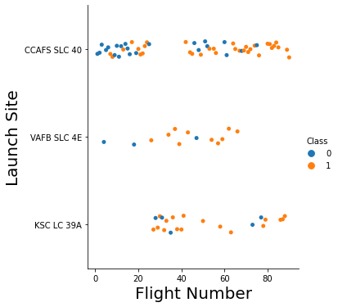
Flight Number vs. Launch Site
There is no really clear relationships can be found between Flight Number and Launch Site with the outcome of the launch.
Generally speaking, VAFB SLC 4E tends to be more likely to be successful for higher flight number.
However, for the remaining launch sites, the relationships are not clearly available at all.

Slide 26
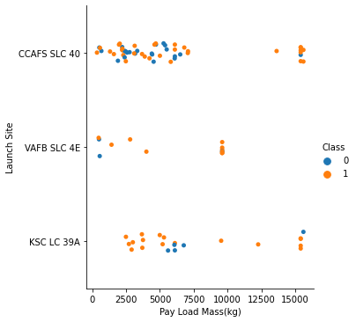
Payload vs. Launch Site
The relationship between payload mass and launch sites in contrast is more clear than flight number.
We can see from the scatter plot that for all three launch sites, the heavier the payload, the more likely it is to be successful.
For CCAFS SLC 40, the result for the ones lighter than 10000 kg is harder to be determined while for the others, there exists a range in which the results are likely to be unsuccessful (for example: close to 0 for VAFB SLC 4E and around 5000 to 7000 for KSC LC 39A).

Slide 27
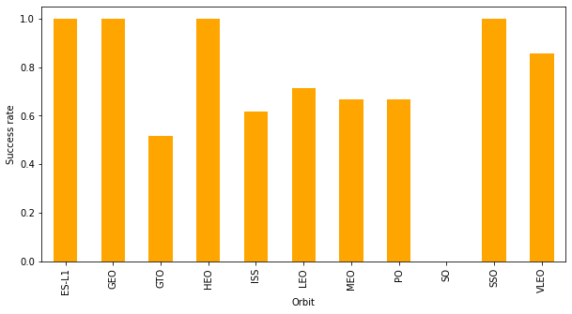
Success rate vs. Orbit type
The bar chart pointed out that there are some types of Orbit that are much more likely to be successful compared to each other.
ES-L1, GEO, HEO, SSO are orbit types with success rates of 100%, while for SO, it is a surprisingly 0% success rate. The remaining varies but in general the success rate is higher than a half.

Slide 28
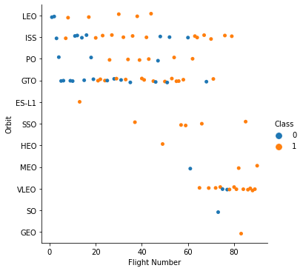
Flight Number vs. Orbit type
Not all types of Orbit have a clear relationship between success rate and flight number except for LEO or MEO where the flights with higher flight number seems to be more likely to be successful.

Slide 29
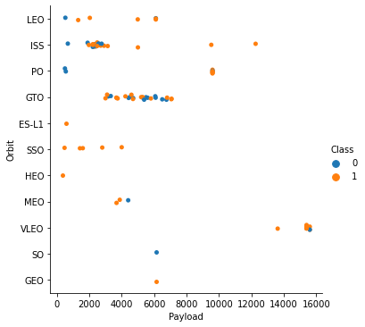
Payload vs. Orbit type
The relationship between Orbit types and Payload seems to be more clear. We can point out that for some orbits, the heavier are more likely to be success, for example LEO, ISS, PO.

Slide 30
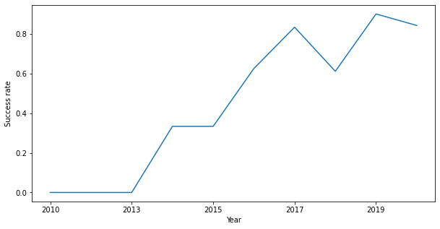
Launch success yearly trend
We can point out that as the project grows further into the time, the more likely it is to be success in launching. Despite the slight fall of success rate to 60% in 2018, the success rate of 2019 reaches the peak of nearly 90%, a noticeable rate.
Generally speaking, the success rates are surely more than a half since 2016 until later on.

Slide 31
EDA with SQL

Slide 32

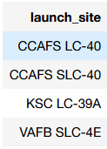
All launch site names
Query:
Result:
Explanation: Simply select all unique values of “LAUNCH_SITE” columns using the SELECT query.

Slide 33

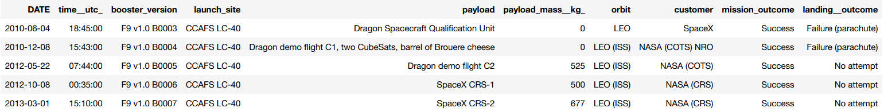
Launch site names begin with `CCA`
Query
Result
Explanation: SELECT all available columns from table, with additional condition of site name begins with ‘CCA’ (using Wildcard character) inside WHERE clauseand limit the result with 5 first record using LIMIT statement

Slide 34


Total payload mass
Query
Result
Explanation: Simply select all payload_mass of the launches of customer ‘NASA (CRS)’ (using WHERE clause to filter) and then using SUM aggregate function to add up the total payload mass.

Slide 35


Average payload mass by F9 v1.1
Query
Result
Explanation: SELECT all payload_mass filtered with booster_version ‘F9 v1.1’ only (using Wildcard character in WHERE statement) then using AVG aggregate function to calculate average. Casting the payload_masses into float in order for the average to be displayed in decimal.

Slide 36


First successful ground landing date
Query
Result
Explanation: Since DATE datatype is comparable in SQL, simple use MIN aggregate function to select the first date. The examining records are filter with “Success” landing outcome only using Wildcard Character inside WHERE statement.

Slide 37
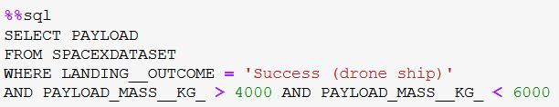
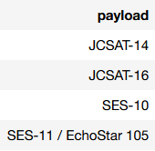
Successful drone ship landing with payload between 4000 and 6000
Query
Result
Explanation: SELECT the name and filter out appropriate Landing_Outcome and Payload_Mass inside WHERE statement.

Slide 38

Total number of successful and failure mission outcomes
Query
Result
Explanation: Execute the COUNT function for successful and failure missions in different tables, then INNER JOIN the tables to get the appropriate result.

Slide 39
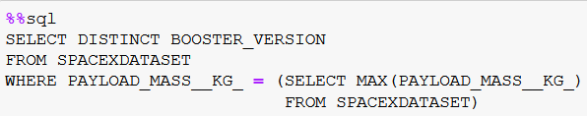
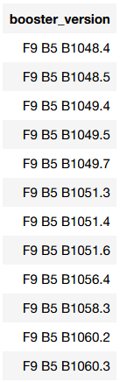
Boosters carried maximum payload
Query
Result
Explanation: Using the sub-query to find out the maximum payload, then add the sub-query into the WHERE statement to filter out the records with maximum payloads and SELECT out the requirement attribute.

Slide 40
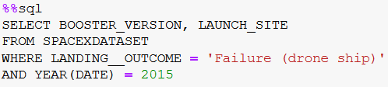
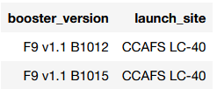
2015 launch records
Query
Result
Explanation: Filter the year of launch by applying YEAR function on Date column and compare with 2015, then filter the appropriate Landing_Outcome also inside WHERE statement before SELECT the required attributes to display.

Slide 41
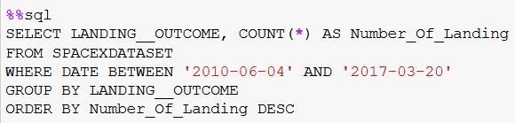
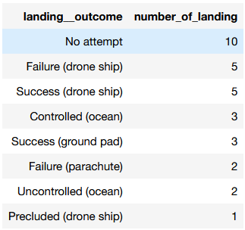
Rank landing outcome count between 2010-06-04 and 2017-03-20
Query
Result
Explanation: Select the landing outcomes, then use GROUP BY clause to group by that attribute and use COUNT aggregate function to retrieve the count of each outcome. Rank the displayed result by using ORDER BY clause with DESC option.

Slide 42
Interactive map with Folium

Slide 43
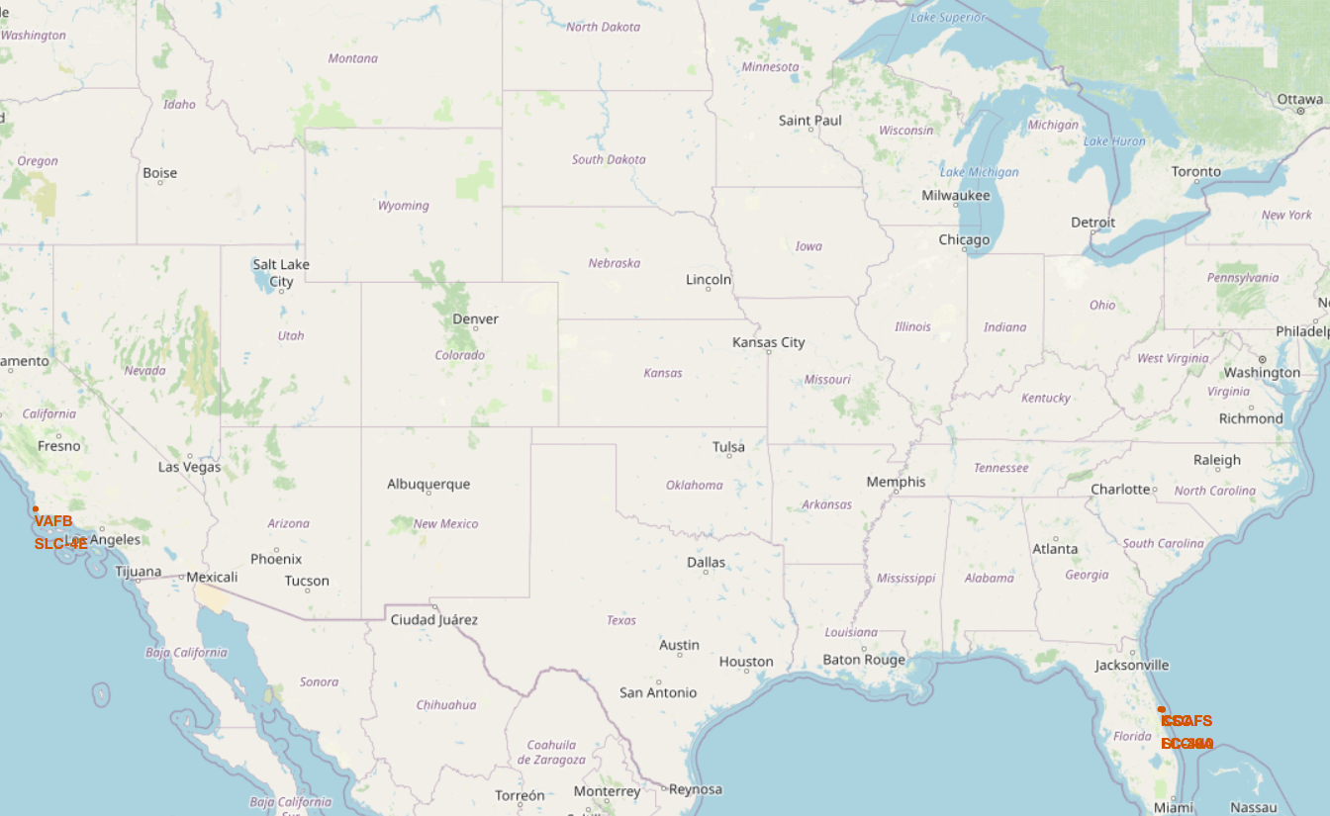
SpaceX Falcon 9 Launch Sites
Although there are 4 different launch sites, they are all cluster around 2 positions. From this map, we can point out that Florida and California are the states where SpaceX chose to launch their rockets, mostly at locations very close to the coastline of the states.

Slide 44
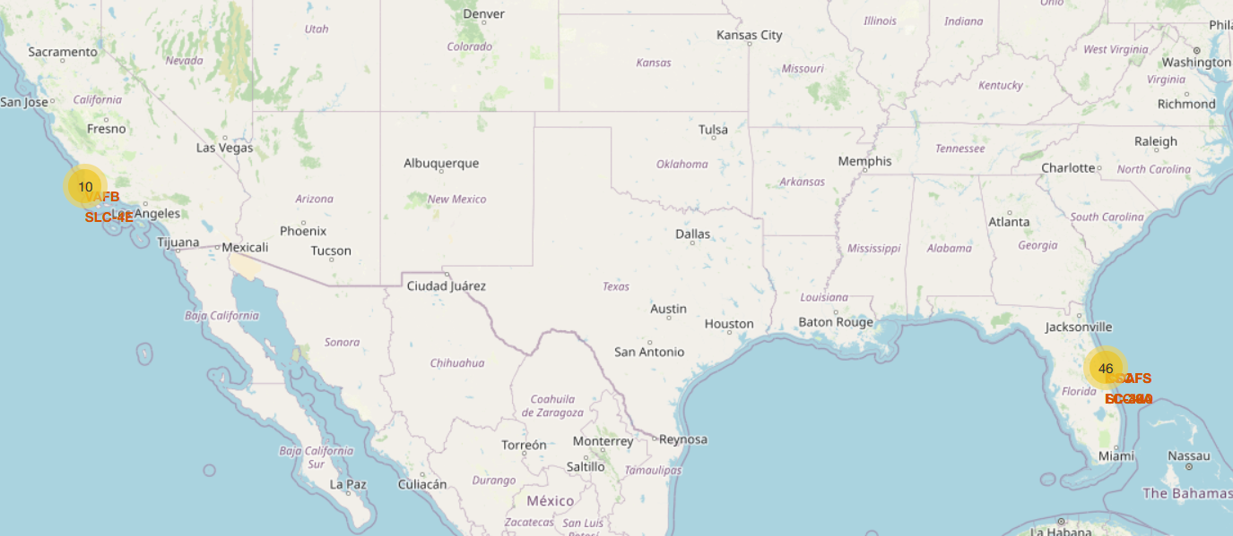
SpaceX Falcon 9 Launches Locations and Outcomes
From the map, it seems like the Eastern launch sites are preferrable by SpaceX for testing its rockets, which 46 launches were made their compared to only 10 launches in the Western launch site.

Slide 45
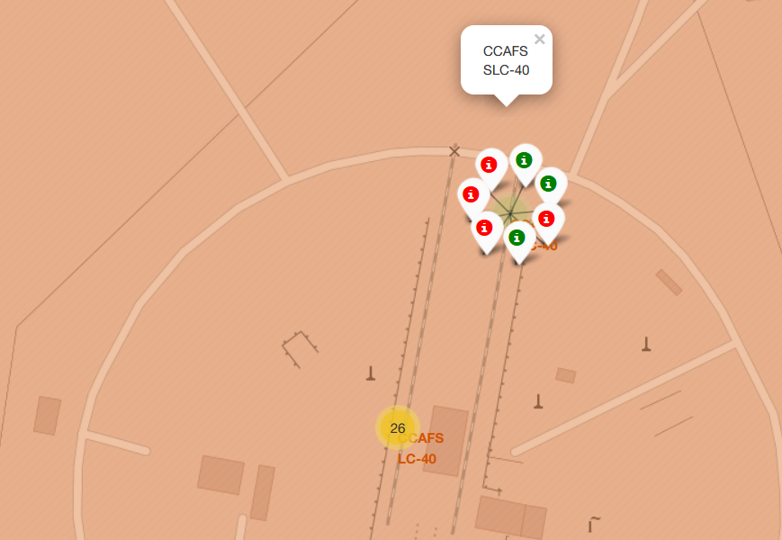
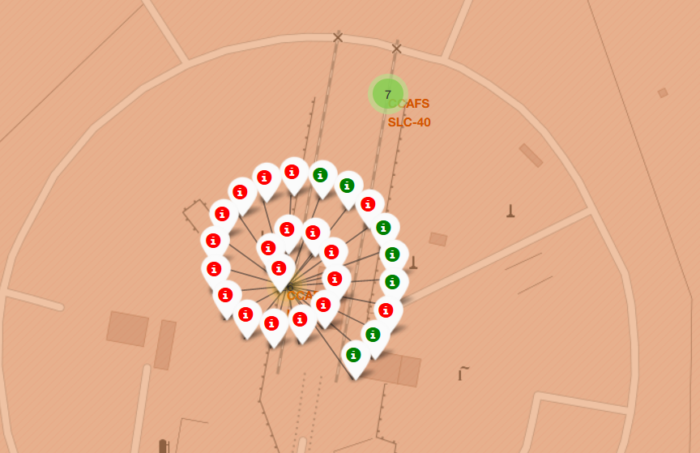
SpaceX Falcon 9 Launches Locations and Outcomes
The group of nearby launch sites CCAFS LC-40 and CCAFS SLC-40 are the common one, fill up to 33 out of 56 launches. Although the success rate for those launch sites are considered quite low.

Slide 46
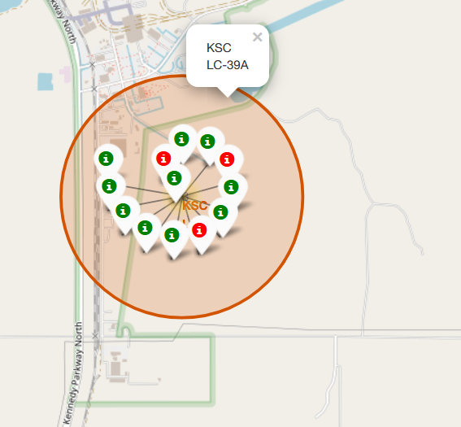
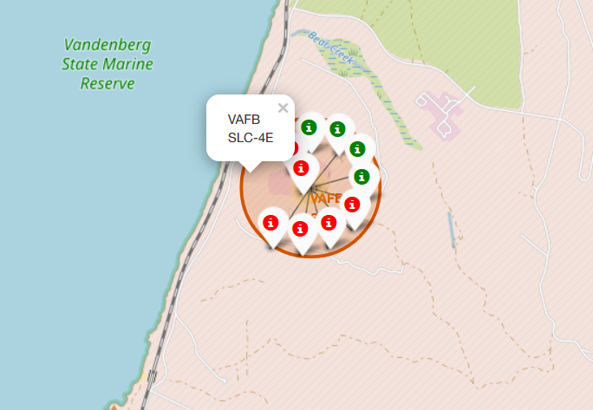
SpaceX Falcon 9 Launches Locations and Outcomes
The Eastern launch site also has a quite low success rate of less than 50% while for the remaining launch site in the Western cluster, the success rate is much higher. It can be concluded that there could be a possibility that the launch sites closer to the land are likely to be more successful than the ones near the beaches and coastlines.

Slide 47
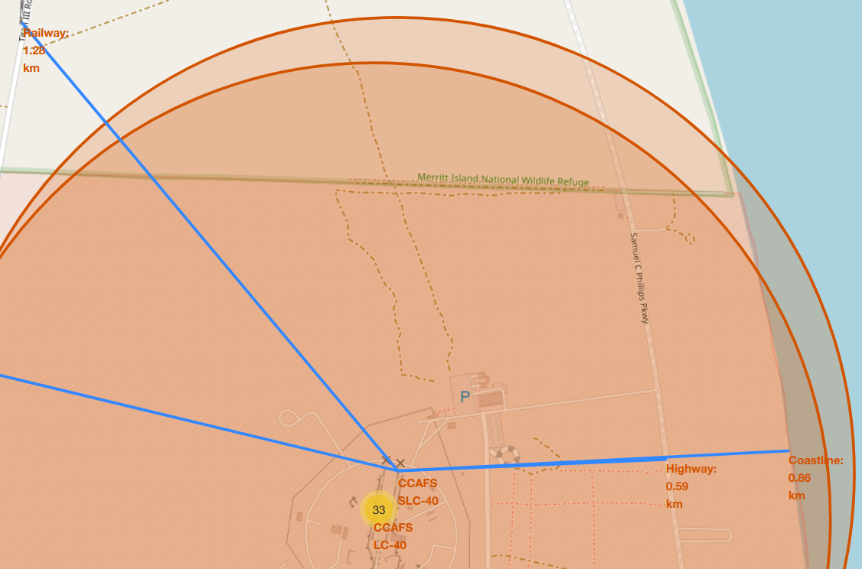
Location of Launch Sites to Public Points
Examine the CCAFS SLC-40 launch site, we can see that the launch site is not very far from some nearby points like Highway, Coastline or Railway. However, almost all of those points are the private ones, not accessible by the public.

Slide 48
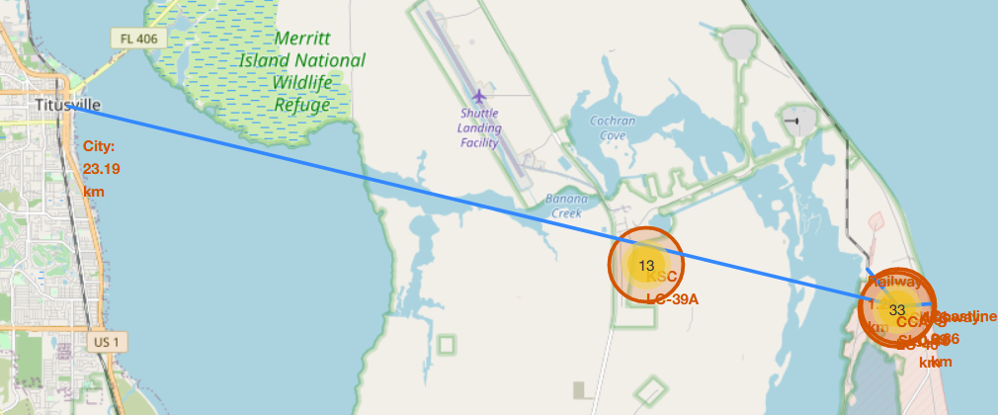
Location of Launch Sites to Public Points
The nearest city point of Titusville is located approximately 23 km away from the launch sites. We can point out that the launch sites tend to be chosen at points that are far from the public. This could be for the purpose of safety in case the launches are unsuccessful.

Slide 49
Build a Dashboard with Plotly Dash

Slide 50
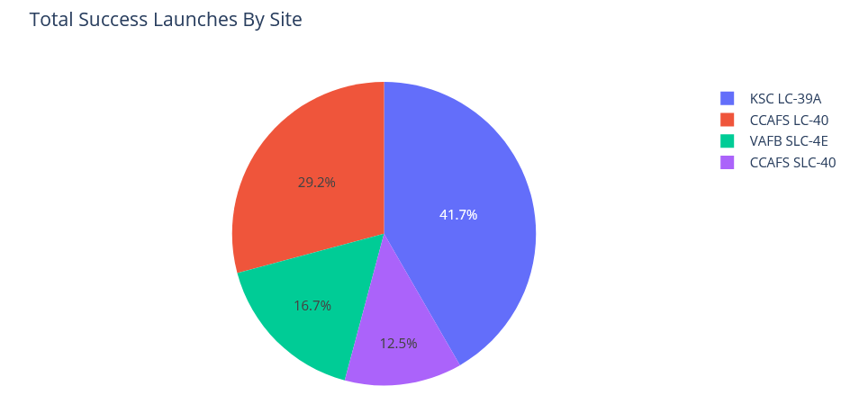
Total Success Launches By All Sites
3 out of 4 “near-coastline” launch sites has an overall proportion rate of less than 30% (with CCAFS SLC-40 has a limited proportion of only one eighth of all success launches). However, KSC LC-39A in contrast has a noticeably proportion that takes up to more than 40% of all the successful launches.

Slide 51
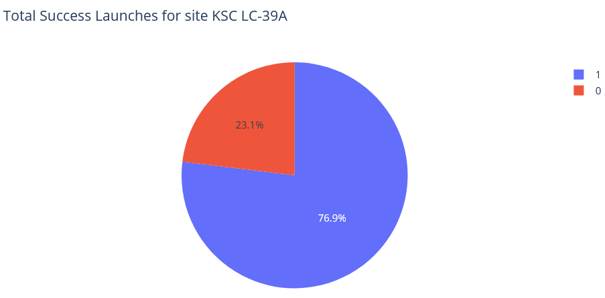
Total Success Launches for site KSC LC-39A
The success rate of site KSC LC-39A is the highest of all four, reaching up to more than three fourth of the total launches at this site.

Slide 52
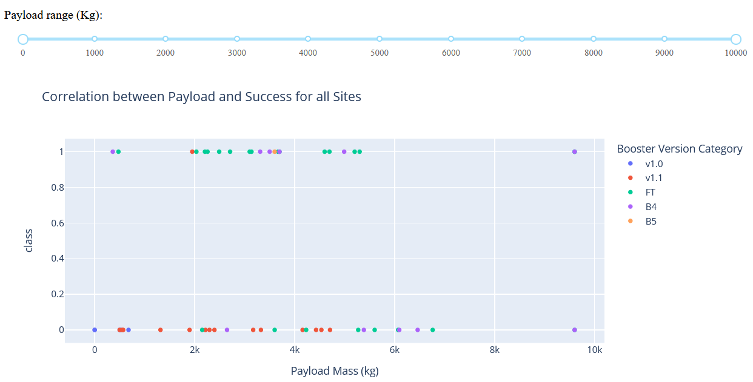
Payload vs Launch Outcome for all Sites
Generally in the whole payload range, FT seems to be the booster version that are more likely to be successful while v1.1 in contrast has quite a lot of failed launches.

Slide 53
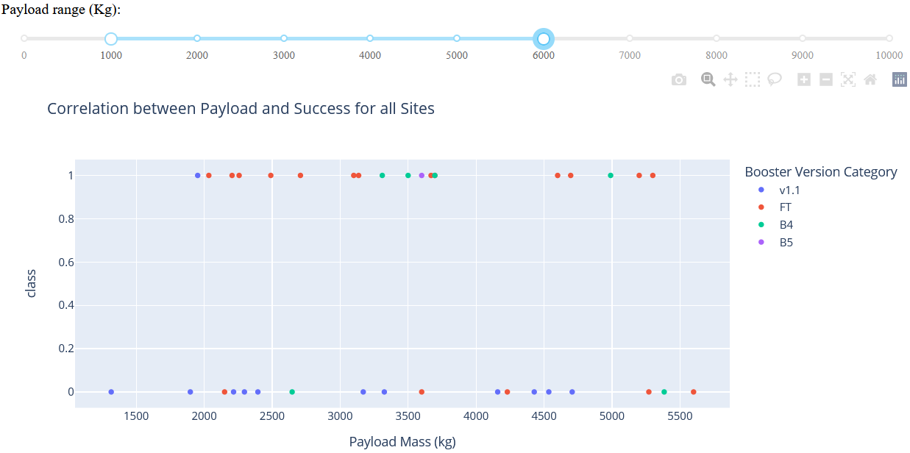
Payload vs Launch Outcome for all Sites
The payload range 1000 – 6000 kg seems to be the common for all launches. The distribution of outcome in this range is similar to the overall range, with FT being the most successful one.

Slide 54
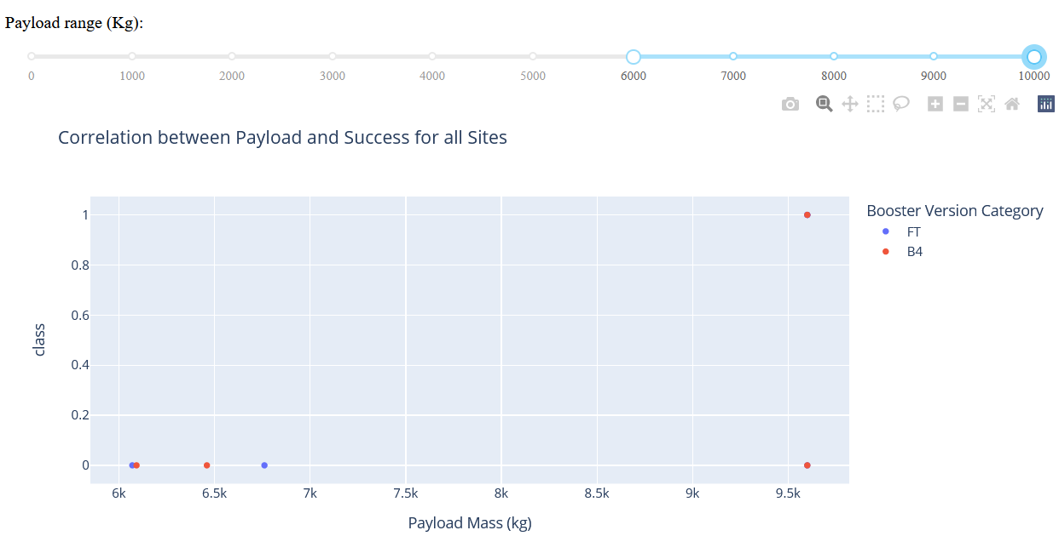
Payload vs Launch Outcome for all Sites
However for the high range from 6000 – 10000, the success rates decrease rapidly as the number of launches in this range is very limited. From 6000 to 9000 only 2 booster versions are available and all of the launches were failed (even FT). Not until a little higher than 9500 that there is a successful launch of booster version B4.

Slide 55
Predictive analysis (Classification)

Slide 56
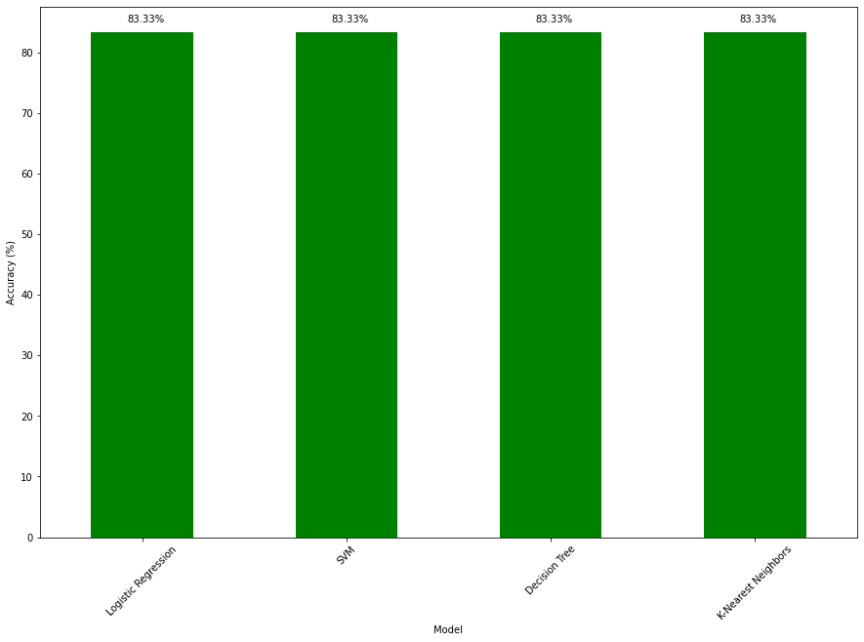
Classification Accuracy
Surprisingly, the performance of all four used models are equal to the others, reaching 83.33% accuracy on test set.
This can be because the size of data set is quite small, so after splitting only 18 samples were included in the test set.
A larger data set can be useful for showing the difference in accuracy between the 4 models.

Slide 57
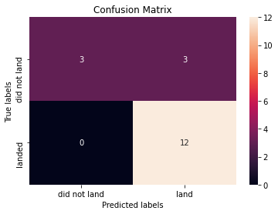
Confusion Matrix
Similarly, the Confusion Matrices of the 4 models are identical to the others.
In general, all the models can predicted quite accurately the test samples, where all landed (successful) launches were predicted correctly.
However, optimization can be made for all the models as among the 6 “unsuccessful” models, only 50% were correctly predicted. This lead to the case that the models tend to predict “landed” labels many more times then “did not land” labels (although the distribution of labels in training set are quite equals), which cause some serious drawbacks and decrease the result of the model on the different evaluation methods.

Slide 58

CONCLUSION
In conclusion, we can point out some points that can better predict whether a launch of Falcon 9 will be successful or not, in detailed:
The heavier the payload, the more likely it is to be a successful launch. This is not true for the payload range of above 6000 kg.
ES-L1, GEO, HEO and SSO are the orbits that are more likely to be successful.
If the launch site is further from the coastline, then there is a higher chance that the launch will be successful.
With lower payload range (common range), FT seems to be the booster version with highest success rate.

Slide 59

APPENDIX
Github Repository: https://github.com/nguyencaonhan271201/IBM-Data-Science-Certificate-Capstone-Project.git
Notebooks:
Data Collection with API: https://github.com/nguyencaonhan271201/IBM-Data-Science-Certificate-Capstone-Project/blob/main/Data%20Collection.ipynb
Data Collection with Web Scraping: https://github.com/nguyencaonhan271201/IBM-Data-Science-Certificate-Capstone-Project/blob/main/Data%20Collection%20with%20Web%20Scraping.ipynb

Slide 60
APPENDIX
Data Wrangling: https://github.com/nguyencaonhan271201/IBM-Data-Science-Certificate-Capstone-Project/blob/main/Data%20Wrangling.ipynb
EDA with Visualization: https://github.com/nguyencaonhan271201/IBM-Data-Science-Certificate-Capstone-Project/blob/main/EDA%20with%20Visualization.ipynb
EDA with SQL:
https://github.com/nguyencaonhan271201/IBM-Data-Science-Certificate-Capstone-Project/blob/main/EDA%20with%20SQL.ipynb

Slide 61
APPENDIX
Visual Analytics with Folium: https://github.com/nguyencaonhan271201/IBM-Data-Science-Certificate-Capstone-Project/blob/main/Visual%20Analytics%20with%20Folium.ipynb
Plotly Dashboard: https://github.com/nguyencaonhan271201/IBM-Data-Science-Certificate-Capstone-Project/blob/main/spacex_dash_app.py
Machine Learning Prediction
https://github.com/nguyencaonhan271201/IBM-Data-Science-Certificate-Capstone-Project/blob/main/Machine%20Learning%20Prediction.ipynb

