Slide 1
INFORMATION TECHNOLOGY PROJECT 2
Instructor: Đặng Minh Thắng
Student: Nguyễn Châu Thảo Quân - 51600072

Slide 2
Construct a student management system
Use Case Diagrams.
System Designs.
Introduction to Laravel.
Conclusions.

Slide 3
Introduction
Student Management System (known as Student Information Management System) is a system that can handle the detail about a student. The detail include their personal information and their academic information.
Student Management System is an automated version of manual Student Management System

Slide 4
Objectives
Store and manage student’s information.
Student can check their information after login successfully.
Admin can manage teacher and resources of an university.

Slide 5
Project descriptions
It is a web-based application.
It is accessible anywhere and anytime via a PC with an Internet connection.

Slide 6
Tools and Platform
Tools
Platform
Front-end: HTML/CSS, JavaScript, Bootstrap, jQuery, SASS.
Back-end: PHP, Laravel.
RDBMS: MySQL (phpMyAdmin with Apache).
Software: XAMPP server
Package management: composer, npm.
Web browser on window.

Slide 7
Construct a student management system
Use Case Diagrams.
System Designs.
Introduction to Laravel.
Conclusions.

Slide 8
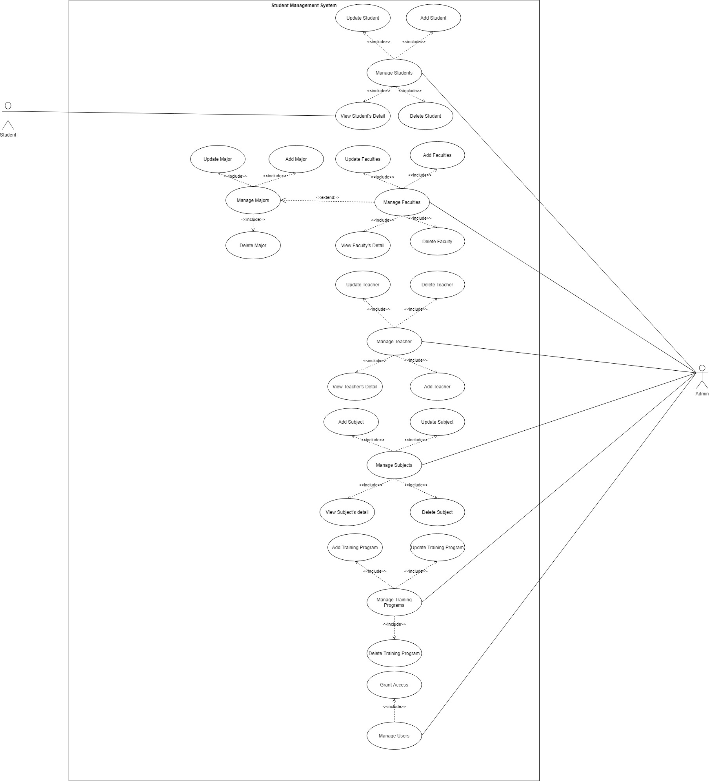

Slide 9
Construct a student management system
Use Case Diagrams.
System Designs.
Introduction to Laravel.
Conclusions.

Slide 10
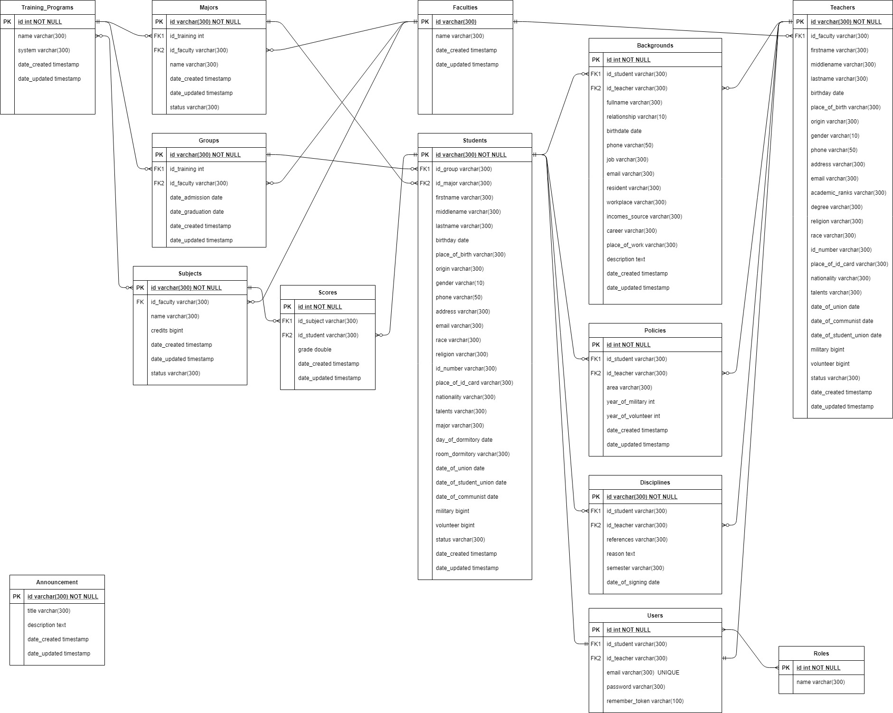

Slide 11
Construct a student management system
Use Case Diagrams.
System Designs.
Introduction to Laravel.
Conclusions.

Slide 12
WHAT IS LARAVEL
Laravel is a powerful and flexible PHP framework provides a structure and starting point for creating a web application. It has a thriving community and a wide ecosystem of tools, and as a result it’s growing in appeal and reach.
Laravel is a free, open-source PHP framework, created by Taylor Otwell and intended for the development of web applications following the MVC architecture pattern and based on Symfony.
Laravel is a web application framework with expression, elegant syntax.

Slide 13
Why Laravel ?
Database migration: create table automatically without SQL first (create database first before starting the migration).
Great Tutorials: support the hints or guides in Laracasts community.
Blade template: use its directives without embedding PHP tag.
MVC support.
High security.
Artisan CLI.

Slide 14
System requirements
PHP 7.0.0+.
PHP extensions: BCMath, Ctype, JSON, Mbstring, PDO, OpenSSL, tokenizer, xml.
Composer
Apache and MySQL (install XAMPP)

Slide 15
Create a Laravel project
Create via composer:
composer create-project laravel/laravel <project_directory>
Create via laravel/installer:
composer global require laravel/installer
laravel new <project_directory>
Run project:
cd <project_directory>
php artisan serve

Slide 16
Construct a student management system
Use Case Diagrams.
System Designs.
Introduction to Laravel.
Conclusions.

Slide 17
Q&A

