Slide 1
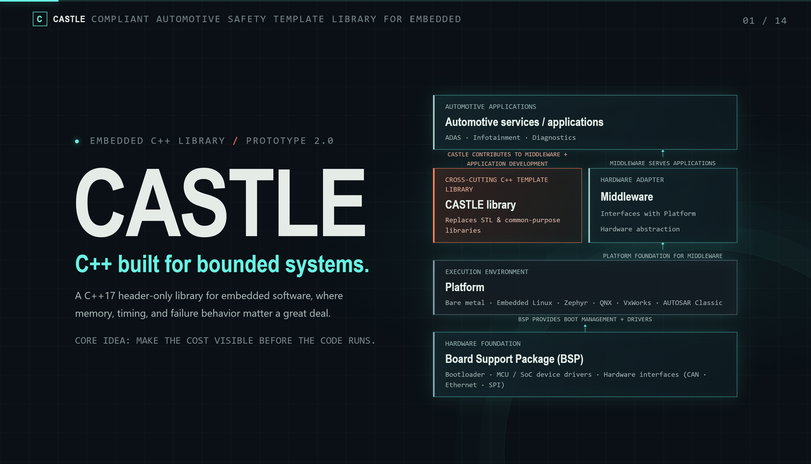
Notes:
The workshop today is to introduce the CASTLE library. But more than a library, we gonna talk about the way of thinking behind it.
CASTLE stands for Compliant Automotive Safety Template Library for Embedded. It is a C++17 header-only library for embedded software. Its goal is simple. It makes familiar C++ tools work well in systems where memory, timing, and errors really matter.
Layered architecture diagram:
CASTLE is not a layer in that stack. It sits besides the middle-ware as a cross-cutting library. Both middle-ware and application code can use it.
It is a C++ toolbox that replaces the STL and other general-purpose libraries where those do not fit the embedded target.
In this presentation, we won’t go through every container or header. Instead, we will look at the problems CASTLE tries to solve, and the habits those problems should build when we write and review code.
Its main idea is this: make the costs visible before the code runs.

Slide 2
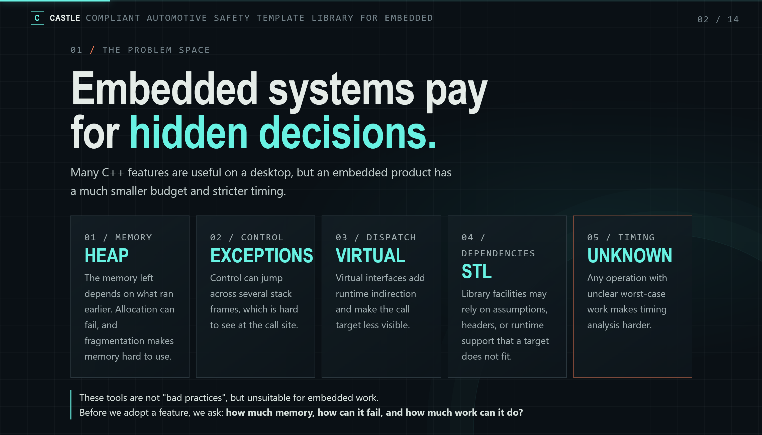
Notes:
Many C++ features are useful. On desktop applications, their cost is usually fine. But the problem is that an embedded device has a small budget, and often strict timing rules.
For examples:
Dynamic allocation: The free memory size depends on what ran before. An allocation can fail. And over time, memory can get fragmented, so it take a few more CPU cycling to look up available segment.
Exceptions: They can jump across many function calls, hard to follow. The exception handling also cost additional performance, cause some unexpected delay.
Virtual functions: They add extra step at runtime.
STL: They may require dynamic allocation that fall back on the first problem.
As we can see, a line of code can cost more than we expect. The worst-case is unclear, making timing analysis harder.
So, modern C++ is not wrong for embedded target. We just need to be careful.
Before we use a feature, ask three questions: How much memory does it cost? How can it fail? How much work can it do?

Slide 3
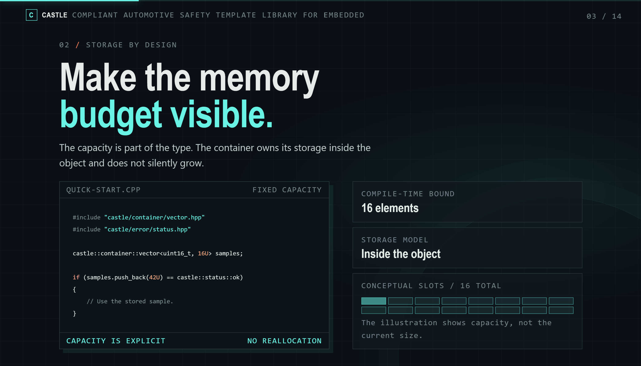
Notes:
And we go for the first one: the memory.
Look at the example, the vector can hold 16 items. That number is written right in the type. It does not change at runtime.
This changes how we think. Instead of asking “How big can this get?”, we ask “How many samples do we really need?”
The caller decides what to do when buffer is full: Reject new item? Drop old item? Slow down the sender? Overwrite data? Log an error? Only the application know what losing data really means, so the decisions belong to the application.
This does not mean operations are fast, it mean the size limit and the full case is clear.

Slide 4
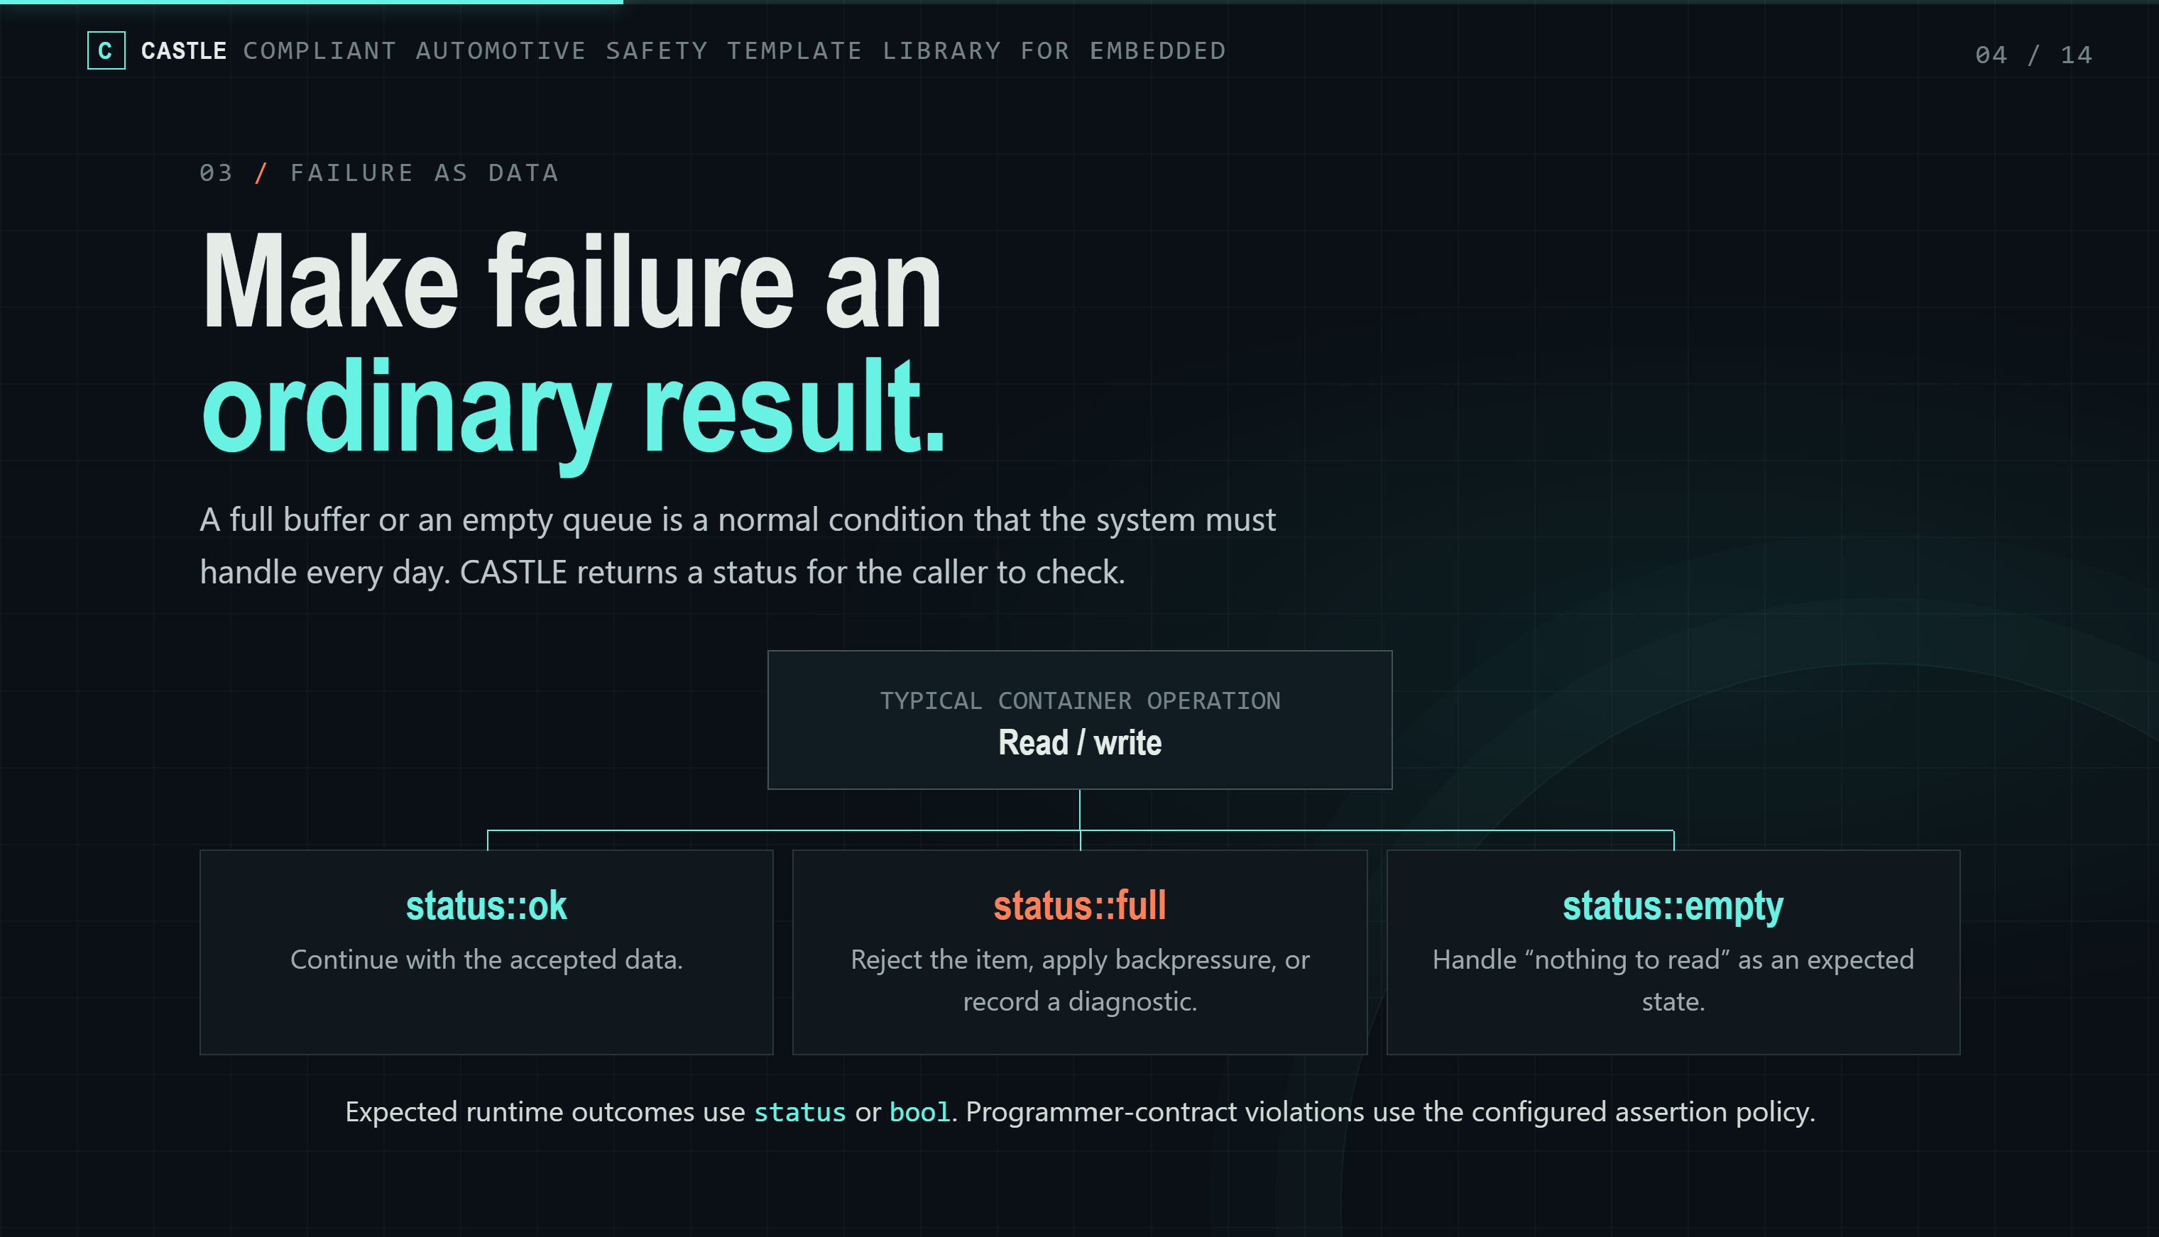
Notes:
Here is a small change in mindset. In embedded code, a full buffer is not a rare error. An empty queue is not a bug. These things can happen every day. So we should handle them as normal.
CASTLE uses a status type for this. status::ok means success. The other values tell us what went wrong. The destination is full. The source is empty. An item was not found. An argument is not valid. A system call failed. Some simple operations just return true or false.
Now the caller can see the failure choice right next to the call. Should we retry? Drop the data? Move to a safe state? Report a fault? These are product decisions. They should not be hidden inside a general-purpose container.
One more thing. A status is for an expected result at runtime. An assert is for a broken rule in our code. For example, using an object outside its valid range. CASTLE has a setting to control how asserts behave.

Slide 5
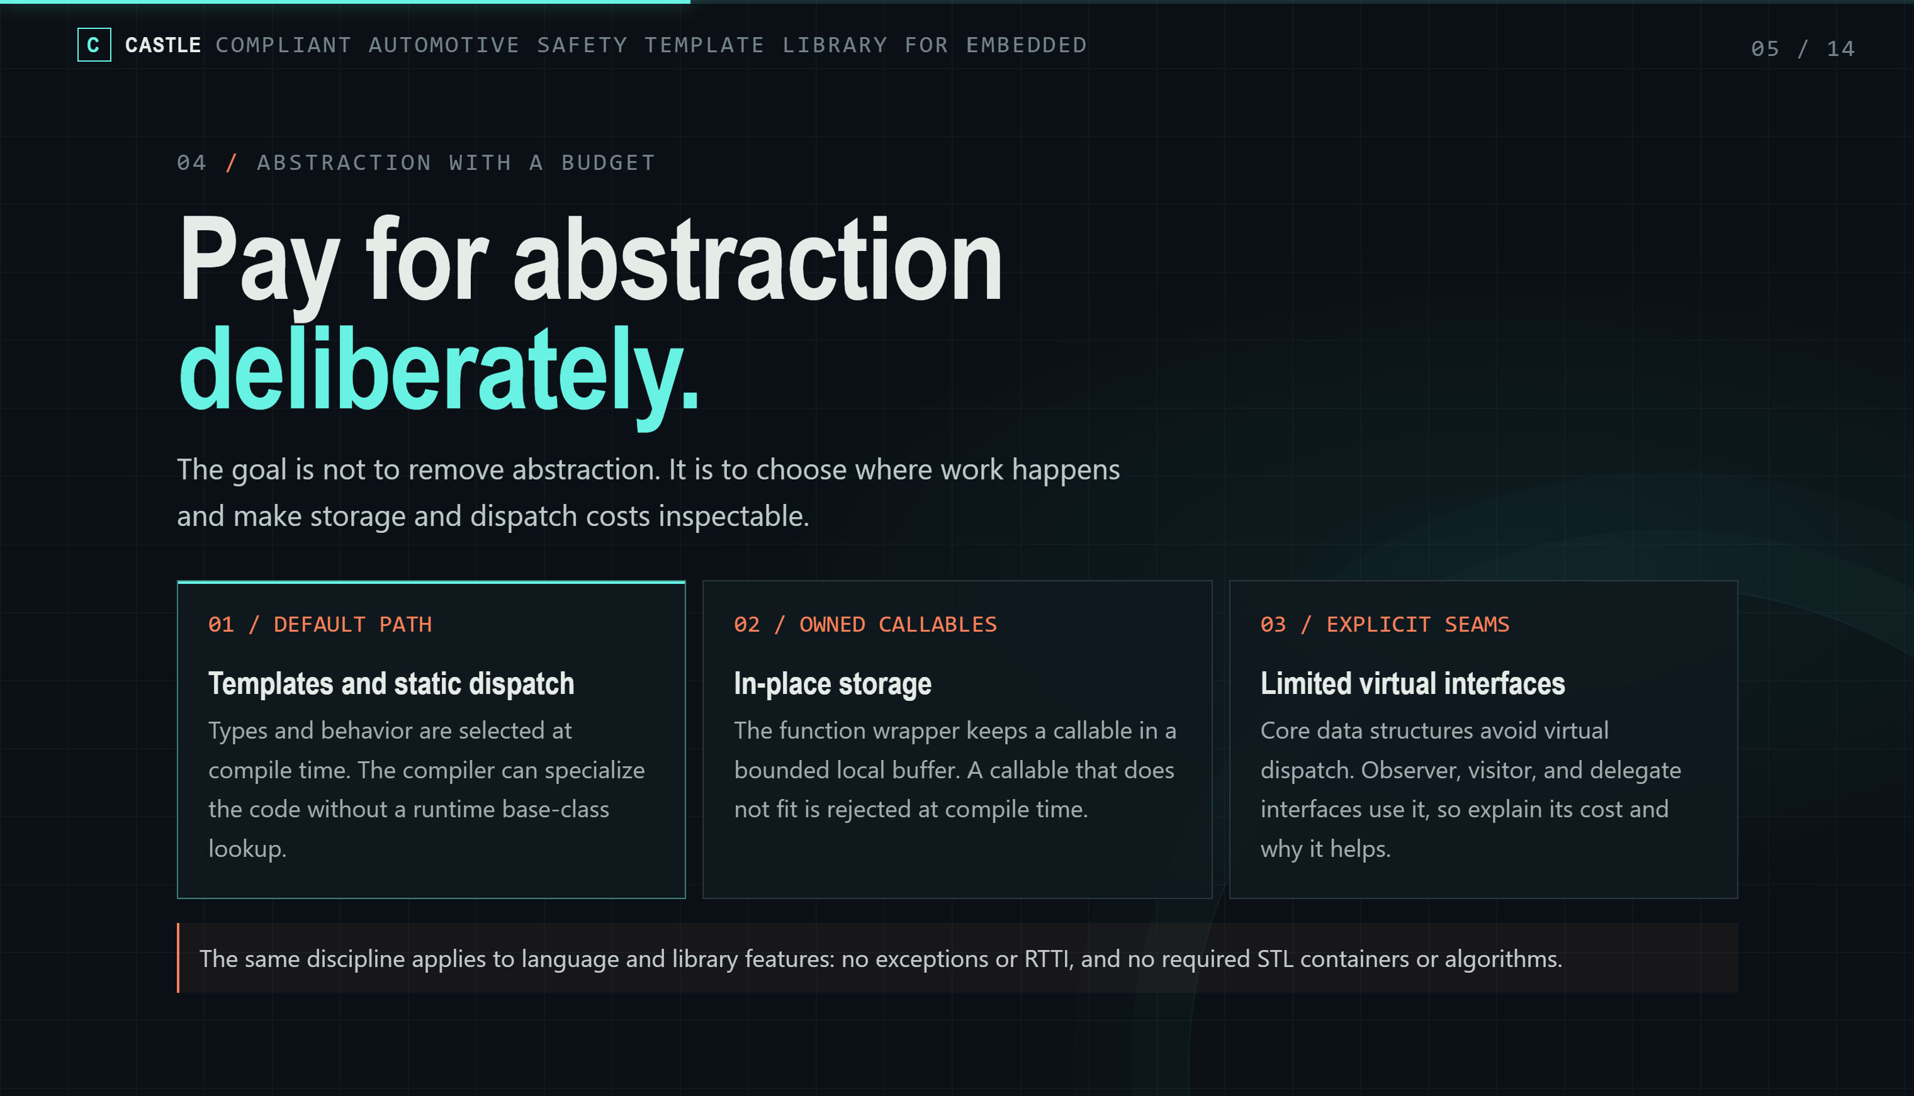
Notes:
The same idea works for abstraction and dispatch. CASTLE does not try to remove abstraction. We still want clean, expressive code. It uses templates, type traits, and small helper types. That way, the code stays easy to read, and it does not need a lot of runtime machinery.
The default choice is compile-time selection. If the type is known at compile time, the compiler can generate the right code directly. We don't need a class hierarchy at runtime just to pick one known action.
For callbacks, CASTLE has fixed-storage options. The function wrapper keeps the callable in a small local buffer. It does not use the heap. If the callable is too big, the compiler gives you an error. So you find the problem before the code runs, not in the field.
Now, be careful with virtual functions. The core data structures do not use them. But some interface parts do. Observer, visitor, and delegate interfaces use virtual functions. That is a deliberate choice, not a rule that virtual functions never show up. When you use one of these, you should know why it helps, and what it costs.

Slide 6
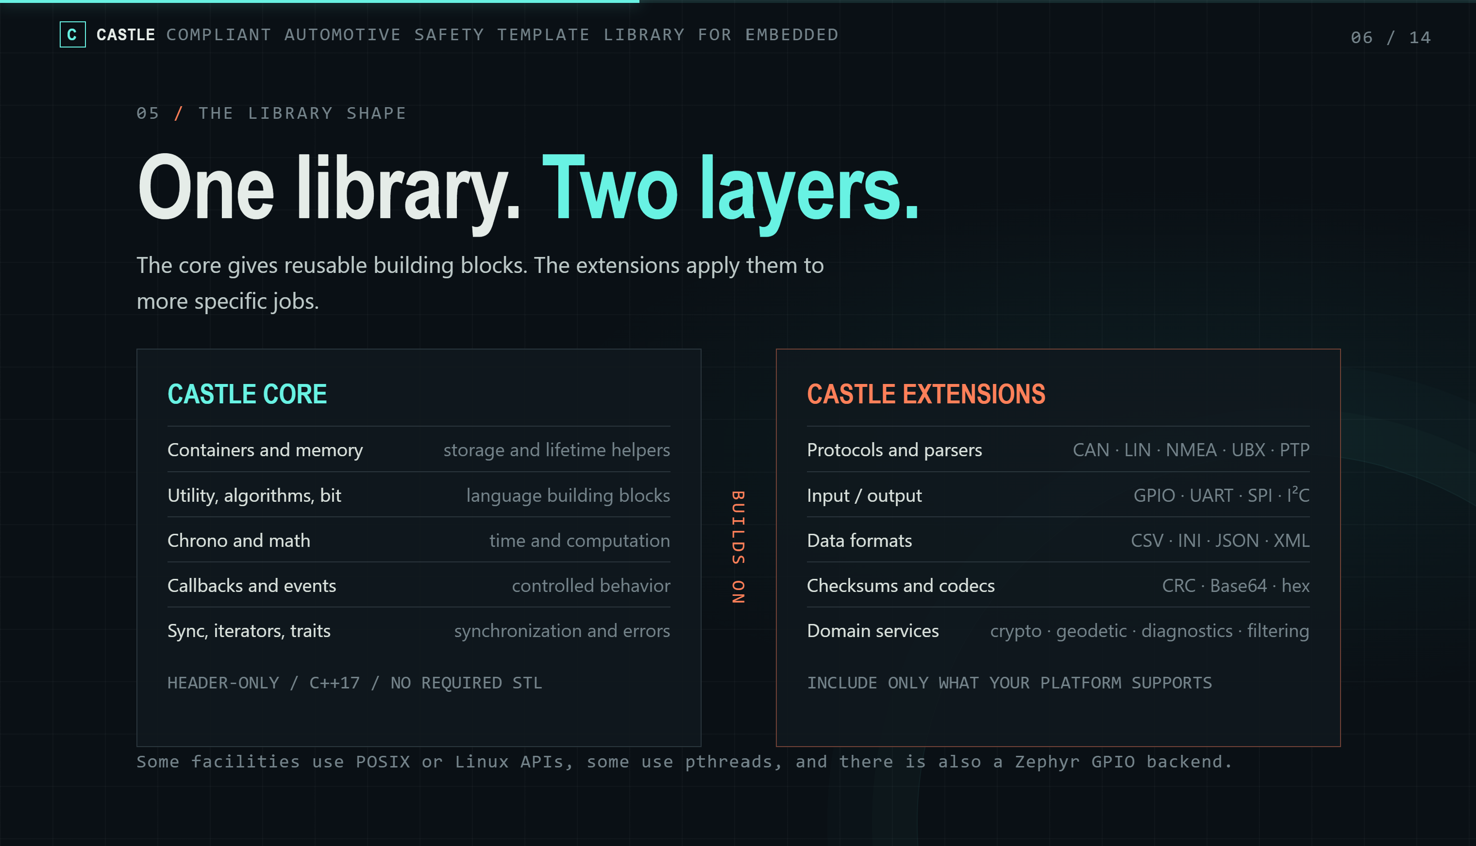
Notes:
These ideas are not only for containers. They show up across many modules.
This slide shows the shape of the project. There are two layers.
The first layer is the core. It has the basic building blocks. Containers. Memory helpers. Utilities and algorithms. Bit operations. Time and math. Callbacks and events. Sync tools. Iterators. And error handling.
The second layer is the extensions. They use the core for more specific jobs. In the source, you will find checksums and codecs, crypto, diagnostics, filters, geodetic math, parsers, protocols like CAN and NMEA, serialization, and hardware I/O.
Why does the ideas we have talked matter? Because the same thinking goes all the way from a small data structure to a real firmware feature.
For example, the protocol and serialization parts use fixed buffers. They don't assume data can grow forever.

Slide 7
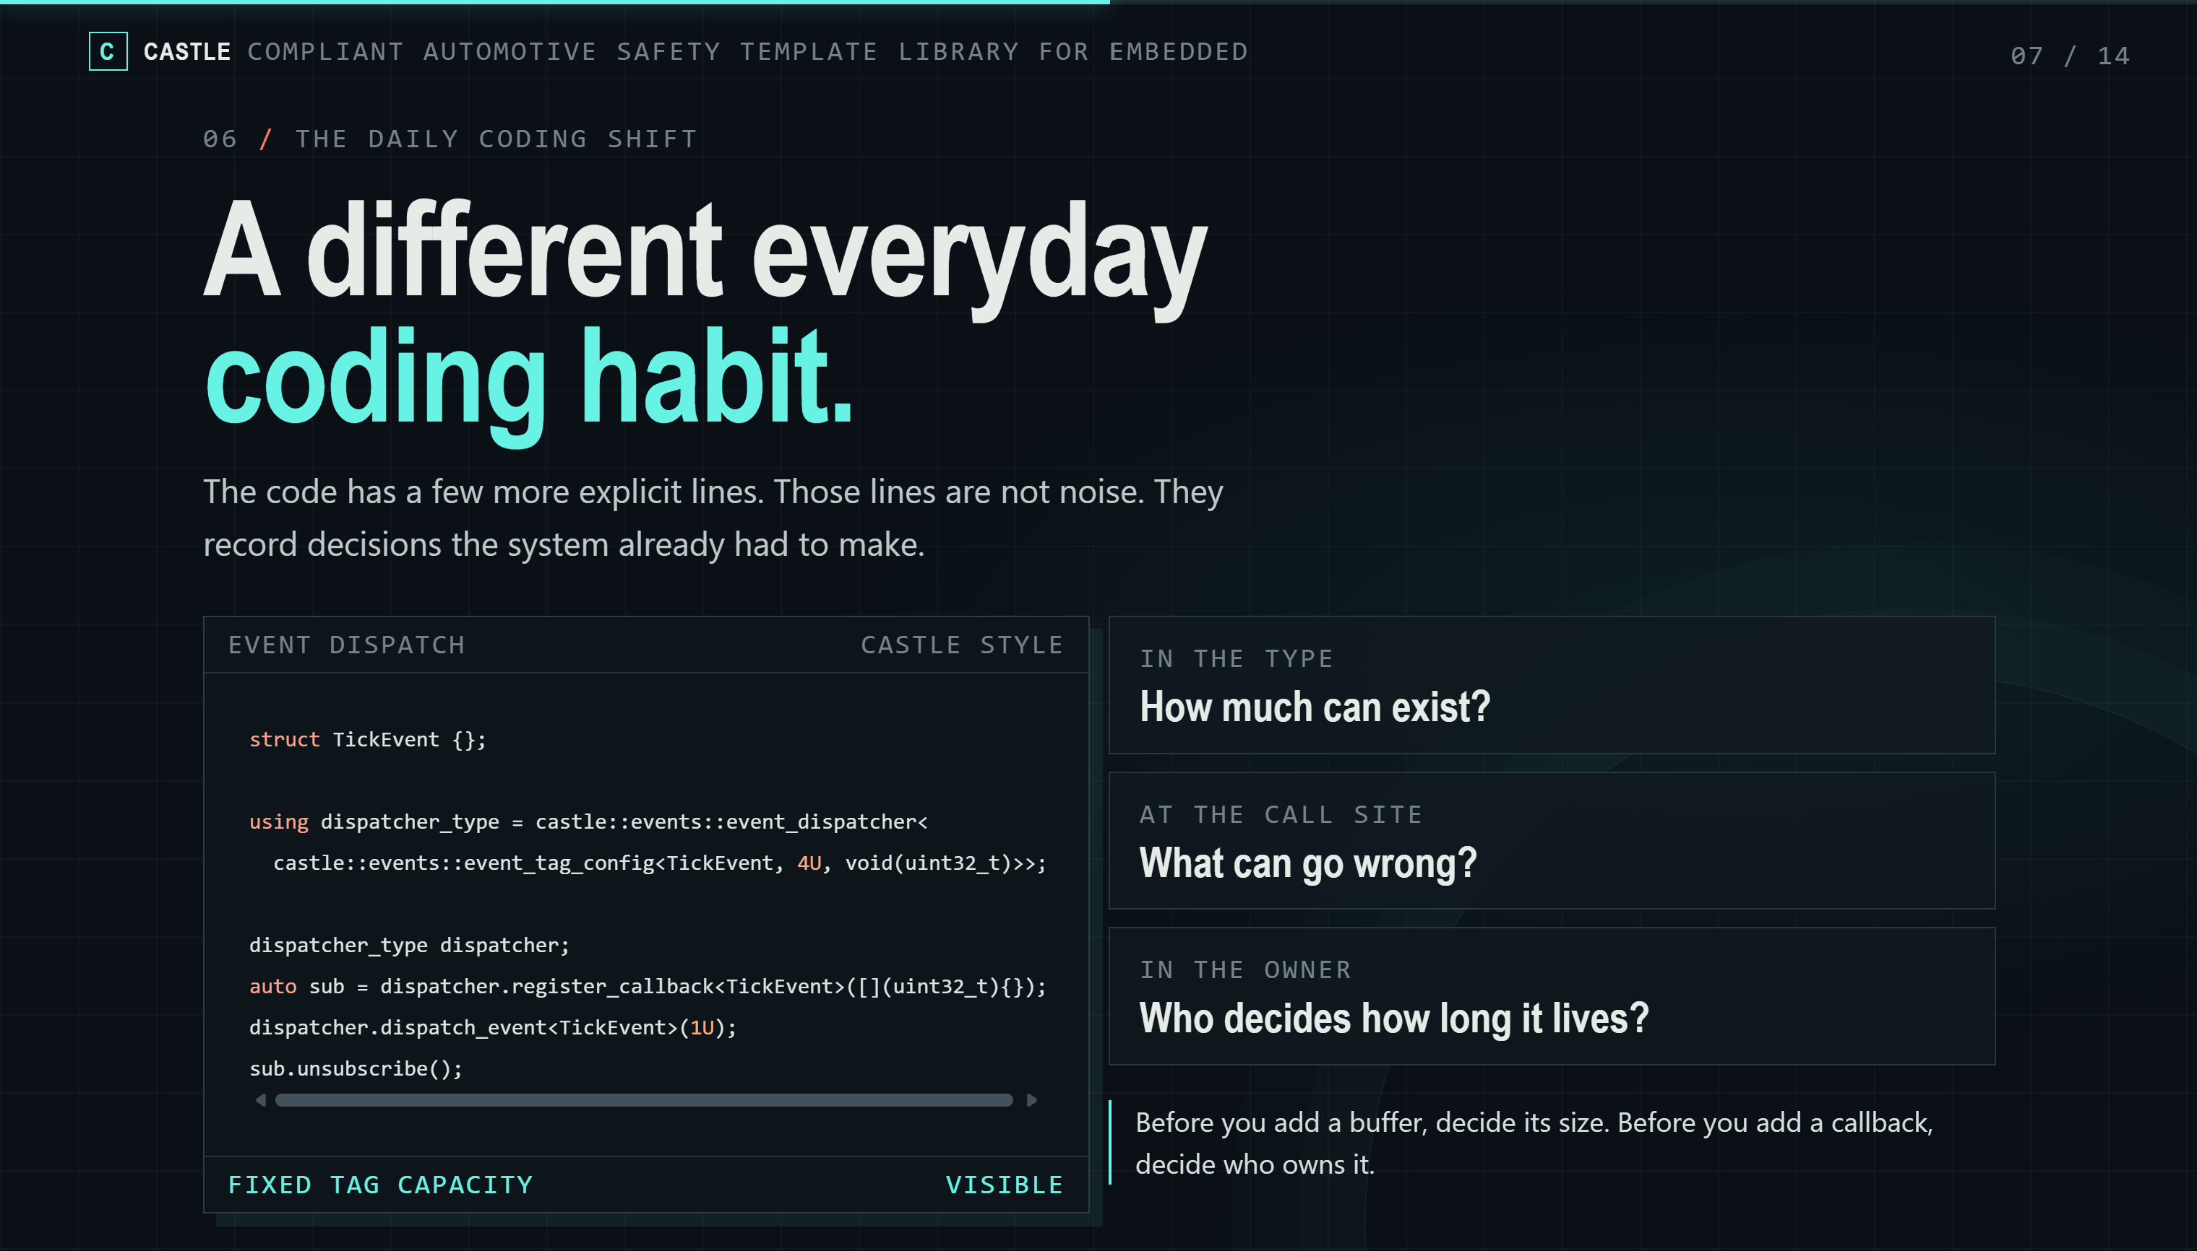
Notes:
Here is what the main ideas look like in daily coding habit.
This example is very simple. We create an event dispatcher to handle Tick event. There are maximum 4 callbacks can be registered for this event.
Then we register a callback, dispatch the event, and unsubscribe.
Let’s look at three questions on the slide:
About memory: how much can exist? The limit is written right in the type. You can see it without searching.
About the caller: What can go wrong? The register and dispatch calls are the main operations here, you can think about what kind of failure can be.
About ownership: Who decides how long it lives? Here, the subscription object is just a handle. We call unsubscribe when we are done. The owner must make sure the callback is not used after that.
So, before adding a buffer, consider its size. Before adding a callback, decide who owns it. The code has a few more lines than usual, but they show the decisions the system had to make anyway.

Slide 8
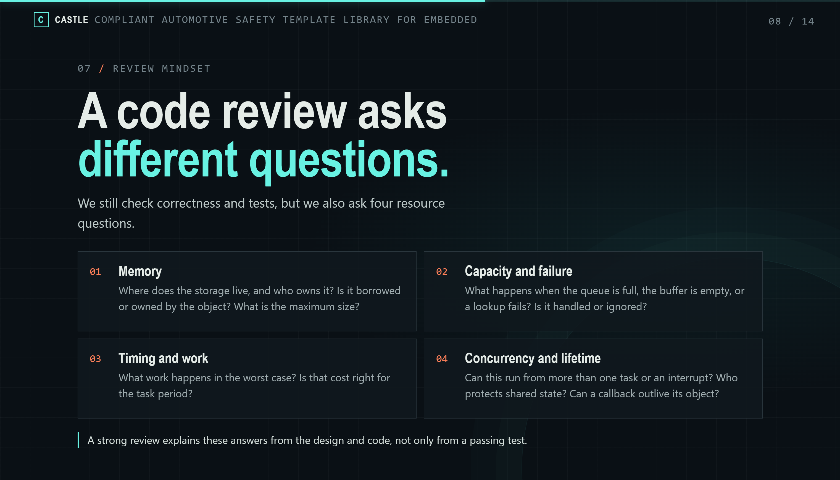
Notes:
Now, these ideas help us ask better questions in a code review.
We still check correctness, readability, and test results. But we also ask four questions about resources.
First, memory. Where does the storage live? Who owns it? Is it a borrowed pointer, or does the object own the data? What is the maximum size?
Second, capacity and failure. What happens when the queue is full? When the buffer is empty? When a lookup fails? Is the failure handled, or is it quietly ignored?
Third, timing. What is the worst case? Is that amount of work okay for the task period? A bounded container helps. But it does not replace understanding the algorithm and counting the operations.
Fourth, concurrency and lifetime. Can this run from more than one task? Can it run from an interrupt? Who protects the shared data? Can a callback or a subscription live longer than the object it points to?
A good review can answer these from the design and the code. A passing test alone is not enough.

Slide 9
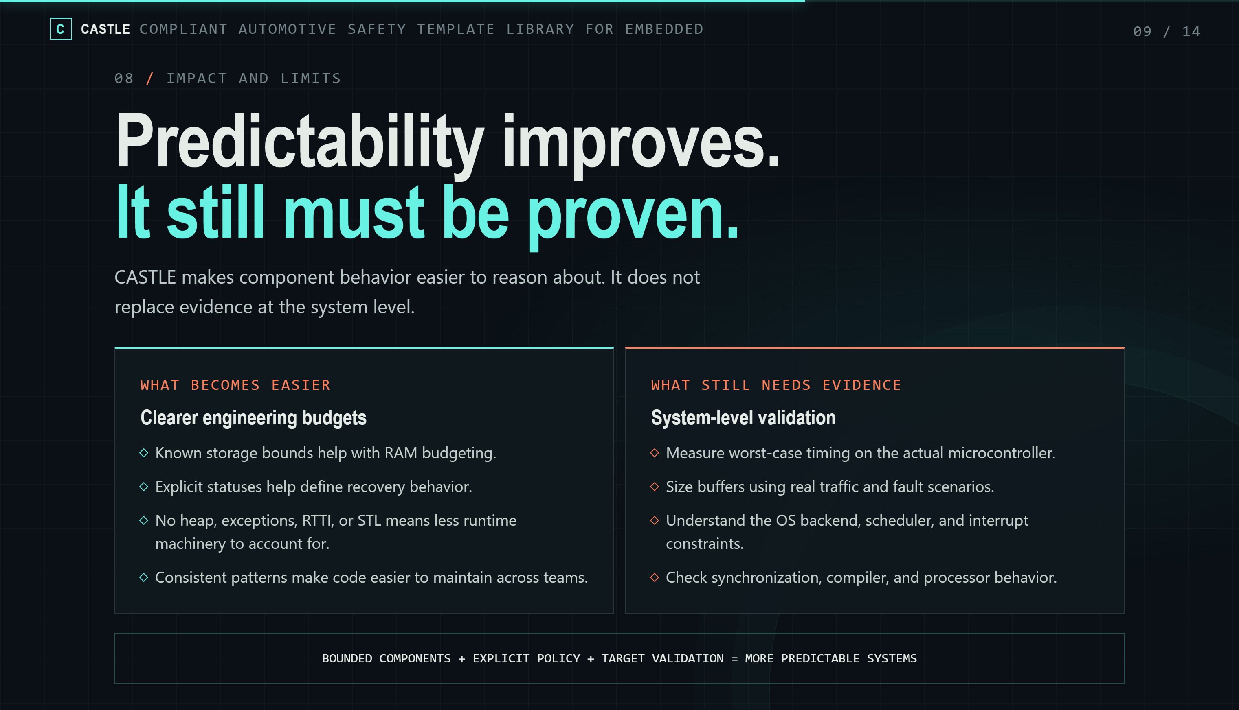
Notes:
These habits make code more predictable. But we must be clear about what the library can prove, and what it can’t.
CASTLE helps us reason about each component. Known storage limits help with RAM planning. Clear statuses help us decide how to recover. Avoiding heap, exceptions, RTTI, and the STL means less hidden runtime work to count. And consistent patterns make code easier for a team to maintain.
But a predictable container does not make a predictable system. We still need to measure worst-case timing on the real microcontroller. We need to size buffers using real traffic and real fault cases. We also need to know the OS, the scheduler, the interrupt rules, the locks, the compiler, and the processor.
A small queue can still be too small. A bounded algorithm can still be too slow. A race condition can still break everything. CASTLE gives us better tools, and better places to make decisions. But it does not replace testing at the system level.

Slide 10
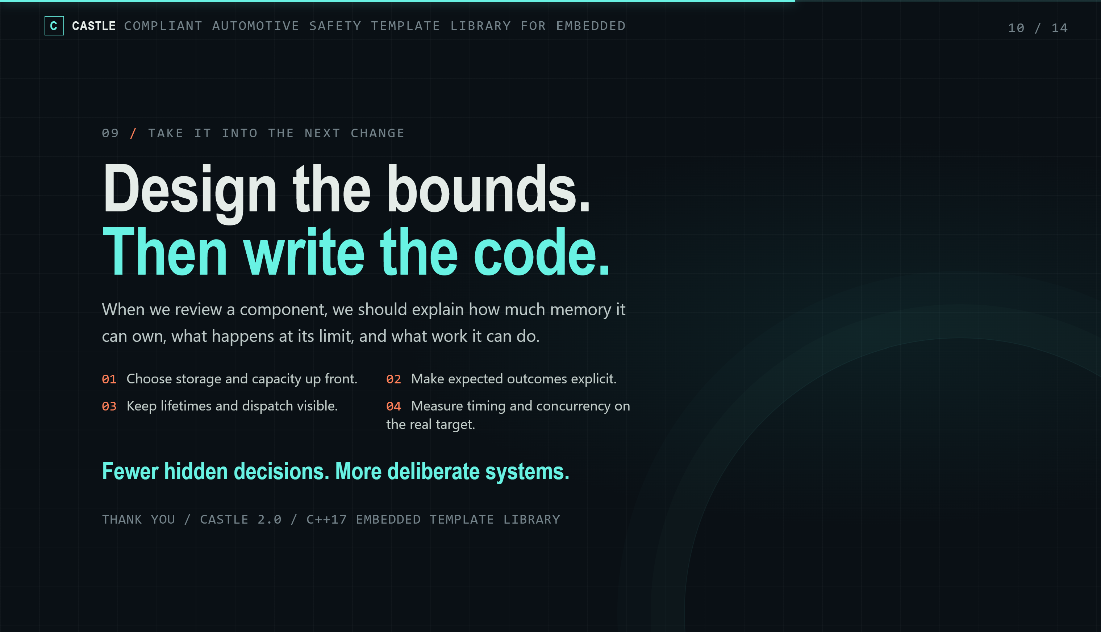
Notes:
To close, here are four things to remember when using CASTLE library:
- Choose storage and capacity at the start.
- Make the expected results clear.
- Keep lifetimes and dispatch easy to see.
- Measure timing and concurrency on the real target.
When you review or design a component, you should be able to answer three things. How much memory can it use? What happens when it hits the limit? How much work can it do?
CASTLE is not about writing less C++. It is about making fewer hidden costs.
We still want clean, reusable, modern C++. We just want the memory model and the failure rules to be part of the design from the first day of development.

Slide 11
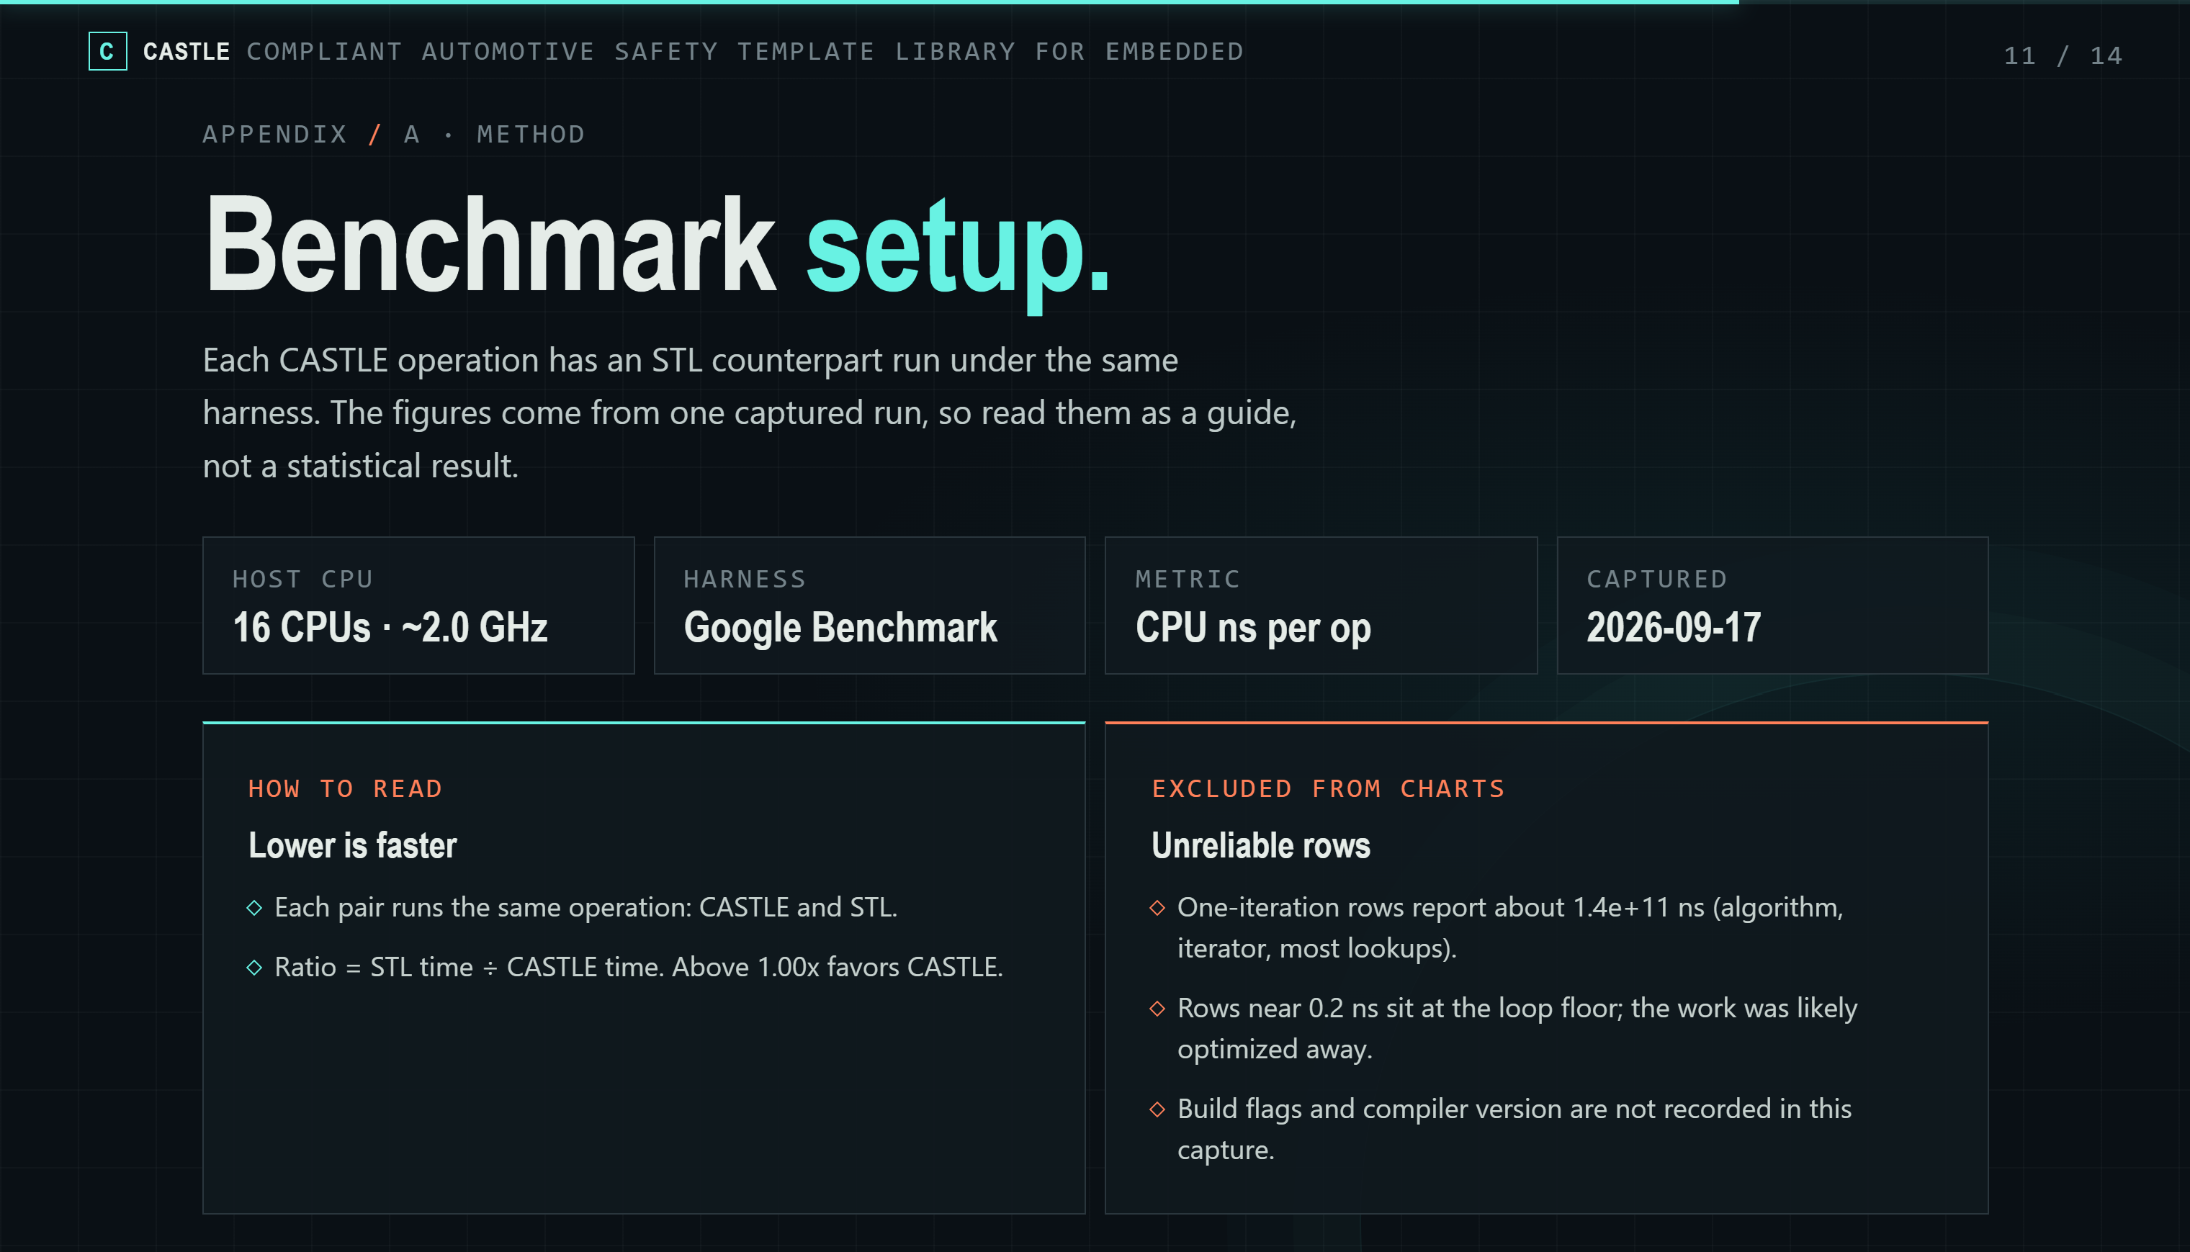
Notes:
Here I ran the benchmarks setup using Google Benchmark. Each CASTLE operation has a STL counterpart, running under the same context. The metric is CPU time per operation, in nanoseconds.

Slide 12
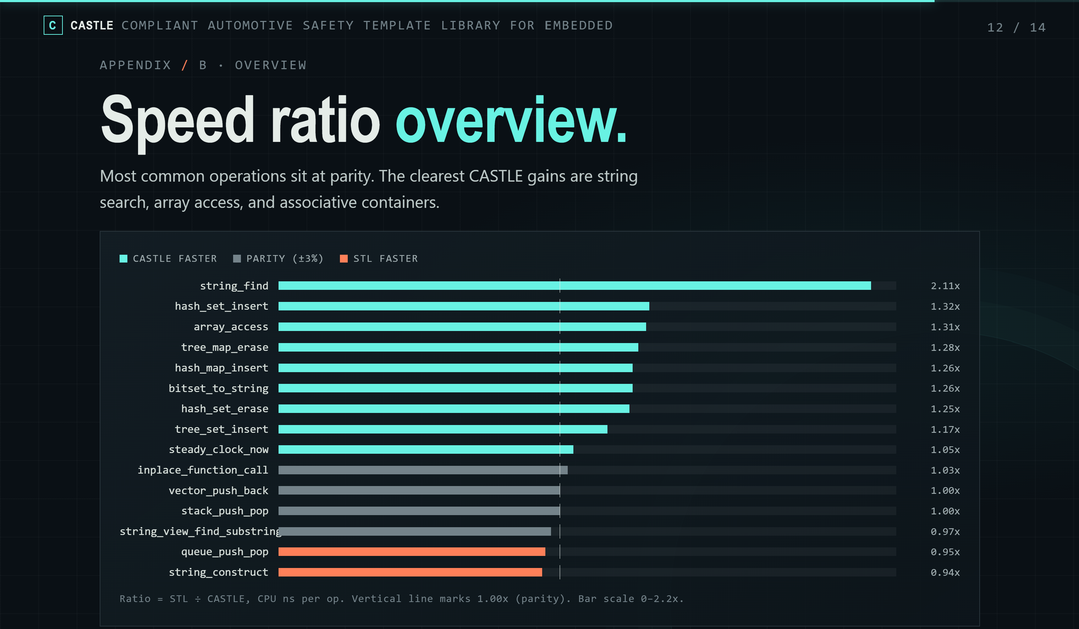
Notes:
A bar past the center line means CASTLE is faster.
CASTLE win STL about algorithms on container, like string finding. Or some basic operations like array access, bitset to string, push/pop elements, hashing or tree insert. Some operations can not catch up the STL library, but it looks near the line, the difference is not too big.

Slide 13
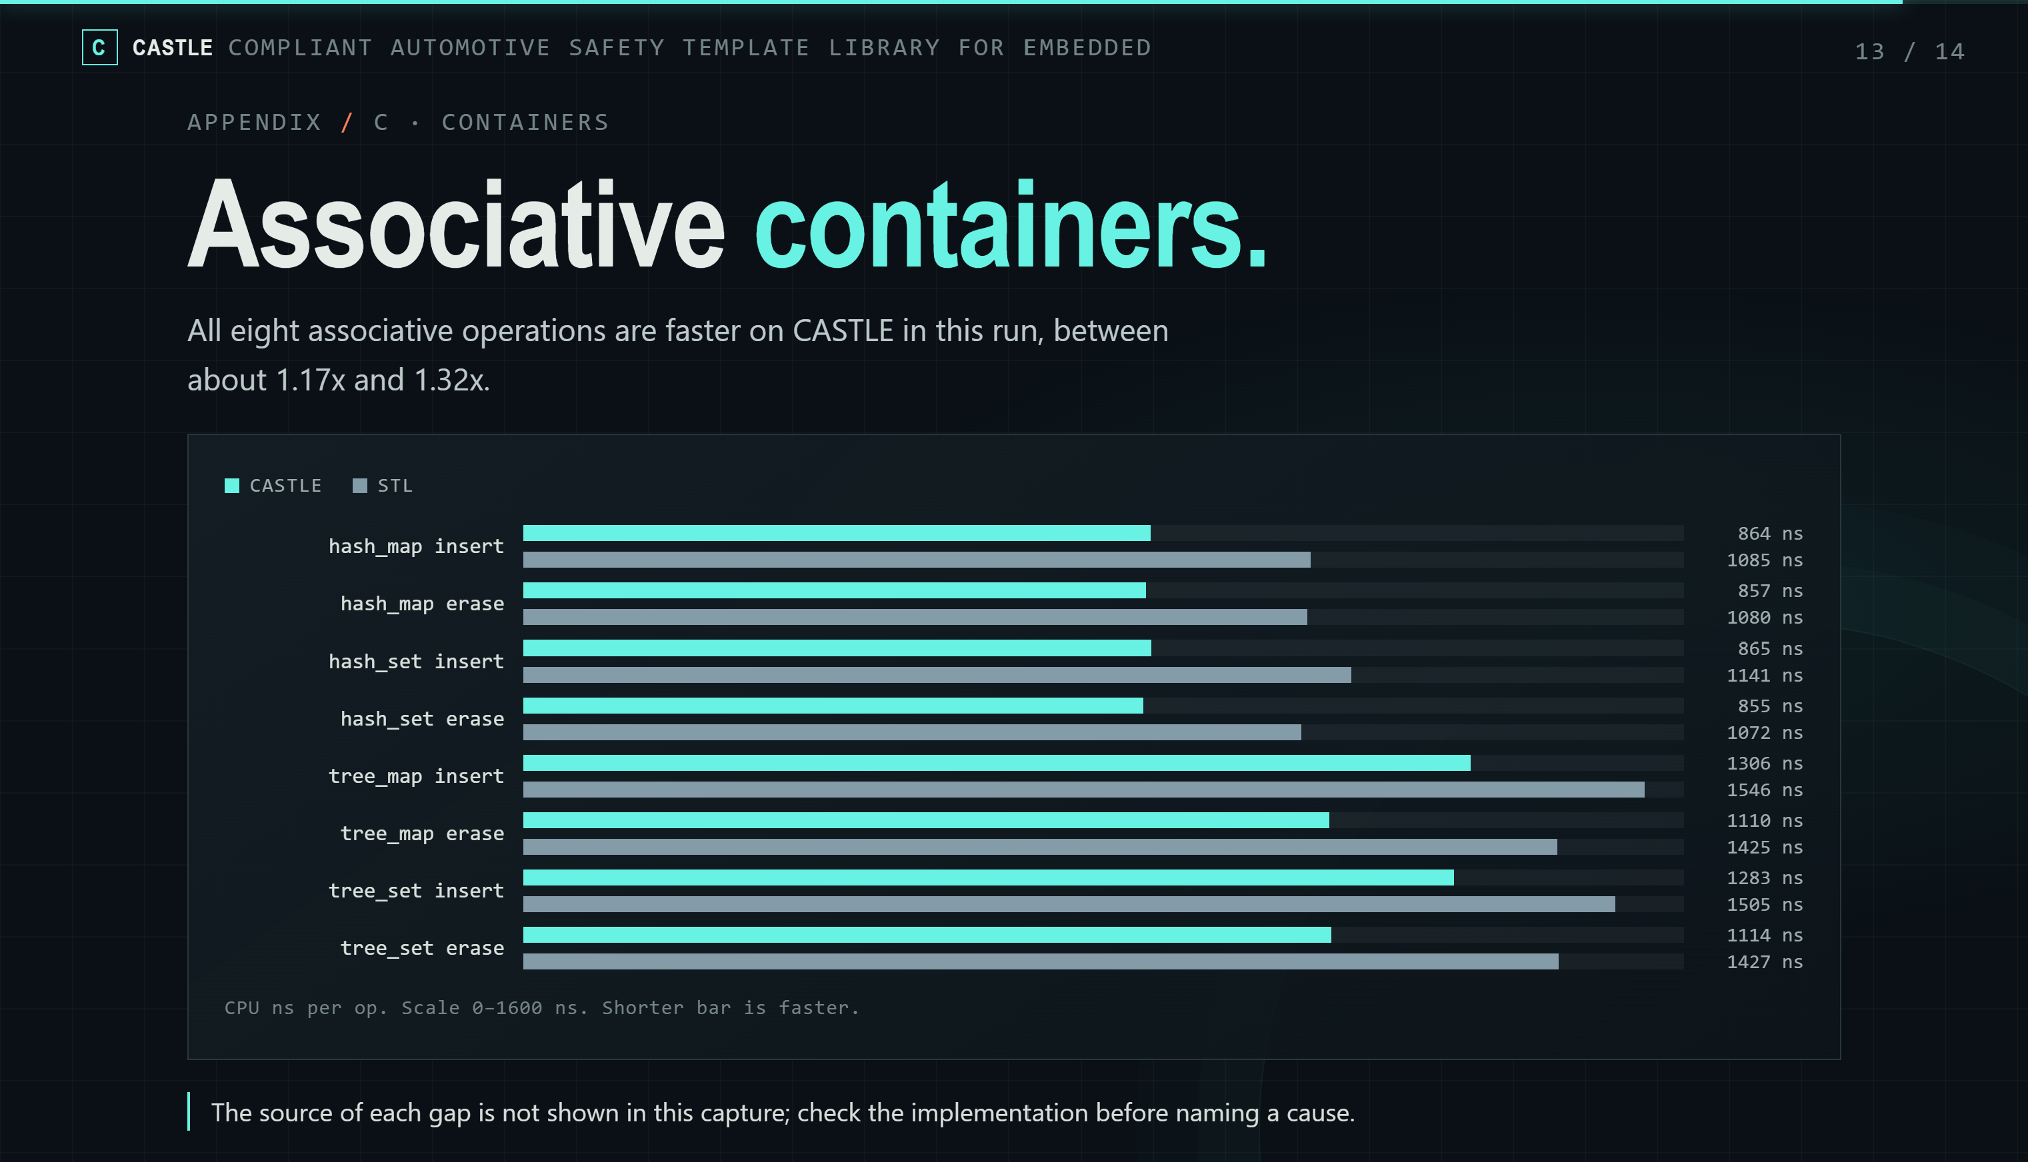
Notes:
This chart compares hash map, hash set, tree map, and tree set, for insert and erase.
CASTLE wins in this run.

Slide 14
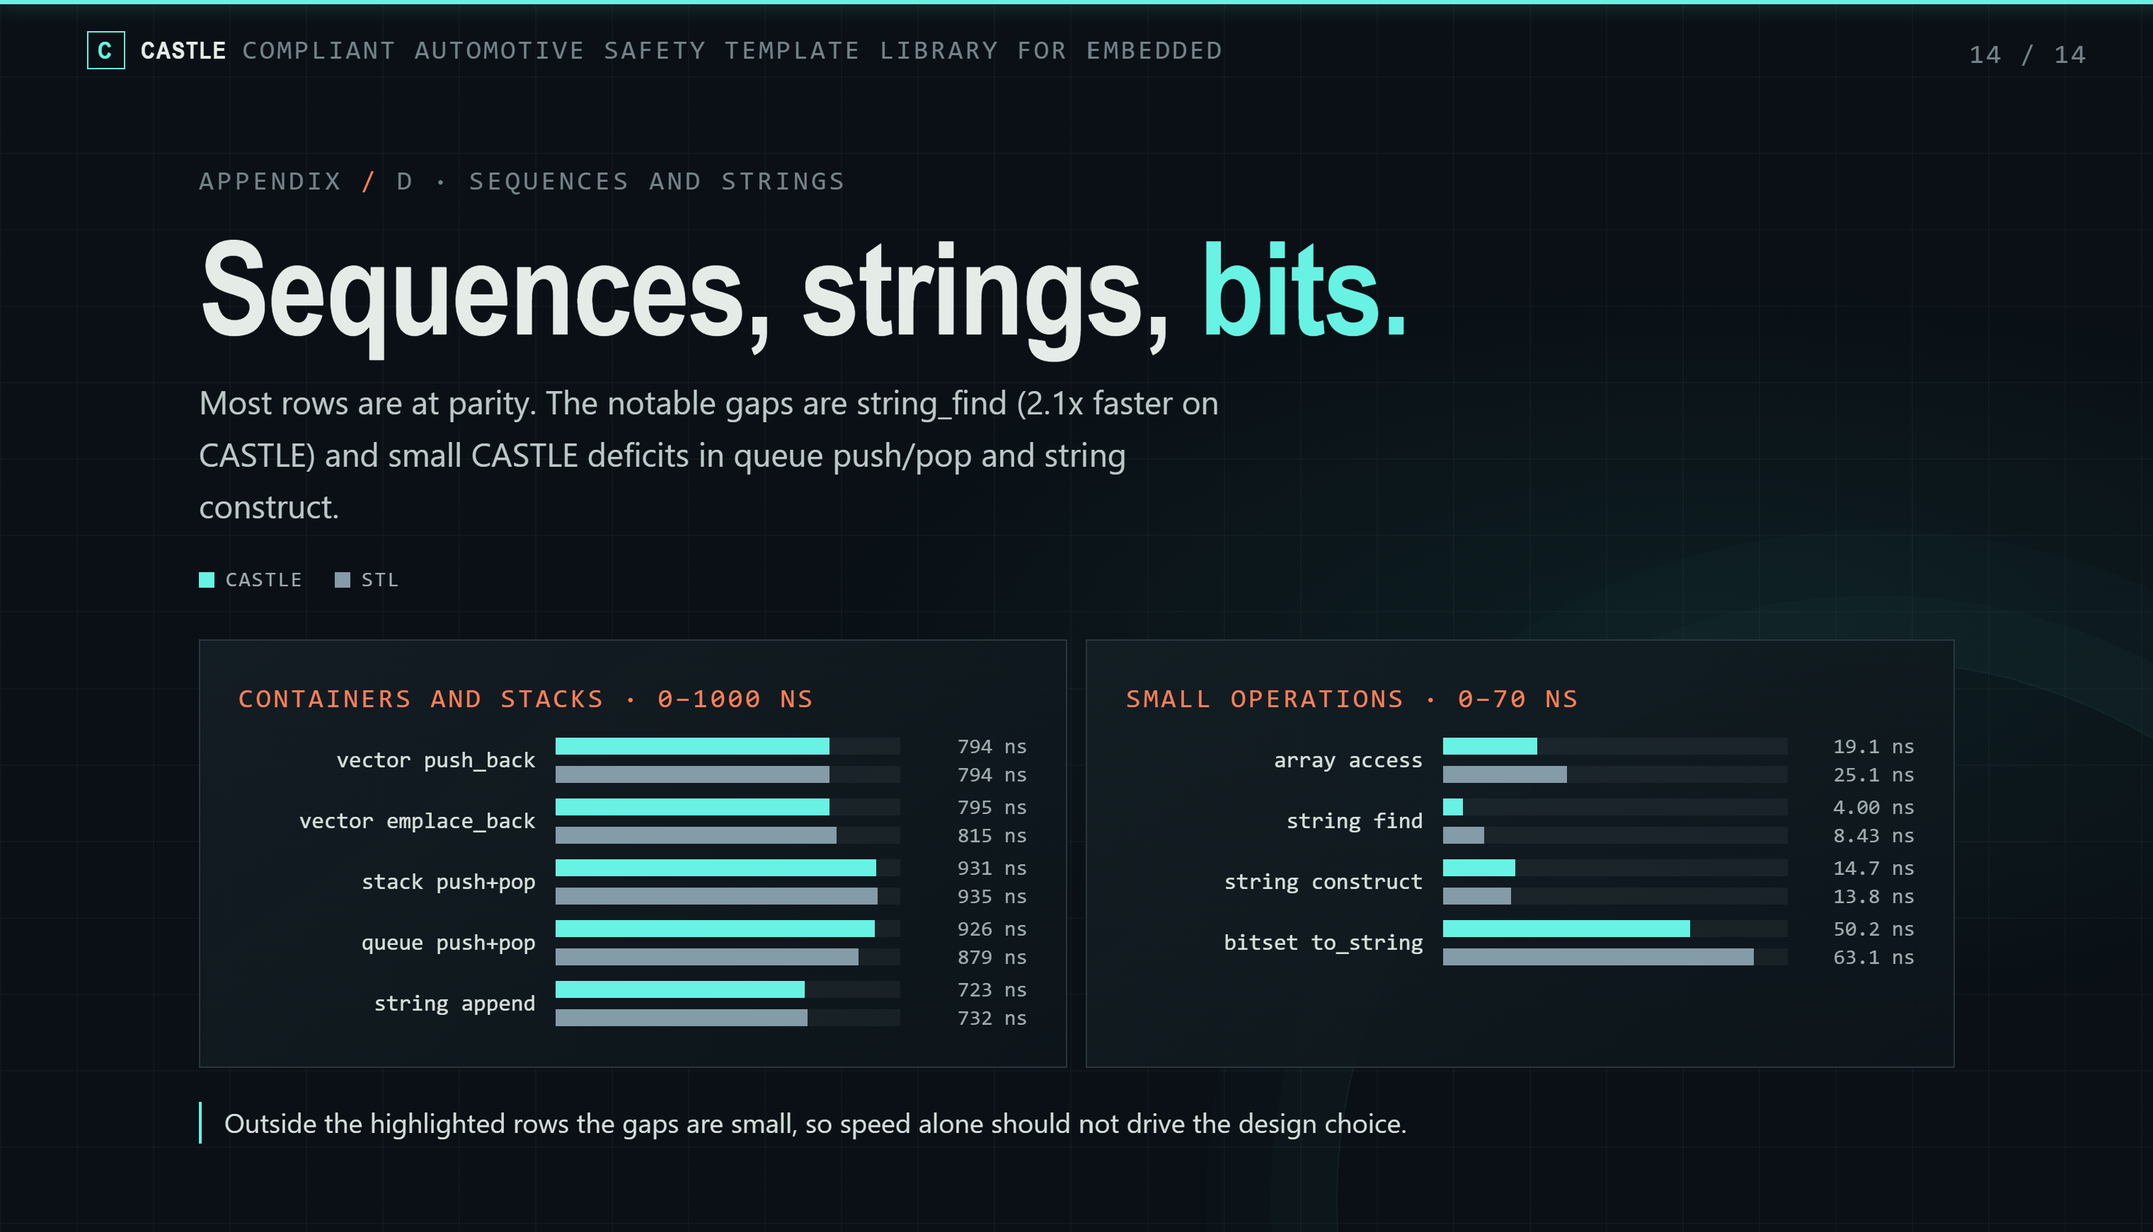
Notes:
And the last benchmark snapshot, on the left side, container operations of CASTLE and STL is quite close, we can’t tell who is faster.
On the right side, CASTLE is a bit faster on string find, array access, … However, the gaps are small.
Overall, the reason to choose CASTLE library is not for performance, but because its bounded storage, explicit failure paths, deterministic behaviors.

