Slide 1

1. Thinking Logically
Written by Rachel J. Morris, last updated Jun 23, 2017

Slide 2

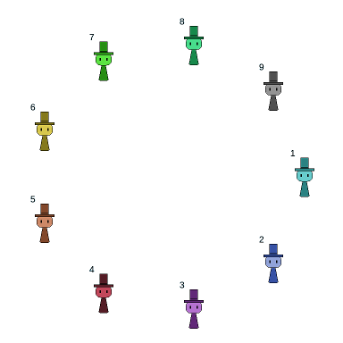
About
This part is meant to get you thinking systematically and logically about solving problems.
These problems can be solved by following some pattern, step-by-step, and we do this as an introduction, rather than coming up with some algorithm to solve the problems.

Slide 3

Topics
1. Flipping a coin
2. Josephus game
3. Game tree

Slide 4


1. Flipping a coin
Let’s start off simple.
We are going to be flipping one coin. How many possible outcomes are there?
(<number>/29)

Slide 5


1. Flipping a coin
Let’s start off simple.
We are going to be flipping one coin. How many possible outcomes are there?
Two possible outcomes: Heads or Tails
1 coin,
2 outcomes
(<number>/29)

Slide 6
1. Flipping a coin
If we have two coins, how many total outcomes are there?
1 coin,
2 outcomes
1
2
(<number>/29)

Slide 7
1. Flipping a coin
If we have two coins, how many total outcomes are there?
There are four possible outcomes.
1 coin,
2 outcomes
2 coins,
4 outcomes
1
2
(<number>/29)

Slide 8
1. Flipping a coin
If we have three coins, how many total outcomes are there?
1 coin,
2 outcomes
2 coins,
4 outcomes
1
2
3
(<number>/29)

Slide 9
1. Flipping a coin
If we have three coins, how many total outcomes are there?
There are eight possible outcomes
1 coin,
2 outcomes
2 coins,
4 outcomes
3 coins,
8 outcomes
1
2
3
(<number>/29)

Slide 10
1. Flipping a coin
Can you see the pattern in these examples?
1 coin = 2 outcomes
2 coins = 4 outcomes
3 coins = 8 outcomes
If we have any arbitrary number of coins n, how many outcomes will there be?
1 coin,
2 outcomes
2 coins,
4 outcomes
3 coins,
8 outcomes
(<number>/29)

Slide 11
1. Flipping a coin
Can you see the pattern in these examples?
1 coin = 2 outcomes
2 coins = 4 outcomes
3 coins = 8 outcomes
If we have any arbitrary number of coins n, how many outcomes will there be?
For any n > 0, there will be outcomes.
1 coin,
2 outcomes
2 coins,
4 outcomes
3 coins,
8 outcomes
n coins,
outcomes
(<number>/29)

Slide 12
2. Josephus Game
You can read about the Josephus game in the textbook, but the general overview is:
Josephus and other rebels are sitting in a circle. One-by-one, they go around the circle, and every n^{th} person dies. The last person alive can escape.
How do we figure out who is the last to go? And maybe the 2nd to last, in case Josephus wants a buddy with him.
Josephus Game:
I guess we can illustrate math with death… ok...
(<number>/29)

Slide 13
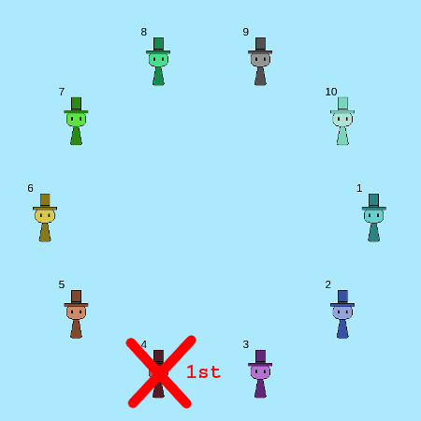
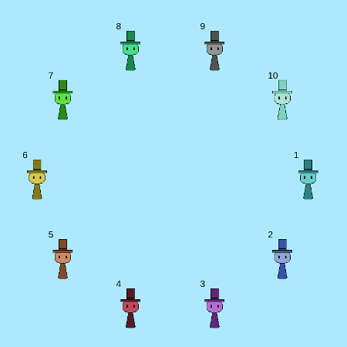
2. Josephus Game
So let’s say we have 10 total people sitting in a circle,
and we “remove” every 4th person,
starting with person at position 4.
Link to JavaScript illustration of the game:
http://edu.moosader.com/course/cs210/illustration_ch_1.1_josephus.php
(<number>/29)

Slide 14
2. Josephus Game
Goodbye 4
Link to JavaScript illustration of the game:
http://edu.moosader.com/course/cs210/illustration_ch_1.1_josephus.php
(<number>/29)

Slide 15
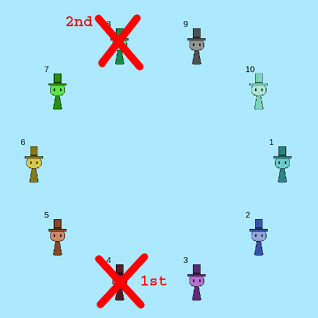
2. Josephus Game
1. Person 5...
2. Person 6...
3. Person 7...
4. Person 8…
Goodbye,
Person 8.
Link to JavaScript illustration of the game:
http://edu.moosader.com/course/cs210/illustration_ch_1.1_josephus.php
(<number>/29)

Slide 16
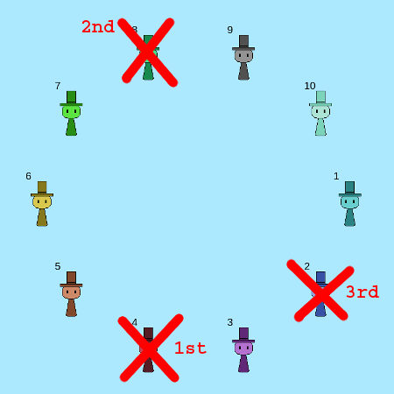
2. Josephus Game
1. Person 9...
2. Person 10...
3. Person 1...
4. Person 2…
Goodbye,
Person 2.
Link to JavaScript illustration of the game:
http://edu.moosader.com/course/cs210/illustration_ch_1.1_josephus.php
(<number>/29)

Slide 17
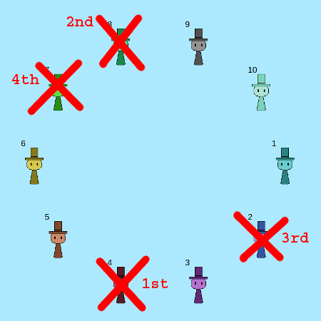
2. Josephus Game
1. Person 3...
2. Person 5...
3. Person 6...
4. Person 7…
Goodbye,
Person 7.
Link to JavaScript illustration of the game:
http://edu.moosader.com/course/cs210/illustration_ch_1.1_josephus.php
(<number>/29)

Slide 18
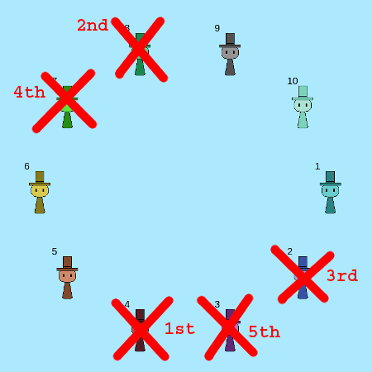
2. Josephus Game
1. Person 9...
2. Person 10...
3. Person 1...
4. Person 3…
Goodbye,
Person 3.
Link to JavaScript illustration of the game:
http://edu.moosader.com/course/cs210/illustration_ch_1.1_josephus.php
(<number>/29)

Slide 19
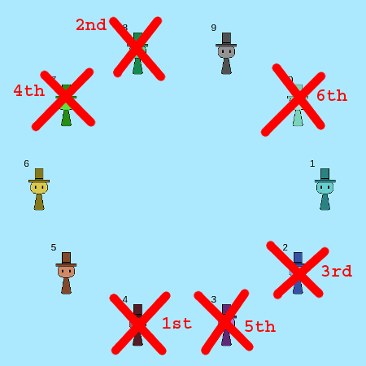
2. Josephus Game
1. Person 5...
2. Person 6...
3. Person 9...
4. Person 10…
Goodbye,
Person 10.
Link to JavaScript illustration of the game:
http://edu.moosader.com/course/cs210/illustration_ch_1.1_josephus.php
(<number>/29)

Slide 20
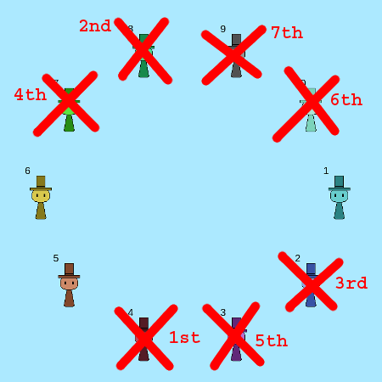
2. Josephus Game
1. Person 1...
2. Person 5...
3. Person 6...
4. Person 9…
Goodbye,
Person 9.
Link to JavaScript illustration of the game:
http://edu.moosader.com/course/cs210/illustration_ch_1.1_josephus.php
(<number>/29)

Slide 21
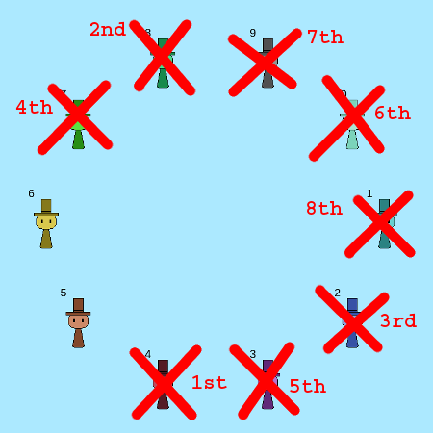
2. Josephus Game
1. Person 1...
2. Person 5...
3. Person 6...
4. Person 1…
Goodbye,
Person 1.
Link to JavaScript illustration of the game:
http://edu.moosader.com/course/cs210/illustration_ch_1.1_josephus.php
(<number>/29)

Slide 22
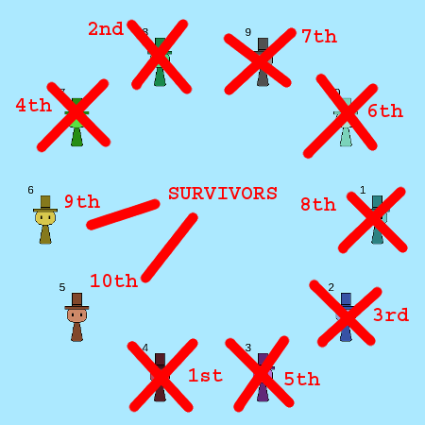
2. Josephus Game
1. Person 5...
2. Person 6...
3. Person 5...
4. Person 6…
Person 6 is
2nd-to-last and
Person 5 is last,
so this is where Josephus and his friend should sit.
Link to JavaScript illustration of the game:
http://edu.moosader.com/course/cs210/illustration_ch_1.1_josephus.php
(<number>/29)

Slide 23










2. Josephus Game
We can take a systematic approach to solving this problem by stepping through the “algorithm”
(every n^{th} person, skipping already-dead ones)
Link to JavaScript illustration of the game:
http://edu.moosader.com/course/cs210/illustration_ch_1.1_josephus.php
(<number>/29)

Slide 24
3. Game Tree
We can use a Game Tree to help us estimate the likelihood of some outcome-set, such as if we were flipping a coin:
50%
50%
1ST FLIP
(<number>/29)

Slide 25
3. Game Tree
We can use a Game Tree to help us estimate the likelihood of some outcome-set, such as if we were flipping a coin:
If we’re just flipping one fair coin, there are two outcomes, and they are equally likely. So we can say the probability is:
Heads: 1 out of 2 outcomes (50%)
Tails: 1 out of 2 outcomes (50%)
50%
50%
1ST FLIP
(<number>/29)

Slide 26
3. Game Tree
We can use a Game Tree to help us estimate the likelihood of some outcome-set, such as if we were flipping a coin:
25%
If we’re flipping a fair coin twice, we have four outcomes, and the likelihood of getting the following sequences are:
Heads-Heads: 1 out of 4 (25%)
Heads-Tails: 1 out of 4 (25%)
Tails-Heads: 1 out of 4 (25%)
Tails-Tails: 1 out of 4 (25%)
H-H
25%
H-T
25%
T-H
25%
T-T
1ST FLIP
2ND FLIP
(<number>/29)

Slide 27
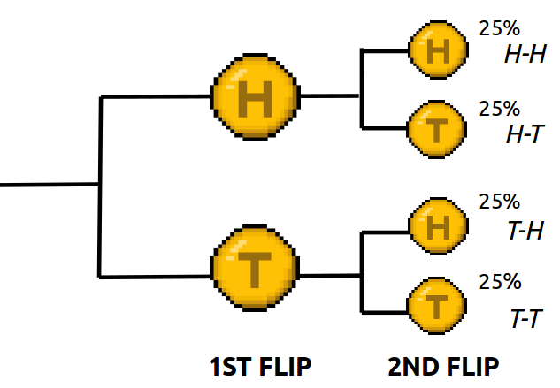
3. Game Tree
We can use a Game Tree to help us estimate the likelihood of some outcome-set, such as if we were flipping a coin:
Those might be obvious, but what about these?
What is the likelihood that the sequence will have at least one heads in it?
What is the likelihood that the sequence will have exactly one tails in it?
(<number>/29)

Slide 28
3. Game Tree
We can use a Game Tree to help us estimate the likelihood of some outcome-set, such as if we were flipping a coin:
Those might be obvious, but what about these?
What is the likelihood that the sequence will have at least one heads in it?
  Possible outcomes: H-H, H-T, T-H, so
  3 out of 4 outcomes (75%)
What is the likelihood that the sequence will have exactly one tails in it?
  Possible outcomes: T-H, H-T, so
  2 out of 4 outcomes (50%)
(<number>/29)

Slide 29



Conclusion
So at this point, we’re not doing much in the way of math, but we are getting some practice in being methodical and thinking about these things as systems.
Next we will be looking at sequences of numbers, and how to come up with a function to represent that sequence, so it can take some work analyzing your numbers to figure out what is in common between them!
(<number>/29)

