Slide 1

Welcome to CS 210
Written by Rachel J. Morris, last updated Jun 20, 2017

Slide 2


Welcome to CS 210!
Welcome to CS 210: Discrete Structures!
This is a math course that is standard in Computer Science curriculum. If you have no idea what Discrete Math is about, this lecture is meant to introduce you to what we will be doing this semester.

Slide 3
What is “Discrete Math”?
“Discrete mathematics is the study of mathematical structures that are fundamentally discrete rather than continuous.”
-Wikipedia (https://en.wikipedia.org/wiki/Discrete_math)
…But what does that mean?

Slide 4
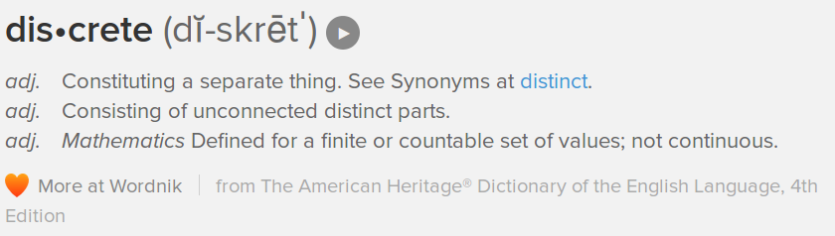
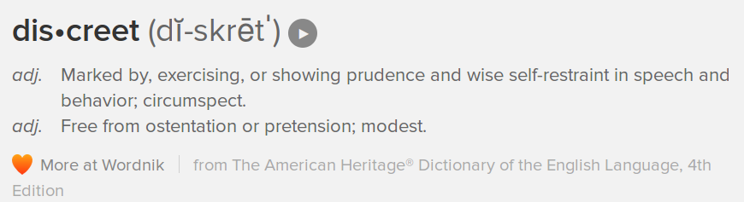
What is “Discrete Math”?

Slide 5
What is “Discrete Math”?
For a lot of this class, we will be working with integers – whole numbers that don’t have an infinite amount of numbers in-between.
0.0625
0.25
0.5
0.75
0
0.125
1
Discrete is defined as “individually separate and distinct.”

Slide 6
What is “Discrete Math”?
We will be working with integers, as well as other topics, such as boolean logic (something that results in either true or false), sets (sets of discrete elements), and functions and relations.

Slide 7

CS 210 Topics
Chapter 1:
Puzzles, patterns, and mathematical language
Chapter 2:
A primer of mathematical writing
Chapter 3:
Sets and boolean algebra
Chapter 4: Functions and relations
Chapter 1 is about…
Figuring out formulas to describe a given sequence of numbers
Evaluating summations
Using AND, OR, and NOT operators to write boolean expressions, which will result in TRUE or FALSE
Writing predicates, which will evaluate to either TRUE or FALSE based on the input
Writing implications (“If-then” statements)
(<number>/18)

Slide 8
CS 210 Topics
Chapter 1:
Puzzles, patterns, and mathematical language
Chapter 2:
A primer of mathematical writing
Chapter 3:
Sets and boolean algebra
Chapter 4: Functions and relations
For example:
s represents “save has finished”, and
q represents “user wishes to quit”.
Write a statement for “the user wishes to quit but the save has not finished.”
q and not s
(<number>/18)

Slide 9
CS 210 Topics
Chapter 2 is about…
Describing numbers (such as even and odd) in mathematical terms
Proofs on mathematical statements
Using induction for proofs and other things
Representing numbers with different number systems, such as binary
Chapter 1:
Puzzles, patterns, and mathematical language
Chapter 2:
A primer of mathematical writing
Chapter 3:
Sets and boolean algebra
Chapter 4: Functions and relations
(<number>/18)

Slide 10
CS 210 Topics
Chapter 1:
Puzzles, patterns, and mathematical language
Chapter 2:
A primer of mathematical writing
Chapter 3:
Sets and boolean algebra
Chapter 4: Functions and relations
For example:
The sum of an even number and an odd number is odd
2 times some integer plus 1 is the definition of an odd integer.
(<number>/18)

Slide 11
CS 210 Topics
Chapter 1:
Puzzles, patterns, and mathematical language
Chapter 2:
A primer of mathematical writing
Chapter 3:
Sets and boolean algebra
Chapter 4: Functions and relations
Chapter 3 is about…
Using Sets
Doing operations on sets, such as UNION, INTERSECTION, and SUBTRACTION
Drawing Venn diagrams
Working with Boolean algebra notation
Working with Logic Circuits
(<number>/18)

Slide 12
CS 210 Topics
Chapter 1:
Puzzles, patterns, and mathematical language
Chapter 2:
A primer of mathematical writing
Chapter 3:
Sets and boolean algebra
Chapter 4: Functions and relations
For example:
Given
set A = { 1, 2, 3 } and set B = { 4, 5 }
What is A ∪ B?
A ∪ B = { 1, 2, 3, 4, 5 }
(A∪B is the union of sets A and B)
(<number>/18)

Slide 13
CS 210 Topics
Chapter 4 is about…
Definitions and properties of functions
Doing composition operations like (f∘g)(x)
Definitions and properties of relations
Diagramming relations
Chapter 1:
Puzzles, patterns, and mathematical language
Chapter 2:
A primer of mathematical writing
Chapter 3:
Sets and boolean algebra
Chapter 4: Functions and relations
(<number>/18)

Slide 14
CS 210 Topics
For example:
Draw the inverse of the following function. Is the inverse also a function?
By knowing function properties, we can determine whether the inverse of a function is also a function… or not.
Chapter 1:
Puzzles, patterns, and mathematical language
Chapter 2:
A primer of mathematical writing
Chapter 3:
Sets and boolean algebra
Chapter 4: Functions and relations
domain
codomain
domain
codomain
A •
B •
C •
• 1
• 2
• 3
1 •
2 •
3 •
• A
• B
• C
NOT A FUNCTION
(<number>/18)

Slide 15
CS 210 Topics
Chapter 1:
Puzzles, patterns, and mathematical language
Chapter 2:
A primer of mathematical writing
Chapter 3:
Sets and boolean algebra
Chapter 4: Functions and relations
Each of these chapters are somewhat independent of the rest, with a few pieces carried over.
If you’re feeling shaky in one area, you might do much better in another area down the road.
(<number>/18)

Slide 16
CS 210 Topics
Chapter 1:
Puzzles, patterns, and mathematical language
Chapter 2:
A primer of mathematical writing
Chapter 3:
Sets and boolean algebra
Chapter 4: Functions and relations
Beyond the textbook, there are also additional resources out there; you just have to search.
YouTube videos
WikiBooks (free books online)
Outline books from other publishers
(<number>/18)

Slide 17
CS 210 Topics
Chapter 1:
Puzzles, patterns, and mathematical language
Chapter 2:
A primer of mathematical writing
Chapter 3:
Sets and boolean algebra
Chapter 4: Functions and relations
Some of the topics in this course directly relate to Computer Science basics (such as propositional logic being used for control flow),
or more advanced CS topics
(such as set theory being used for machine learning),
but overall this class will teach you problem solving skills that will help in all areas of CS.
(<number>/18)

Slide 18

CS 210 Topics
Chapter 1:
Puzzles, patterns, and mathematical language
Chapter 2:
A primer of mathematical writing
Chapter 3:
Sets and boolean algebra
Chapter 4: Functions and relations
I hope that you enjoy this course!
Ask the instructor questions
at any time if you need help
with a topic!
Or keep in touch with some
classmates so you can
study together!
(<number>/18)

