Slide 1
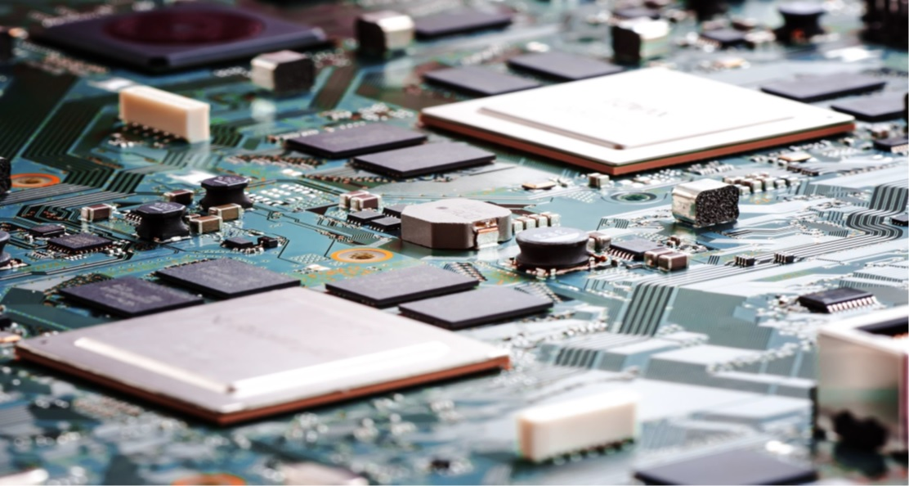
APB PROTOCOL
Nguyen Cong Huan, OA-ICT
May 5th, 2018
Rev: 1.00

Slide 2
INTRODUCTION
APB (Advanced Peripheral Bus) is part of the AMBA 3 protocol family.
The APB interfaces to any peripherals that are low-bandwidth and do not require the high performance of pipelined bus interface.
All signal transactions are only related to the rising edge of the clock. Every transfer take at least two cycles.

Slide 3
ARCHITECTURE
PADDR[31:0]
PSEL
PENABLE
PWRITE
APB BRIDGE
SLAVE
PWDATA[31:0]
PRDATA[31:0]
PREADY
SLVERR

Slide 4
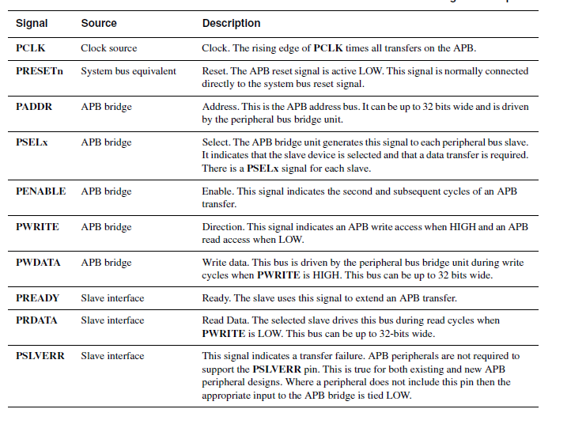
ARCHITECTURE

Slide 5
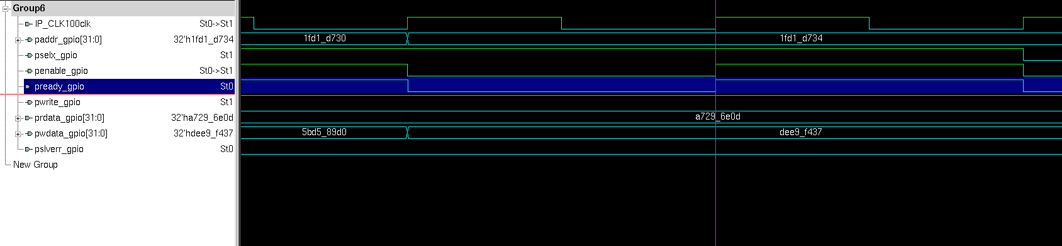
WRITE TRANSFER (NO WAIT STATE)
The transfer completes, PSEL goes to LOW because no more transfer
PSEL set to HIGH, start Setup phase
PWRITE set to HIGH, write transfer
After 1 cycle, PENABLE is asserted, start Access phase

Slide 6
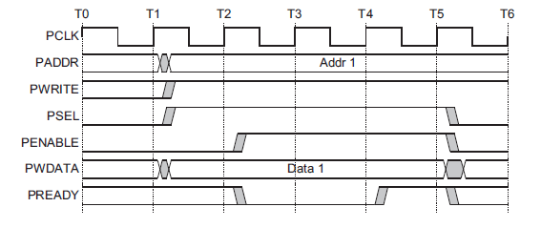
WRITE TRANSFER (WITH WAIT STATE)
The Access phase is the same as no-wait-state
PREADY set to LOW to extend the transfer
The transfer complete, all control signals go to LOW

Slide 7
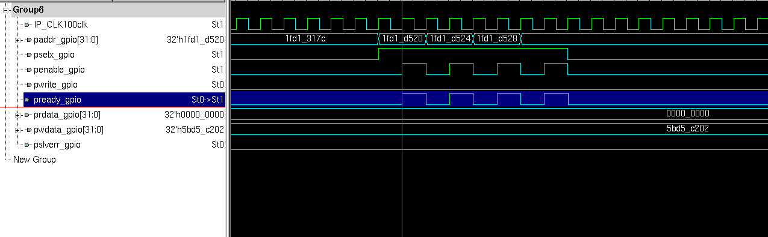
READ TRANSFER (NO WAIT STATE)
The transfer completes, another transfer start so PSEL still HIGH
PSEL set to HIGH, start Setup phase
PWRITE set to LOW, Read transfer
After 1 cycle, PENABLE is asserted, start Access phase

Slide 8
READ TRANSFER (WITH WAIT STATE)

