Slide 1

MENTOR – MENTEE TRAINING SYSTEM
THE 1ST presentation
July 12th , 2016
Nhan Le
OA-ICT Group / Frontend Design Department
HW Engineering Division
Renesas Design Vietnam Co., Ltd
Notes:
Date

Slide 2
MENTOR - MENTEE SYSTEM
23G MENTOR-MENTEE TRAINING PLAN
Group : OA-ICT
Mentor : Nghia Vo - 1104
Mentee : Nhan Le - 1687
Duration : Jul/2016 – Mar/2018

Slide 3
OUTLINE
TARGETS 4
PLAN TO ACHIEVE 8
MENTOR – MENTEE ACTIVITY 14

Slide 4

TARGETS

Slide 5
Targets – 1/3
Become a
Verification & RTL Design
Engineer
(Mar 2018)
Determine verification strategy
Create LSI functional description
Check specification
Create module design spec
Create checklist
3
2.7
Create RTL description
Create test patterns
Create timing budget
Conduct RTL verification
Create top level netlist
Evaluate verification result
Determine testing strategies
Notes:
Need improve

Slide 6
TARGETS – 2/3
Role | Skill | Jul-16 | Dec-16 | Jun-17 | Dec-17 | Mar-18
Functional Verification | Able to check specification | 1 | 1.5 | 2 | 2.5 | 3
 | Able to create check list | 1 | 1.5 | 2 | 2.5 | 3
 | Able to create test patterns for functional verification | 1 | 1.5 | 2 | 2.5 | 3
 | Able to conduct the functional verification of RTL | 1 | 1.5 | 2 | 2.5 | 3
 | Able to evaluate functional verification result | 1 | 1.5 | 2 | 2.5 | 3
 | Average | 1 | 1.5 | 2 | 2.5 | 3
Functional Design | Able to modify Top module in order to connect with system | 1 | 1.5 | 2 | 2.5 | 3
 | Able to create Top module and understand its structure | 1 | 1.2 | 1.5 | 2 | 2.5
 | Able to perform Synthesis and Static Verification | 1 | 1.2 | 1.5 | 2 | 2.5
 | Average | 1 | 1.3 | 1.67 | 2.17 | 2.67
Total Average |  | 1 | 1.4 | 1.84 | 2.34 | 2.84

Slide 7
TARGETS – 3/3
6-months Review

Slide 8
PLAN TO ACHIEVE

Slide 9
PLAN TO ACHIEVE - OVERVIEW
System Investigation
NIC-400 RTL Design
CCI-400 Verification
PCIE Gen2 Verification
PCIE Gen4 Verification
Additional tasks
Make summary report
Notes:
Copy slide from Phuc-san presentation

Slide 10
PLAN TO ACHIEVE – 1/4
JUL/16
Skill: 1 → 1.4
DEC/16
JUN/17
DEC/17
MAR/18
MAIN TASK | SUB TASK | TARGET
System Investigation | ARM946 Investigation (Instruction Set, Address Mode) | Understand the instruction set of ARM9, ARM9 I/F
 | AXI Bus Investigation | Understand 5 channels of AXI Bus, Signals Description, Handshake mechanism, Transactions
NIC-400 RTL Design | Investigate NIC-400 Specification | Understand functionalities of S-IF, M-IF of NIC-400
 | RTL generation by AMBA Designer | Understand how to apply the tool to generate AXI Bus
CCI-400 Verification | Investigation: ACE/ACE-Lite Protocol CCI-400 TRM | - Understand about Coherency transactions, ACE Protocol and its requirements Understand functionalities of CCI-400
 | Verification: Interface check Clock & Reset check Register check Outstanding Check Snoop Response check QoS Function Check Snoop Transaction check | Can do Interface check for similar ARM-IP Can do Clock & Reset check for similar ARM-IP Can do Register check for similar ARM-IP Can check Outstanding Count for CCI-400 Can verify all of possible response for Snoop Transaction Can verify QoS function of CCI-400 Can verify all supported Snoop Transaction within a system

Slide 11
PLAN TO ACHIEVE – 2/4
JUL/16
DEC/16
Skill: 1.4 → 1.84
JUN/17
DEC/17
MAR/18
MAIN TASK | SUB TASK | TARGET
PCIE Gen2 Verification | Investigation: PCIE Specification PCIE Design Specification | Understand Standard of PCIE 3.0 Protocol Understand Basic Operation, States, Transactions (DMA, PEXPIO, AXIPIO, MESSAGES), Interrupts function
 | RTL making/modification: PCIE Top modification Top Design making | Modify PCIE Top in order to connect with this system Know how to create a Top Module and understand its structure
 | Test-bench making | Know how to connect and configure the VIP and start doing handshake
 | Checklist making | Know how to make Linkage Verification Checklist
 | Verification: LinkUp Interrupt check - Data Transfer (PIO, DMA) | Understand the setting flow for doing handshake mechanism using model Understand the setting flow for confirming PCIE Interrupt Understand the setting flow for PCIE Data Transfer (PIO, DMA)

Slide 12
PLAN TO ACHIEVE – 3/4
JUL/16
DEC/16
JUN/17
Skill: 1.84 → 2.34
DEC/17
MAR/18
MAIN TASK | SUB TASK | TARGET
PCIE Gen2 Verification | Verification: LinkUp Interrupt check - Data Transfer (PIO, DMA) | Understand the setting flow for doing handshake mechanism using model Understand the setting flow for confirming PCIE Interrupt Understand the setting flow for PCIE Data Transfer (PIO, DMA)
PCIE Gen4 Verification | Investigation: PCIE 4.0 Specification Cadence PCIE Design Specification | Understand Standard of PCIE 4.0 Protocol Understand Basic Operation, States, Transactions (DMA, PEXPIO, AXIPIO, MESSAGES), Interrupts function

Slide 13
PLAN TO ACHIEVE – 4/4
JUL/16
DEC/16
JUN/17
DEC/17
MAR/18
Skill: 2.34 → 2.84
MAIN TASK | SUB TASK | TARGET
PCIE Gen4 Verification | Verification: LinkUp Interrupt check - Data Transfer (PIO, DMA) | Understand the setting flow for doing handshake mechanism using model Understand the setting flow for confirming PCIE Interrupt Understand the setting flow for PCIE Data Transfer (PIO, DMA)
Additional Tasks | Get toggle coverage result | Understand the purpose of Toggle Coverage and how to generate it
 | Do Toggle Improvement and make reports | Make a report following a format and increase the Toggle Ratio
 | Change environment from VCS to NCVERILOG | Can use both tools for simulation

Slide 14
MENTOR – MENTEE ACTIVITIES

Slide 15
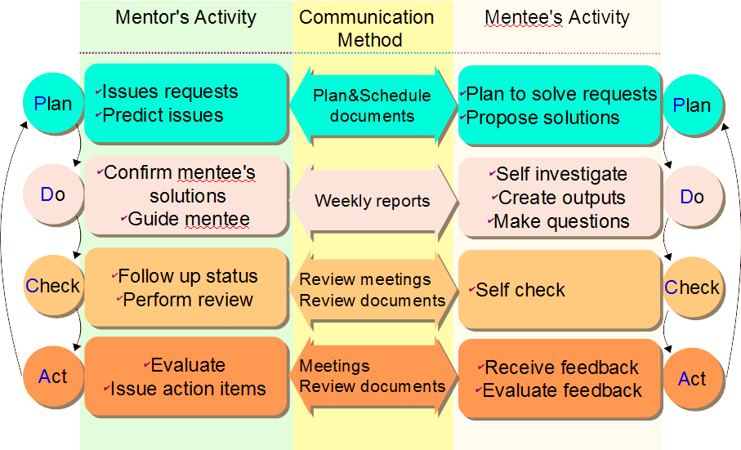
MENTOR – MENTEE ACTIVITIES
Notes:
Phuong thuc PDCA, report la du, k can weekly report.

Slide 16
ISSUE SOLVING PROCEDURE
Mentee try to solve problem
OK/NG
OK
Problem
happens
Mentee try to explain reason
NG
Confirm with Mentor
Notes:
Sau tat ca, em tu tin lam dc cai gi? Kha nang co the lam dc gi.

Slide 17
THANK YOU FOR YOUR LISTENING

