Slide 1

AXI PROTOCOL
Nguyen Cong Huan, OA-ICT
Tran Vu Thuyet, OA-ICT
May 5th, 2018
Rev: 1.00

Slide 2
INTRODUCTION
AXI (Advanced Extensible Interface) protocol is one of AMBA 3 protocol family and it is targeted at high-performance, high-frequency system designs and high-speed submicron interconnect
The key features of the AXI protocol are:
Separate address/control and data phase
Support for unaligned data transfer using byte strobes
Burst-based transactions with only start address issued
Separate read and write data channel to enable low cost DMA
Ability to issue multiple outstanding addresses
Out-of-order transaction completion
Easy addition to register stages to provide timing closure

Slide 3
ARCHITECTURE - CHANNELS
The AXI protocol has 5 independent channel belong to two phase detail as below table:
No | Phase | Channel | Abbr | Function
1 | ADDRESS | Write address | AW
2 |  | Read address | AR
3 | DATA | Write Data | W | Channel for passing all writing data info
4 |  | Write Response | B | Response for writing from Slave to to Master
5 |  | Read Data | R | Channel for passing all reading data info

Slide 4
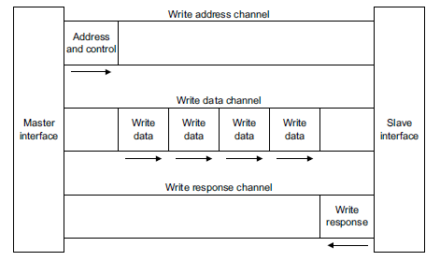
ARCHITECTURE – WRITE CHANNEL

Slide 5
ARCHITECTURE – READ CHANNEL

Slide 6
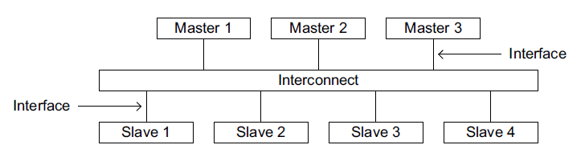
ARCHITECTURE – INTERFACE AND INTERCONNECT

Slide 7
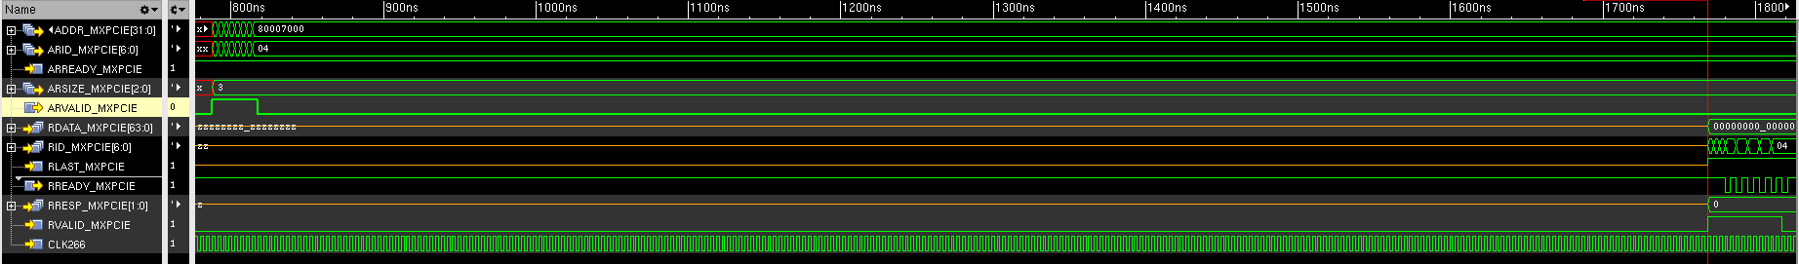
Basic transactions – Read burst
Address/Control phase
Data phase

Slide 8
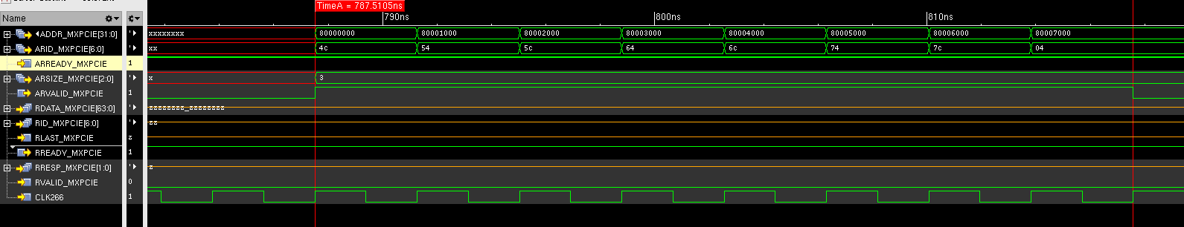
Basic transactions – Read burst
Address/Control phase

Slide 9
