Slide 1




The Paradox of Connectivity: Rapid Migration Enhances Fish Biomass but Not Maximum Sustainable Yield in Generalized Logistic Two-Patch Fishery System
Thanh Nguyen-Cung
Cosmos Lab, VinUniversity, Vietnam & UMMISCO, IRD, France
join work with Doanh Nguyen-Ngoc, Pierre Auger and Tri Nguyen-Huu

Slide 2


http://vinuni.edu.vn

Slide 3



Slide 4


Slide 5


Slide 6


Slide 7

http://cei.vinuni.edu.vn

Slide 8
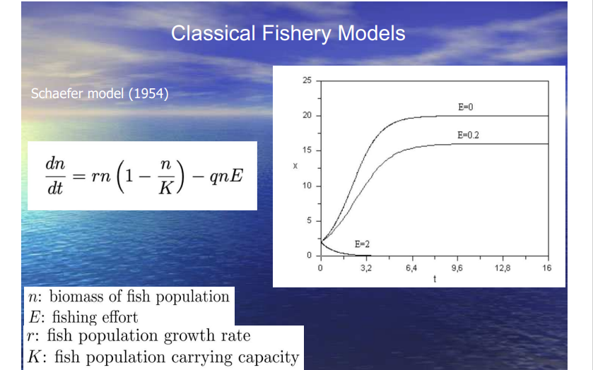

Slide 9
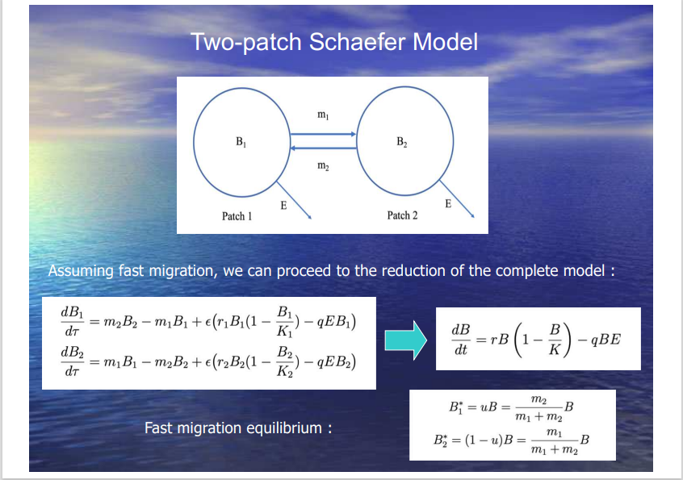

Slide 10
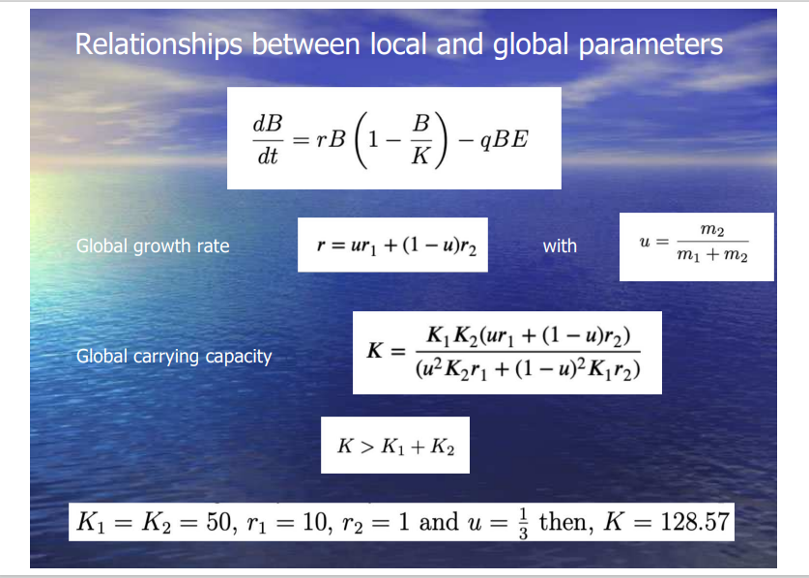

Slide 11
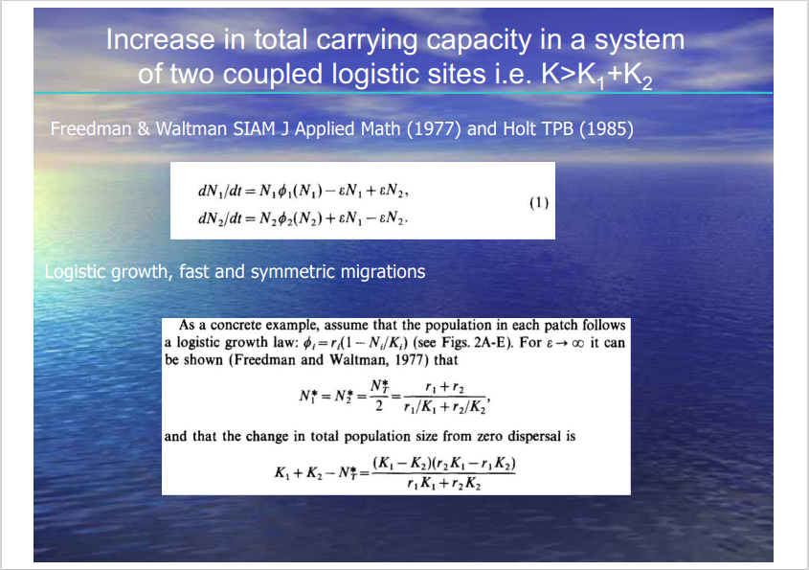

Slide 12
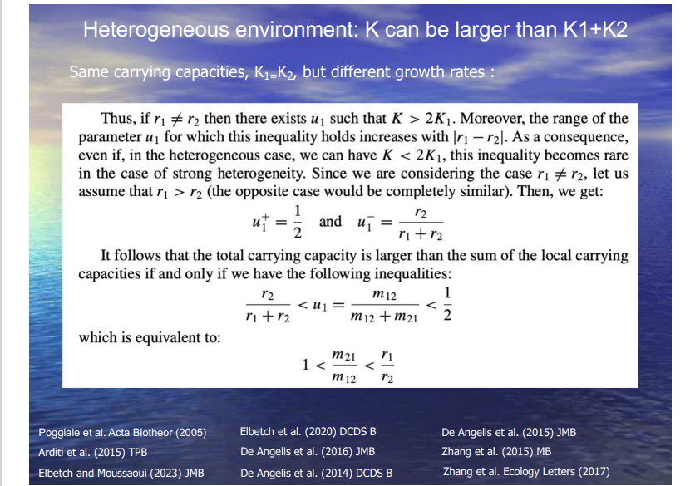

Slide 13
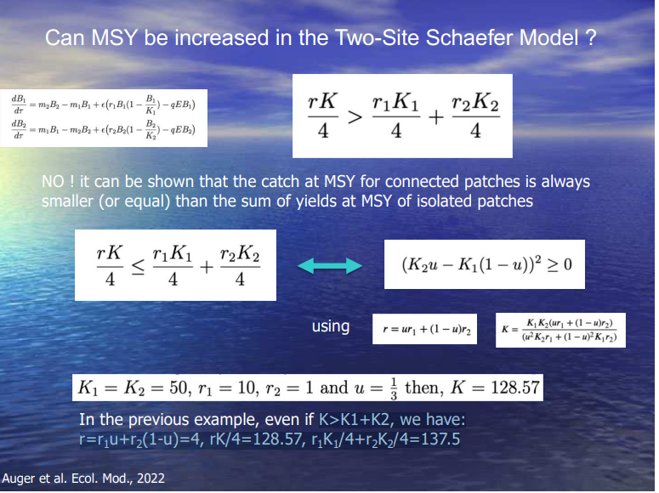

Slide 14

Single Patch Generalized Logistic Model
The dynamics of the system is described by the following differential equation
B: biomass
K: carrying Capacity r: growth rate
q: catchability coefficient
E: fishing effort
m: generalizes the growth function
When m = 1, this equation reduces to the well- known classical logistic growth model.

Slide 15
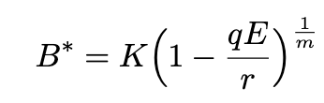
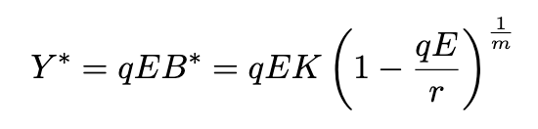
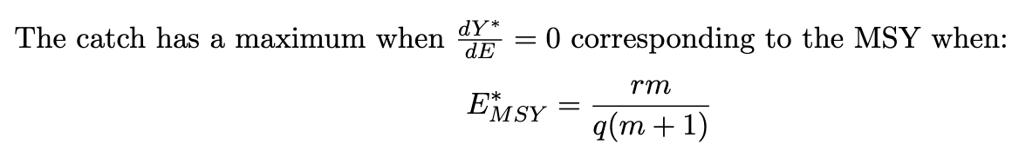
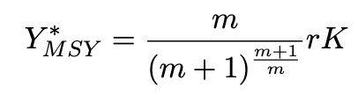
At Equilibrium
The biomass is given by
The catch is
The maximum sustainable yield now reads

Slide 16
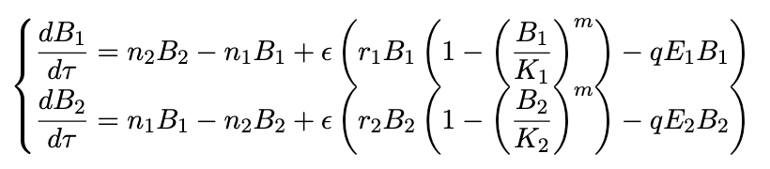

Two-patch Generalized Logistic Model
Migratory processes are assumed to operate on a fast time scale τ, leading to the following dynamic equations:
The fishing effort E is distributed between patches such that Ei = viE.
By substituting this fast migration equilibrium into the original system and subsequently
rescaling time via
We derive the following aggregated model, which describes the system’s dynamics on the slow time scale

Slide 17


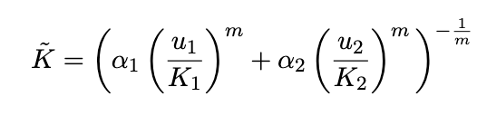
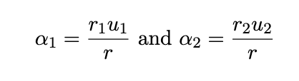

Two-patch Generalized Logistic Model
Assuming the fast migration, we can have the reduction model:
Overall fishing effort:
Overall fish carrying capacity:
with
The global fishing efficiency:

Slide 18
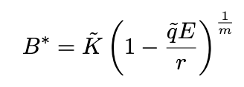
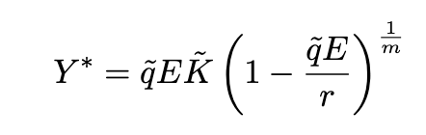
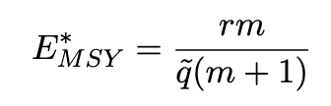
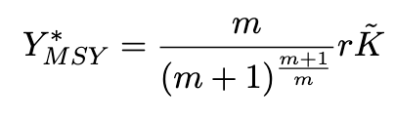
At Equilibrium
The biomass is given by
The catch is
The catch has maximum when:
The maximum sustainable yield:

Slide 19
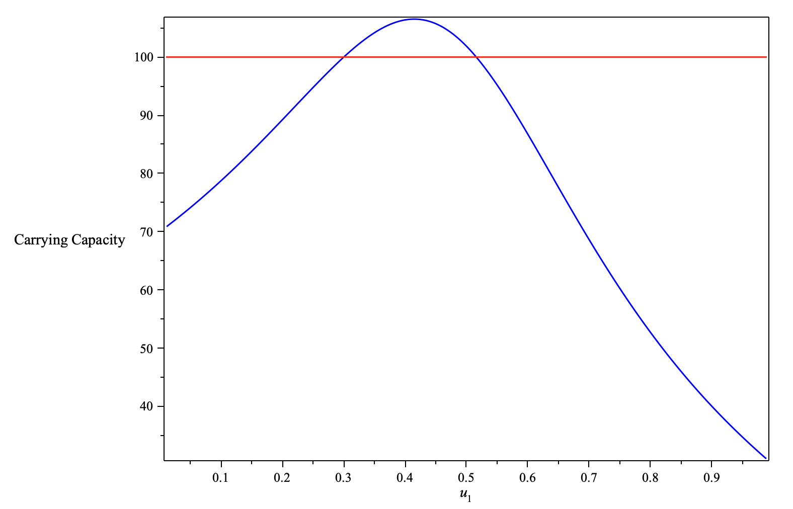
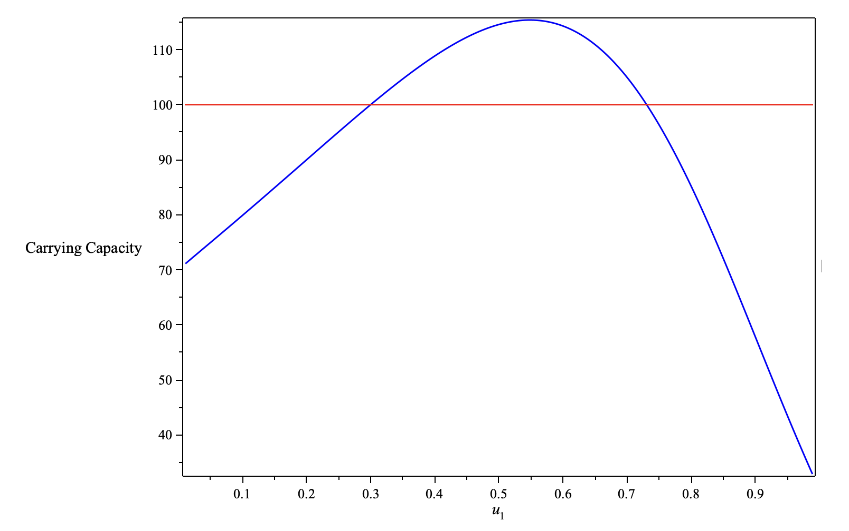
Comparing Carrying Capacity
The global carrying capacity when connected (in blue) and the sum of local carrying capacities (in red) with respect to u1. The parameters are as follows r1 = 0.2, r2 = 0.8, K1 = 30, K2 = 70, m = 2
The global carrying capacity when connected (in blue) and the sum of local carrying capacities (in red) with respect to u1. The parameters are as follows r1 = 0.2, r2 = 0.8, K1 = 30, K2 = 70, m = 0.5

Slide 20
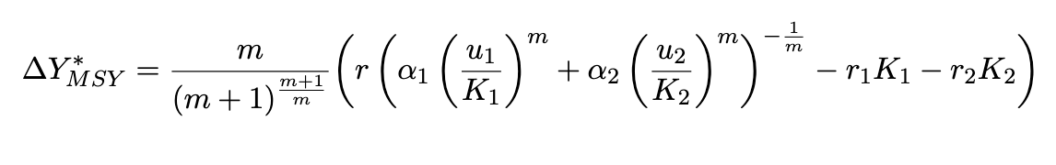

Comparing Maximum Sustainable Yields
We define the excess yield at MSY
Equality holds when the fish population adheres to an Ideal Free Distribution (IFD), specifically when the per capita biomass is equal across patches

Slide 21
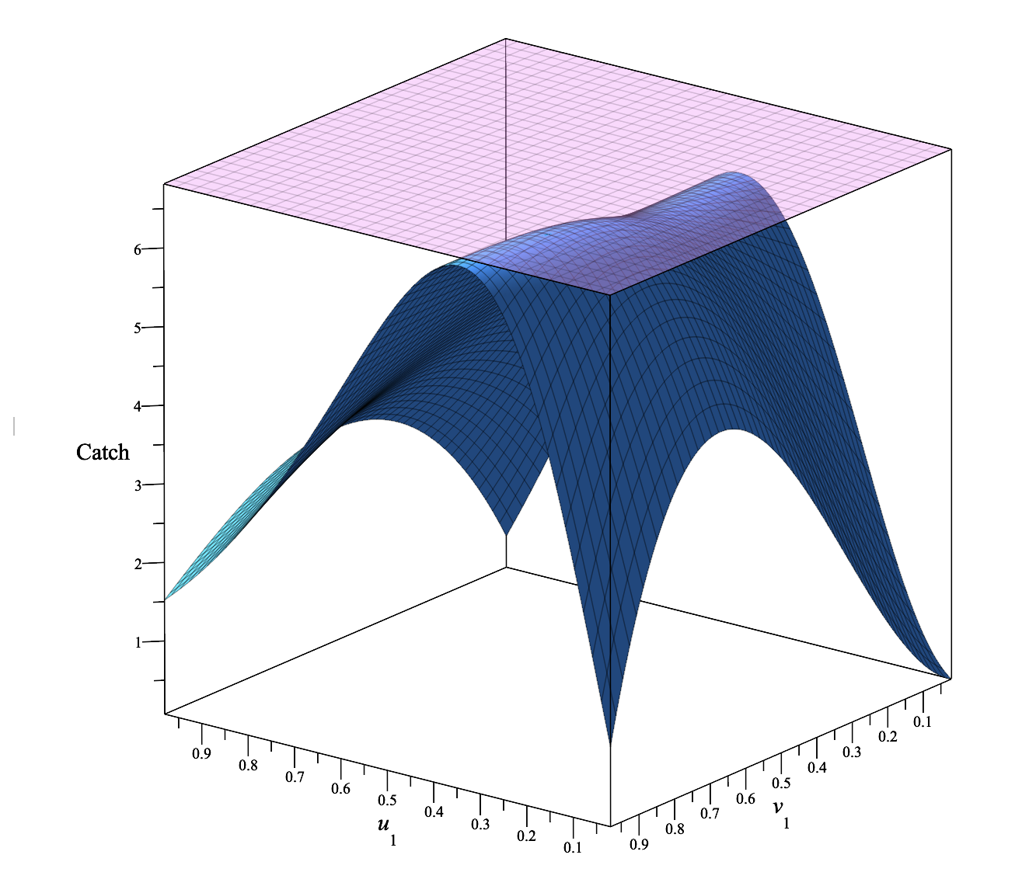
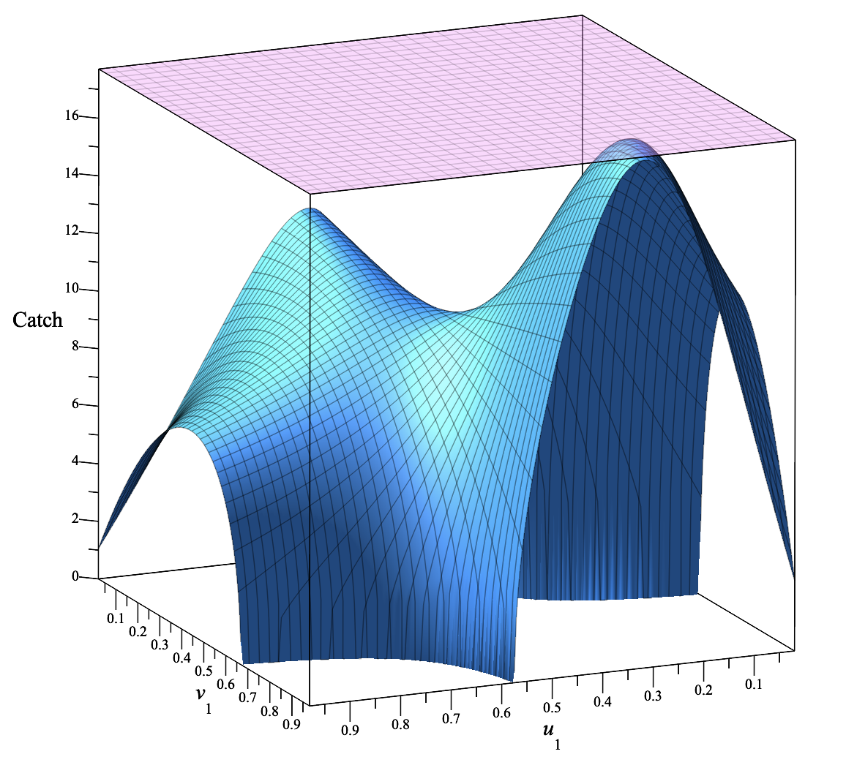
Simulations
Global catch (in blue) at connected patches with respect to u1 and v1. The sum of the catches at MSY of the disconnected patches is represented by the violet plane and is always larger than the global catch for connected sites, with the equality holding at IFD. The parameters are given by: r1 = 0.6, r2 = 0.4, K1 = 30, K2 = 70, q = 1, E = 0.9, m = 2.
Global catch (in blue) at connected patches with respect to u1 and v1. The sum of the catches at MSY of the disconnected patches is represented by the violet plane and is always larger than the global catch for connected sites, with the equality holding at IFD. The parameters are given by: r1 = 0.6, r2 = 0.4, K1 = 30, K2 = 70, q = 1, E = 0.4, m = 0.5.

Slide 22
Thank you very much for your attention !
Thanh Nguyen-Cung. Email: 24thanh.nc@vinuni.edu.vn
Cosmos Lab, VinUniversity, Vietnam & UMMISCO, IRD, France
joint work with Doanh Nguyen-Ngoc, Pierre Auger and Tri Nguyen-Huu

