Slide 1
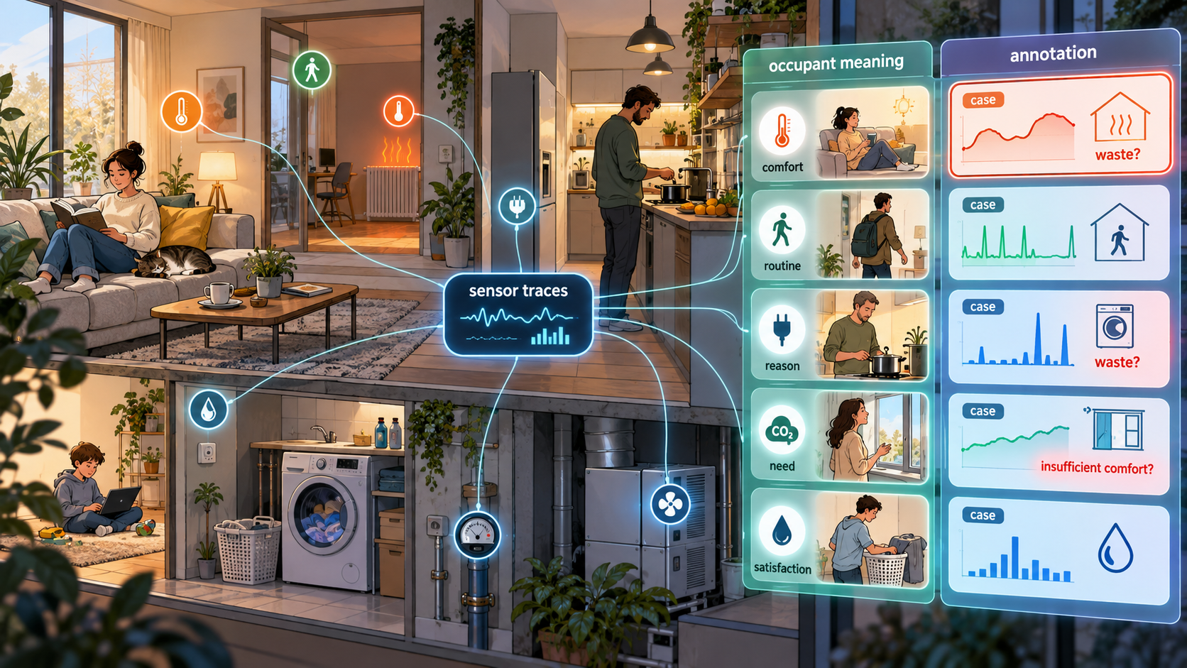
When Smart Buildings Listen And Support inhabitants
AnnoBot as infrastructure for occupant-defined inquiry
Grenoble INP, G-SCOP Laboratory
September 2026
Notes:
Based on the supplied source deck AnnoBot_presentation_v10.pptx.
Theory draws from 13_manuscript_ERSS_restructured_updated.docx and Annotation_System.pdf.

Slide 2
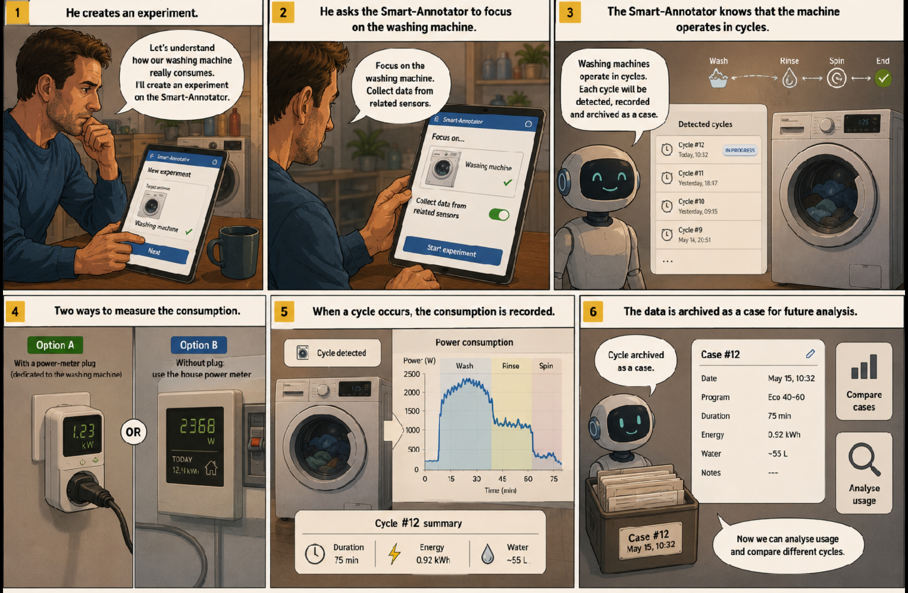
Example of listening smart-building service
8
Notes:
Annotation_System.pdf section 3.1, pages 8 to 12, defines E = <Q,S,T> and the role of each component.
The washing-machine examples in the source distinguish annotation-free and annotation-based recognition.

Slide 3
Listening smart-building requirements
Underlying philosophy of listening smart-building
Most smart-building systems improve sensing or control. Sufficiency asks whether the service itself fits the situation.
Technical efficiency
Automation
Feedback and advice
Improves how a service is delivered, but can still provide an unnecessary service efficiently.
Acts when objectives are stable, but cannot decide alone whether a service is meaningful or acceptable.
Makes energy visible, but often stays detached from activities, service expectations, and household constraints.
The missing bridge is an operational way for occupants and buildings to investigate service relevance together.
3
Notes:
ERSS manuscript sections 1, 3.1, 3.2, and 3.3.
The manuscript frames household energy use as service relevance rather than optimization alone.

Slide 4
Listening smart-building requirements
A dwelling provides services to inhabitants.
In performant smart-buildings, a dwelling should provide smart-services supporting inhabitants in revealing how the needs match the services
  improve service efficiency:
    do the energy costs required to the demanded service quality?
  overall sufficiency (well being)
    do the services provided required for improving well-being?
Therefore, smart-dwelling must perceive the needs of inhabitants: it's not only a matter of sensors and controls, human state of mind matters

Slide 5
Why it can cope with sufficiency
A listening smart-building helps occupants investigate domestic services
Service sufficiency
Situated inquiry
User-defined experiments
AnnoBot prototype
Which service was needed, useful, acceptable, or excessive in this situation?
Occupants connect measured traces with lived reasons, constraints, and meanings.
A question selects the sensors, annotation scope, and listening period.
The current system implements selected parts of the annotation and interaction workflow.
The implementation should therefore support a loop: observe, annotate, interpret, experiment, revise.
2
Notes:
Synthesis from the ERSS manuscript abstract, sections 2.4 and 5, and the prior source deck outline.

Slide 6
Why it can cope with sufficiency
Dealing with service sufficiency
A domestic service is sufficient when occupants judge it useful, proportionate, timely, and acceptable in context.
Useful
Proportionate
Sufficient Service
Timely
Acceptable
Example: a dishwasher cycle within a routine, constraint, and desired result
4
Notes:
ERSS manuscript sections 4.1 and 5.1.
The source defines service sufficiency as situated adequacy in relation to well-being, constraints, and resource use.

Slide 7

Why annotations are mandatory
Human state of mind must be collected thanks to annotations
  beliefs
  desires
  intentions
  activities
  deliberations
  context: who, what, when, why, where, how
An annotation is a piece of text related to an instant (or possibly to a time period)
  annotation = <meaningful text, time, duration>
annotation is not labelling:
annotations are considered as input data
whereas labels stands for output data in
machine learning

Slide 8
Why it is inclusive
The building provides decision support. Occupants remain legitimate interpreters of their own needs.
Conceptual requirement
Design implication
Starts from services, not consumption alone
Frames suggestions as hypotheses to test
Treats measurements as traces requiring interpretation
Shows delayed and indirect effects
Asks only when human meaning has high value
Supports autonomy without defining one good life
5
Notes:
ERSS manuscript sections 4.2 and 4.3.
The manuscript describes inclusive sufficiency management as non-coercive home energy management that includes inhabitant knowledge.

Slide 9
Why experimenting?
It's complex to improve all the services in parallel
It's easier when services come into the focus one after the other
Here come the concept of experiment
  it structures the inquiry
  it is implicitly or explicitly related to a question related to a service (Q)
  it specifies the meaningful sensors for the considered service (S)
  it specifies the indicators that can be plotted (I)
  it contains the description of how to detect a service or a case (D)
    they can be temporary (with cycle) and permanent (daily cycle)

Slide 10
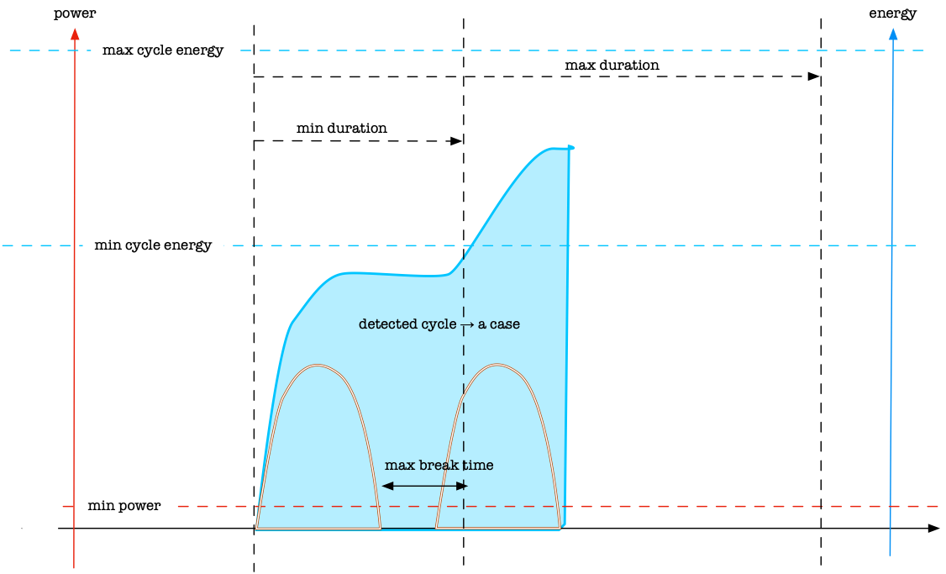
Why experimenting?
temporary services can be detected thanks to the power consumption: min and max possible durations, min and max cycle energy, max break time and min power. It is specific to a type of service appliance

Slide 11
Why experimenting?
An occupant experiment couples a question with selected sensors and a temporal horizon.
E = < Q, S, I, D >
Q: Question
S: Sensors
I: Indicators
T: Cycle detection
Defines the inquiry and the semantic detail needed to answer it.
Selects only the observations relevant to the occupant's question.
List selected indicators for inquiry
Define how to detect a cycle. it can last few hours (temporary service) or a complete day (permanent service)
The question also determines whether annotation-free recognition is enough or semantic annotation is required.
8
Notes:
Annotation_System.pdf section 3.1, pages 8 to 12, defines E = <Q,S,T> and the role of each component.
The washing-machine examples in the source distinguish annotation-free and annotation-based recognition.

Slide 12
What does an annotation aiding system?
Because it's tough to follow every days what's going on, annotation process has to be aided
  calling out when the moment is valuable thanks to interactive learning
  suggesting annotations to inhabitants that can validate or change some of them taking advantage of repetitions thanks to supervised learning
  detecting annotations singularities like
    multiple annotations for the same event
    Indistinguishable events with different annotations

Slide 13
What does an annotation aiding system?
Listening smart-buildings includes
  an annotation aiding system
    a Large Language Model for generating explanations based of global knowledge combined with local information like data and model based indicators
    a rapid building physics representation tools
  an case based reasoning system for recommending future behavior and to recommend future actions
  ...

Slide 14
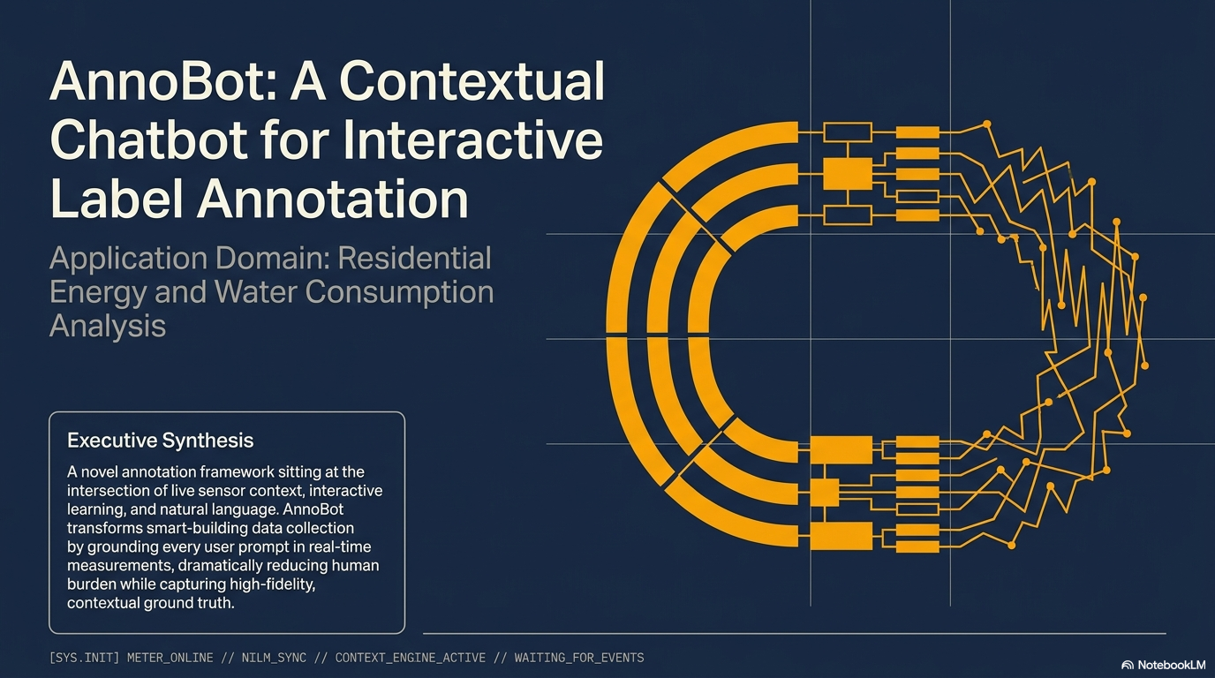
Illustration

Slide 15
Traces And Meanings
Sensors capture observable traces. Occupants supply meanings, intentions, and acceptability judgments.
Sensor-observable traces
Occupant-only meanings
Power, water, temperature
Motion, contact, occupancy
Timing, duration, recurrence
Purpose and intention
Satisfaction or discomfort
Constraints, care, habits, deliberation
Semantic annotation connects the two without pretending that one replaces the other.
6
Notes:
ERSS manuscript sections 1, 2.3, and 5.2.
Annotation_System.pdf introduction and problem formulation, especially pages 1 and 8 to 12.

Slide 16
Occupants As Intentional Learners
A listening building treats occupants as co-investigators in their own living environment.
Question
Observe
Reflect
What do I want to understand about this service?
What can the building measure continuously and reliably?
What does the measured event mean for comfort, need, or routine?
The system supports learning from everyday life rather than enforcing predefined behaviour change.
7
Notes:
Annotation_System.pdf section 3, pages 8 to 9, defines occupants as intentional learners who question, observe, and reflect.
ERSS manuscript sections 3.3 and 8.1 support the co-investigator framing.

Slide 17
Domestic Situations
A service episode is a socio-physical object: measured states plus household meanings.
Physical side
Social side
Energy use, indoor temperature, humidity, appliance status, occupancy, outdoor conditions
Comfort, cleanliness, convenience, care, privacy, fatigue, habits, social expectations
Case
Cases make situated comparison possible without imposing one universal rule.
9
Notes:
ERSS manuscript sections 5.1 and 5.3.
A case can include context, action, service, measured effect, inhabitant evaluation, and outcome.

Slide 18
Selective Semantic Annotation
The system should ask when annotation has interpretive value, not whenever a sensor fires.
Low semantic uncertainty
High semantic uncertainty
Sensor facts can answer the question.
Example: start time, end time, duration, energy.
The answer needs lived context.
Example: programme, load type, reason, satisfaction.
Selective annotation protects attention, privacy, and trust while preserving the meaning needed for learning.
10
Notes:
ERSS manuscript section 5.2.
Annotation_System.pdf sections 3.1 and 4.2, pages 9 to 12 and 18 to 22.
The source emphasizes low burden and privacy-preserving environmental and power sensors.

Slide 19
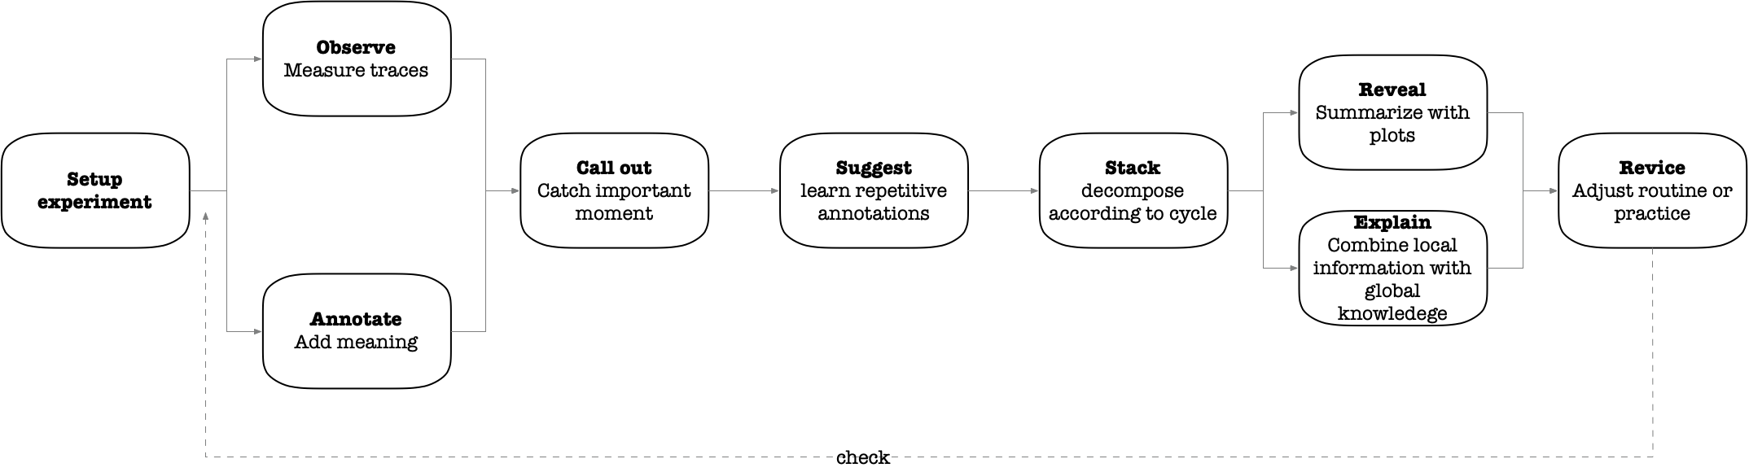

Inquiry Loop
A listening smart building repeats an inquiry loop as routines and expectations change.
Self-experimentation tests hypotheses. It does not turn recommendations into prescriptions.
11
Notes:
ERSS manuscript sections 2.4, 5, and 6.1.
The loop is observe, annotate, interpret, experiment, revise.

Slide 20
Needs And Services
A listening building starts from human needs, then asks which domestic service satisfies them in a given situation.
Need
Satisfier
Sufficiency judgment
Comfort, hygiene, safety, care, information, or convenience as the occupant understands it.
A concrete service configuration: heating a room, running a wash cycle, ventilating, lighting, charging, or cooking.
The occupant evaluates whether the service level and timing fit well-being, constraints, and resource use.
This prevents sufficiency from becoming a simple reduction rule. Sometimes less service helps. Sometimes maintaining service protects dignity, health, or care.
12
Notes:
Theory added in response to the request for more theory with references.
Max-Neef et al. (1991) and Brand-Correa & Steinberger (2017) are listed in the supplied ERSS manuscript references.
ERSS manuscript section 4.1 defines service sufficiency as situated adequacy in relation to well-being, constraints, and resource use.

Slide 21
Practices And Service Episodes
Domestic demand comes from practices, not isolated appliance choices.
Practice
Material setting
Service episode
Washing, cooking, heating, hosting, working, caring, cleaning, and relaxing organize what households come to need.
Appliances, sensors, rooms, tariffs, weather, time constraints, and building fabric shape what options feel realistic.
A concrete occurrence links the practice and setting to a measured effect and a lived evaluation.
AnnoBot should therefore store cases that keep the situation intact, including context, service, measured effect, meaning, and outcome.
13
Notes:
ERSS manuscript section 3.4 summarizes social practice approaches and the operationalization challenge.
ERSS manuscript section 5.1 defines domestic situations as socio-physical objects.
Sovacool (2014) is retained from the supplied ERSS manuscript reference list.

Slide 22
From Feedback To Inquiry
Feedback shows consumption. Sufficiency inquiry asks why a service happened and what alternative deserves a test.
Feedback and persuasion
Automation
Situated inquiry
Information, prompts, goals, and advice can influence consumption, but effects vary across households and situations.
Control works best when objectives are stable and meanings are clear. It struggles when acceptability depends on lived context.
The system helps occupants reveal relations, compare cases, and test hypotheses in their own homes.
This reframes the smart building from a persuasion or control system into an instrument for household learning.
14
Notes:
The cited works are retained from the ERSS manuscript reference list.
ERSS manuscript section 3 contrasts efficiency, feedback, occupant-centric control, and practice-based analysis.

Slide 23
Cases And Explanations
Interpretation turns traces and annotations into comparable cases that occupants can question.
Case memory
Explanation
Experiment proposal
The system retrieves similar past situations instead of applying one universal rule.
The system shows why two situations look similar, why a pattern matters, or why more annotation is needed.
A proposed change remains a hypothesis until the occupant tests comfort, cost, timing, and acceptability.
Explanations matter because trust depends on whether occupants can inspect the system's reasons and limits.
Refs: Das et al. 2021; Fiori et al. 2024; Boulmaiz 2024; ERSS manuscript, sections 5.3 and 6.3.
15
Notes:
Das et al. (2021), Fiori et al. (2024), and Boulmaiz (2024) are listed in the supplied materials.
ERSS manuscript section 5.3 frames interpretation through cases and explanations.
Boulmaiz details are marked for verification in the supplied ERSS manuscript, so the deck treats it as supplied/internal reference material.

Slide 24
Autonomy, Burden, And Privacy
A listening building must preserve the conditions that make participation acceptable.
Autonomy
Low burden
Privacy
Occupants define questions, judge sufficiency, and choose whether an experiment fits their constraints.
The system asks selectively and reuses past labelled cases instead of requesting constant manual labels.
Ambient and energy sensors reduce intrusiveness, but annotations can reveal sensitive domestic meanings.
Responsible implementation needs clear data governance and the ability to explain why a question is being asked.
Refs: Suboticki et al. 2019; Silva et al. 2022; Demrozi et al. 2023; Tan et al. 2024; Annotation_System.pdf, sections 1 and 4.
16
Notes:
Suboticki et al. (2019) appears in the ERSS manuscript reference list.
Silva et al. (2022), Demrozi et al. (2023), and Tan et al. (2024) appear in Annotation_System.pdf references.
Annotation_System.pdf introduction emphasizes privacy-preserving sensing and low annotation burden.

Slide 25
Human-In-The-Loop Learning
Current AnnoBot feature
The implemented annotation pipeline links sensor context to occupant-provided meaning.
1. Data collection
2. Label assignment
3. Quality control
Acquire relevant sensor events and convert them into comparable timeslots.
Use interactive learning and LLM dialogue to collect required semantic fields.
Check completeness and revisit uncertain or conflicting annotations.
The pipeline supports cooperative repair instead of treating missing labels as simple errors.
17
Notes:
Annotation_System.pdf sections 3.2 and 4, pages 12 to 24.
Retained and rewritten from existing source deck slide 8.

Slide 26
When AnnoBot Asks
Current AnnoBot feature
Current trigger logic asks when the local labelled neighbourhood is too sparse.
Prototype settings
Distance-based neighbourhood after feature normalization
Ask if fewer than 3 labelled neighbours are found
Radius epsilon = 0.3, minimum neighbours = 3
Error, redundancy, and spread criteria remain defined but inactive
well-supported context
ASK
18
Notes:
Annotation_System.pdf section 4.2 and trigger criteria table, pages 18 to 22.
Retained and clarified from existing source deck slide 9.

Slide 27
Interaction Modes
Listening requires both reflective review and real-time dialogue.
System-initiated
Occupant-initiated
AnnoBot asks, proposes, or confirms when a timeslot needs human meaning.
The occupant asks questions, requests explanations, or reviews past cases.
A cooperative system can explain why it asks and can report limits when sensors cannot distinguish a situation.
19
Notes:
Annotation_System.pdf section 4.3, pages 23 to 25.
ERSS manuscript section 6.4 on reflective interfaces.

Slide 28
AnnoBot Scope
AnnoBot implements the annotation and interaction layer of the wider listening-building framework.
Implemented now
Partly implemented
Conceptual or future work
Experiment creation by chat
Sensor registration through backend mapping
Telegram questions and reply parsing
Structured annotation records
Dashboard visualization
Selective triggering through neighbourhood density
Follow-up questions for incomplete replies
Case search through stored embeddings
Full service-sufficiency decision support
Case explanations for occupants
Longitudinal household appropriation
Integrated observe to revise validation
This boundary keeps the prototype credible while showing how it fits the theoretical ambition.
20
Notes:
Current features summarized from Annotation_System.pdf implementation sections 5 and 6 and existing source deck slides 12 to 16.
Conceptual or future items draw from ERSS manuscript evidence-status and future-validation sections.

Slide 29
System Architecture
Current AnnoBot feature
LLM
Database
Question generation
Reply parsing
Experiments
Sensor events
Annotations
Telegram
Web dashboard
AnnoBot core
Occupant interface
Review and analysis
Interactive learning
MCP tools
Trigger logic
Reliable actions
21
Notes:
Retained and redrawn from existing source deck slide 15.
Annotation_System.pdf section 5 describes Home Assistant, TimescaleDB/PostgreSQL, LangChain/OpenRouter, Telegram Bot, and backend APIs.

Slide 30
Walkthrough: Annotation Event
Current AnnoBot walkthrough
1
Define experiment
2
Register sensor
3
Detect activity
Washing machine experiment created through Telegram
Power sensor linked and trigger threshold set
The appliance draws power during a real cycle
4
Ask
5
Reply
6
Store
Interactive learning flags a new event
Occupant provides the missing context
Annotation and embedding are written to the database
22
Notes:
Condensed from existing source deck slide 12.
Annotation_System.pdf sections 5 and 6 describe the implemented daily workflow and Telegram-based label assignment test.

Slide 31
Walkthrough: From Event To Case
Current AnnoBot walkthrough
Pattern
Filter
Interpret
Revise
Repeated replies reveal a weekly laundry habit.
The dashboard filters by device, date range, or research question.
Wash days following football training become visible as a case pattern.
The occupant can test a different schedule, programme, or routine.
The final revision step expresses the theory. The current prototype mainly supports event capture, annotation, storage, and review.
23
Notes:
Condensed from existing source deck slide 13.
The revision step is a conceptual extension from the ERSS inquiry loop and should not be presented as fully implemented.

Slide 32
Evidence And Limits
The supplied work supports component feasibility. It does not yet validate a complete inclusive sufficiency system.
Supported by current materials
Requires future validation
Sensor-event visualization
Telegram annotation loop
Structured semantic labels
Selective querying logic
Component-level feasibility
Live ingestion from real residential sensors
Longitudinal multi-household deployment
Case explanations and decision support
Annotation burden and privacy governance
Durable sufficiency effects
Evaluation should include revelation, interpretive relevance, decision support, and sufficiency effects.
24
Notes:
ERSS manuscript sections 2.1, 7.2, 7.3, 7.4, and 8.4.
Annotation_System.pdf section 6 reports simulated dishwasher data and Telegram interaction tests.
Existing source deck slide 16 listed implementation limitations; this slide separates prototype limits from framework validation limits.

Slide 33
Add the screenshots of the demo here !

Slide 34
References
Theory and sufficiency sources
1. Abrahamse, W., Steg, L., Vlek, C., & Rothengatter, T. (2005). Journal of Environmental Psychology, 25(3), 273-291.
2. Brand-Correa, L. I., & Steinberger, J. K. (2017). Ecological Economics, 141, 43-52.
3. Fogg, B. J. (2002). Persuasive technology. Morgan Kaufmann.
4. Greening, L. A., Greene, D. L., & Difiglio, C. (2000). Energy Policy, 28(6-7), 389-401.
5. Karlin, B., Zinger, J. F., & Ford, R. (2015). Psychological Bulletin, 141(6), 1205-1227.
6. Max-Neef, M. A., Elizalde, A., & Hopenhayn, M. (1991). Human scale development. Apex Press.
7. Sovacool, B. K. (2014). Energy Research & Social Science, 1, 1-29.
8. Suboticki, I., Heidenreich, S., Ryghaug, M., & Skjølsvold, T. M. (2019). Energy Research & Social Science, 56, 101228.
9. International Energy Agency (2019). The Critical Role of Buildings.
References retained from the supplied materials. Verify manuscript-status entries before external submission.
25
Notes:
References preserved from the supplied ERSS manuscript and source deck.
The IEA reference is retained from the original deck.

Slide 35
References
Annotation, interaction, and implementation sources
10. Alemdar, H., Ertan, H., Incel, O. D., & Ersoy, C. (2013). PervasiveHealth, 232-235.
11. Bouchabou, D. et al. (2021). Sensors, 21, 6037.
12. Bouchabou, D. et al. (2021). Electronics, 10, 2498.
13. del Castillo Cardoso, E. A. (2025). Self-experimentation aiding system for energy management in residential buildings. Ph.D. thesis.
14. Das, D. et al. (2021). Explainable activity recognition for smart home systems. arXiv:2105.09787.
15. Demrozi, F. et al. (2023). Automated data annotation techniques in human activity recognition. arXiv:2307.05988.
16. Fiori, M. et al. (2024). Using large language models to compare explainable models for smart home human activity recognition.
17. Silva, J. B., Amayri, M., Ploix, S., Reignier, P., & Silva, C. S. (2022). Energy and Buildings, 258, 111727.
18. Tan, Z. et al. (2024). Large language models for data annotation and synthesis. arXiv:2402.13446.
19. Thukral, M. et al. (2024). Layout agnostic human activity recognition in smart homes through textual descriptions of sensor triggers.
Longer internal entries from the supplied manuscripts are summarized to preserve slide readability.
26
Notes:
References preserved from Annotation_System.pdf and the ERSS manuscript.
Some doctoral and working-manuscript entries in the supplied files are incomplete or marked for verification.

Slide 36
Thank you
Questions?
Grenoble INP, G-SCOP Laboratory
September 2026
Notes:
Closing slide adapted from the supplied source deck.

