Slide 1
Bkav software
Group members:
Nguyễn Đăng Quý
Trịnh Quang Trường
Nguyễn Ngọc Hồng Phúc

Slide 2
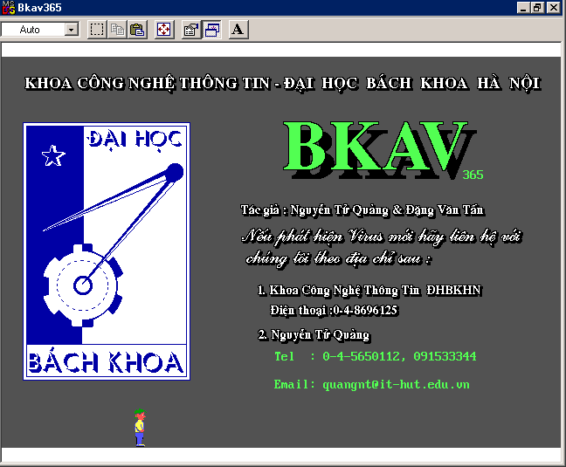
Bkav Released for the first time: 13 tháng 7, 1995

Slide 3
Founder of Bkav
Mr. Nguyen Tu Quang is the Chairman of the Board of Directors cum General Director (CEO). He was voted as one of 10 typical young faces of Vietnam in 1998.
And in 2017, he was honored by Vietnam Internet Association as one of the 10 prominent figures who have influenced the development of the Internet in Vietnam in a decade (2007-2017).

Slide 4
About Bkav software
is a technology group operating in the fields of network security, software, e-government, smartphone manufacturers, devices, ...
is one of the 10 most famous brands in Vietnam

Slide 5
About Bkav software
is the first company in Vietnam to discover many vulnerabilities in the world such as Google Chrome facial recognition system - Face ID of iPhone X, ...
is a pioneer company with the mission of building Vietnam's smartphone manufacturing industry

Slide 6
Available on these operating systems
Microsoft Windows
iOS
Android
Windows Phone
Symbian
Blackberry
Notes:
Microsoft Windows
iOS
Android
Windows Phone
Symbian
Blackberry

