Slide 1
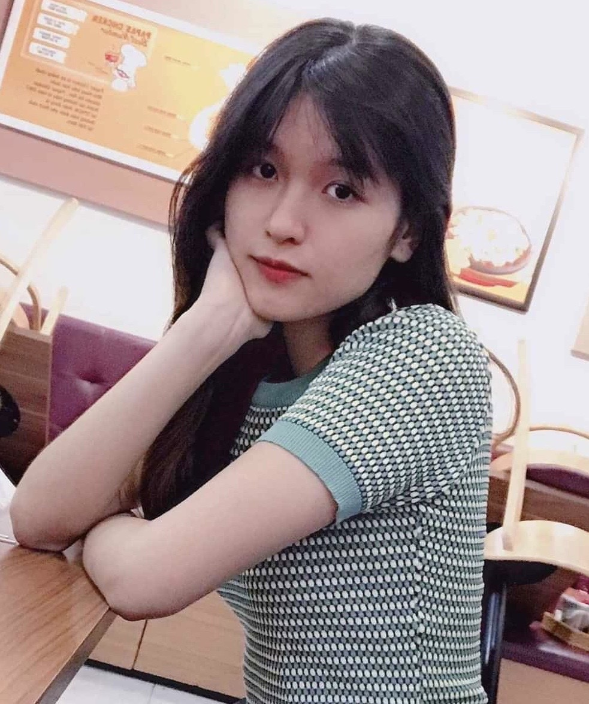



EDUCATION
hTai Nguyen va Moi Truong University
Major Information Technology
Third-year student
I have now learned web programming at school
Hoang Dung
Date of birth
Match 17/1999
Gender
Female
INTERSHIP
0962465452
My intership lasts 8 weeks
Start from July 6, 2020 to August 28,2020
levuhoangdung17@gmail.com
Go Vap district, Tp.HCM city Vietnam
SKILLS
TARGET
Java
Week 7 practice process report at school
C #
INTERESTING
C ++
When I have a free time, I usually choose something such as read book, listen to music, watch cartoon, walk in the park. I enjoy traveling to beautiful places and I like blue of rose
SQL
HTML/CSS

