Slide 1
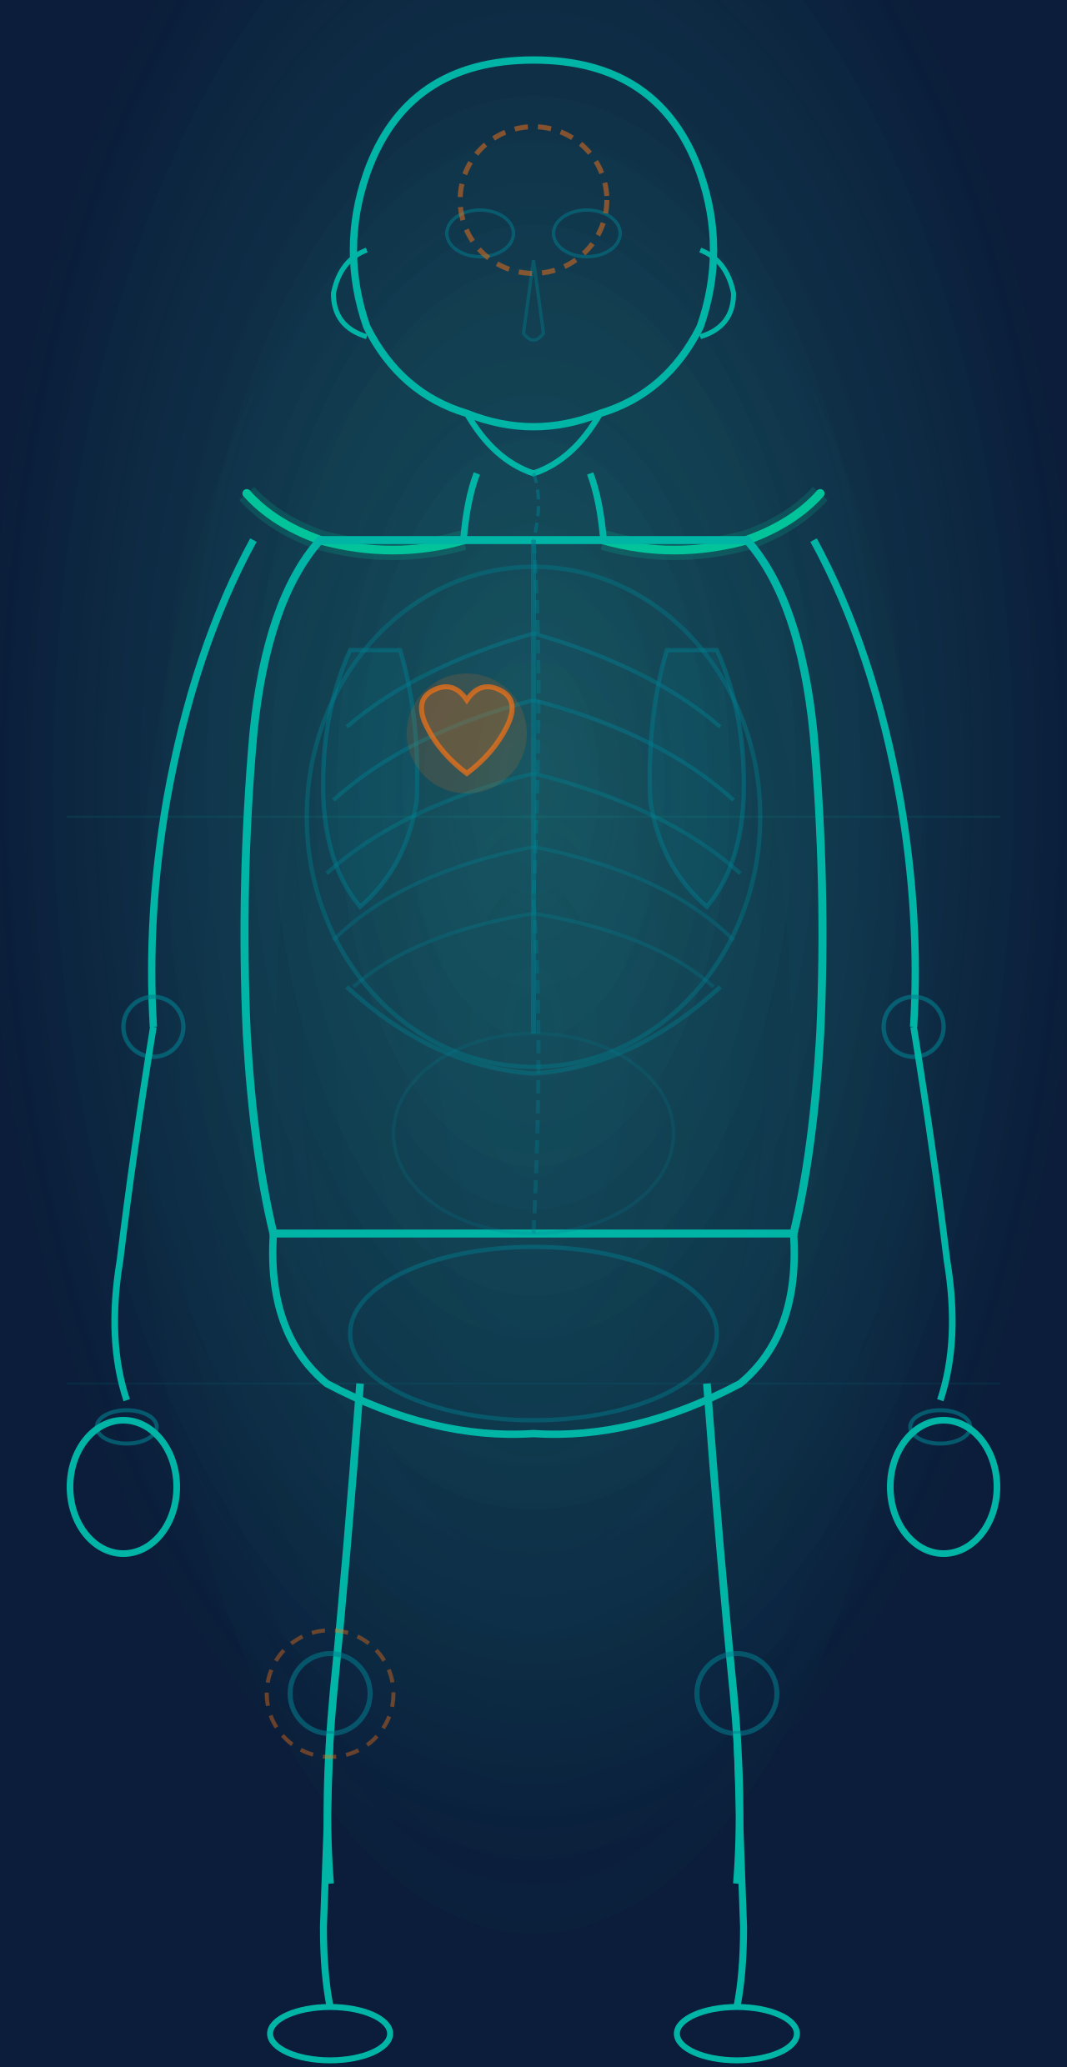
Clavicular
AI Medical Triage for Faster, Safer Decisions
LotusHacks 2026 · Team of 4 · 30-hour MVP
Give anyone instant first-pass health guidance — body-map
interaction, clinical AI reasoning, and voice support in
English & Vietnamese.

Slide 2
The Problem We Solve
02 / 06
🏥
⚠️
⏳
Uneven Access
Self-Diagnosis Risk
Slow Early Triage
Rural and busy communities lack timely access to qualified healthcare, especially outside clinic hours.
People delay care or rely on unreliable social media, risking serious and avoidable health outcomes.
A first-pass assessment is slow, expensive, or unavailable when patients need it most.
Users need: ✔ Fast symptom understanding ✔ Clear urgency guidance (home vs. urgent care) ✔ Trusted references in simple language

Slide 3
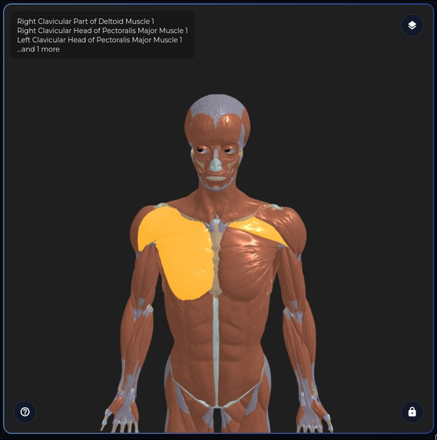
Our Solution: Clavicular Flow
03 / 06
1
Tap Body Map
Tap the region of discomfort on an interactive anatomy diagram
2
Add Symptoms
Text or voice input
3
AI Reasons
Follow-up questions, clinical reasoning & risk scoring
4
Get Results
Conditions · Actions · Medical references
5
Find Treatment
Clavicular helps you find nearby clinics
⚠ Safety: Clavicular supports triage — not final diagnosis. Always consult a physician.

Slide 4
Technical Architecture (MVP)
04 / 06
Frontend (Flutter + HTML/CSS/JS)
Integrations & Tools
Flutter app + web UI workstream
Interactive 3D body map + symptom capture
Codex
Coding acceleration, debugging, rapid iteration
OpenRouter / OpenAI
LLM routing (OpenAI-compatible)
Backend (NodeJS + Python FastAPI)
Blender
/chat — conversational triage + session memory
3D human anatomy.
/diagnose — structured first-pass diagnosis
/clinics — nearby clinic recommendations
Exa.ai
/tts — spoken guidance output
Medical source retrieval & references

Slide 5
Clavicular fits all 4 tracks
05 / 06
✓ Social & Mobility
✓ Technology & Consumer
Improves healthcare accessibility for underserved & rural communities
Low-friction experience on Flutter + Web
Bridges gap between symptom onset and professional care
Voice-first interaction via OpenAI Whisper for ease of access
Body-map UI is intuitive — no medical jargon required
✓ Enterprise
✓ EdTech
API-ready 3-layer body model for clinics, hospitals & insurers
Anatomy + symptom learning through interactive body-map
Session-aware AI backend with structured output for integration
Clinical AI reasoning teaches users about conditions in plain language
Modular architecture scales from MVP to production
Integrates with university health & nursing curriculum
🏆 Bonus: Strong sponsor-tool alignment — Codex · ElevenLabs · OpenRouter · Exa.ai used across ALL tracks

Slide 6
Roadmap & Our Journey
06 / 06
FUTURE IMPROVEMENTS
Improve customization (more body types) and 3D model quality
Expand Vietnamese clinical phrasing quality
Add analytics for triage outcomes & model confidence
\
Harden deployment pipeline + monitoring
WHAT WE LEARNED
01
A great deal of software architectural techniques
02
Medical knowledge of body anatomy
03
3D rendering and Medical AI
Collaboration
04

