Slide 1
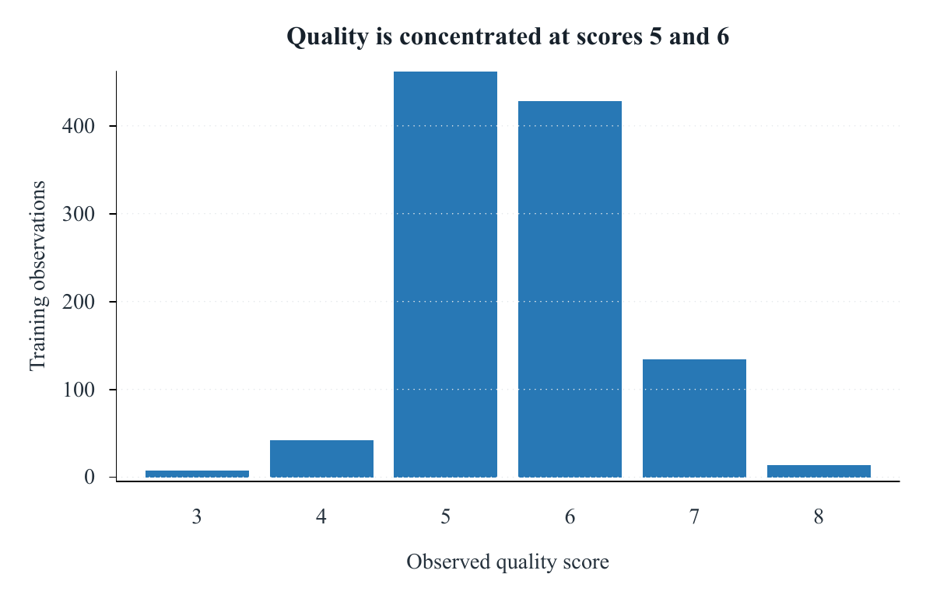
STAT452 · GROUP 8
Can chemistry predict red-wine quality?
A leakage-controlled prediction study — plus an observational two-factor analysis of student mathematics scores
Academic Year 2025–2026
Notes:
Timing: 0:35. Open with the shared theme: strong conclusions depend on protecting the analysis from leakage and overclaiming.
[Sources]
- D:/Stats2/output/figures/fig_p2_quality_distribution.pdf
- D:/Stats2/finals/part1/report/references.bib (UCIWine; Cortez2009)
[/Sources]

Slide 2
Two studies, one standard: protect the claim
PART 1 · PREDICTION
PART 2 · FACTORIAL ANALYSIS
How well can 11 physicochemical measurements predict expert wine-quality scores?
How do observed test-preparation and lunch groups differ in mean mathematics score?
Regression · fixed 80/20 split · shared five-fold CV · one-time holdout evaluation
2×2 ANOVA · effect-coded marginal tests · HC3 sensitivity · non-causal interpretation
02
Notes:
Timing: 0:55. Explain that the methods differ, but the standard is the same: define the question before seeing the answer and separate association from causation.
[Sources]
- D:/Stats2/references/STAT452_FinalProject_Y2526.pdf
- D:/Stats2/report/final-report.pdf
[/Sources]

Slide 3
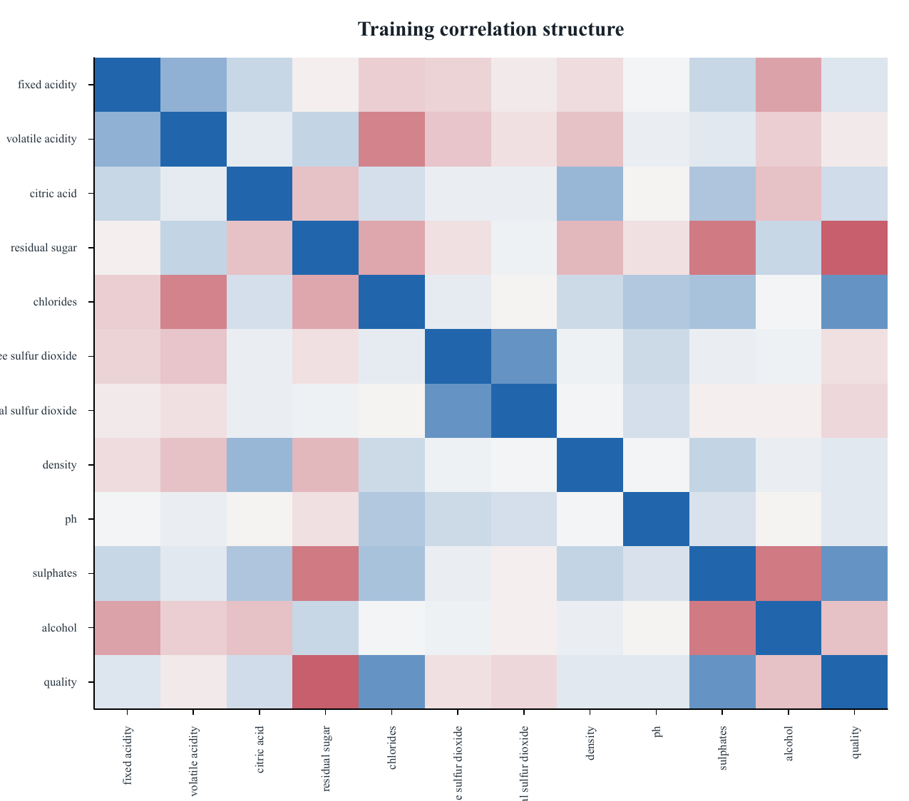
Wine scores cluster at 5–6; predictors are correlated
• 1,599 raw records; 240 exact duplicates removed before splitting
• Alcohol is the strongest positive marginal signal; volatile acidity is the strongest negative
• Acidity, density, pH, and sulfur-dioxide measures share information — ideal conditions for shrinkage
03
Notes:
Timing: 1:00. Emphasize that overlap and collinearity make a single-variable story inappropriate; regularization is motivated by the data structure, not added decoratively.
[Sources]
- D:/Stats2/output/figures/fig_p2_correlation_heatmap.pdf
- D:/Stats2/output/tables/tab_p2_target_correlations.csv
- D:/Stats2/output/tables/tab_p1_data_audit.csv
[/Sources]

Slide 4
Holdout outcomes stayed sealed until the Ridge lock
Preprocessing and tuning are refit inside each analysis fold; the final recipe is applied unchanged to predictor-only holdout data.
01
02
03
04
TRAIN
CROSS-VALIDATE
LOCK
EVALUATE
1,088 rows
5 shared folds
Ridge
271 rows
Learn winsor limits, log choices, centering and scaling
Tune Ridge, Lasso and Elastic Net on identical splits
Lowest CV RMSE = 0.6711 before holdout reconstruction
Compare every predeclared model once on identical rows
04
Notes:
Timing: 1:05. This is the credibility slide. Stress that transformation selection itself is made inside each cross-validation fold, not just scaling parameters.
[Sources]
- D:/Stats2/R/part1_helpers.R
- D:/Stats2/analysis/03_regularized_models.R
- D:/Stats2/output/model_lock.csv
[/Sources]

Slide 5
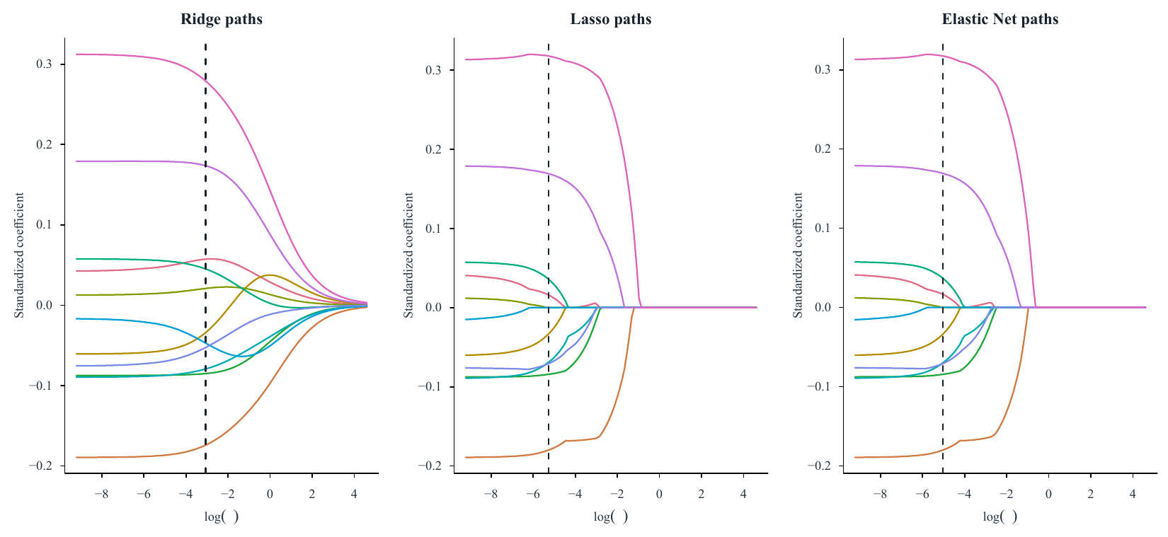
Regularization changes stability—not accuracy
Ridge shares weight across correlated predictors; Lasso and Elastic Net produce sparse seven-feature interpretations at the one-SE penalty.
05
Notes:
Timing: 0:55. Explain the path direction: stronger penalties move coefficients toward zero. Avoid implying that a zero coefficient proves scientific irrelevance.
[Sources]
- D:/Stats2/output/figures/fig_p4_coefficient_paths.pdf
- D:/Stats2/output/tables/tab_p4_lasso_selection.csv
- D:/Stats2/finals/part1/report/references.bib (Hoerl1970; Tibshirani1996; Zou2005; Friedman2010)
[/Sources]

Slide 6
The fitted models are effectively tied on holdout RMSE
Holdout RMSE × 1,000 · lower is better
0.613
Ridge holdout RMSE
0.482
Ridge holdout MAE
OLS is lower by only 0.0003 RMSE. We keep Ridge because CV—not the holdout—made the decision.
06
Notes:
Timing: 1:10. State the honest negative result: regularization did not materially improve holdout RMSE over OLS, although all chemistry models greatly outperform the mean baseline.
[Sources]
- D:/Stats2/output/tables/tab_p5_holdout_display.csv
- D:/Stats2/output/model_lock.csv
[/Sources]

Slide 7
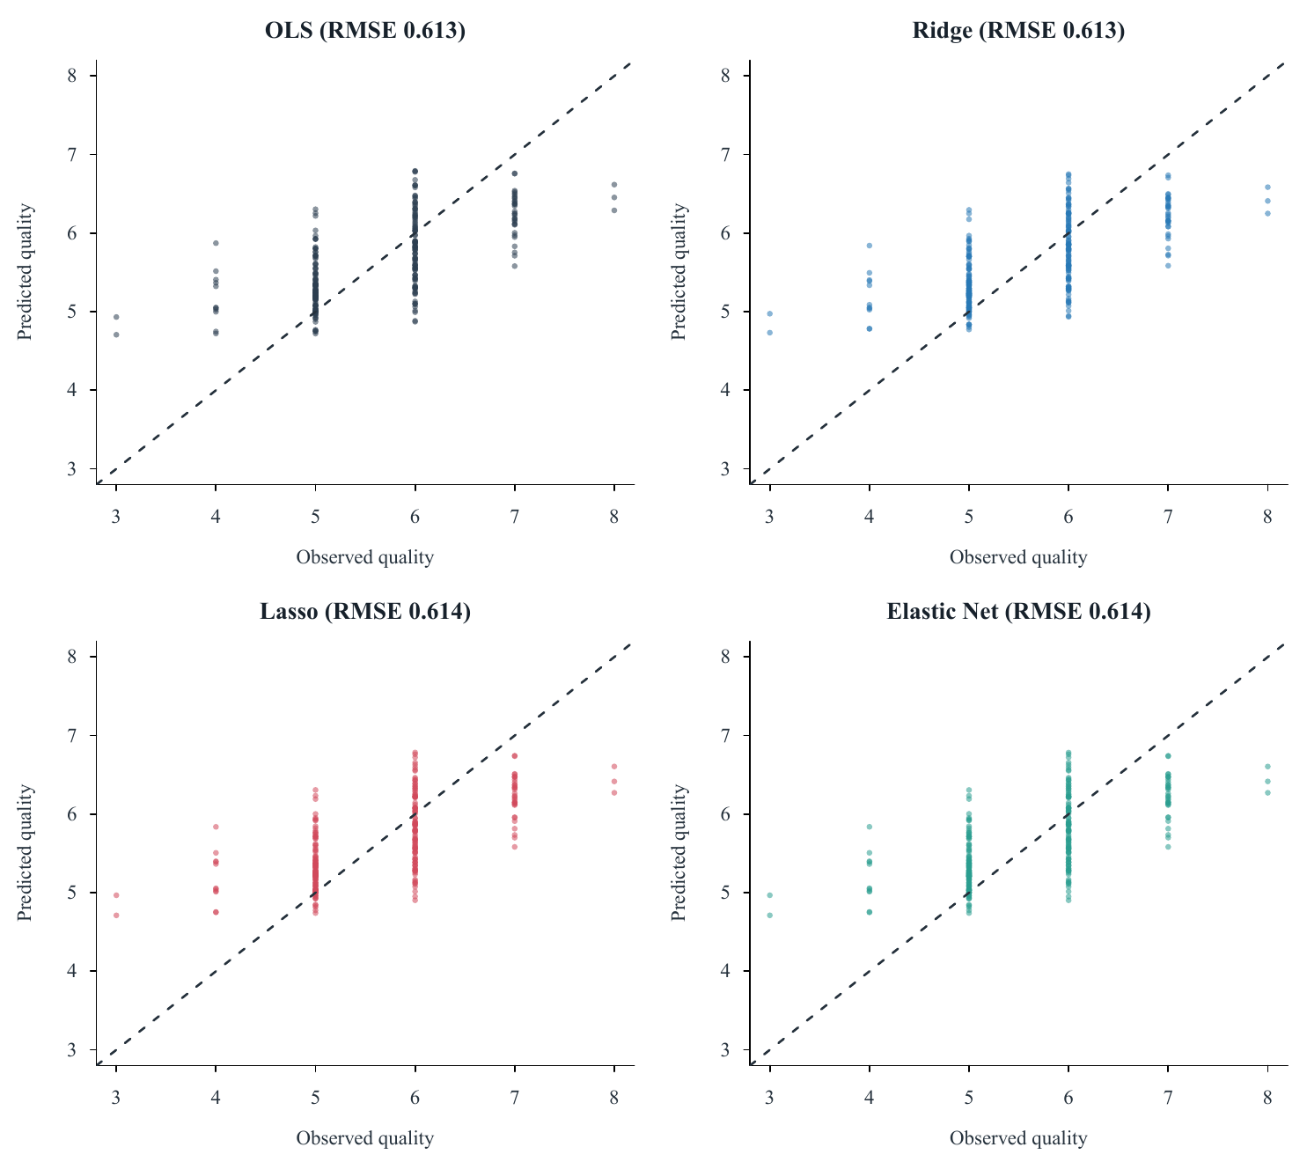
Rare scores expose the central-score bias
Predictions contract toward 5–6.
Ridge RMSE by observed score:
• score 3: 1.86 (n=2)
• score 5: 0.45 (n=115)
• score 8: 1.59 (n=3)
Use the model for expected score, not exact ordinal classification.
07
Notes:
Timing: 0:55. Connect regression-to-the-mean with the imbalanced target. Rare-score metrics are highly uncertain because their sample sizes are tiny.
[Sources]
- D:/Stats2/output/figures/fig_p5_actual_vs_predicted.pdf
- D:/Stats2/output/tables/tab_p5_error_by_quality.csv
[/Sources]

Slide 8
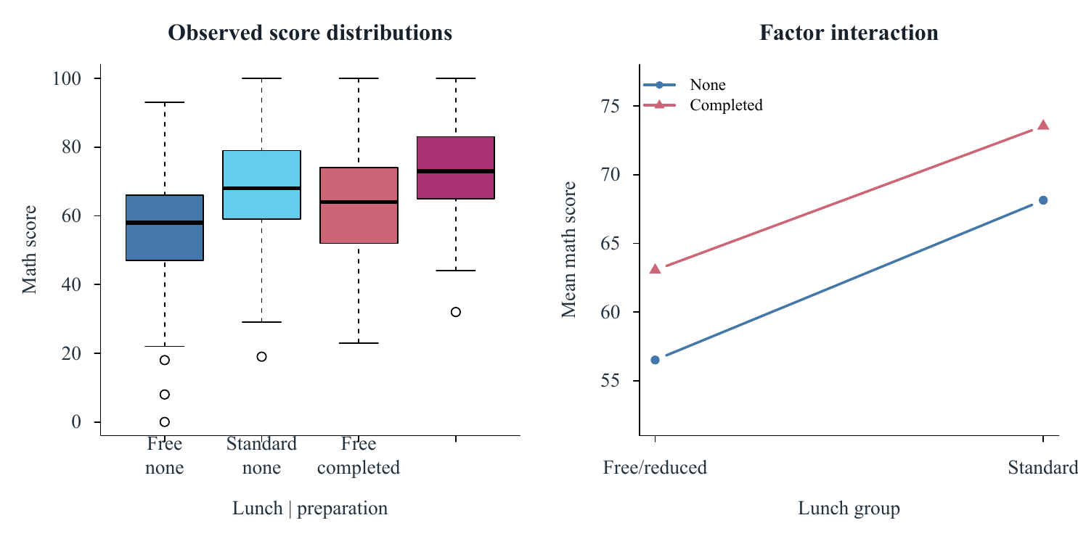
Part 2 estimates associations—not causal effects
Response
Mathematics score (0–100)
Factor A
Test preparation: none / completed
Factor B
Lunch: free/reduced / standard
All 1,000 rows retained; no missing or duplicate profiles.
No random assignment or sampling frame → associations only
08
Notes:
Timing: 1:00. Make the causal boundary explicit before showing p-values. Lunch is treated as a contextual socioeconomic proxy, not a manipulable treatment.
[Sources]
- D:/Stats2/output/figures/fig_part2_factorial_patterns.pdf
- D:/Stats2/output/tables/tab_part2_data_audit.csv
- https://www.kaggle.com/datasets/timothyadeyemi/students-performance-in-exams
[/Sources]

Slide 9
Preparation and lunch differ; the interaction does not
+5.97
Preparation difference
+11.06
Lunch-group difference
Interaction: -1.14 points, p=0.553. Brown–Forsythe p=0.364; HC3 sensitivity gives the same decisions.
09
Notes:
Timing: 1:15. Report score-point effects before statistical significance. Both marginal associations are clear; the interaction estimate is small and uncertain. Diagnostics and HC3 do not change the decisions, but independence cannot be verified.
[Sources]
- D:/Stats2/output/tables/tab_part2_key_findings.csv
- D:/Stats2/output/tables/tab_part2_assumptions.csv
- D:/Stats2/output/tables/tab_part2_robust_sensitivity.csv
- D:/Stats2/finals/part2/report/references.bib (BrownForsythe1974; MacKinnonWhite1985; Lakens2013)
[/Sources]

Slide 10
WHAT THE EVIDENCE SUPPORTS
Better discipline changed what we can honestly claim
1. Ridge is the pre-locked predictor, but OLS and regularized models are practically tied.
2. Rare wine-quality scores remain difficult; no model removes the central-score bias.
3. Preparation and lunch groups differ in math score, but the observational data do not identify causal effects.
Next study: ordinal/robust prediction for wine; randomized preparation access with baseline blocking for students.
Notes:
Timing: 1:10. Close by resolving both opening questions. Do not end on p-values; end on the boundary between what the evidence supports and what the next design should test.
[Sources]
- D:/Stats2/report/final-report.pdf
- D:/Stats2/output/tables/tab_p5_holdout_display.csv
- D:/Stats2/output/tables/tab_part2_key_findings.csv
[/Sources]

