Slide 1

Gogojungle Vietnam Co., Ltd
Business vision
2017~2020

Slide 2
COMPANY Overview
Gogo Jungle Inc.
Task
Styler
$
Task
$
GVN
Task
$
EC
eDCC
Upfile
Notes:
22

Slide 3
COMPANY Overview
Gogo Jungle Inc.
Task
Styler
Task
GVN
Task
EC
eDCC
Upfile
Notes:
33

Slide 4
COMPANY Overview
Gogo Jungle Inc.
Styler
$
$
GVN
$
Notes:
44

Slide 5
Contents
Philosophy and Principles
Vision and Missions
Strategy, Approach and ACTION
Notes:
55

Slide 6
Philosophy & Principles
Notes:
66

Slide 7
Philosophy
HUMAN FIRST
SYNERGY
SUSTAINABLE
WIN-WIN
Notes:
77

Slide 8
Philosophy
HUMAN FIRST
We work for the happiness of HUMAN
our society
our customers
our family
Notes:
88

Slide 9
Philosophy
SYNERGY
We believe that
together is better than two
go alone - go fast, go together - go far
dependence → independence → interdependence
Notes:
99

Slide 10
Philosophy
WIN-WIN
xxx
xxx
xxx
xxx
Notes:
1010

Slide 11
Philosophy
HUMAN FIRST
Our highest value is sustainability. We don't compromise our long-term values for any kind of short-term benefit.
SYNERGY
WIN-WIN
Notes:
1111

Slide 12
Principles
Integrity
NEVER LIE. Tell the truth and only the truth.
Listen First
Win-Win or No DEAL
Think for others, but NEVER compromise your VALUEs. Be BRAVE!
First thing first
Stay FOCUS and make thing DONE, one by one.
Put your self in others’ shoes. If you understand each other you will be kind to each other.
Notes:
1212

Slide 13
Vision and Missions
Notes:
1313

Slide 14
Vision
Service
Service
Technical
Sales & Operation
Marketing
Service
Service
Service
Service
Service
Notes:
1414

Slide 15
Mission 1: STRONG TEAM
Technical: Turn biz idea into service in short-time
Marketing: Sense the market NEED and turn it into biz idea
Sales & Operation: Bring the services to USERs effectively
Notes:
1515

Slide 16
Mission 2: Develop SERVICES
High POTENTIAL
Low COMPETE
Match with NEED
Notes:
1616

Slide 17
Mission 3: Realize VISION
MISSION 1
Technical
Sales & Operation
Marketing
Notes:
1717

Slide 18
Mission 3: Realize VISION
Service
Service
Service
MISSION 2
Service
Service
Service
Service
Notes:
1818

Slide 19
Mission 3: Realize VISION
MISSION 3
Service
Service
Technical
Sales & Operation
Marketing
MISSION 1
Service
Service
MISSION 2
Service
Service
Service
Notes:
1919

Slide 20
Mission 3: Realize VISION
Service
Service
Technical
Sales & Operation
Marketing
Service
Service
Service
Service
Service
Notes:
2020

Slide 21
Strategy, Approach
&
ACTION
Notes:
2121

Slide 22
Status quo
GOOD people
Local knowledge
Global view
Lack of skill & experience
Low capability
Lack of resources
Emerging market
No BIG rival
Accessibility:
Knowledge
Resource
Infrastructure
Timing
Market maturity
Unseen rival
Notes:
2222

Slide 23
Improvement Plan
Training & Study
Lack of skill & experience
Improve Productivity
Lack of resources
Low capability
Observe
Fail fast, Fail cheap
Timing
Market maturity
Speed up @ right timing
Unseen rival
Notes:
2323

Slide 24
Services: Keywords
Open source
IoT
Technical
Big Data
Cloud
Mobile
Biz
Niche
Connect
Sharing
Notes:
2424

Slide 25









Services: Focus fields
c2c
SNS for specific group
eLearning, sharing
b2c
EC for specific genre
Productivity tools
b2b
CRM tools
Industrial management tools

Slide 26
Services: Strategy
Align
Adapt
Agile
L e a n
fail fast - fail cheap
Notes:
2626

Slide 27
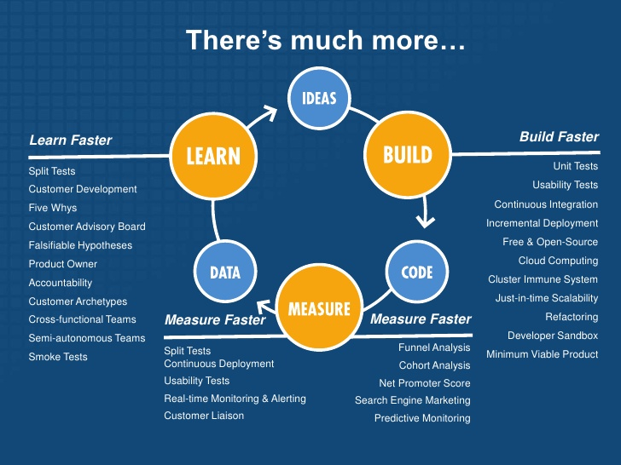

Slide 28



Technical Approach
Microservices
Notes:
2828

Slide 29

Technical Approach
stand on the shoulders of giants
Productivity
UP
Microservices
Contribute back to open source community
Notes:
2929

Slide 30
Business Approach
1～5 POTENTIAL
20~100 SERVICES ★★
FOCUS
5
Find POTENTION ones
Release 20~100
2-star-services.
Notes:
3030

Slide 31
ACTIONs
HR
Operation
Financial
Invite GOOD partners
Pay WELL
Study TOGETHER
Outsourcing
Styler
Gogojungle Japan
Products
For FOOD
For FUTURE

Slide 32
Challenge
Notes:
3232

Slide 33
FINANCIAL RISK: No Styler
Gogo Jungle Inc.
$
$
Task
Task
GVN
Task
$
Task
Other CLIENTS
Services
Notes:
3333

Slide 34
FINANCIAL RISK: No Styler
Gogo Jungle Inc.
$
$
Task
Task
GVN
$
Task
Services
Notes:
3434

Slide 35
HUMAN: How to grow?

Slide 36
Comment PLEASE !!!
Notes:
3636

