Slide 1
Operating Systems
Tutorial 2: Linux Kernel Compilation
Nguyen Trung Nam (tutor)
Hanoi University of Science and Technology
Compiled with reference to other presentations

Slide 2
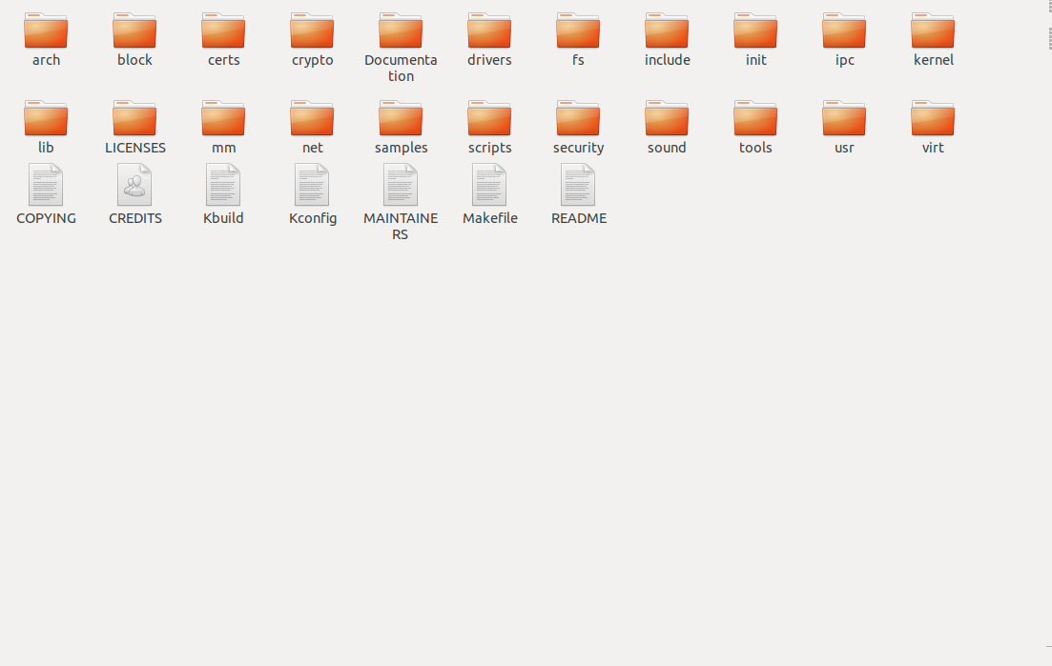
Compile Kernel
The main component of a Linux operating system (OS).
The core interface between a computer's hardware and its processes.
Managing resources as efficiently as possible.

Slide 3
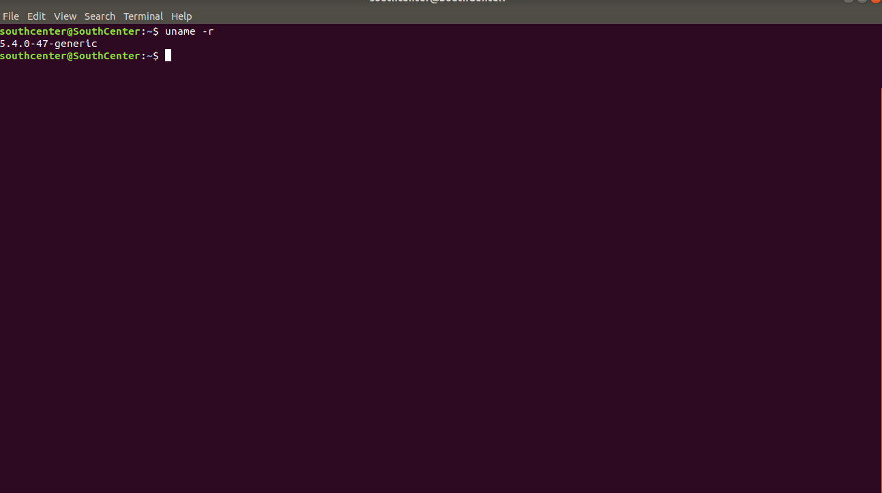
Compile Kernel
Uname –r
Link download kernel source-code :
https://cdn.kernel.org/pub/linux/kernel/

Slide 4
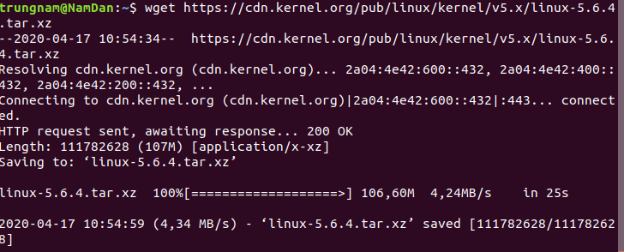
Compile Kernel
#wget https://cdn.kernel.org/pub/linux/kernel/v5.x/linux-5.6.4.tar.xz (example for version 5.6.4)
#unxz –v linux-5.6.4.tar.xz

Slide 5
Validation (optional)
wget https://cdn.kernel.org/pub/linux/kernel/v5.x/linux-5.6.4.tar.sign
gpg --verify linux-5.6.4.tar.sign
gpg --recv-keys 647F28654894E3BD457199BE38DBBDC86092693E
gpg --verify linux-5.6.4.tar.sign

Slide 6
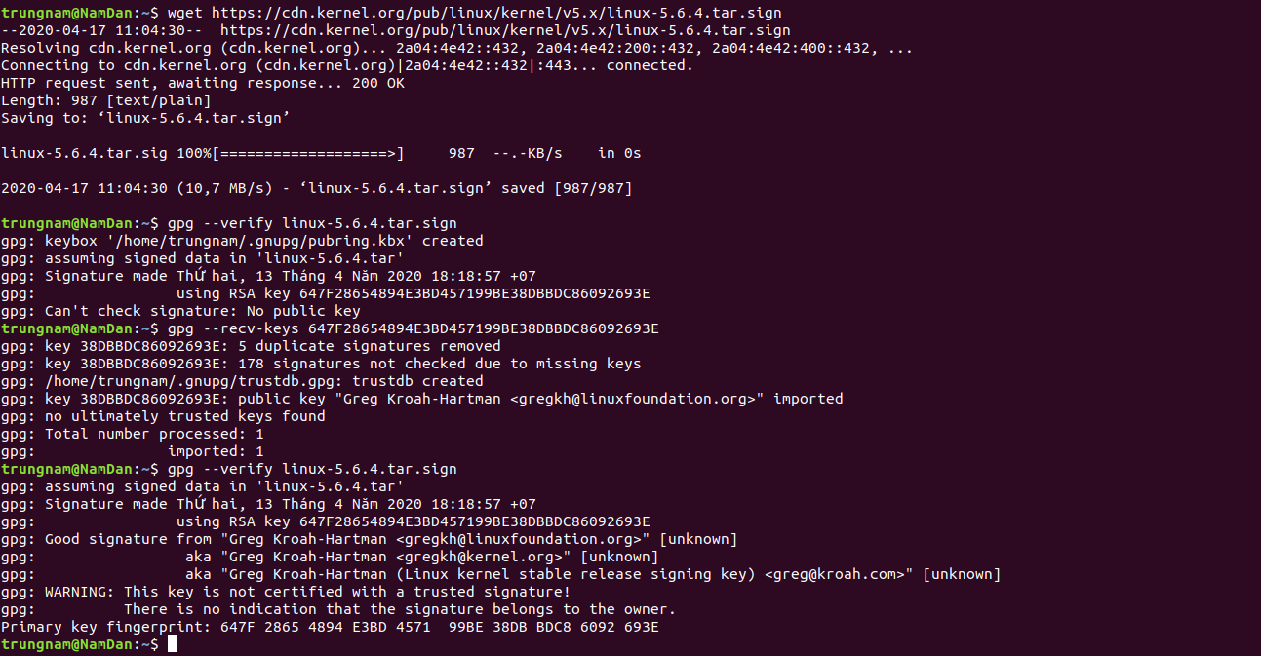
Compile Kernel
Result in terminal

Slide 7
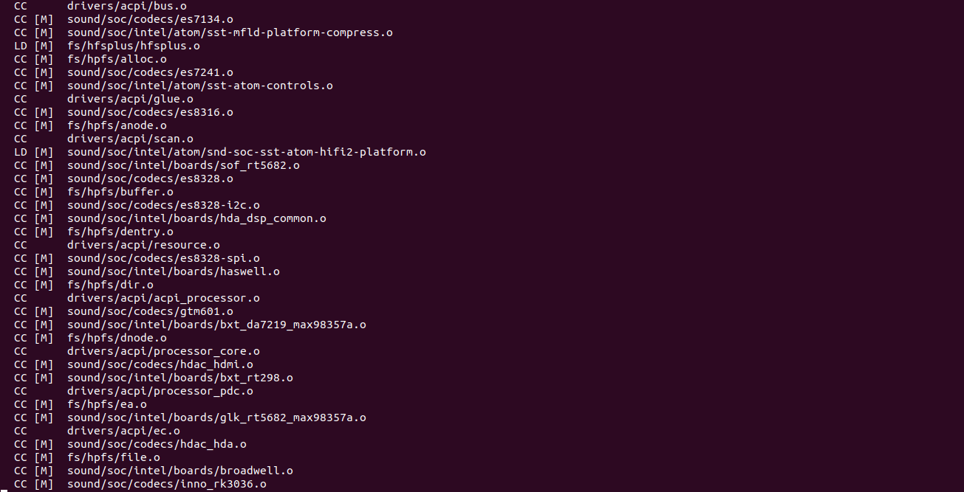
Compile Kernel

Slide 8
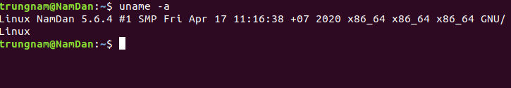
Compile Kernel
sudo update-initramfs -c -k 5.6.4
sudo update-grub
reboot
uname -r

Slide 9
Compile Kernel
Algorithm of Kernel Core :https://cstheory.stackexchange.com/questions/19759/core-algorithms-deployed?fbclid=IwAR3WihkHkbHbeH8jF3KQxqJiDZ-D6H9naVAJUuXKu6PPnr5s-2SAj-Loi8A

