Slide 1
CHAPTER 18 Requirements reuse

Slide 2
Objectives
Describes several kinds of requirements reuse, identifies some classes of requirements information that have reuse potential in various contexts, and offers suggestions about how to perform requirements reuse.
It presents some issues around making requirements reusable.
Concluding with both barriers to effective reuse and success factors that can help organization better take advantage of its existing body of requirements knowledge.

Slide 3
Contents
Why reuse requirements?
Dimensions of requirements reuse
Types of requirements information to reuse
Common reuse scenarios
Requirement patterns
Tools to facilitate reuse
Making requirements reusable
Requirements reuse barriers and success factors

Slide 4
Why reuse requirements?
Faster delivery, lower development costs, consistency both within and across applications, higher team productivity, fewer defects, and reduced rework.
Reusing trusted requirements can save review time, accelerate the approval cycle, and speed up other project activities, such as testing.
Reuse can improve your ability to estimate implementation effort if you have data available from implementing the same requirements on a previous project.
From the user’s perspective, requirements reuse can improve functional consistency across related members of a product line or among a set of business applications
If the implementation varies in different environments, the requirements might be the same.

Slide 5
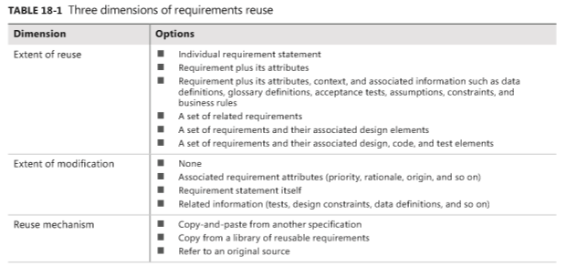
Dimensions of requirements reuse

Slide 6
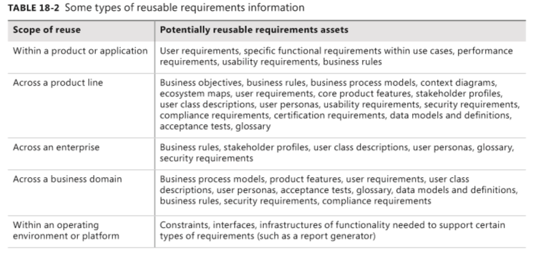
Types of requirements information to reuse
Notes:
Trên môn dòng sản phẩm complian requirement: các yêu cầu phải tuân thủ
-glossary: bảng chú giải
-xuyên suốt một doanh nghiệp: enterprise
hoạt động trong một môi trường hoặc nền tảng hoạt động
Các bộ phận chức năng cần thiết để hỗ trợ một số loại yêu cầu
Ví dụ như các bài báo cáo
Hạn chế: constraints

Slide 7
Common reuse scenarios
Software product lines
Reengineered and replacement systems
Other likely reuse opportunities

Slide 8
Requirement patterns
Guidance
Content
Template
Examples
Extra requirements
Considerations for development and testing

Slide 9
Requirements reuse barriers and success factors
Reuse barriers
Missing or poor requirements
NIH and NAH
Writing style
Inconsistent organization
Project type
Ownership
Reuse success factors
Repository
Quality
Interactions
Terminology
Organizational culture

