Slide 1
Lab 4 – SE1751 – Đào Quang Nguyên – HE176610

Slide 2
Danh sach class, method

Slide 3
UserDAO
findByUserAndPassword
isUserExist
signUp

Slide 4
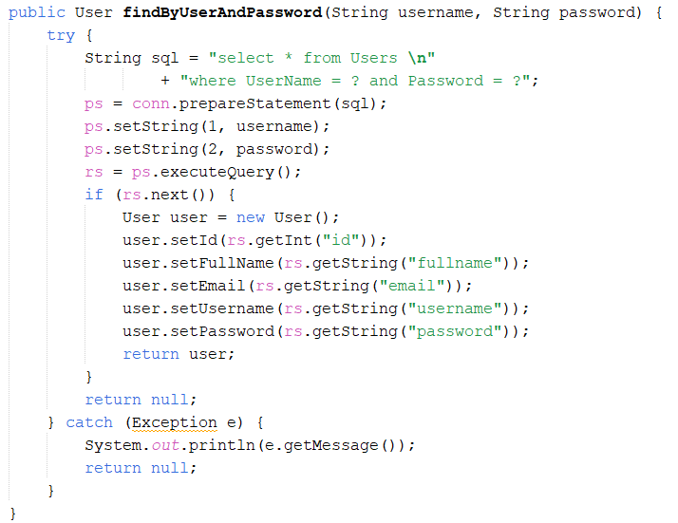
findByUserAndPassword

Slide 5
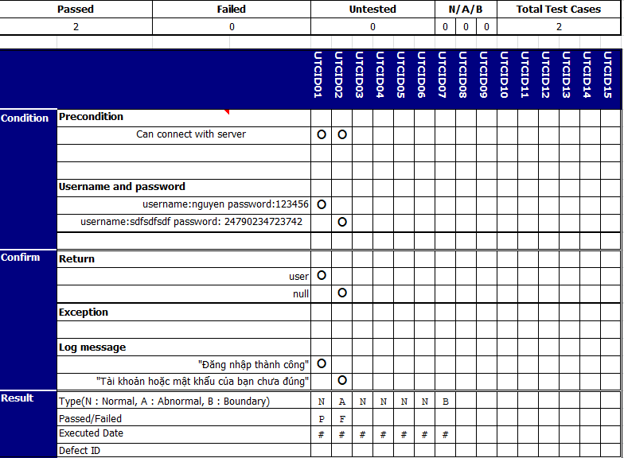
findByUserAndPassword

Slide 6
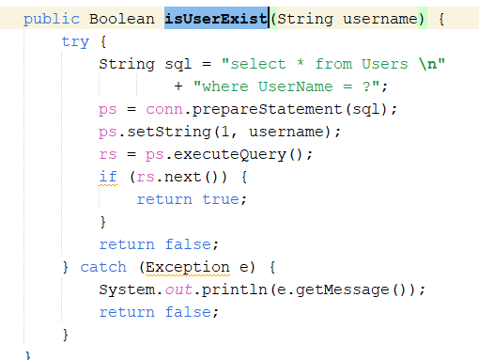
isUserExist

Slide 7

isUserExist

Slide 8
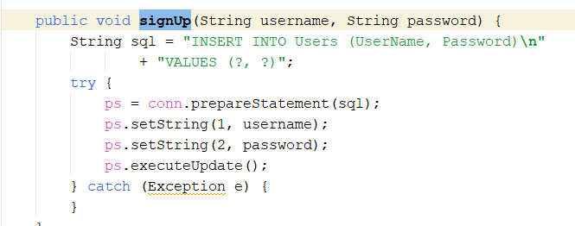
signUp

Slide 9

signUp

