Slide 1
Problem & Research Question
Federated Image Classification
under Non-IID Data
How does client label skew change global classification quality?
10 clients, equal image counts, different label proportions.
Compare centralized training, skew severity and local epochs.
Group 9 - Topic 27
Notes:
0:00–0:40. We study image classification with unequal client label proportions. Ten clients retain equal quantities. Our questions concern the centralized gap, label skew and aggregation frequency. Sources: project report Section I; FedAvg https://proceedings.mlr.press/v54/mcmahan17a.html .

Slide 2
Method & Experiments
Fashion-MNIST: 54k train / 6k validation / 10k test
Small CNN, 105,866 parameters. Weighted FedAvg in PyTorch.
Setup 1: Centralized versus FedAvg IID
Setup 2: IID, mild and strong label skew
Setup 3: Strong E1R30 versus E3R10 at equal exposure
5 configurations x 3 seeds. 1,620,000 image exposures per run.
Group 9 - Topic 27
Notes:
0:40–1:25. One CNN and a fixed split support all three setups. Each client receives the same global snapshot. Setup 1 compares centralized and IID; Setup 2 varies skew; Setup 3 compares E1R30 and E3R10 at fixed exposure. Dataset: https://github.com/zalandoresearch/fashion-mnist . Evidence: DATA.md and configs.

Slide 3
Key Results
Setting | Accuracy (%) | Macro-F1
Centralized | 90.13 +/- 0.14 | 0.9004
FedAvg IID | 83.25 +/- 0.58 | 0.8317
FedAvg mild | 81.93 +/- 0.18 | 0.8154
FedAvg strong | 77.73 +/- 0.92 | 0.7685
Strong E3R10 | 77.77 +/- 0.60 | 0.7711
Strong skew: -5.52 pp
versus IID
E3R10: +0.04 pp
versus E1R30 with
20 fewer rounds
Final checkpoints. Mean +/- sample SD over three seeds.
Group 9 - Topic 27
Notes:
1:25–2:15. The table shows final checkpoints, mean and sample SD across seeds 42/43/44. Strong loses 5.52 pp versus IID. E3 differs by +0.04 pp, without proof of equivalence. Source: outputs/tables/summary.csv and the fifteen final_metrics.json files.

Slide 4
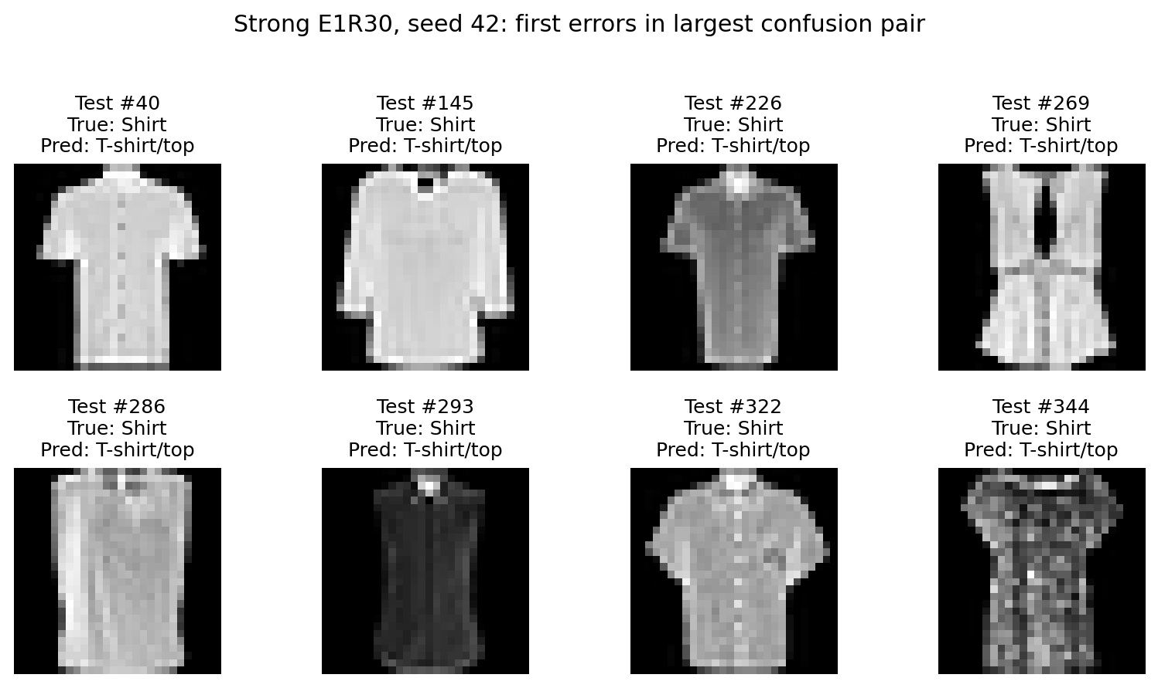
Conclusion / Demo
Label skew reduces global quality in this protocol.
Fewer rounds retain similar observed mean accuracy at fixed exposure.
Limits: one dataset/CNN, three seeds, simulated clients.
Shirt recall: 0.2690
Demo: strong seed 42, one test prediction from a trained checkpoint.
Shirt to T-shirt/top: 267 errors (seed 42)
Group 9 - Topic 27
Notes:
2:15–2:55. The result applies to this dataset, CNN and simulation. Client drift is plausible but unmeasured. Show one pretrained strong seed-42 prediction; stop before three minutes. All members prepare for the following twelve-minute Q/A. Image: Fashion-MNIST, Zalando Research, MIT; recorded test indices 40,145,226,269,286,293,322,344. Source: outputs/tables/error_examples.csv. Drift context: https://proceedings.mlr.press/v119/karimireddy20a.html .

