Slide 1
C++ Pointer
Contributor: [MCU Modelling Team] [Anh-Duc Nguyen]

Slide 2
What can we achieve
Get more familiar with C++ pointer
Avoid some errors when using pointer
Improve debugging skills

Slide 3
Agenda
I. Basics knowledge about Pointer
Stack and Heap
Why we use pointer?
Use pointer:
3.1 Pointer point to a variable
3.2 Assign Pointer to Pointer
3.3 Pointer point to Pointer
Difference pointer and reference in C++
Common pointer mistakes in C++ programming
Usage pointer cases cause “access violation” error
Usage pointer cases cause memory leak
III. Other

Slide 4
I. Basics knowledge about Pointer
1. Stack and Heap:

Slide 5
I. Basics knowledge about “Pointer”
1. Stack and Heap:
Memory Layout in C/C++
High address
Stack
Focus
Free space
Heap
Uninitialized data
(BSS)
Initialized data
(DS)
Text
Low address

Slide 6
I. Basics knowledge about “Pointer”
1. Stack and Heap:
Memory Layout in C/C++
High address
Where
function parameters
local variables
and other function-related information
are stored
Stack
Low address

Slide 7
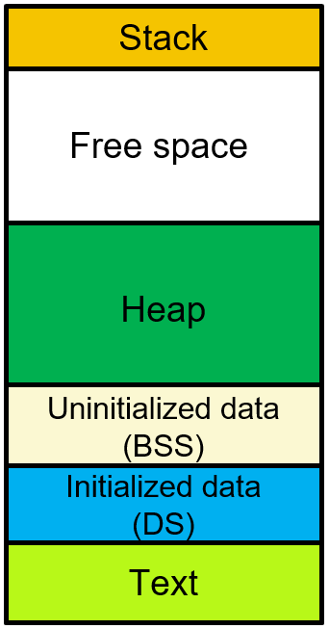
I. Basics knowledge about “Pointer”
1. Stack and Heap:
Function parameters
Return address
Saved previous frame pointer
Function 1
Local variables
Function parameters
Return address
Saved previous frame pointer
Function 2
Local variables
…
Function …

Slide 8
I. Basics knowledge about “Pointer”
Function parameters:
(x1, x2)
Function parameters:
(argc, argv)
1. Stack and Heap:
Memory Stack
Last In First Out (LIFO)
Return address
Return address
MyFunc
Saved previous frame pointer
main
Example:
#include <stdio.h>
int MyFunc(int x1, int x2){
int sum = x1 + x2;
return sum;
}
int main(int argc, char* argv[]){
int a;
int b;
int c = MyFunc(a,b);
cout << c << endl;
return 0;
}
Saved previous frame pointer
Local variables:
(sum)
Local variables:
(a, b, c)
Size of stack memory is very limited.

Slide 9
I. Basics knowledge about “Pointer”
Function parameters:
(x1, x2)
Function parameters:
(argc, argv)
1. Stack and Heap:
Memory Stack
Last In First Out (LIFO)
Return address
Return address
MyFunc
Saved previous frame pointer
main
Stack overflow
Used
Saved previous frame pointer
Local variables:
(sum)
Local variables:
(a, b, c)
Used
Size of stack memory is very limited.
Used
Used full Stack
With Visual Studio 2015 run on window, Stack memory only has 1MB
Used
Used

Slide 10
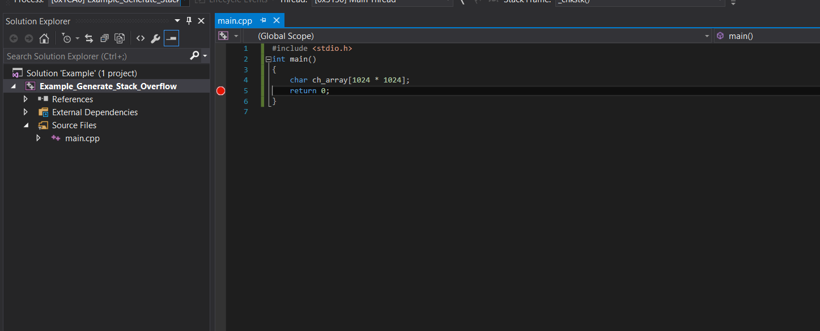
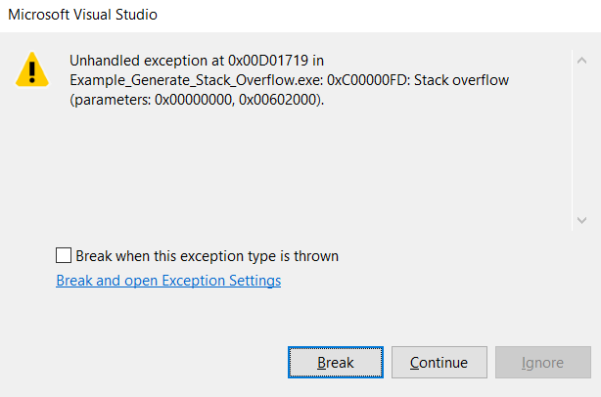
I. Basics knowledge about “Pointer”
1. Stack and Heap
Example 1:

Slide 11
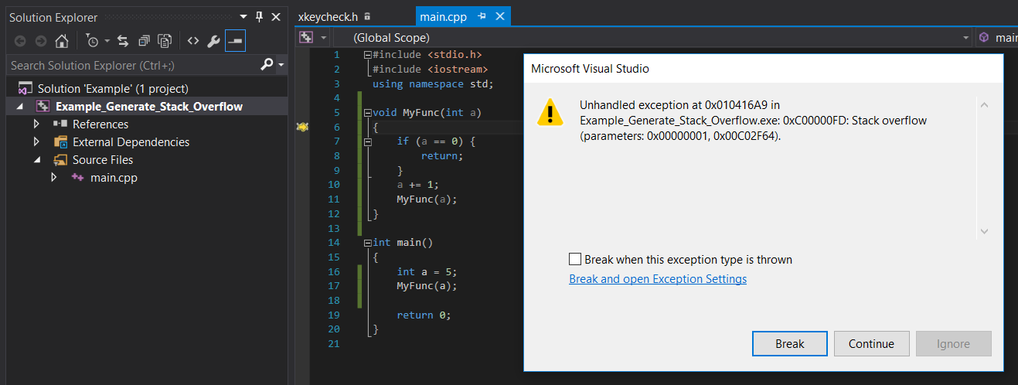
I. Basics knowledge about “Pointer”
1. Stack and Heap
Example 2:

Slide 12
I. Basics knowledge about “Pointer”
1. Stack and Heap
Memory Layout in C/C++
High address
Stack
Free space
Heap
Uninitialized data
(BSS)
Initialized data
(DS)
Text
Low address

Slide 13
I. Basics knowledge about “Pointer”
1. Stack and Heap
Heap
Where dynamically allocated variables are allocated from

Slide 14
I. Basics knowledge about “Pointer”
1. Stack and Heap
Memory Heap
Managed by new/new[] and delete/delete[] operator

Slide 15
I. Basics knowledge about “Pointer”
1. Stack and Heap
Memory Heap
Example:
#include <stdio.h>
int main(){
int* a = NULL;
a = new int;
*a = 100;
delete a;
return 0;
}
Warning
Heap have memory size is large
Memory Stack
sizeof(int)*1
100
int main()
int* a
It represents an invalid memory location
NULL

Slide 16
I. Basics knowledge about “Pointer”
1. Stack and Heap
Heap overflow
Memory Heap
used
used
used
Heap have memory size is large
It’s depend on RAM
Size of Heap even goes upto GB unit
Used full Heap
used
used
used
used
NULL

Slide 17
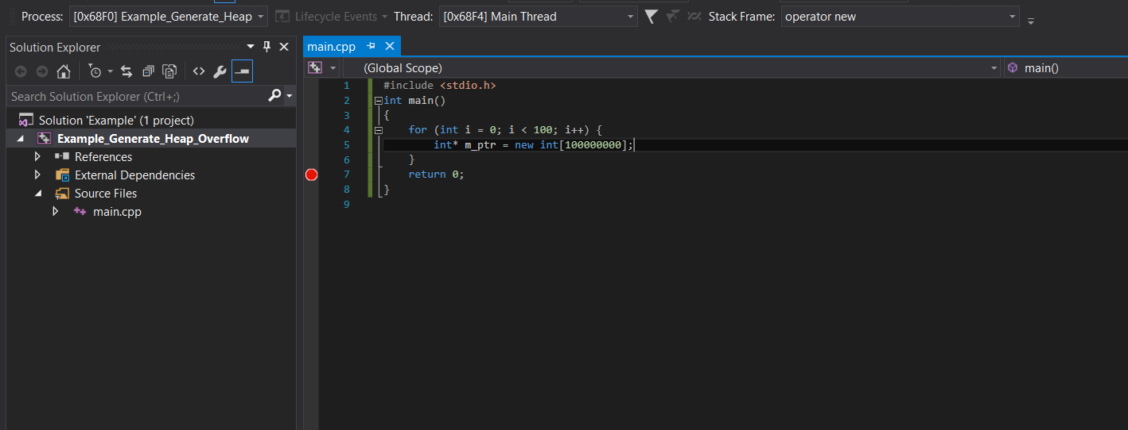
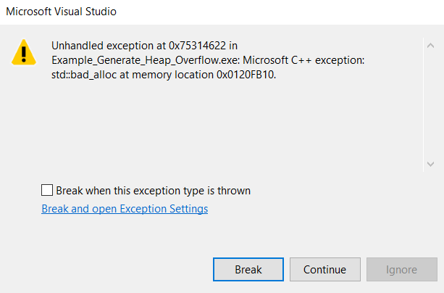
I. Basics knowledge about “Pointer”
1. Stack and Heap
Example:

Slide 18
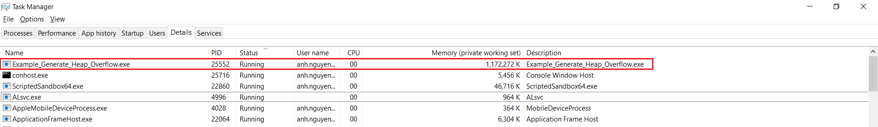
I. Basics knowledge about “Pointer”
1. Stack and Heap
Example:

Slide 19
I. Basics knowledge about Pointer
2. Why use Pointer?

Slide 20
I. Basics knowledge about “Pointer”
2. Why use C++ pointer?:
Just like use it
Imagine, if your project (IMP_Cve, PSC, CNN,…) only uses local variables without dynamic allocation and pointers => Not enough Stack for declare new variable
So, I think if we use pointer + new operator => Save the Stack memory
- Memory can be dynamically allocated and de-allocated using pointers.
- …

Slide 21
I. Basics knowledge about Pointer
3. Use Pointer:

Slide 22
I. Basics knowledge about “Pointer”
3. Use Pointer:
3.1 Pointer point to a variable in Stack:
3.2 Assign Pointer to a Pointer:
3.3 Pointer point to a Pointer:

Slide 23
I. Basics knowledge about “Pointer”
3. Use Pointer:
3.1 Pointer point to a variable in Stack:
3.2 Assign Pointer to a Pointer:
3.3 Pointer point to a Pointer:

Slide 24
I. Basics knowledge about “Pointer”
3. Use Pointer:
3.1 Pointer point to a variable in Stack:
3.2 Assign Pointer to a Pointer:
3.3 Pointer point to a Pointer:
Memory Stack
Example:
#include <stdio.h>
int main(){
int a = 10;
int* p = &a;
return 0;
}
int* p
int a = 10

Slide 25
I. Basics knowledge about “Pointer”
3. Use Pointer:
3.1 Pointer point to a variable in Stack:
3.2 Assign Pointer to a Pointer:
3.3 Pointer point to a Pointer:

Slide 26
I. Basics knowledge about “Pointer”
3. Use Pointer:
3.1 Pointer point to a variable in Stack:
3.2 Assign Pointer to a Pointer:
3.3 Pointer point to a Pointer:
Memory Stack
Example1:
#include <stdio.h>
int main()
{
int a = 10;
int* p1 = &a;
int* p2 = p1;
return 0;
}
int* p1
int* p2
int a = 10

Slide 27
I. Basics knowledge about “Pointer”
3. Use Pointer:
3.1 Pointer point to a variable in Stack:
Memory Heap
3.2 Assign Pointer to a Pointer:
3.3 Pointer point to a Pointer:
Memory Stack
Example2:
#include <stdio.h>
int main()
{
int* p1 = new int[3];
int* p2 = p1;
return 0;
}
int* p1
sizeof(int)*3
int* p2
NULL

Slide 28
I. Basics knowledge about “Pointer”
3. Use Pointer:
3.1 Pointer point to a variable in Stack:
3.2 Assign Pointer to a Pointer:
3.3 Pointer point to a Pointer:

Slide 29
I. Basics knowledge about “Pointer”
3. Use Pointer:
3.1 Pointer point to a variable in Stack:
3.2 Assign Pointer to a Pointer:
3.3 Pointer point to a Pointer:
Pointer
Pointer
Variable
Address
Address
Value
ptr2**
ptr1*
ptr2*

Slide 30
I. Basics knowledge about “Pointer”
3. Use Pointer:
3.1 Pointer point to a variable in Stack:
3.2 Assign Pointer to a Pointer:
3.3 Pointer point to a Pointer:
Memory Stack
Example1:
#include <stdio.h>
int main()
{
int a = 10;
int* p1 = &a;
int* p2 = &p1;
return 0;
}
int* p2
int* p1
int a = 10

Slide 31

I. Basics knowledge about “Pointer”
3. Use Pointer:
3.1 Pointer point to a variable in Stack:
3.2 Assign Pointer to a Pointer:
3.3 Pointer point to a Pointer:
Memory Stack
Example2:
#include <stdio.h>
int main()
{
int a = 10;
int* p1 = &a;
int** p2 = &p1;
return 0;
}
int** p2
int* p1
int a = 10

Slide 32
I. Basics knowledge about “Pointer”
3. Use Pointer:
3.1 Pointer point to a variable in Stack:
Memory Heap
3.2 Assign Pointer to a Pointer:
3.3 Pointer point to a Pointer:
Memory Stack
Example3:
#include <stdio.h>
int main()
{
int* p1 = new int[3];
int** p2 = &p1;
return 0;
}
int** p2
sizeof(int)*3
int* p1
NULL

Slide 33
I. Basics knowledge about Pointer
4. Difference Pointer & Reference in C++

Slide 34
I. Basics knowledge about “Pointer”
4. Difference Pointer & Reference in C++:
4.1 What is Reference:
4.2 Diff Pointer and Reference:

Slide 35
I. Basics knowledge about “Pointer”
4. Difference Pointer & Reference in C++:
4.1 What is Reference:
4.2 Diff Pointer and Reference:

Slide 36
I. Basics knowledge about “Pointer”
4. Difference Pointer & Reference in C++:
4.1 What is Reference:
4.2 Diff Pointer and Reference:
For simplicity, reference is an alias (nick name) of an existing variable.
Example1:
int main()
{
int Sy_san = 10;
int& Cun_con = Sy_san;
return 0;
}
Memory Stack
Cun_con
addr = 0xAAAACCCC
Sy_san
(Cun_con)
value = 10
addr = 0xAAAABBBB

Slide 37
I. Basics knowledge about “Pointer”
4. Difference Pointer & Reference in C++:
4.1 What is Reference:
4.2 Diff Pointer and Reference:
For simplicity, reference is an alias (nick name) of an existing variable.
Example2:
Swap(int& par1, int& par2)
{
int temp = par1;
par1 = par2;
par2 = temp;
}
int main()
{
int Sy_san = 28;
int Anh_san = 24;
Swap(Sy_san, Anh_san);
return 0;
}
Memory Stack
Anh_san
(par2)
24
28
value = ….
addr = 0xAAAACCCC
Sy_san
(par1)
28
value = ….
int& par1 = Sy_san
int& par2 = Anh_san
addr = 0xAAAABBBB
24

Slide 38
I. Basics knowledge about “Pointer”
4. Difference Pointer & Reference in C++:
4.1 What is Reference:
4.2 Diff Pointer and Reference:

Slide 39
I. Basics knowledge about “Pointer”
4. Difference Pointer & Reference in C++:
4.1 What is Reference:
4.2 Diff Pointer and Reference:

Slide 40
I. Basics knowledge about “Pointer”
4. Difference Pointer & Reference in C++:
4.1 What is Reference:
4.2 Diff Pointer and Reference:
Memory Stack
Example:
Swap(int* par1, int* par2)
{
int temp = *par1;
*par1 = *par2;
*par2 = temp;
}
int main()
{
int Sy_san = 28;
int Anh_san = 24;
Swap(&Sy_san, &Anh_san);
return 0;
}
*par1
*par2
Anh_san
24
28
value = ….
addr = 0xAAAACCCC
int* par1 = &Sy_san
int* par2 = &Anh_san
Sy_san
28
24
value = ….
addr = 0xAAAABBBB

Slide 41

I. Basics knowledge about “Pointer”
4. Difference Pointer & Reference in C++:
4.1 What is Reference:
4.2 Diff Pointer and Reference:
When use reference?

Slide 42
I. Basics knowledge about “Pointer”
4. Difference Pointer & Reference in C++:
4.1 What is Reference:
When use reference?
4.2 Diff Pointer and Reference:
Large object
Example:
MyFunc(IMP_CNN* _CNN)
{
..
// Do something with CNN
..
}
Example:
MyFunc(IMP_CNN& _CNN)
{
..
// Do something with CNN
..
}
Create a pointer with size is sizeof(IMP_CNN) in stack memory => consume Stack memory
No create any variable in Stack memory => No consume Stack memory

Slide 43
II. Common pointer mistakes in programing
1. Usage pointer cases “access violation” error:

Slide 44
II. Common pointer mistakes in programing
1. Usage pointer case cause “access violation” error or “undefine behavior” in program :
A memory access violation, also called a segmentation fault (or segfault), occurs when the program tries to access a memory location that doesn't exist, or is otherwise inaccessible. We call this trying to access an illegal memory location. That memory is either non-existent or we aren't aren't allowed to touch it.

Slide 45
II. Common pointer mistakes in programing
1. Usage pointer case cause “access violation” error or “undefine behavior” in program :
1.1 Pointer point to a memory area outside/inside the scope of the program being managed
1.2 Not point to NULL after delete()
1.3 Two pointers point to same memory in Heap
1.4 Pointer point a local variable

Slide 46
II. Common pointer mistakes in programing
1. Usage pointer case cause “access violation” error or “undefine behavior” in program :
1.1 Pointer point to a memory area outside/inside the scope of the program being managed
1.2 Not point to NULL after delete()
1.3 Two pointers point to same memory in Heap
1.4 Pointer point a local variable

Slide 47
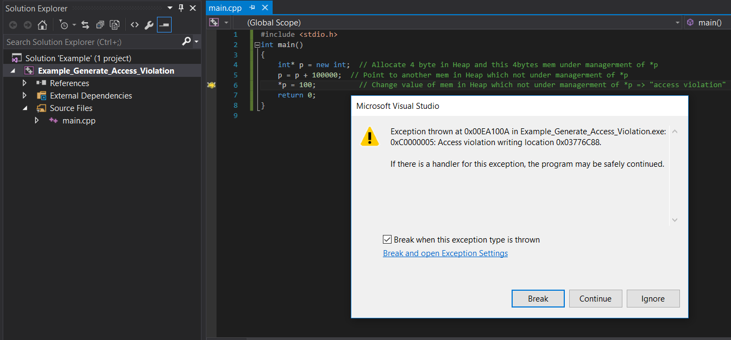
II. Common pointer mistakes in programing
1. Usage pointer case cause “access violation” error or “undefine behavior” in program :
1.1 Pointer point to a memory area outside/inside the scope of the program being managed
Example1: Access outside/an illegal memory location the scope of program => Throw exception “Access violation”

Slide 48
II. Common pointer mistakes in programing
1. Usage pointer case cause “access violation” error or “undefine behavior” in program :
1.1 Pointer point to a memory area outside/inside the scope of the program being managed
Example1: Access outside the scope of program => Throw exception “Access violation”
Memory Heap
Error
#include <stdio.h>
#include <iostream>
int main()
{
int* p = new int;
p = p + 100000;
*p = 100;
return 0;
}
Memory Stack
sizeof(int)
This area being used by other program
int* p
NULL

Slide 49
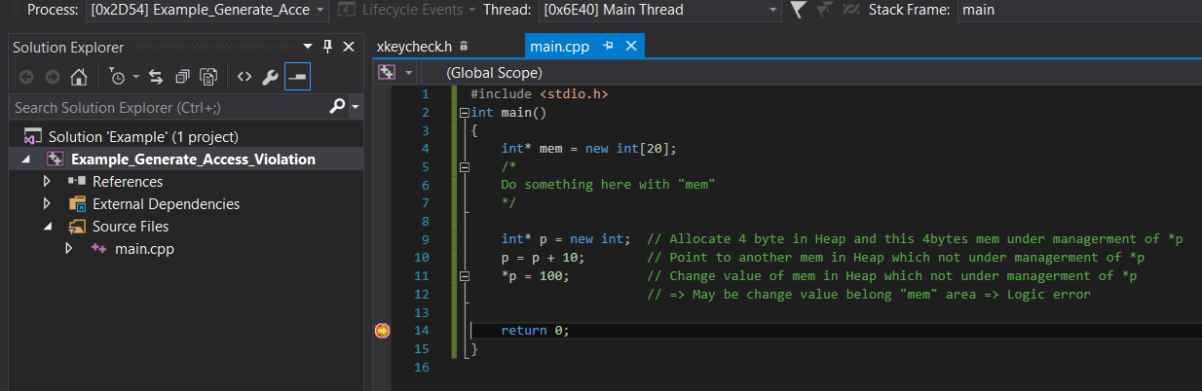
II. Common pointer mistakes in programing
1. Usage pointer case cause “access violation” error or “undefine behavior” in program :
1.1 Pointer point to a memory area outside/inside the scope of the program being managed
Example2: Access inside the scope of program => May be do not throw exception => Unfortunately
change value of other variable in program (unexpected) => “Error code logic” => “Undefined behavior” of program

Slide 50
II. Common pointer mistakes in programing
1. Usage pointer case cause “access violation” error or “undefine behavior” in program :
1.1 Pointer point to a memory area outside/inside the scope of the program being managed
1.2 Not point to NULL after delete()
1.3 Two pointers point to same memory in Heap
1.4 Pointer point a local variable

Slide 51
II. Common pointer mistakes in programing
1. Usage pointer case cause “access violation” error or “undefine behavior” in program :
1.2 Not point to NULL after delete()
Memory Heap
Example:
#include <stdio.h>
#include <iostream>
int main(){
int* a = NULL;
a = new int;
*a = 100;
delete a;
//do something
//with *a
return 0;
}
Need
a = NULL;
after delete
Warning
Memory Stack
sizeof(int)*1
100
a = NULL;
int main()
int* a
NULL

Slide 52
II. Common pointer mistakes in programing
1. Usage pointer case cause “access violation” error or “undefine behavior” in program :
1.1 Pointer point to a memory area outside/inside the scope of the program being managed
1.2 Not point to NULL after delete()
1.3 Two pointers point to same memory in Heap
1.4 Pointer point a local variable

Slide 53
II. Common pointer mistakes in programing
*p2 became ”Dangling pointer”
=> “access violation” or “undefine behavior” if *p2 continue access this area
1. Usage pointer case cause “access violation” error or “undefine behavior” in program :
1.3 Two pointers point to same memory in Heap
Memory Heap
Example:
int main()
{
int* p1 = new int;
*p1 = 10;
int* p2 = p1;
delete p1;
int a = 50;
p1 = &a;
return 0;
}
Memory Stack
*p2
*p1
10
a = 50
NULL

Slide 54
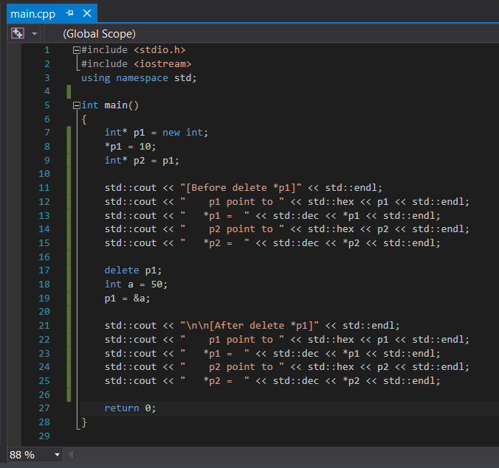
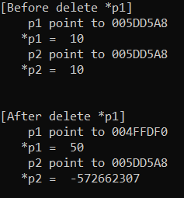
II. Common pointer mistakes in programing
1. Usage pointer case cause “access violation” error or “undefine behavior” in program :
1.3 Two pointers point to same memory in Heap

Slide 55
II. Common pointer mistakes in programing
1. Usage pointer case cause “access violation” error or “undefine behavior” in program :
1.1 Pointer point to a memory area outside/inside the scope of the program being managed
1.2 Not point to NULL after delete()
1.3 Two pointers point to same memory in Heap
1.4 Pointer point a local variable

Slide 56
II. Common pointer mistakes in programing
1. Usage pointer case cause “access violation” error or “undefine behavior” in program :
1.4 Pointer point a local variable
Memory Heap
Stack corruption
Example:
#include <stdio.h>
int* Func()
{
int a = 10;
return &a;
}
int main(){
int* ptr;
ptr = Func();
*ptr = 3000;
return 0;
}
Memory Stack
a = 10
*ptr
Lifetime of “a” is ended when out scope of Func()
NULL

Slide 57
II. Common pointer mistakes in programing
2. Usage pointer cases “Memory Leak”:

Slide 58
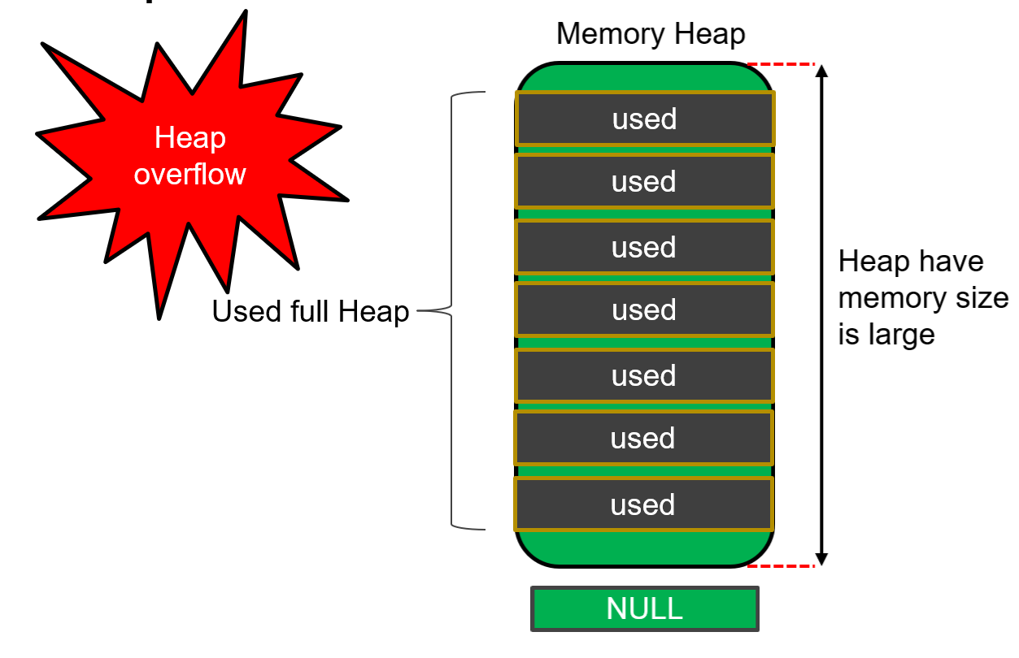
II. Common pointer mistakes in programing
2. Usage pointer cases cause “Memory Leak” in program:
2.1 What is “Memory Leak”
Memory leakage occurs in C++ when programmers allocates memory by using new keyword and forgets to deallocate the memory by using delete() function or delete[] operator.
Lead to: Heap Overflow

Slide 59
II. Common pointer mistakes in programing
2. Usage pointer cases cause “Memory Leak” in program:
2.1 What is “Memory Leak”
- The delete operator should be used to free a single allocated memory space.
Example:
unsigned int* ptr = new int;
=> delete ptr;
IMP_CNN* cnn1 = new IMP_CNN();
=> delete cnn1;
- The delete [] operator should be used to free an array of data values.
Example:
unsigned int* ptr = new int[100];
=> delete[] ptr;
IMP_CNN* cnn_ptr = new IMP_CNN()[10];
=> delete[] cnn_ptr;

Slide 60
II. Common pointer mistakes in programing
2. Usage pointer cases cause “Memory Leak” in program:
2.2 Some cases cause “Memory Leak”
Example1:
#include <stdio.h>
#include <iostream>
int main()
{
char* ptr = new char[30]; // Allocate 30 bytes
// Do something here
// …
// …
ptr = new char[60];
delete[] ptr; // This deletes the 60 bytes, not just the first 30 bytes
return 0;
}
“Delete”: will delete memory area which pointer currently point to
Memory Leak

Slide 61
II. Common pointer mistakes in programing
2. Usage pointer cases cause “Memory Leak” in program:
2.2 Some cases cause “Memory Leak”
Memory Heap
Example1:
#include <stdio.h>
#include <iostream>
int main()
{
char* ptr = new char[30];
ptr = new char[60];
delete[] ptr;
return 0;
}
Memory Stack
30 bytes
60 bytes
*ptr

Slide 62
II. Common pointer mistakes in programing
2. Usage pointer cases cause “Memory Leak” in program:
2.2 Some cases cause “Memory Leak”
Example2:
#include <stdio.h>
#include <iostream>
int main()
{
char* ptr1 = new char[30]; // Allocate 30 bytes
char* ptr2 = new char[60]; // Allocate 60 bytes
ptr1 = memcpy(ptr1, “Hello Cun con”);
ptr2 = ptr1; // “Assign pointer to a pointer” at 3.2 Assign Pointer to a Pointer
delete[] ptr1; // This deletes the 30 bytes => OK
delete[] ptr2; // Possible “Access violation” => This not deletes the 60 bytes
return 0;
}
Memory Leak

Slide 63
II. Common pointer mistakes in programing
2. Usage pointer cases cause “Memory Leak” in program:
2.2 Some cases cause “Memory Leak”
Example2:
#include <stdio.h>
#include <iostream>
int main()
{
char* ptr1 = new char[30];
char* ptr2 = new char[60];
ptr1 = memcpy(ptr1, “Hello Cun con”);
ptr2 = ptr1;
delete[] ptr1;
delete[] ptr2;
return 0;
}
Error
Memory Stack
30 bytes
*ptr1
60 bytes
“Hello Cun con”
*ptr2
Memory Leak

Slide 64
II. Common pointer mistakes in programing
2. Usage pointer cases cause “Memory Leak” in program:
2.2 Some cases cause “Memory Leak”
Example3: Be careful with dynamic allocated memory with local pointer
#include <stdio.h>
#include <iostream>
int subFunc()
{
char* ptr = new char[30]; // Allocate 30 bytes
// Do something with ptr
// End
// Should delete ptr before go out scope of subFunc() because:
When out of scope of subFunc():
- OS only remove the “ptr” variable in Stack Memory
- But with new, it is allocated in Heap => it also exist in Heap => Leak Memory
}
Memory Leak

Slide 65
II. Others

