Slide 1
Adaptive Enrichment Design to Address Emerging Uncertainty Regarding Optimal Target Population - Case Study
Anh Nguyen Duc, Dominik Heinzmann,
Marcel Wolbers and Claude Berge

Slide 2
Content
Background
Adaptive Design
Type-I Error Control
Fine-tunning Criteria for Adaptive Design
Statistical & Operational Considerations

Slide 3




Background
Triple Negative Breast Cancer (TNBC): high unmet medical need
Absence of ER, PR and HER-2 gene ⇒ reduced or voided
benefit from drug targeting these biomarkers
Poor outcome: rapid progression, short time to relapseª
Early Triple-NegativeBreast Cancer (eTNBC)
S
U R G E R Y
Neoadjuvant
(eTNBC)
Adjuvant
(eTNBC)
1L / Metastatic
(1L / mTNBC)
ENDPOINTS: | pCR | EFS / DFS / OS | PFS / OS
Roche Studies: | IMpassion031 Atezo/pla+chemo | IMpassion030 Atezo/none+chemo | IMpassion130 Atezo/pla+chemo
pCR: pathological complete response; EFS: event-free survival; DFS: disease-free survival; OS: overall survival; PFS: progression-free survival. ª Dent et al. 2007

Slide 4

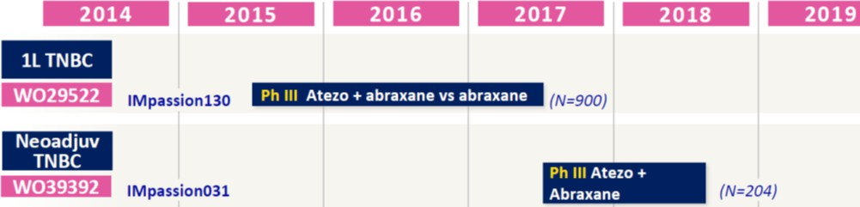

Background
ª https://www.esmo.org/Press-Office/Press-Releases/IMpassion130-atezolizumab-nab-pac-triple-negative-breast-cancer-Schmid
Population | PFS-HRª
ITT | 0.80 (0.69, 0.92)
PD-L1+ Formal testing | 0.62 (0.49, 0.78)
FPI
LPI
IA
FPI
LPI
Original neoadjuvant TNBC Design
Pathological complete response (pCR): binary endpoint
All-comer: no pre-specified formal testing for PD-L1+

Slide 5


Background
Emerging Goals for neoadjuvant TNBC study
Current AC design MIGHT not lead to ITT label even with positive read-out AND
Efficacy in PDL1+ not formally tested
⇒ Optimize chance of success and timeline for timely patient’s access & Minimize exposing patients to futile treatment
Challenges in extrapolating from 1L to neo-adj. TNBC
PD-L1 predictive value: inconsistency across treatment lines
observed in other indications
Different entpoints: PFS vs pCR
⇒ Fixed (re)design options at high risk of misspecification

Slide 6












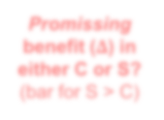










Neo-adjuvant Trial - Adaptive Design
F = ITT population, S = PDL1+ subpopulation, C = PDL1- subpopulation
Stop for lack of efficacy
1
Only 𝚫_{𝑪} promising: Select F as
Target Population
Stage 1
Reject
Promissing benefit (𝚫) in either C or S? (bar for S > C)
Both 𝚫 ,𝚫 promising:
Stage 2 (𝑵_{𝟐} patients fixed)
(𝑵 patients)
𝑯^{𝑭} or
2
𝑪 𝑺
Select F and S as
Target Populations
𝟏
Co-primary
F & S
𝟎
𝑯^{𝑺} or
𝟎
both?
3
Only 𝚫_{𝑺} promising: Select S as
Target Population
Stop for efficacy
Analysis at end of Stage 1 conducted by independent statisticians and reviewed by iDMC, following above prespecified algorithm.

Slide 7



Type-I Error - Sources of Inflation
Stage 2 and final target population driven by stage 1 outcomes
No direct pooling of data BUT: 𝑝 ⊥ 𝑝 under 𝐻
p-value combination (inverse weighted normal approach)^{b}
ℎ ℎ ℎ
2 1 0
a
_{𝑝}ℎ
= 1 − Φ 𝑤₁ × Φ⁻¹ 1 − 𝑝^{ℎ} + 𝑤₂ × Φ⁻¹ 1 − 𝑝^{ℎ}
1 2
1,2
c
Early look at data for efficacy claim at stage 1: 𝛼₁, 𝛼₂ specified via
0
0
1 𝑤₁
𝑤₁ 1
𝑍^{ℎ}, 𝑍^{ℎ} ~𝑁 𝜇 =
1 1,2
, Σ =
under 𝐻^{ℎ}
0
Multiplicity in target populations: F and S
– Sime’s closed test procedure^{d}: exploit positivity in correlation
between F and S
2
𝑁
1
2
𝑁
2
ª ℎ ∈ 𝐹, 𝑆, 𝐹 ∩ 𝑆 . Wassmer & Brannath 2016. E.g. 𝑤 =
,𝑤 =
. ^{d} 𝑝^{𝐹∩𝑆} = min 2 × min 𝑝^{𝐹}, 𝑝^{𝑆} , max 𝑝^{𝐹}, 𝑝^{𝑆}
b c
1
𝑁₁+𝑁₂
2
𝑁₁+𝑁₂

Slide 8
Fine-tuning Criteria for Adaptive Design
Frequency of making “correct” IA decision across key scenarios.
E.g. Frequency of Decision at IA - Threshold: 𝚫_{𝑺}=0.14, 𝚫_{𝑪}=0.11
(Results for illustration only)
Subgroup S credential | 𝚫_{𝑺} | 𝚫_{𝑪} | Stop |  | Continue & Target Population
 |  |  | Efficacy | Futility | S only | F only | F &S
Very Strong | 0.20 | 0.04 | 0.34 | 0.16 | 0.38 | 0.05 | 0.07
Dismal | 0.00 | 0.00 | 0.013 | 0.74 | 0.11 | 0.13 | 0.01

Slide 9

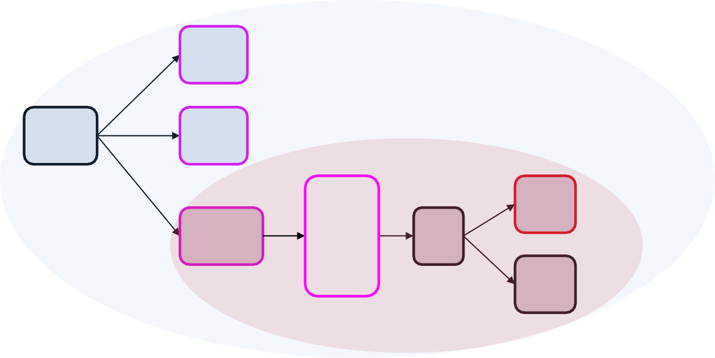
Fine-tuning Criteria for Adaptive Design
Frequency of making “correct” IA decision across key scenarios.
Overall power: more relevant if decision made at trial onset or when investment at stage 1 matters.
Go (conditional) power i.e. Prob. of Success conditional on GO: more relevant if not concerned by wasting stage 1 investment
Hit
Overall
Power
IA
Ful. stop
Opt.
1
2
3
Hit
Cont.
FA
Fail
Go Power

Slide 10


Why NOT Conditional Power as Decision Criteria?
At IA „precise“ estimate for each hypothesis not easy due to rejection of their intersection 𝑯^{𝑭∩𝑺} as gate keeper.
𝟎
– For Sime: 𝑝^{𝐹∩𝑆} = min 2 × min 𝑝^{𝐹}, 𝑝^{𝑆} , max 𝑝^{𝐹}, 𝑝^{𝑆}
⇒ reject 𝑯^{𝑭∩𝑺} at 𝛼-level iff at least one p-value ≤ 𝟎. 𝟓 × 𝜶
𝟎
OR both p-values ≤ 𝜶
Not straight-forward for clinician to give input
⇒ More complex decision tree & simulation needed for optimal thresholds e.g. TAPPAS trial*
Might be warranted for sample size re-estimation
* An adaptive population enrichment phase III trial of TRC105 and pazopanib versus pazopanib alone in patients with advanced angiosarcoma (TAPPAS trial)

Slide 11
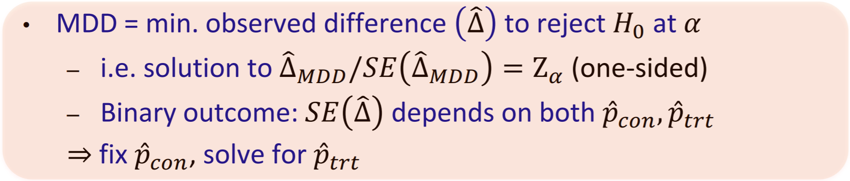

Minimum Detectable Difference
Rejection of 𝐻^{𝐹}(resp. 𝐻^{𝑆}) depends on both p-values through
0 0
rejection of 𝐻^{𝐹∩𝑆} in closed test procedure ⇒ E.g. at Stage 1
0
Significance level for 𝜟^{෡𝑭} 𝑴𝑫𝑫 | 𝑯^{𝑺} not rejected at 𝛼₁ 𝟎 | 𝑯^{𝑺} rejected at𝛼₁ 𝟎
 | 𝛼₁/2 (higher MDD) | 𝛼₁
Different choice for target populations at stage 2 ⇒ various sets of MDDs

Slide 12


Operational and Regulatory Challenges
Stage 1 enrollment already concluded before amendment → need to minimize accrual gap if stage 2 initiated
Timely protocol / SAP / iDMC amendment and gain alignment from iDMC / Regulators
Keep sites motivated during enrollment break
Acceptance by Regulators
FDA: minimal questions and swift approval
EMA: all statistical details mandated in protocol NOT SAP*
* Reflection Paper on Methodological Issues in Confirmatory Clinical Trials Planned with an Adaptive Design

Slide 13



CONCLUSION
Adaptive design = „rescue strategy“ for ad-hoc mid-trial
adaptation if original design is challenged
Update trial based on its own data → mimimize mispecification risk
Established and straight forward theory (at least for
binary endpoint) to maintain study‘s integrity
Operational and regulatory challenges expected
Cross-functional discussions: stats, science, ops and reg …
Sponsor & iDMC / Regulators interactions
Prospective design of an adaptive enrichment trial would be preferable in general.

Slide 14
Reference
Gernot Wassmer and Werner Brannath. Group Sequential and Confirmatory Adaptive Designs in Clinical Trials.
Mehta, et al. An adaptive population enrichment phase III trial of TRC105 and pazopanib versus pazopanib alone in patients with advanced angiosarcoma (TAPPAS trial)
Dent R, Trudeau M, Pritchard KI, et al. Triple-negative breast cancer: clinical features and patterns of recurrence.
https://www.ema.europa.eu/en/documents/scientific- guideline/reflection-paper-methodological-issues-confirmatory- clinical-trials-planned-adaptive-design_en.pdf

