Slide 1
Pragmatic Use of Bayesian (Non-)Exchangeability Model
for Decision Making
in Ovarian Cancer
Hybrid Basel Biostatistics Community
Knowledge Sharing Event (part 2)
04 June 2023
Anh-Duc Nguyen

Slide 2
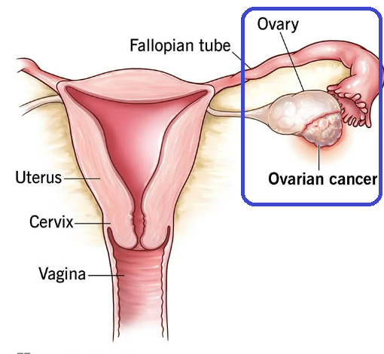
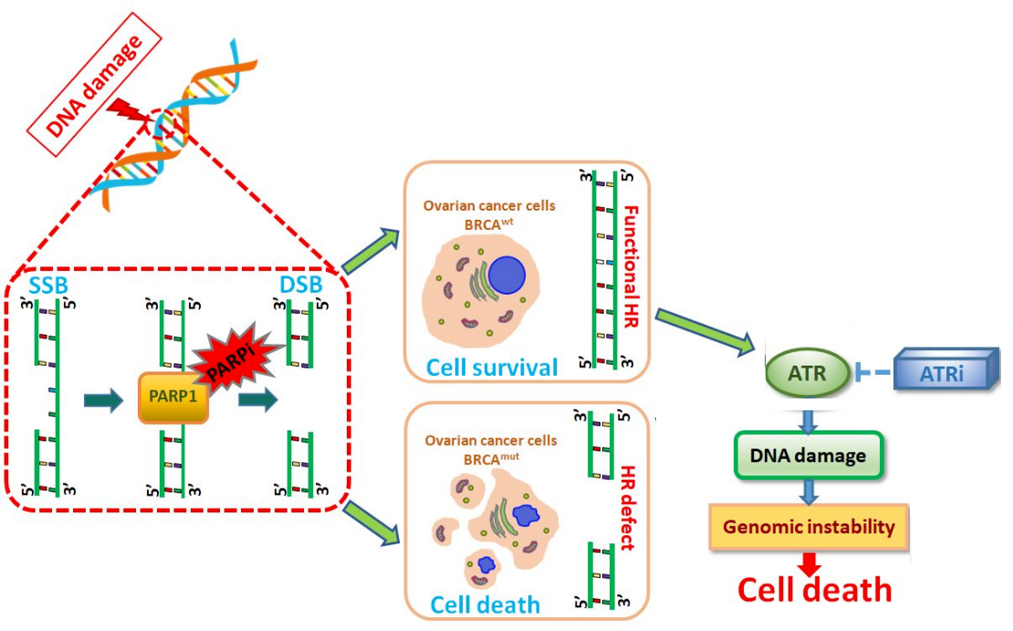
Background
Late-line Platinum-resistant Recurrent Ovarian Cancer (PR-ROC)
Relapse < 6 months after platinum-based chemotherapy, mOS < 12 mo*
SOC = systemic (nonplatinum) chemotherapy e.g. Gemcitabine or PLD / Avastin
Synthetic lethality: ATRi and chemo
Chemo e.g. Gem causes DNA-damage in cancer cell and ATRi hinders repairing mechanism
Competitive landscape
On-going + launched combos: chemos / Avastin and CITs.
Concurrent competition for other ATRis-based combos
Post Avastin Roche has no further footprint (also for the whole GYN) ⇒ important to be first in class (FIC)
Gem
* Davis et al.“Platinum resistant” ovarian cancer: What is it, who to treat and how to measure benefit?

Slide 3
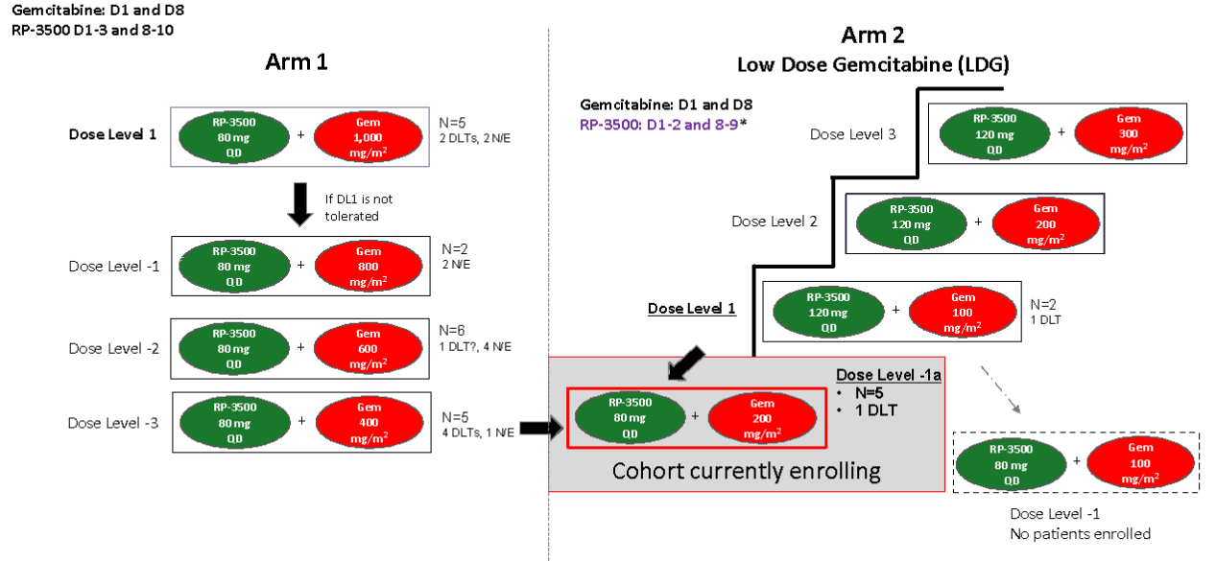
Background
Camonsertib a potential ATRi
In-licensed from REPARE Therapeutics in 2022
Post due diligence: data for PR ROC based on REPARE’s on-going p1 dose-finding for Camonsertib + Gem
⇒ Expansion cohort with only 20 patients dosed at RP2D
Later-phase development
Control arm: Inv. choice of Gemcitabine or PLD: No in-house individual patient data (IPD)
FIC is important ⇒ Avoid standalone phase 2
Leverage 20 PR-ROC patients from expansion cohort for PIV-GO
⇒ How to support PIV-GO decision with only ~ 20 patients from a (single-arm) cohort with objective response as the main endpoint?

Slide 4
Potential Options
Methods | Description
mState Modelling*,** | Currently suitable when control arm IPD is available to jointly model ORR and PFS/OS
Bayesian approach | When IPD is not available but it is not difficult to Populate prior distribution about activities in the experimental arm, at least on ORR Or there exists (aggregate-level) literature data to augment the single-arm cohort
Frequentist approach | Using point estimate and/or CI
* Beyer et al.“A multistate model for early decision-making in oncology? **Considered e.g. for Tiragolumab in mTNBC
Notes:
Unicycle framework?

Slide 5
Bayesian Exchangeability / non-exchangeability (EXNEX) model
Notation
𝛳_{j} = aggregate statistic e.g. logit-ORR from j^{th} trials incl. 𝛳₀ from internal data
Calculate P( 𝛳₀> c) using expert opinions and observed internal / external data
Incorporation of external data
Ignored .. i.e. posterior distribution based solely on expert opinions in the prior
Hierarchical / fully exchangeable models
𝜇₀ ^{NEX}
𝜇 ^{EX}~ H(𝜂 )
𝛳₀ ~ F( 𝜇₀ ^{NEX})
𝛳₀ ~ G( 𝜇 ^{EX})
𝛳₂ ~ G( 𝜇 ^{EX})
𝛳₁ ~ G( 𝜇^{EX})

Slide 6
Bayesian Exchangeability / non-exchangeability (EXNEX) model
Notation
𝛳_{j} = aggregate statistic e.g. logit-ORR from j^{th} trials incl. 𝛳₀ from internal data
Calculate P( 𝛳₀> c) using expert opinions and observed internal / external data
Incorporation of external data
Exchangeability / non-exchangeability (EXNEX)*,**
𝜇₀ ^{NEX}
𝜇 ^{EX}~ H(𝜂 )
𝜇₁ ^{NEX}
𝛳₀ ~ p₀F( 𝜇 ₀ ^{NEX})+(1-p₀ )F(𝜇 ^{EX})
𝛳₁ ~ p₁F( 𝜇 ₁ ^{NEX})+(1-p₁ )F(𝜇 ^{EX})
p_{j} fixed or stochastic
* Neuenschwander et al. “Robust exchangeability designs for early phase clinical trials with multiple strata” ** Kaspar “Platform trials: demystifying the statistics”

Slide 7
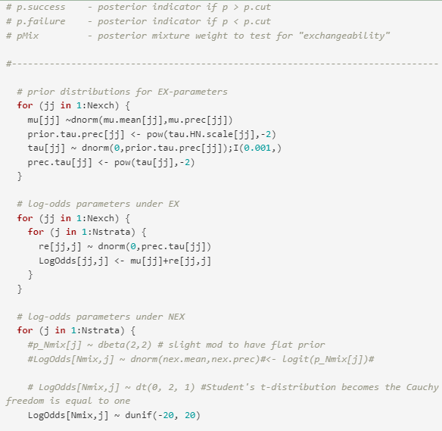
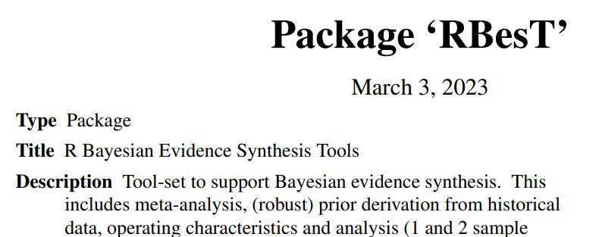
Implementation
WinBUG or JAGS codes available and easy to modify from Neuenschwander et al.
Recently available R-packages e.g. RBest (disclaimer: I have not tried these myself ..)

Slide 8
Conclusion
EXNEX could be a pragmatic tool to support decision making
When IPD for benchmark is lacking
Literature data from potentially relevant setting is available
General caveats of single-arm based decision making still applies ..
No direct assessment of relative benefit
Lack of association between early- and late-stage endpoints e.g. ORR vs. PFS/OS
Potentially better options (putting urgency aside ..)
Randomized phase 2
Seamless phase 2/3

Slide 9
Reference
Neuenschwander et al. “Robust exchangeability designs for early phase clinical trials with multiple strata”
Kaspar “Platform trials: demystifying the statistics”
Beyer et al.“A multistate model for early decision-making in oncology?
RBesT
Davis et al.“Platinum resistant” ovarian cancer: What is it, who to treat and how to measure benefit?

Slide 10
Back up

Slide 11



Treatment Algorithm (Focused mainly on Advanced HGSOC)
Treatment Flow
Disease Onset
Diagnosis & Staging
Front Line Treatment
(Focus on OS)
Second Line
Third Line
Fourth Line…
PLATINUM-SENSITIVE
Relapse in > 6 mon
Relapse in > 6 mon
Presentation
Diagnosis
No
Neoadjuvant Platinum-doublet x 3
± bev
Relapse in > 6 mon
Platinum-doublet ± bev
± PARPi maintenance
± bev maintenance
Platinum-doublet ± bev³
± PARPi maintenance
± bev maintenance
Platinum-doublet ± bev
± PARPi maintenance
± bev maintenance
Early stage &/or Completely Resectable?
~75%
Surgery
Yes
~50%
Incidental diagnosis of OC/FTC
STIC diagnosis
Platinum-doublet ± bev
x3 (if rec’d neoadjuvant) or x6 (if chemo-naïve)
± Bev maintenance
PARPi maintenance
PARP + Bev
Relapse in < 6 mon
Relapse in < 6 mon
~25%
Chemo ± bev
Chemo ± bev
PARPi monotherapy
Pembro (MSI-hi, TMB-hi)
Chemo ± bev³
PARPi monotherapy
Pembro (MSI-hi, TMB-hi)
Relapse in < 6 mon
Prophylactic BSO
BRCAm testing
Germline &/or Somatic
PLATINUM-RESISTANT
Targeted therapies for rare EOC
(e.g., VS-6766 + defactinib: LGS; CDK4/6i + AI: LGS; Enhertu: HER2+; Trametinib)
gBRCA testing beyond the OC pt
Future
Notes:
CarboTaxol, with or without bevacizumab, is highly preferred in the first-line
+More than 70% patients receive maintenance or consolidation therapy after receiving induction therapy
Bevacizumab maintenance continues to be most common for BRCA WT/HRD(-) patients, while PARP inhibitor use continues to increase across other patient subsets
Bevacizumab maintenance is still commonly used for BRCA WT/unknown and HRD(-) patients following induction without bevacizumab, while PARPi use is increasing across all subsets

Slide 12

PROC competitive landscape
2017 |  |  |  | 2018 |  |  |  | 2019 |  |  |  | 2020 |  |  |  | 2021 |  |  |  | 2022 |  |  |  | 2023 |  |  |  | 2024+
Q1 | Q2 | Q3 | Q4 | Q1 | Q2 | Q3 | Q4 | Q1 | Q2 | Q3 | Q4 | Q1 | Q2 | Q3 | Q4 | Q1 | Q2 | Q3 | Q4 | Q1 | Q2 | Q3 | Q4 | Q1 | Q2 | Q3 | Q4 | Q1 | Q2 | Q3 | Q4
KEY THEMES
CP + Avastin ± TECENTRIQ
1
Combination of CIT + PARPi is a new approach in a difficult to treat space
CIT
Ph3 AGO-OVAR 2.29* / NCT03353831 / n=550
PFS/OS
CP ± TECENTRIQ ± Avastin
PFS
OS
Ph2/3 NRG-GY009* / NCT02839707 / n=444
2
PARPi monotherapy is the current SoC in PROC
Nemvaleukin alfa + Pembro vs CP
Ph3 ARTISTRY-7 / NCT05092360 / n=376 / Alkermes
Pembrolizumab + paclitaxel ± bevacizumab vs. Placebo
Ph3 KEYNOTE-B96 / NCT05116189 / n=616 / Merck
3
Mirvetuximab soravtansine may be a chemo-sparing approach in FRα-high (~20% of PROC)
1
ORR
Dostarlimab + niraparib (Stopped in Q2 2021)
Ph2 MOONSTONE / NCT03955471 / n=41 / GSK/Tesaro†
PARPi Combos
2
Alpelisib + Olaparib vs. CP
PFS
ORR
Rucaparib
Ph3 EPIK-O / NCT04729387 / n=358 / Novartis
Ph2 ARIEL2 / NCT01891344 / n=491 / Clovis§
ORR
Niraparib
Ph2 QUADRA / NCT02354586 / n=463 / Tesaro¶
Cediranib ± olaparib vs. CP
Ph2/3 COCOS / NCT02502266 / n=562 / NCI
PFS
ROC PR
AVB-S6-500 + Paclitaxel vs P
Ph3 AXLerate-OC / NCT04729608 / n=400 /Aravive
PFS
CA-125
OS /
CA-125
OS
VB-111 + P vs. P
Ph3 OVAL / NCT03398655 / n=400 / VBL Therapeutics
IA
IA
3
Other
PFS
PFS
Mirvetuximab soravtansine vs. CT
Ph3 MIRASOL / NCT04209855 / n=430 /ImmunoGen***
Mirvetuximab soravtansine + Avastin/C/PLD/pembro/Avastin + C
Mirvetuximab soravtansine
Ph1/2 FORWARD II / NCT02606305 / n=264 /ImmunoGen**
ORR
Ph3 SORAYA / NCT04296890 / n=106 / ImmunoGen***
Trial Milestone
Molecule Category
Other Information
Upifitamab Rilsodotin
AE
ORR
Initiation
Data Readout
CIT
PARPi
Ph1b/2 UPLIFT / NCT03319628 / n=444 / Mersana
Purple Background: Internal
*
L
M
H
ADC
Other
Negative readout
Launch & Threat Level

Slide 13
Potential Options
Methods | Description | Pros | Cons
mState Modelling*,** | Currently suitable when control arm IPD is available to jointly model ORR and PFS/OS | Decision making based not only on ORR but a consistent modelling of (e.g. tree) using ORR and PFS/OS | Patient-level data is required.
Bayesian approach | When IPD is not available but it is not difficult to Populate prior distribution about activities in the experimental arm, at least on ORR Or there exists (aggregate-level) literature data | Allow borrowing of (relevant) external data Allow incorporating various prior beliefs about activity in the exp. arm | Decision based only on ORR (not PFS/OS) Decision is still based on absolute instead of relative treatment activity i.e. not Delta-ORR or HR Not suitable when prior not easy to populate e.g. when there is potential heterogeneity in the experimental arm.
Frequentist approach | Using point estimate and/or CI | Easy to implement Suitable PLD and / or relevant ext. Data not available Or when it is not easy to populate prior | Same cons as Bayesian approach Does not account for potential relevant external data or expert’s knowledge.
* Beyer et al.“A multistate model for early decision-making in oncology? **Considered e.g. for Tiragolumab in mTNBC

Slide 14
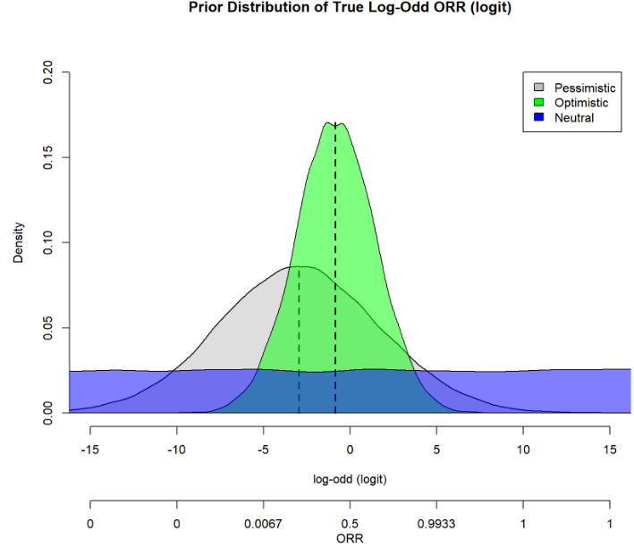
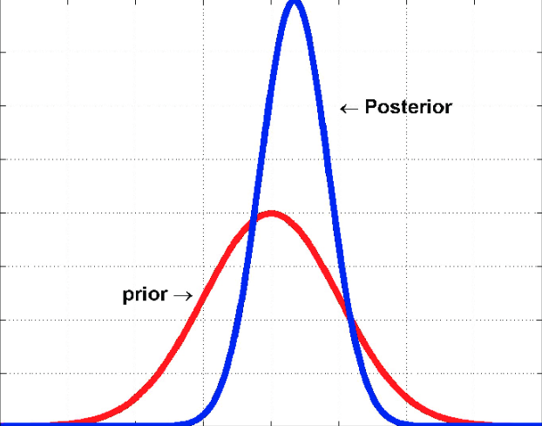
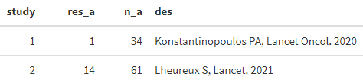
Bayesian Exchangeability / non-exchangeability (EXNEX) model
Prior assumption: Align on assumptions about possible distribution of true ORR before (prior) to seeing data
Pessimistic: ORR most likely ~ 5%
Optimistic: ORR most likely~ 30%
Agnostic: all values equally likely
Mixture of these 3
Data
Observed ORR in expansion cohort
ORR from the relevant literature

Slide 15
Bayesian ungating approach - Example results for N=20
Probability of “true” ORR > 15%
no resp. out of 20 ORR (%) | 3/20 15%
Observed ORR In 20 pts | 0.15
Pessimistic | 0.20
Optimistic | 0.26
Agnostic | 0.46
Mix | 0.39
Assuming 3 responders → Observed ORR is 15%
Probability of true ORR >15% is 20 - 39%
Probability of true ORR <15% is 61 - 80%
Probability of “true” ORR < 15%
Observed ORR In 20 pts | 0.15
Pessimistic | 0.80
Optimistic | 0.74
Agnostic | 0.54
Mix | 0.61

Slide 16
Bayesian ungating approach - Example results for N=20
Probability of “true” ORR > 15%
no resp. out of 20 ORR (%) | 3/20 15% | 6/20 30%
Observed ORR In 20 pts | 0.15 | 0.30
Pessimistic | 0.20 | 0.84
Optimistic | 0.26 | 0.87
Agnostic | 0.46 | 0.94
Mix | 0.39 | 0.92
Assuming 3 responders → Observed ORR is 15%
Probability of true ORR >15% is 20 - 39%
Probability of true ORR <15% is 61 - 80%
Assuming 6 responders → Observed ORR is 30%
Probability of true ORR >15% is 84 - 92%
Probability of true ORR <15% is 8 - 16%
What is the lowest probability are we confident for a “Go” Decision?
Probability of “true” ORR < 15%
Observed ORR In 20 pts | 0.15 | 0.30
Pessimistic | 0.80 | 0.16
Optimistic | 0.74 | 0.13
Agnostic | 0.54 | 0.06
Mix | 0.61 | 0.08

Slide 17
Bayesian ungating approach - Example results for N=20
Probability of “true” ORR > 15%
Observed ORR In 20 pts | 0.05 (1/20) | 0.10 (2/20) | 0.15 (3/20) | 0.20 (4/20) | 0.25 (5/20) | 0.30 (6/20) | 0.35 (7/20)
Pessimistic | 0.02 | 0.07 | 0.20 | 0.41 | 0.66 | 0.84 | 0.93
Optimistic | 0.03 | 0.12 | 0.26 | 0.50 | 0.71 | 0.87 | 0.95
Agnostic | 0.05 | 0.20 | 0.46 | 0.70 | 0.85 | 0.94 | 0.98
Mix | 0.04 | 0.16 | 0.39 | 0.64 | 0.83 | 0.92 | 0.98
Probability of “true” ORR < 15%
Observed ORR In 20 pts | 0.05 (1/20) | 0.10 (2/20) | 0.15 (3/20) | 0.20 (4/20) | 0.25 (5/20) | 0.30 (6/20) | 0.35 (7/20)
Pessimistic | 0.98 | 0.93 | 0.80 | 0.59 | 0.34 | 0.16 | 0.07
Optimistic | 0.97 | 0.88 | 0.74 | 0.50 | 0.29 | 0.13 | 0.05
Agnostic | 0.95 | 0.80 | 0.54 | 0.30 | 0.15 | 0.06 | 0.02
Mix | 0.96 | 0.84 | 0.61 | 0.36 | 0.17 | 0.08 | 0.02
Probability of ‘true’ ORR >15% is at least 80% if observed ORR is 30% and above

Slide 18
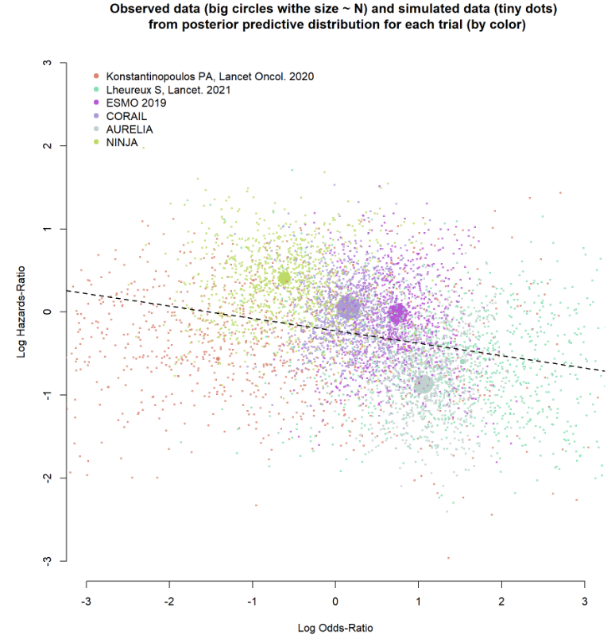
Association between ORR and PFS

