Slide 1

Lecture | React
REACT BASICS
WHATEVER YOU WANT, MAKE IT REAL.
NGUYỄN ĐỨC HUY

Slide 2
Lecture | React
1. SPA
2. Lifecycle Components
3. Props and State
4. Hooks: UseEffect
{
}

Slide 3
Lecture | React
Single Page Application (SPA)
A single web page, website, or web application that works within a web browser and loads just a single document
It does not need page reloading during its usage, and most of its content remains the same while only some of it needs updating
When the content needs to be updated, the SPA does it through JavaScript APIs

Slide 4



Lecture | React
Single Page Application (SPA)

Slide 5
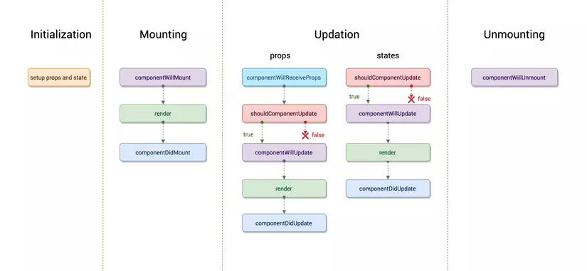
Lecture | React
Lifecycle Components

Slide 6
Lecture | React
Props and State
Use props to pass data & event handlers down to your child components.
Use state to store the data your current page needs in your controller-view.

Slide 7
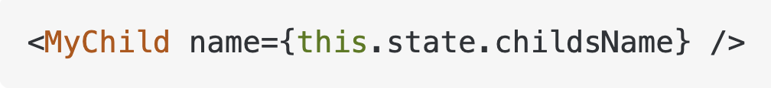
Lecture | React
Props and State
Props:
are immutable -> which lets React do fast reference checks
are used to pass data down from your view-controller -> your top level component
have better performance -> use this to pass data to child components

Slide 8
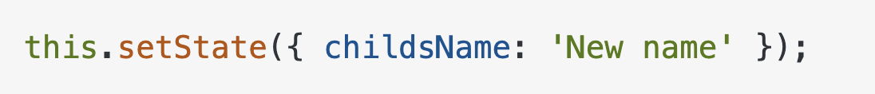
Lecture | React
Props and State
State:
should be managed in your view-controller -> your top level component
is mutable
has worse performance
should not be accessed from child components -> pass it down with props instead

Slide 9
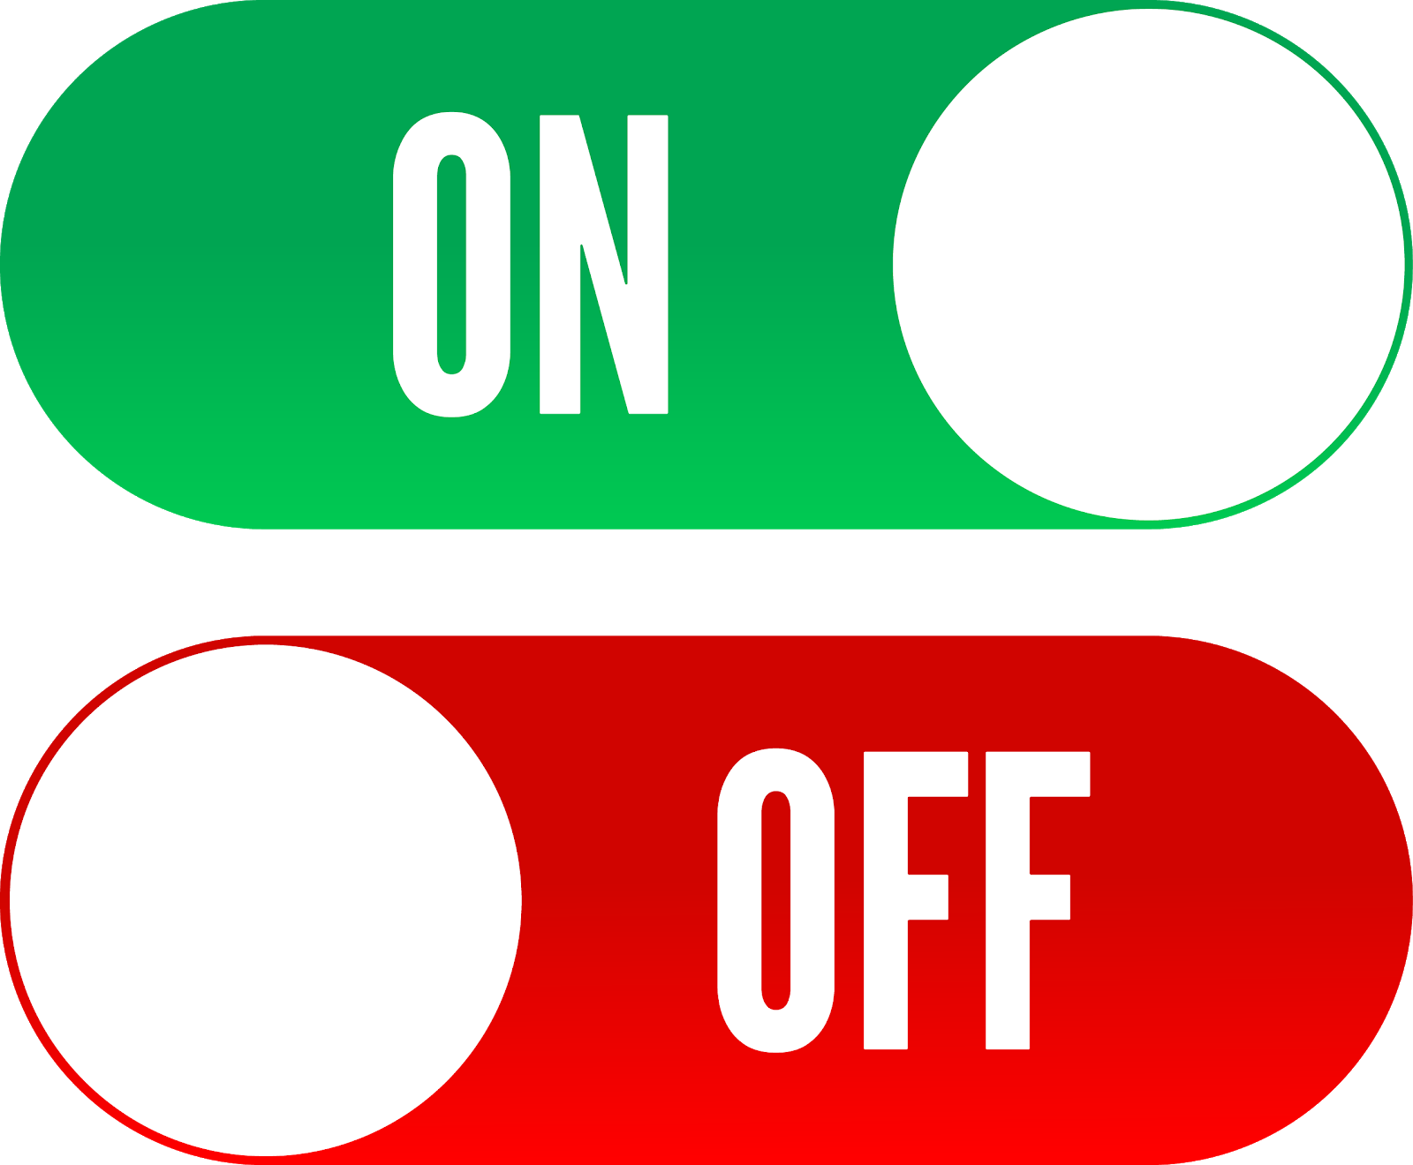
Lecture | React
Hooks: useState
Allows us to track state in a function component

Slide 10
Lecture | React
5. Event Handling
6. Conditional Rendering
7. Hooks: UseEffect
8. CSS in React
9. Project
{
}

Slide 11
Lecture | React
Event Handling
Handling events with React elements is very similar to handling events on DOM elements. There are some syntax differences:
React events are named using camelCase, rather than lowercase.
With JSX you pass a function as the event handler, rather than a string.

Slide 12
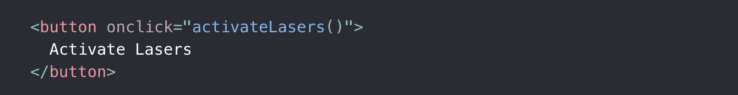
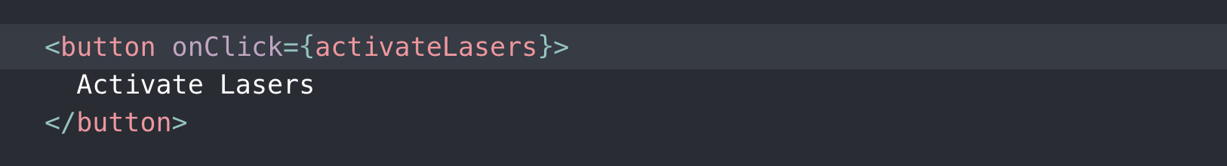
Lecture | React
Event Handling
HTML
React

Slide 13
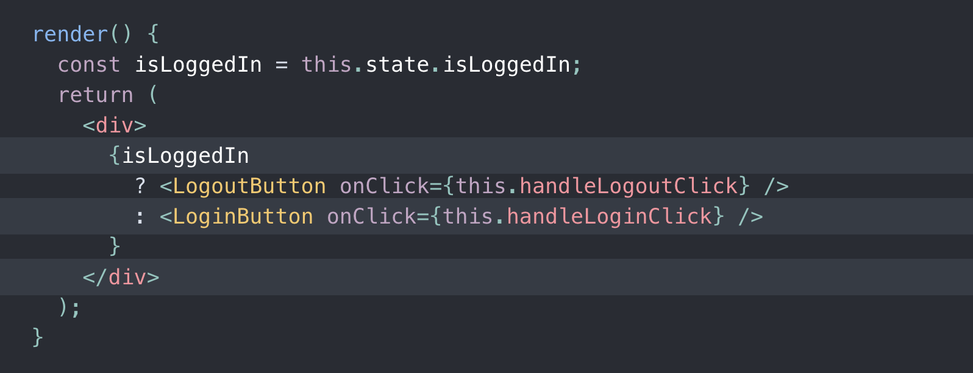
Lecture | React
Conditional Rendering
Describe the ability to render different user interface (UI) markup if a condition is true or false

Slide 14
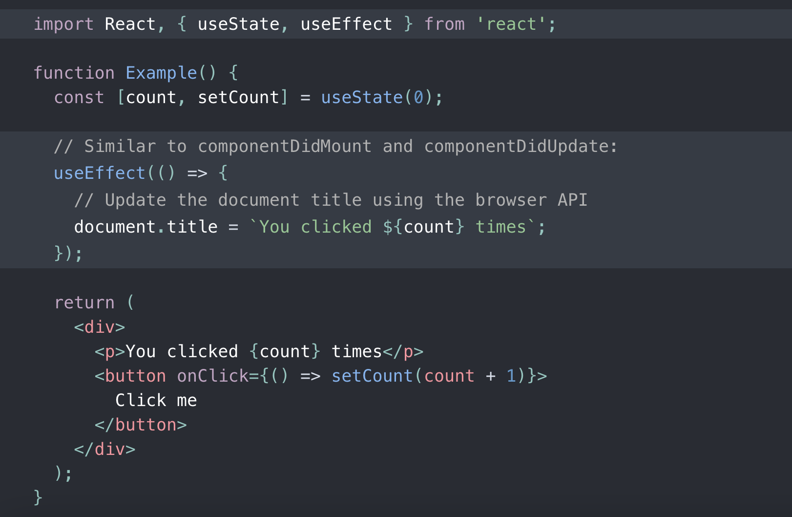
Lecture | React
Hooks: useEffect
Lets you perform side effects in function components

Slide 15
Lecture | React
CSS in React
Inline styles (Bad)
CSS classes
CSS modules
CSS-in-JS

Slide 16
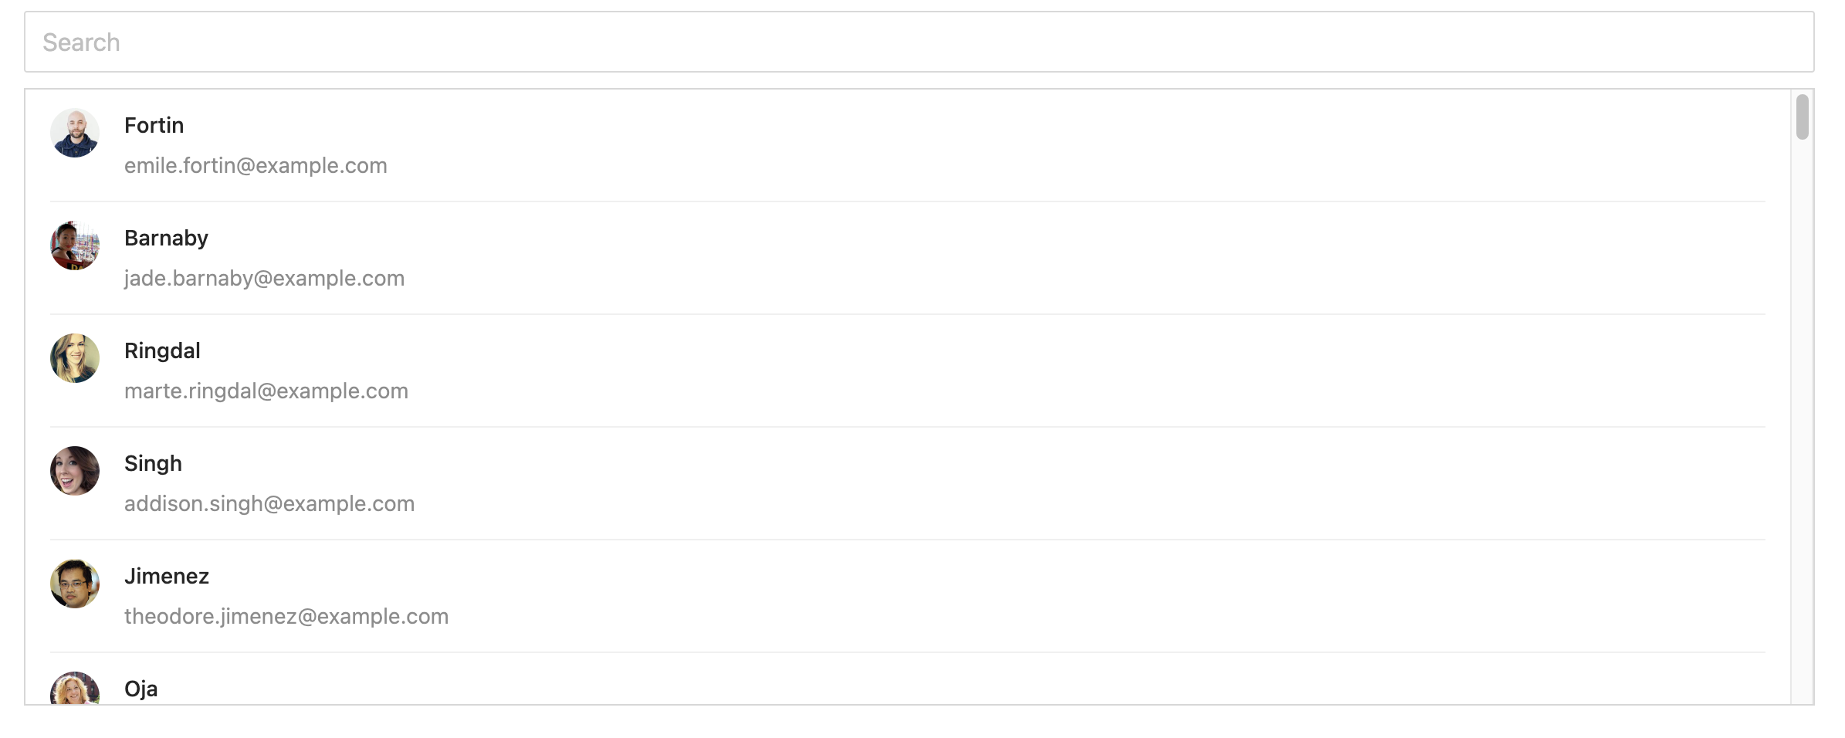
Lecture | React
Project: Make a search/filter list

Slide 17
Lecture | React
5. React Router DOM
6. Authentication with Firebase
{
}

Slide 18
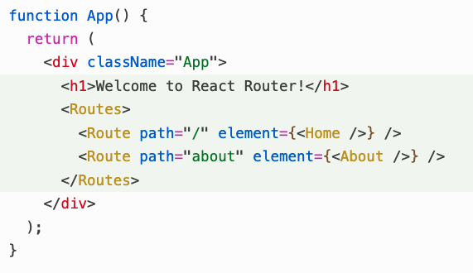
Lecture | React
React Router Dom
React Router Dom is a popular and powerful routing library for React applications

Slide 19
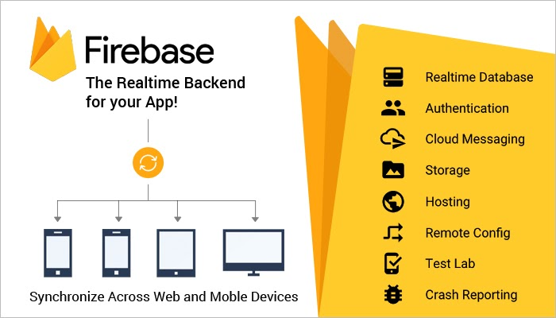
Lecture | React
Firebase
Firebase is an app development platform that helps you build and grow web apps

Slide 20
Lecture | React
Thank you!
Reminder:
Practice makes perfect

