Slide 1

Lecture | React
REACT KEY CONCEPTS
WHATEVER YOU WANT, MAKE IT REAL.
NGUYỄN ĐỨC HUY

Slide 2
Lecture | React
1. Why React?
2. Declarative and Imperative
3. Component Architecture
4. Unidirectonal Data Flow
{
}

Slide 3

Lecture | React
Why React?
React is simple yet powerful
React is component-based
React is declarative
React supports mobile support

Slide 4
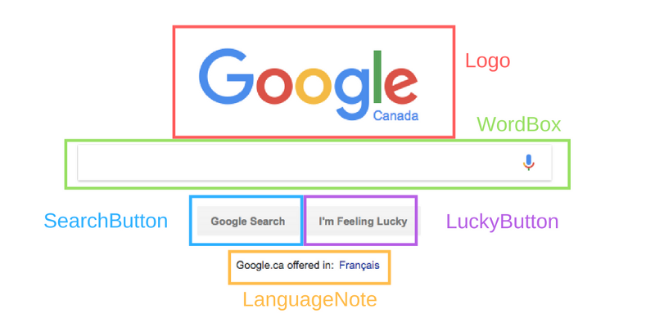
Lecture | React

Slide 5
Lecture | React
Declarative and Imperative
Imperative Programming: tell the "machine" how to solve it and what result you want.
Declarative Programming: tell the "machine" what you want to happen and the computer calculates how to make it.

Slide 6
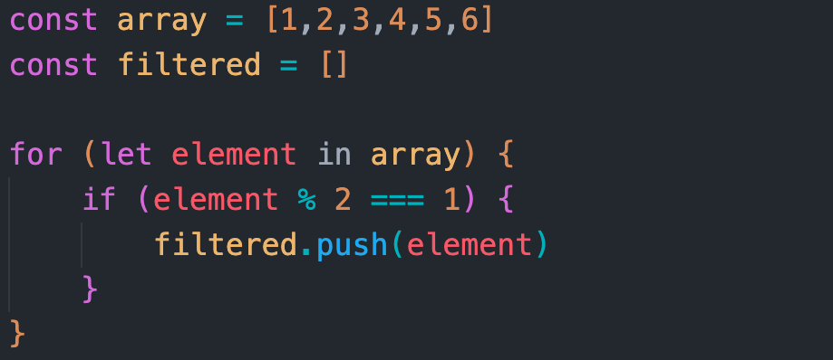
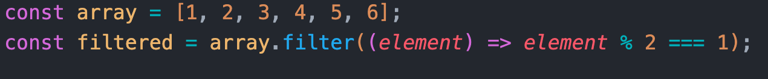
Lecture | React
Imperative
Declarative

Slide 7
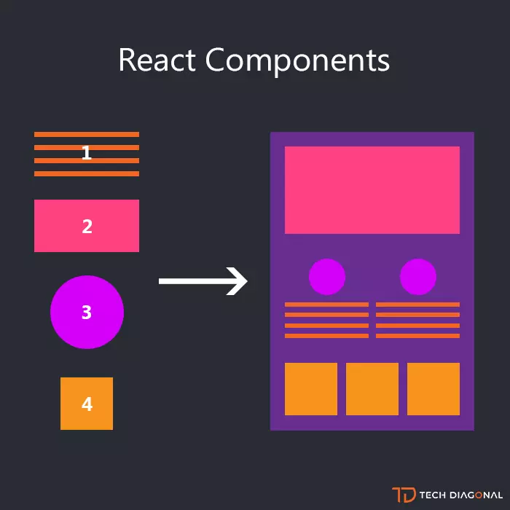
Lecture | React
Component Architecture
Components are independent and reusable bits of code

Slide 8
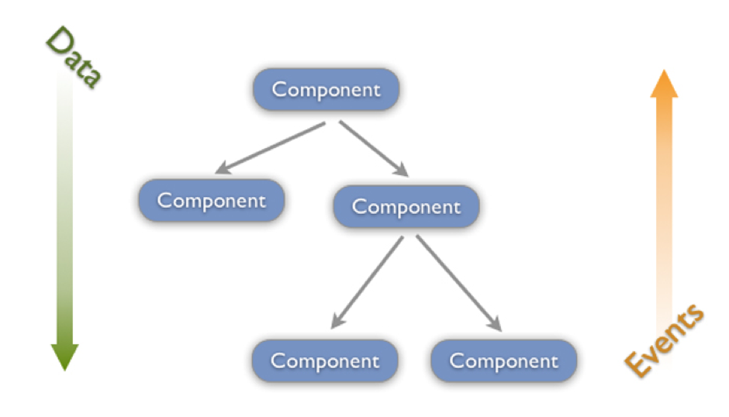
Lecture | React
Unidirectional Data Flow

Slide 9
Lecture | React
1. React docs
2. Environment setup
3. Create-react-app
4. JSX
5. Babel
{
}

Slide 10
Lecture | React
React Docs
https://reactjs.org/
https://vi.reactjs.org/
https://devdocs.io/react/
https://www.w3schools.com/REACT/

Slide 11
Lecture | React
Environment setup
Code editor: Vscode
CLI commands: Bash
Version control system: Git
Javascript runtime: Nodejs

Slide 12
Lecture | React
Environment setup
Vscode Extensions:
Reactjs code snippets
Auto close tag
Babel ES6/ES7

Slide 13
Lecture | React
React Docs
https://reactjs.org/
https://vi.reactjs.org/
https://devdocs.io/react/
https://www.w3schools.com/REACT/

Slide 14
Lecture | React
Create-react-app
Set up a React environment by running one command
https://reactjs.org/docs/create-a-new-react-app.html

Slide 15
Lecture | React
Create-react-app
A development server with hot reload
Provide a test environment with Jest
Allows to build React apps
Ready for ES6 syntax
Bundle all your JavaScript files
Comes with CSS auto corrector, supports SASS and CSS Modules

Slide 16
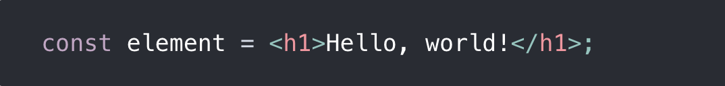
Lecture | React
What is JSX?
This funny tag syntax is neither a string nor HTML.
JSX produces React “elements”

Slide 17
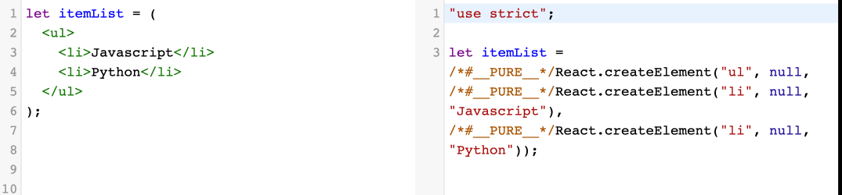
Lecture | React
What is Babel?
A JavaScript compiler

Slide 18
Lecture | React
Thank you!
Reminder:
Practice makes perfect

